Slide 1
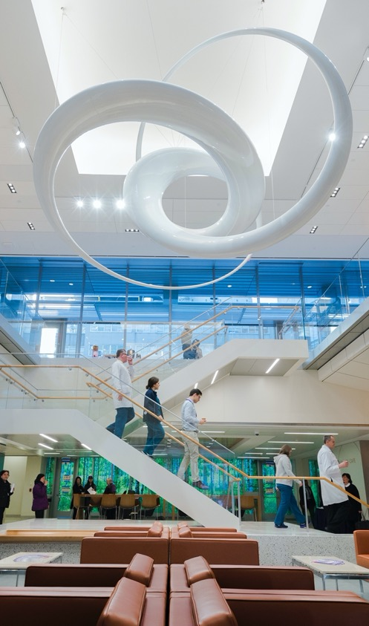
Rigor and Reproducibility:
Computational Reproducbility II
Fred LaPolla MLS

Slide 2
Review

Slide 3


Name some of the best practices discussed last week for computational reproducibility.
ⓘ
Click Present with Slido or install our Chrome extension to activate this poll while presenting.
Notes:
📣 This is Slido interaction slide, please don't delete it. ✅ Click on 'Present with Slido' and the poll will launch automatically when you get to this slide.

Slide 4

With stochastic computations we would expect a reproducible study to:
ⓘ
Click Present with Slido or install our Chrome extension to activate this poll while presenting.
Notes:
📣 This is Slido interaction slide, please don't delete it. ✅ Click on 'Present with Slido' and the poll will launch automatically when you get to this slide.

Slide 5
Which of the following does NOT help with computational reproducibility?
ⓘ
Click Present with Slido or install our Chrome extension to activate this poll while presenting.
Notes:
📣 This is Slido interaction slide, please don't delete it. ✅ Click on 'Present with Slido' and the poll will launch automatically when you get to this slide.

Slide 6
Agenda

Slide 7
Outcomes

Slide 8
Computational Reproducibility in Context

Slide 9
Fekete and Freire 2020
Analyzing the reproducibility of data visualization tools.
Break down into five different types of papers and presentations from the Association of Computer Machinery (ACM) Journals and Conferences:
Technique and Algorithm
System
Application and Design Study
Empirical Study
Theory and Model

Slide 10
Fekete and Freire 2020
Broadly we can break these down into:
Studies where a computer based tool or solution is presented or tested
Studies where human interaction with a computer based tool is tested

Slide 11
Dependencies
One major challenge is “dependencies”: programs, algorithms, code or systems that rely on other programs, algorithms, code or systems
E.g. R Packages, Python Libraries or Modules, necessary operating systems

Slide 12
Dependencies
In analysis code: make explicit, but comment out download commands:
e.g. # install.packages(“dplyr”)
library(dplyr)

Slide 13

Dependencies
For computationally intensive work, virtual containers capture OS and dependency information:
Docker
ReproZip

Slide 14
Fekete and Freire 2020
Technique and Empirical Studies rely on testing human participants:
Similar to other human studies research
Minimize Bias
Clear Methods, protocols
Capture dependencies
Whenever possible automate and make steps explicit to cut down on differing techniques between users

Slide 15
Emerging Issues

Slide 16
Gundersen and Kjensmo 2018
Review of AI papers and found experimental code available for 6% of 400 papers

Slide 17
Hutson 2018
Zhao et. al. 2023
Notes incentives not aligned to reproducibility
Further impacted by stochastic nature
Huge resources needed to reproduce a whole AI LLM

Slide 18
Kaddour et. al. 2023
Web resources serving as training models are crawled, not downloaded for LLMs, so those trying to review or reproduce may not have access due to link rot
Moreover training strategies are non-deterministic so a repeat if possible will not result in the same training data
Black box setting
AI drift: ChatGPT 3.5 and 4 have both shown decrease in accuracy in calculating numbers, e.g. prime numbers.

Slide 19
Haibe-Kains et al. 2020
AI increasingly proposed in clinical settings (with a case study on radiology)
Lack of code and dependencies prevent reproducibility

Slide 20
Benjamin 2019
Discusses how social and racial biases are baked into algorithms
(Not in Benjamin) As LLMs are stochastically trained on large bodies of web articles that are not transparently available, it is reasonable to conclude or at least be wary that social biases are baked in to generative AI algorithms.

Slide 21

What are ways that you feel research with AI could be made more reproducible?
ⓘ
Click Present with Slido or install our Chrome extension to activate this poll while presenting.
Notes:
📣 This is Slido interaction slide, please don't delete it. ✅ Click on 'Present with Slido' and the poll will launch automatically when you get to this slide.

Slide 22
What are factors that you feel may be barriers to making AI based research reproducible?
ⓘ
Click Present with Slido or install our Chrome extension to activate this poll while presenting.
Notes:
📣 This is Slido interaction slide, please don't delete it. ✅ Click on 'Present with Slido' and the poll will launch automatically when you get to this slide.

Slide 23
Review

Slide 24
Where might we store and publish our code?
ⓘ
Click Present with Slido or install our Chrome extension to activate this poll while presenting.
Notes:
📣 This is Slido interaction slide, please don't delete it. ✅ Click on 'Present with Slido' and the poll will launch automatically when you get to this slide.

Slide 25
When describing studies testing human interactions with computational tools we should NOT:
ⓘ
Click Present with Slido or install our Chrome extension to activate this poll while presenting.
Notes:
📣 This is Slido interaction slide, please don't delete it. ✅ Click on 'Present with Slido' and the poll will launch automatically when you get to this slide.

Slide 26
List factors that limit experimental replicability.
ⓘ
Click Present with Slido or install our Chrome extension to activate this poll while presenting.
Notes:
📣 This is Slido interaction slide, please don't delete it. ✅ Click on 'Present with Slido' and the poll will launch automatically when you get to this slide.

Slide 27
Limits of Experimental Reproducibility
Complexity
Variation
Unknown Information
Limited measurement accuracy
Poor study design
Poor study execution
Misunderstood statistics
Bias

Slide 28
Which of the following is not a benefit of using code for analysis with regards to reproducibility?
ⓘ
Click Present with Slido or install our Chrome extension to activate this poll while presenting.
Notes:
📣 This is Slido interaction slide, please don't delete it. ✅ Click on 'Present with Slido' and the poll will launch automatically when you get to this slide.

Slide 29
When working with stochastic models, if we rerun our code we would expect a reproducible project to:
ⓘ
Click Present with Slido or install our Chrome extension to activate this poll while presenting.
Notes:
📣 This is Slido interaction slide, please don't delete it. ✅ Click on 'Present with Slido' and the poll will launch automatically when you get to this slide.

Slide 30
Define a p value:
ⓘ
Click Present with Slido or install our Chrome extension to activate this poll while presenting.
Notes:
📣 This is Slido interaction slide, please don't delete it. ✅ Click on 'Present with Slido' and the poll will launch automatically when you get to this slide.

Slide 31
Which of the following is NOT true of p values:
ⓘ
Click Present with Slido or install our Chrome extension to activate this poll while presenting.
Notes:
📣 This is Slido interaction slide, please don't delete it. ✅ Click on 'Present with Slido' and the poll will launch automatically when you get to this slide.

Slide 32
Why should we provide our sample size in papers? What statistical concept should we generally relate sample size to?
ⓘ
Click Present with Slido or install our Chrome extension to activate this poll while presenting.
Notes:
📣 This is Slido interaction slide, please don't delete it. ✅ Click on 'Present with Slido' and the poll will launch automatically when you get to this slide.

Slide 33
Name elements of a data management plan:
ⓘ
Click Present with Slido or install our Chrome extension to activate this poll while presenting.
Notes:
📣 This is Slido interaction slide, please don't delete it. ✅ Click on 'Present with Slido' and the poll will launch automatically when you get to this slide.

Slide 34
Limits of Experimental Reproducibility
Data inventories
Protocol for description
Planning data preservation
Planning data access

Slide 35
Setting up projects in our coding environment helps us:
ⓘ
Click Present with Slido or install our Chrome extension to activate this poll while presenting.
Notes:
📣 This is Slido interaction slide, please don't delete it. ✅ Click on 'Present with Slido' and the poll will launch automatically when you get to this slide.

Slide 36
What element of the NIH's Rigor and Reproducibility requirements does a literature search relate to:
ⓘ
Click Present with Slido or install our Chrome extension to activate this poll while presenting.
Notes:
📣 This is Slido interaction slide, please don't delete it. ✅ Click on 'Present with Slido' and the poll will launch automatically when you get to this slide.

Slide 37
What does PECO/PICO stand for and why can it help literature search?
ⓘ
Click Present with Slido or install our Chrome extension to activate this poll while presenting.
Notes:
📣 This is Slido interaction slide, please don't delete it. ✅ Click on 'Present with Slido' and the poll will launch automatically when you get to this slide.

Slide 38
Adding terms with AND is use between...
ⓘ
Click Present with Slido or install our Chrome extension to activate this poll while presenting.
Notes:
📣 This is Slido interaction slide, please don't delete it. ✅ Click on 'Present with Slido' and the poll will launch automatically when you get to this slide.

Slide 39
Name elements to include in a methods section to make it more reproducible
ⓘ
Click Present with Slido or install our Chrome extension to activate this poll while presenting.
Notes:
📣 This is Slido interaction slide, please don't delete it. ✅ Click on 'Present with Slido' and the poll will launch automatically when you get to this slide.

Slide 40
Name some guidelines/checklists researchers can follow to make sure their methods are reproducible.
ⓘ
Click Present with Slido or install our Chrome extension to activate this poll while presenting.
Notes:
📣 This is Slido interaction slide, please don't delete it. ✅ Click on 'Present with Slido' and the poll will launch automatically when you get to this slide.

Slide 41
We might overcome/limit the impact of publication bias in our literature review by....
ⓘ
Click Present with Slido or install our Chrome extension to activate this poll while presenting.
Notes:
📣 This is Slido interaction slide, please don't delete it. ✅ Click on 'Present with Slido' and the poll will launch automatically when you get to this slide.

Slide 42
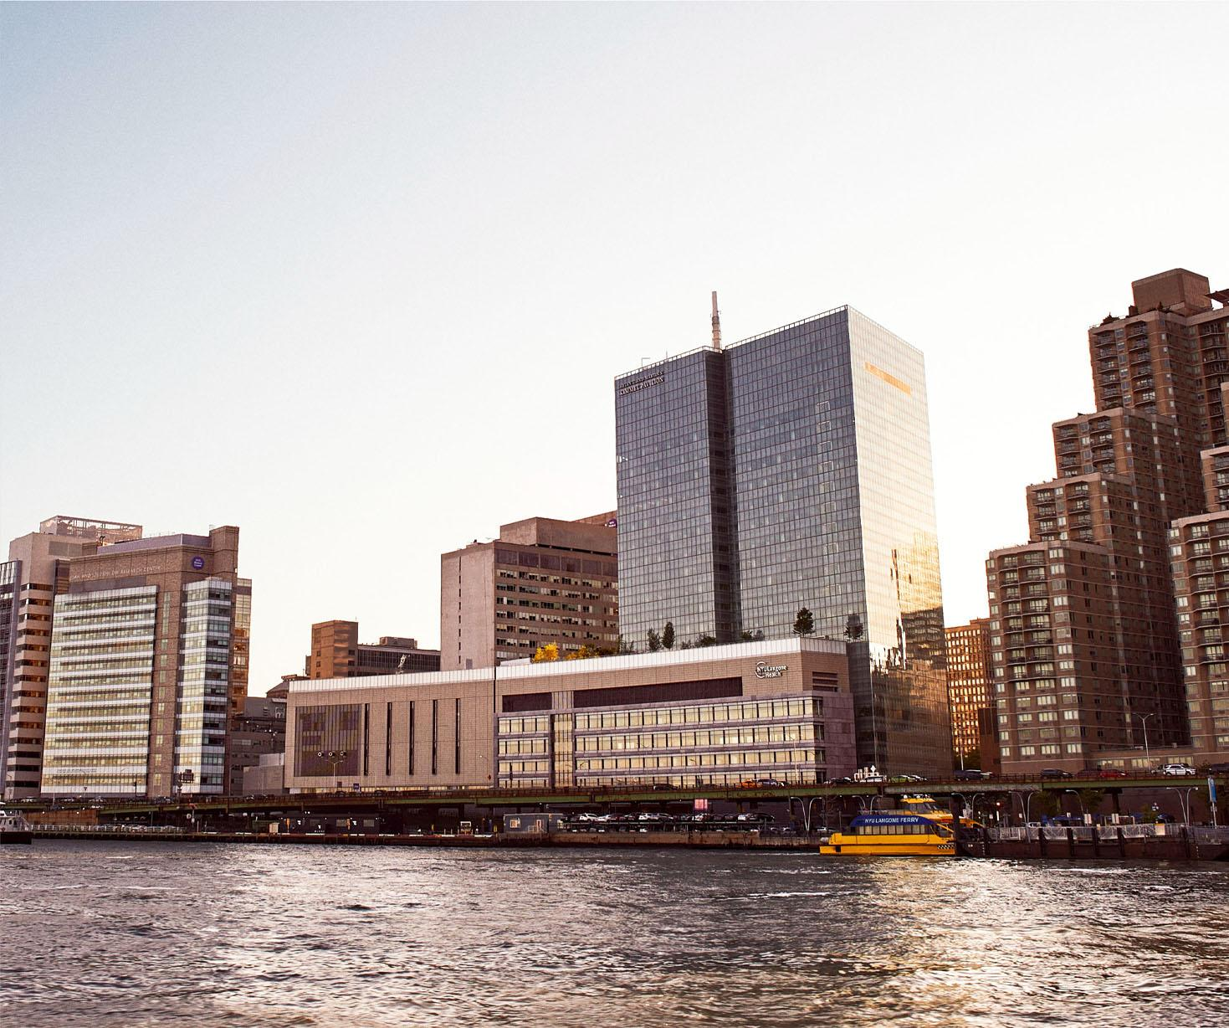
Homework
Final Exam Open Book Take Home. Upload to Brightspace

Slide 43
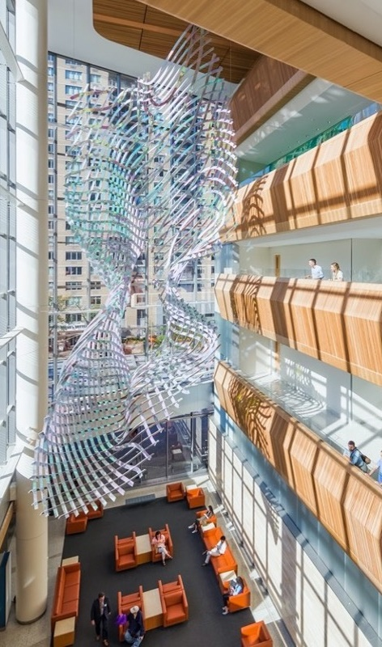
Have a great week!
fred.lapolla@nyulangone.org

Slide 44
References
1. Reproducibility and Replicability in Science [Internet]. Washington, D.C.: National Academies Press; 2019 [cited 2023 Aug 15]. Available from: https://www.nap.edu/catalog/25303
2. pandas - Python Data Analysis Library [Internet]. [cited 2023 Aug 23]. Available from: https://pandas.pydata.org/
3. Adityawarman FW. Medium. 2022 [cited 2023 Aug 23]. How to use R in Google Colab. Available from: https://towardsdatascience.com/how-to-use-r-in-google-colab-b6e02d736497
4. Good enough practices in scientific computing | PLOS Computational Biology [Internet]. [cited 2023 Aug 23]. Available from: https://journals.plos.org/ploscompbiol/article?id=10.1371/journal.pcbi.1005510

