Slide 1
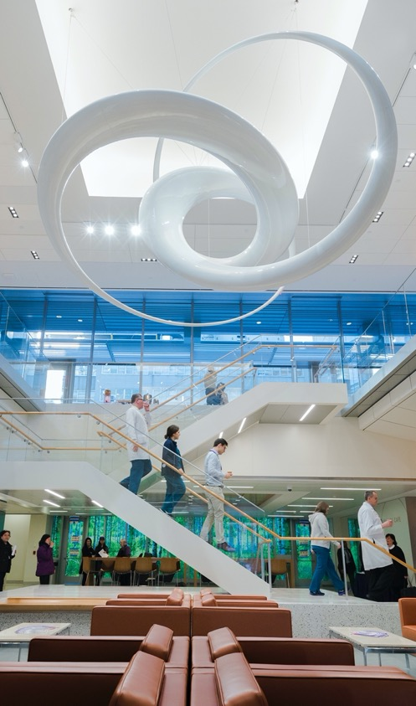
Rigor and Reproducibility:
Computational Reproducbility I
Fred LaPolla MLS

Slide 2
Review

Slide 3


Which of the following will NOT help make research reproducible
ⓘ
Click Present with Slido or install our Chrome extension to activate this poll while presenting.
Notes:
📣 This is Slido interaction slide, please don't delete it. ✅ Click on 'Present with Slido' and the poll will launch automatically when you get to this slide.

Slide 4

Name items to include in a methods section to make our research reproducible
ⓘ
Click Present with Slido or install our Chrome extension to activate this poll while presenting.
Notes:
📣 This is Slido interaction slide, please don't delete it. ✅ Click on 'Present with Slido' and the poll will launch automatically when you get to this slide.

Slide 5
What words do you associate with experimental reproducibility/replicability?
ⓘ
Click Present with Slido or install our Chrome extension to activate this poll while presenting.
Notes:
📣 This is Slido interaction slide, please don't delete it. ✅ Click on 'Present with Slido' and the poll will launch automatically when you get to this slide.

Slide 6
Agenda
Computational reproducibility defined
Discussion of deterministic and stochastic algorithms
Best practices for computational reproducibility

Slide 7
Outcomes
Students will be able to explain the goals of computational reproducibility
Students will be able to identify best practices to improve their projects’ reproducibility
Students will be able to explain the difference between stochastic and deterministic algorithms and its relevance to reproducibility

Slide 8
What tools do you currently use to analyze data?
ⓘ
Click Present with Slido or install our Chrome extension to activate this poll while presenting.
Notes:
📣 This is Slido interaction slide, please don't delete it. ✅ Click on 'Present with Slido' and the poll will launch automatically when you get to this slide.

Slide 9
Computational Reproducibility

Slide 10
Experimental Reproducibility
Up until now we have primarily discussed experimental reproducibility or replicability:
Running a new experiment with different subjects
Collecting data anew
Expect consistent results but not identical results

Slide 11
Computational Reproducibility
We also would want to make our work computationally reproducible:
If working with the same data and following the same analysis steps: can we reproduce the same results
Per the National Academies of Science, it is difficult to estimate the prevalence of computational reproducibility problems given different definitions

Slide 12
Computational Reproducibility
We also would want to make our work computationally reproducible:
If working with the same data and following the same analysis steps: can we reproduce the same results
Per the National Academies of Science, it is difficult to estimate the prevalence of computational reproducibility problems given different definitions

Slide 13
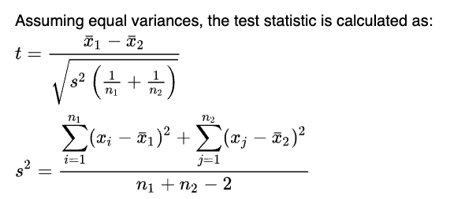
Computational Reproducibility
Deterministic: Equations that consistently provide the same output with the same input.
e.g. Student’s Unpaired T-Test:

Slide 14
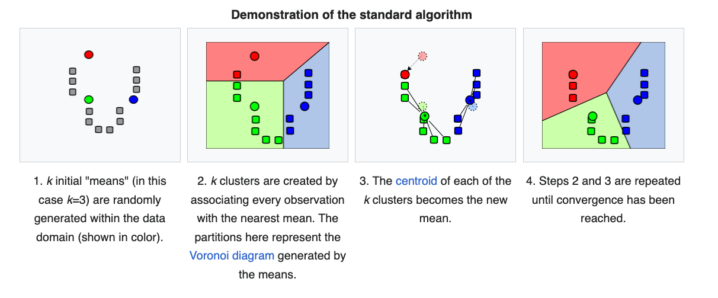
Computational Reproducibility
Stochastic: Algorithms that use random probabilities to make statistical determinations.
e.g. K-Means Clustering:

Slide 15
Computational Reproducibility
Depending on our analysis choices (deterministic vs. stochastic) we will have different expectations for reproducing:
Deterministic we should get the same exact results from the same input
Stochastic we would expect consistent but different results
We take similar steps to make both reproducible

Slide 16
Computational Reproducibility
In both cases: provide input data and steps taken
Describe detailed methods including steps in order
Provide information on the computational environment (OS, programs, versions)

Slide 17
Best Practices

Slide 18
Wilson et. al. “Good Enough Practices in Scientific Computing” 2017
Six domains:
Data Management
Software
Collaboration
Project Organization
Track Changes
Writing Manuscripts

Slide 19
Thinking back to the session on Research Data Management, what are some techniques for making our data computationally reproducible?
ⓘ
Click Present with Slido or install our Chrome extension to activate this poll while presenting.
Notes:
📣 This is Slido interaction slide, please don't delete it. ✅ Click on 'Present with Slido' and the poll will launch automatically when you get to this slide.

Slide 20
Wilson et. al. “Good Enough Practices in Scientific Computing” 2017
Data Management
Save raw data
Back-up raw data
Create clean, tidy data
Record steps in analysis
Use unique identifiers for each record/experimental unit
Store in a repository

Slide 21
Wilson et. al. “Good Enough Practices in Scientific Computing” 2017
To assist in computational reproducibility, it can help to make data available in a repository, and increasingly funders and journals require this.
Go to https://sharing.nih.gov/data-management-and-sharing-policy/sharing-scientific-data/repositories-for-sharing-scientific-data and see if there is a repository relevant to your field.

Slide 22
If you found a relevant data repository, what is it called?
ⓘ
Click Present with Slido or install our Chrome extension to activate this poll while presenting.
Notes:
📣 This is Slido interaction slide, please don't delete it. ✅ Click on 'Present with Slido' and the poll will launch automatically when you get to this slide.

Slide 23
Wilson et. al. “Good Enough Practices in Scientific Computing” 2017
Clean Data:
Dealing with Missing Values
Disambiguating text
Dichotomizing when necessary
Tidy Data (Wickham 2014)
Each variable is a column
Each observation is a row
Note: certain data types will have observations as columns, e.g. genomics data

Slide 24
What software/code tools do you use for analysis?
ⓘ
Click Present with Slido or install our Chrome extension to activate this poll while presenting.
Notes:
📣 This is Slido interaction slide, please don't delete it. ✅ Click on 'Present with Slido' and the poll will launch automatically when you get to this slide.

Slide 25
Wilson et. al. “Good Enough Practices in Scientific Computing” 2017
Software and code
Provide explanations and comments
Simplify
Use well-maintained libraries (e.g. BioConductor, Pandas)
Use meaningful names for variables and functions
Make dependencies explicit
Provide simple examples
Store code in a repository

Slide 26
Wilson et. al. “Good Enough Practices in Scientific Computing” 2017
Software and code
Code should expressly include automated workflows
R, Python, GraphPad Prism, SPSS etc. all allow for Scripts to automate workflow to save time and make it explicit what you have done
Always add comments to make it clear what each step is doing.

Slide 27
Wilson et. al. “Good Enough Practices in Scientific Computing” 2017
Project/File Organization
Store all project files in one “directory” or file folder
Name files to reflect purpose
Organize code, raw data, output documents in a clear system

Slide 28
Wilson et. al. “Good Enough Practices in Scientific Computing” 2017
Project/File Organization
R Projects
Python Projects
Both store materials in one directory/file folder

Slide 29
What were some file organization tips from the Research Data Management session to keep your directories and files organized?
ⓘ
Click Present with Slido or install our Chrome extension to activate this poll while presenting.
Notes:
📣 This is Slido interaction slide, please don't delete it. ✅ Click on 'Present with Slido' and the poll will launch automatically when you get to this slide.

Slide 30
Wilson et. al. “Good Enough Practices in Scientific Computing” 2017
Track Changes
Back-up files
Document changes and rationale, and save frequently
User a version control system

Slide 31
Wilson et. al. “Good Enough Practices in Scientific Computing” 2017
Track Changes: GitHub
Git is a tool for tracking changes
You can use Git in the command line
https://www.codecademy.com/learn/learn-the-command-line
https://www.datacamp.com/courses/introduction-to-git-for-data-science

Slide 32
Wilson et. al. “Good Enough Practices in Scientific Computing” 2017
Track Changes: GitHub
GitHub is a site for tracking changes and collaborating
Projects can be public or private
Projects can link to R Studio or Python and GitHub
Similarly tools like Google Colab can set up projects directly in your GitHub.

Slide 33
Wilson et. al. “Good Enough Practices in Scientific Computing” 2017
Collaboration
Create shared overview
To-Do lists and clear roles
Licensing
Citatable
Manuscripts
Use online shareable tools (e.g. Google Docs, Word in Sharespace)
Clearly describe methods

Slide 34
Wilson et. al. “Good Enough Practices in Scientific Computing” 2017
Google Colab
Interactive free coding environment
Default is Python, but can also work with other languages
Allows integration into GitHub, making steps of analysis clear and explicit and helping with creating manuscripts/text alongside analysis code

Slide 35

Do you currently share code, analysis files, documents related to your research, and if so, where?
ⓘ
Click Present with Slido or install our Chrome extension to activate this poll while presenting.
Notes:
📣 This is Slido interaction slide, please don't delete it. ✅ Click on 'Present with Slido' and the poll will launch automatically when you get to this slide.

Slide 36
Wilson et. al. “Good Enough Practices in Scientific Computing” 2017
Additional places to store code/files
OSF
Zenodo
FigShare

Slide 37
Review

Slide 38
Which of the following is not a benefit of using code for analysis with regards to reproducibility?
ⓘ
Click Present with Slido or install our Chrome extension to activate this poll while presenting.
Notes:
📣 This is Slido interaction slide, please don't delete it. ✅ Click on 'Present with Slido' and the poll will launch automatically when you get to this slide.

Slide 39
When working with stochastic models, if we rerun our code we would expect a reproducible project to:
ⓘ
Click Present with Slido or install our Chrome extension to activate this poll while presenting.
Notes:
📣 This is Slido interaction slide, please don't delete it. ✅ Click on 'Present with Slido' and the poll will launch automatically when you get to this slide.

Slide 40
Setting up projects in our coding environment helps us:
ⓘ
Click Present with Slido or install our Chrome extension to activate this poll while presenting.
Notes:
📣 This is Slido interaction slide, please don't delete it. ✅ Click on 'Present with Slido' and the poll will launch automatically when you get to this slide.

Slide 41

Homework
Set up a free GitHub account and create your first repository. Go to Google Colab and create a simple analysis file. In that analysis file, print today’s date, a simple arithmetic operation (e.g. 2*5) and write a brief reflection (no more than 300 words) on how using repositories, tracking changes and publishing like GitHub can help with computational reproducibility. Post this file to your GitHub repository and submit the link to the repository with your homework in it.

Slide 42
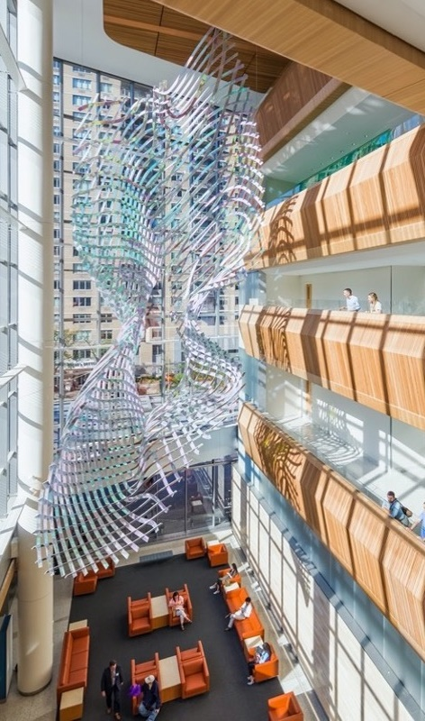
Have a great week!
fred.lapolla@nyulangone.org

Slide 43
References
1. Reproducibility and Replicability in Science [Internet]. Washington, D.C.: National Academies Press; 2019 [cited 2023 Aug 15]. Available from: https://www.nap.edu/catalog/25303
2. pandas - Python Data Analysis Library [Internet]. [cited 2023 Aug 23]. Available from: https://pandas.pydata.org/
3. Adityawarman FW. Medium. 2022 [cited 2023 Aug 23]. How to use R in Google Colab. Available from: https://towardsdatascience.com/how-to-use-r-in-google-colab-b6e02d736497
4. Good enough practices in scientific computing | PLOS Computational Biology [Internet]. [cited 2023 Aug 23]. Available from: https://journals.plos.org/ploscompbiol/article?id=10.1371/journal.pcbi.1005510

