Slide 2


Development of a file sharing by invitation service based on AWS S3 Project 17
Mathieu Devaud
Frederic Montet

Slide 3
Plan
Context
Objectives
Amazon S3
Technology
Concept
Key functions
Demonstration
Conclusion

Slide 4



Context
File sharing system on Amazon AWS S3
Primary user with Amazon account
Secondary users without account
Invitation via presigned URL

Slide 5
Objectives
No full user account management
Assume one principal user
Principal user can create temporary URLs to invite another user to deposit a file on the service
Invited user navigates to URL and sees customized page inviting him to upload file (no registration or authentication necessary)
Principal user is able to see status for each URL generated (file has been uploaded or not) and download the file

Slide 6

Amazon S3
Bucket A bucket is a container for objects stored in Amazon S3
Object Objects are the fundamental entities stored in Amazon S3
Key A key is the unique identifier for an object within a bucket

Slide 7







Technologies

Slide 8
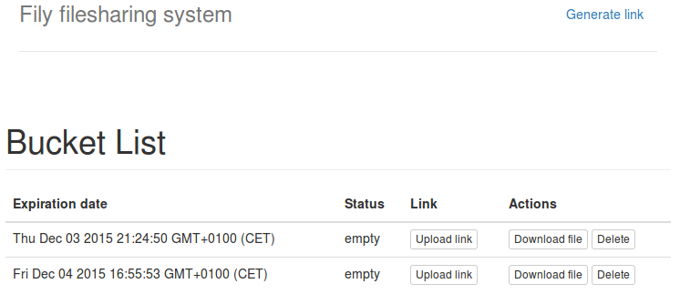
Concept
url download
url upload
Primary user
update view
url custom
url download
url upload
Secondary user

Slide 9
Keys
Change the CORS parameters of the bucket to allow upload
Generate valid PUT presigned URL to upload
Generate valid GET presigned URL to download
Use ajax to generate a valid request to the presigned URL

Slide 10
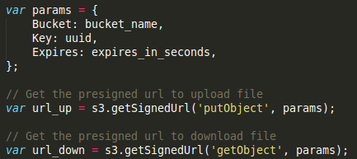
Presigned URL
Parameters :

Slide 11
Demonstration
Enjoy the demonstration !

Slide 12
Conclusion
90 % objectives reached
Good team spirit
Lots of new things learned (the hard way)
Improvements :
Handle the boundary problem when uploading
Status monitoring based on Cloudwatch
URL shortener
Deployement on production

Slide 13
?
Question

