Slide 2

Fily A cloud based file sharing application
Mathieu Devaud
Frederic Montet

Slide 3
Presentation Plan
Application Context
Application Requirements
Used Technologies
Choices and Key Aspects
Application Concept
Demonstration
Encountered difficulties
Conclusion

Slide 4

Application Context
Development of a file sharing service by invitation based on AWS S3
File sharing system on Amazon AWS S3
Application user can generate links to upload files
Invited users are able to upload files without authentication
No full user account mangement

Slide 5







Used Technologies

Slide 6
Choices and Key Aspects
Use AWS S3 JS SDK to minimize client - server requests
Using UUID for key unicity in a bucket
Change the CORS parameters of the bucket to allow upload
Generate valid PUT presigned URL to upload
Generate valid GET presigned URL to download
Use ajax to build a valid request to the presigned URL

Slide 7
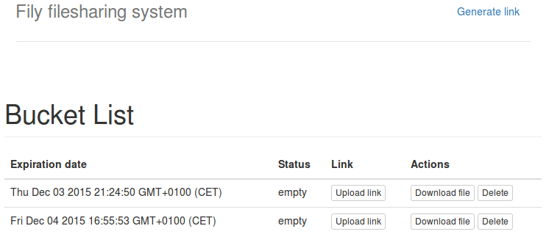
Application Concept
url download
url upload
Primary user
update view
url custom
url download
url upload
Secondary user

Slide 8
Demonstration

Slide 9
Encountered difficulties
Signature mismatch
Nested ajax requests
Webkit boundaries due to formData() objects

Slide 10
Future improvements
Handle the boundary problem when uploading
Status monitoring based on Cloudwatch
URL shortener
Client applications
Deployement on Amazon Beanstalk

Slide 11
Conclusion
File transfer is not easy
90 % objectives reached
Lots of new things learned (the hard way)
For productivity, choose the most commonly used SDK
For product oriented developement, choose the SDK that fits best with your requirements
Good team spirit

Slide 12
Questions ?

Slide 13
Thank you

