Slide 1


GMSH Meshing Workshop for OpenFOAM
Fred Morin
The completed files for this workshop can be downloaded here:
https://github.com/fredmorin18/GmshTutorial

Slide 2
GMSH Installaiton
Install instructions: https://gmsh.info/#Download
Ubuntu
  sudo apt-get install gmsh
  or from website: https://gmsh.info/bin/Linux/gmsh-4.13.1-Linux64.tgz
Windows
  Latest release from website: https://gmsh.info/bin/Windows/gmsh-4.13.1-Windows64.zip
With Python via pip
  pip install --upgrade gmsh

Slide 3
Optional software
OpenFOAM 11 or 12 (instructions: https://openfoam.org/download/)
Will be used to test the meshes, but not strictly necessary just to make them

Slide 4
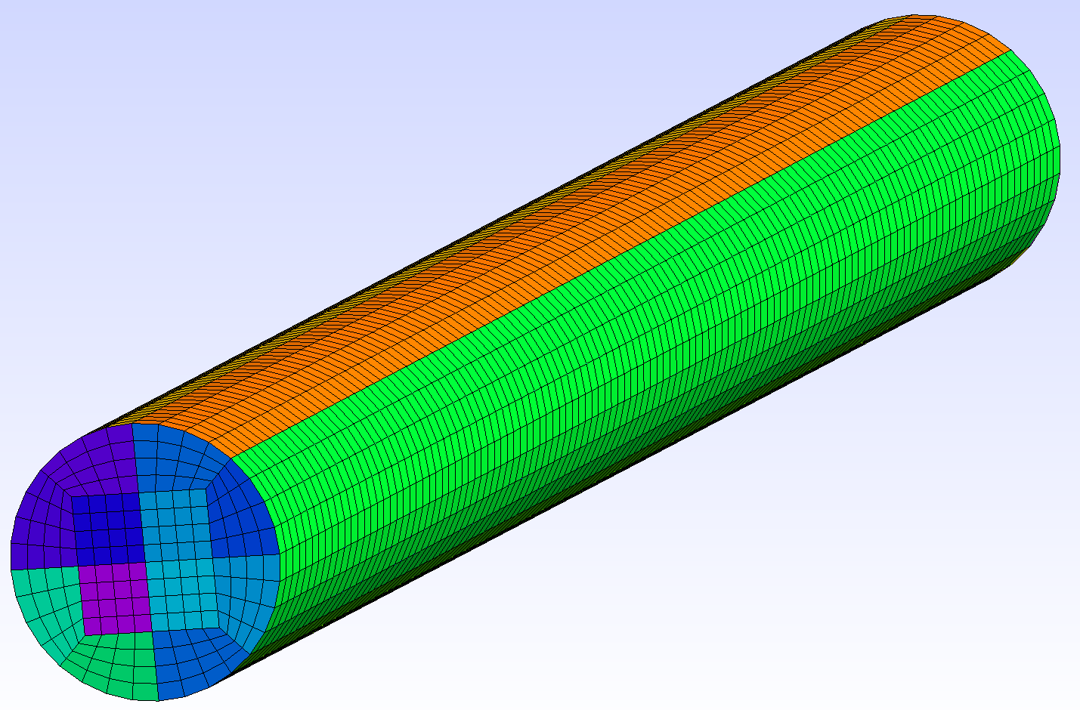
Tutorial 1 – Baby’s First O-Grid Mesh
Structured Pipe Mesh
w/ Square O-Grid

Slide 5
Getting Started
To create a mesh in GMSH, you must specify the geometry to mesh either by importing a CAD model or creating one in GMSH using a .geo file
  We will create one in GMSH here
To get started, follow these steps:
Open GMSH via the terminal or app launcher
Create a .geo file (File→New then create a .geo file by typing Tutorial1.geo and save it)
Open the new file (Modules→Geometry→Edit script)
You’re ready to make your mesh now :)

Slide 6
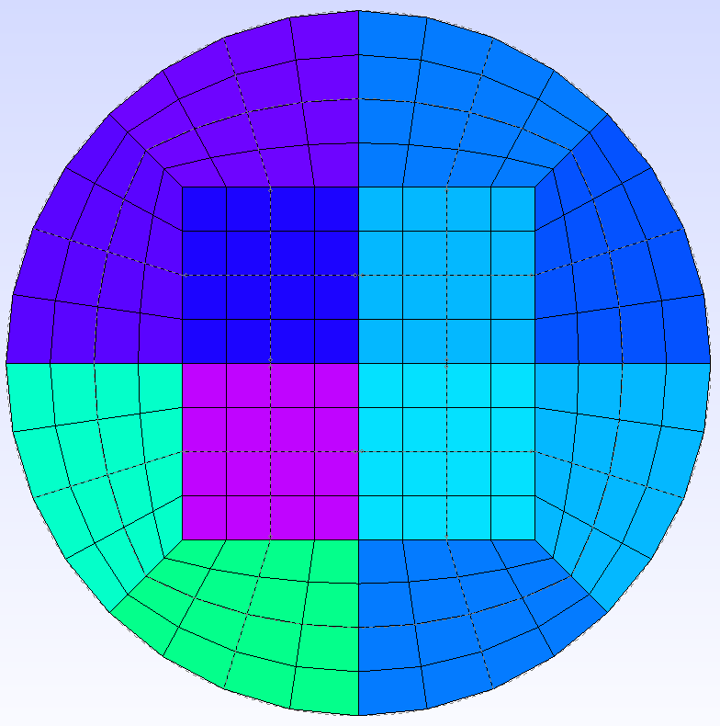
Making Our First Surface Mesh
We’ll be making a pipe with a diameter of 2 and a length of 40
Let’s start by making the surface mesh for the upper-right corner of the pipe inlet (notice symmetry in shape)
Afterward, we can just copy-rotate our mesh to fill in the other three quarters
Our inlet will be incident to the xy-plane and centered at the origin (flow in z-axis)

Slide 7
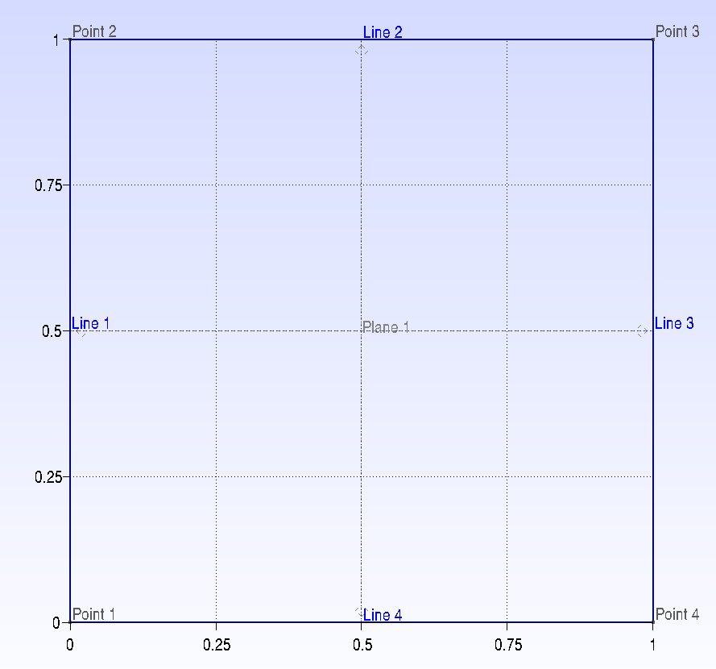
Making Our First Surface Mesh Cont...
To start, let’s make four points representing the vertices of the square in our quarter of the inlet:
  Point(1) = {0, 0, 0};
  Point(2) = {0, 1, 0};
  Point(3) = {1, 1, 0};
  Point(4) = {1, 0, 0};
Now let’s make four lines from those points
  Line(1) = {1, 2};
  Line(2) = {2, 3};
  Line(3) = {3, 4};
  Line(4) = {4, 1};
The last step is to make a Curve Loop that defines the edges of our surface, then create a surface from that:
  Curve Loop(1) = {1, 2 ,3, 4};
  Plane Surface(1) = {1};
Wow!!

Slide 8
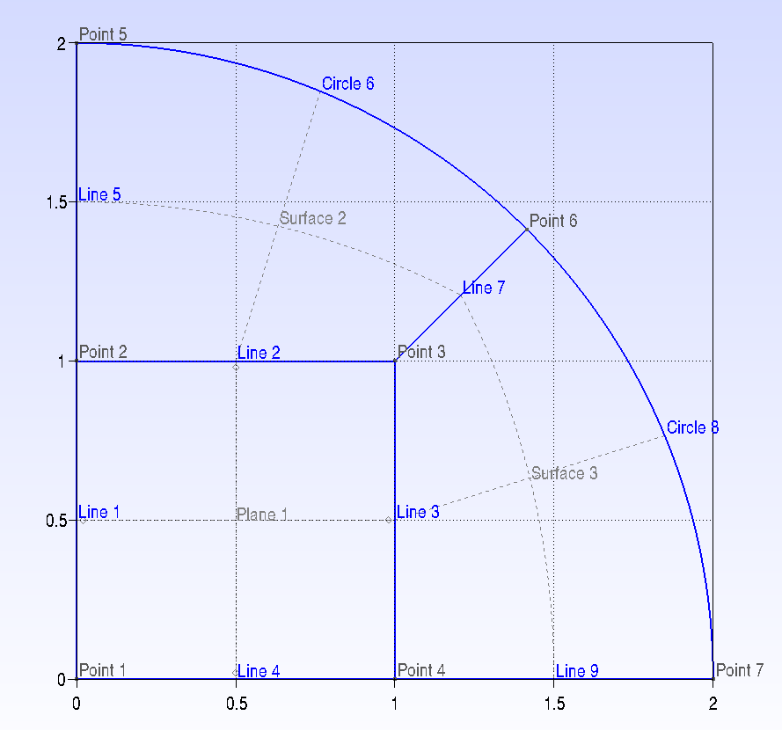

Making Our First Surface Mesh Cont...
Let’s make the curved wall portions now. First, make points for the vertices on the arcs:
  Point(5) = {0, 2, 0};
  Point(6) = {2*Cos(Pi/4), 2*Cos(Pi/4), 0};
  Point(7) = {2, 0, 0};
Next, let’s make the remaining lines and arcs:
  Line(5) = {2, 5};
  Circle(6) = {5, 1, 6}; // Creates an arc starting from point 5 to point 6 centred on point 1 in
  Line(7) = {6, 3};
  Circle(8) = {6, 1, 7};
  Line(9) = {7, 4};
Finally, let’s make the two new surfaces as before:
  Curve Loop(2) = {5, 6, 7, -2};
  Surface(2) = {2};
  Curve Loop(3) = {8, 9, -3, -7};
  Surface(3) = {3};
Wait!! Wanna know what this (-) sign is for?
GMSH needs all lines/curves in a loop to be oriented tip-to-tail so that it knows not to cross lines over (like a bowtie). All lines have an orientation from point a to point b, and we can reverse its direction with a (-) sign

Slide 9
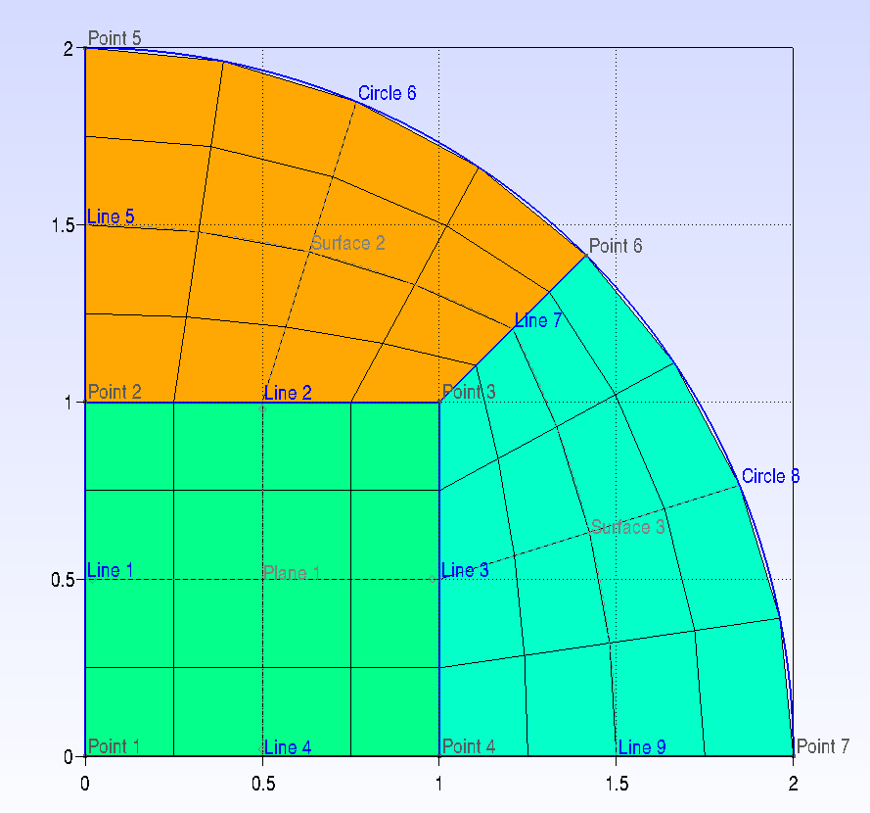
Making Our First Surface Mesh Cont...
Now we’re all ready to mesh the surface.
Let’s start by defining some refinement parameters for the angular/center and radial discretizations:
  dX = 5; // Angular & center
  dRad = 5; // Radial
Then, we can discretize our lines (and surfaces as a result):
  Transfinite Curve {1, 2, 3, 4, 6, 8} = dX;
  Transfinite Curve {5, 7, 9} = dRad;
  Transfinite Surface {1, 2, 3};
  Recombine Surface {1, 2, 3};
  Mesh 2;
This tells GMSH how many nodes, meaning cells in that direction - 1
We’ll mesh all the curves opposite each other with the same discretization
Now we tell GMSH to discretize the surface from those discretized lines
Break up the surface into quadrilaterals (default is triangles)
Create the 2D mesh
Lists go in curly braces {}!

Slide 10
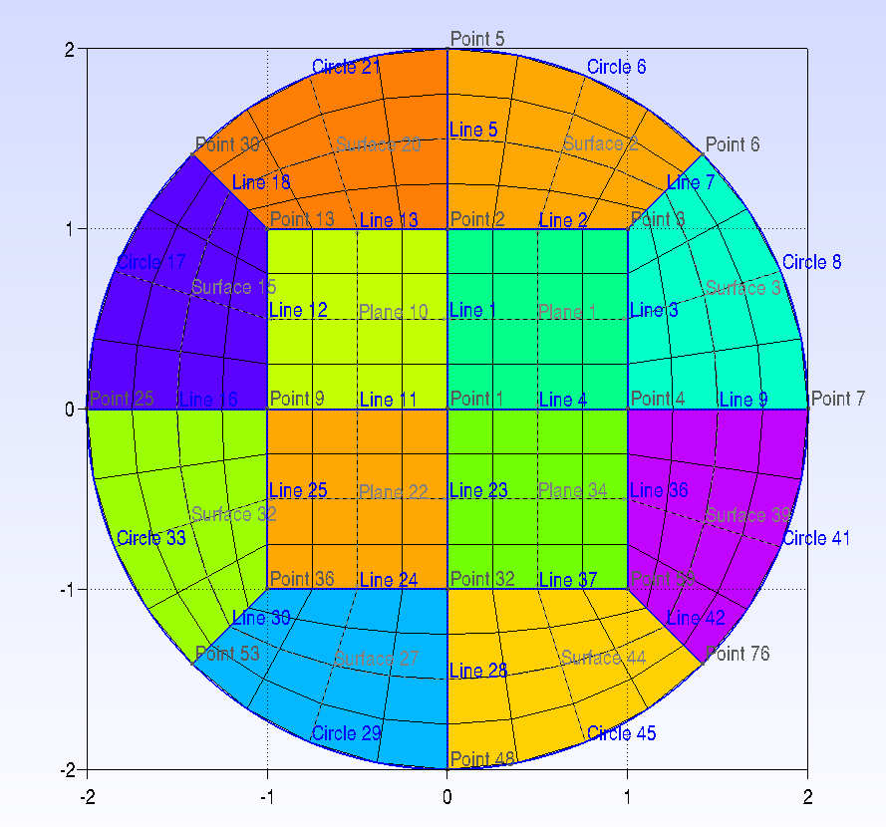
Making Our First Surface Mesh Cont...
Now to make the other three quarters.
Start by using this command, which tells GMSH to copy the meshing method along with the geometry:
  Geometry.CopyMeshingMethod = 1;
Then, time to copy the mesh:
  topLeft[] = Rotate{{0, 0, 1}, {0,0,0}, Pi/2} {Duplicata{Surface{1,2,3};}};
  bottomLeft[] = Rotate{{0, 0, 1}, {0,0,0}, Pi} {Duplicata{Surface{1,2,3};}};
  bottomRight[] = Rotate{{0, 0, 1}, {0,0,0}, 3*Pi/2} {Duplicata{Surface{1,2,3};}};
  Mesh 2;
  Coherence;
This action produces a list that can be stored in an object[]
Axis of rotation
Angle of rotation
For more GMSH commands, go here:
https://gmsh.info/doc/texinfo/gmsh.html
Be careful! GMSH command syntax is very specific and somewhat inconsistent.
Rotates a copy instead of the original
Point around which to rotate
Tells GMSH to merge overlapping lines, nodes, etc.

Slide 11
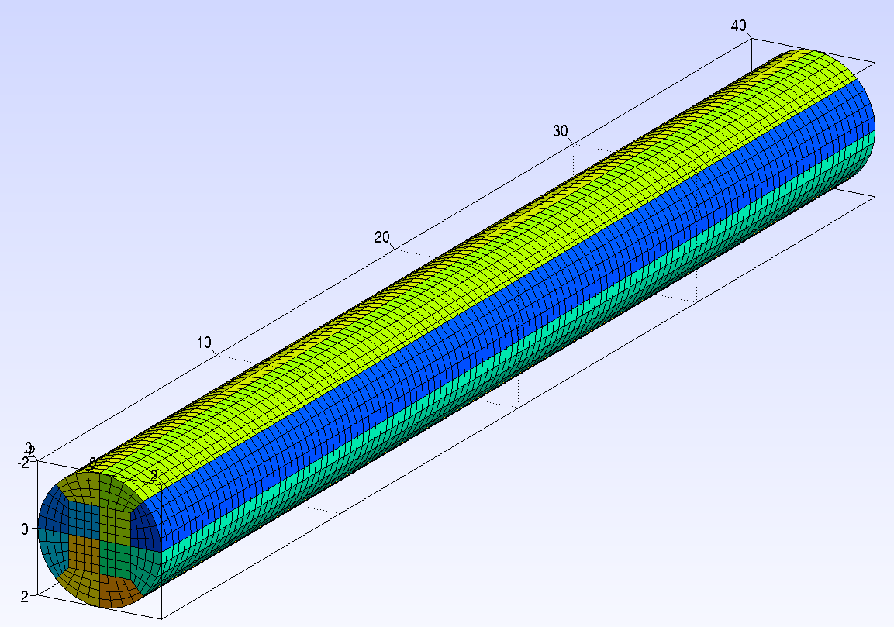
Making the Volume Mesh
It’s finally time to make the volume mesh.
Here, we’ll simply extrude our 2D mesh in the z-direction:
  pipe[] = Extrude{0, 0, 40} {Surface{:}; Layers{120}; Recombine;};
  Mesh 3;
Congrats! You’ve made a 3D mesh!
We could now export the mesh for use in OpenFOAM 12, but we can do better than this mesh, which is under-resolved near the walls and has heavily skewed cells around the corners of the square
Let’s go over some basic mesh quality checks in the next slide

Slide 12
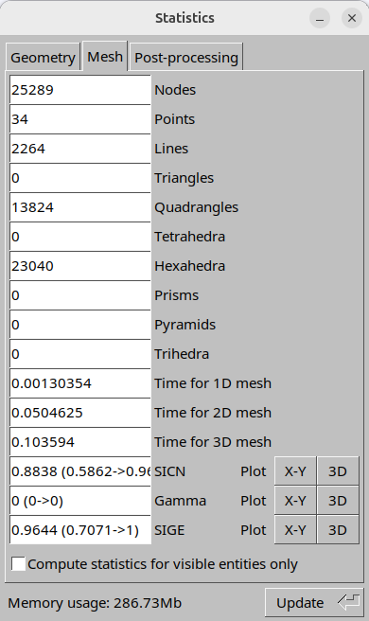
Assessing Mesh Quality in GMSH
Go to Tools→Statistics
In the Mesh tab, click Update
For hexahedral meshes like this one, we will look at SICN and SIGE
  SICN = Signed inverse condition number (lower = harder to solve for this element)
  SIGE = Signed inverse gradient error
  For both of these, lower = worse
  We will generate histograms of these indicators (X-Y Pot) and see where in the mesh the worst elements are (3D Plot)
There are other quality metrics such as skewness, orthogonality, etc, and these can be obtained from OpenFOAM after import.

Slide 13
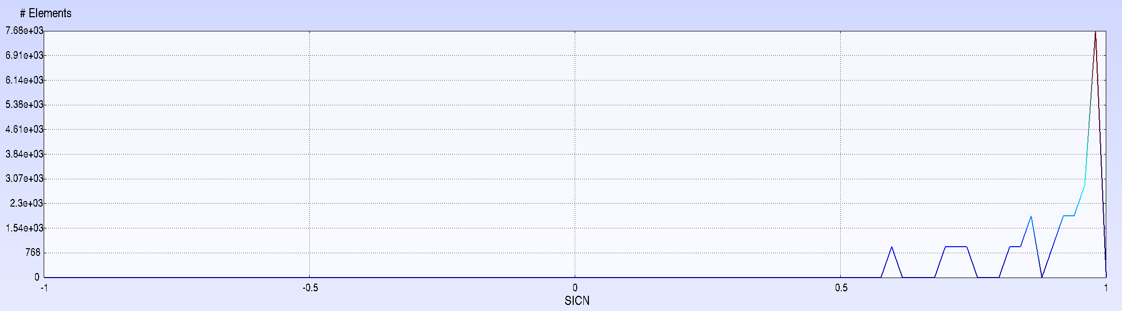
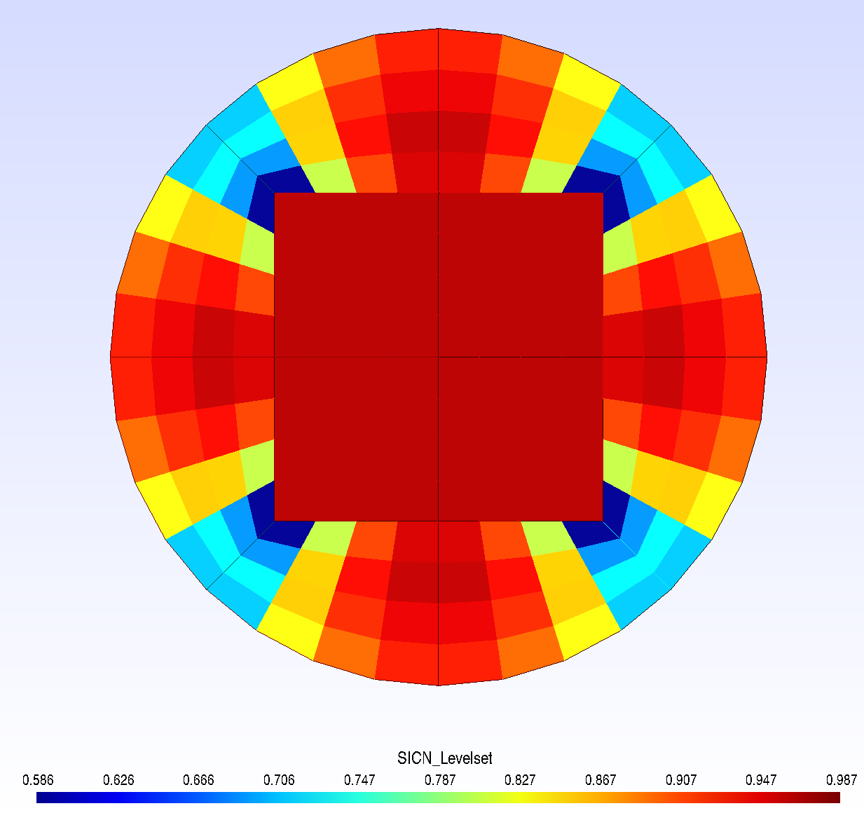
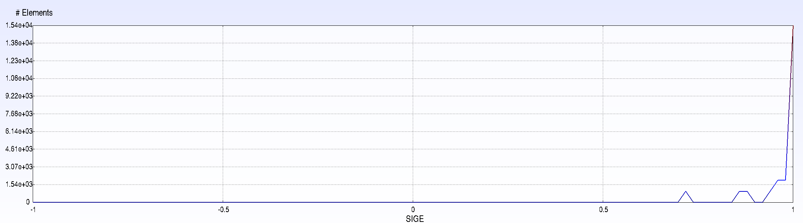
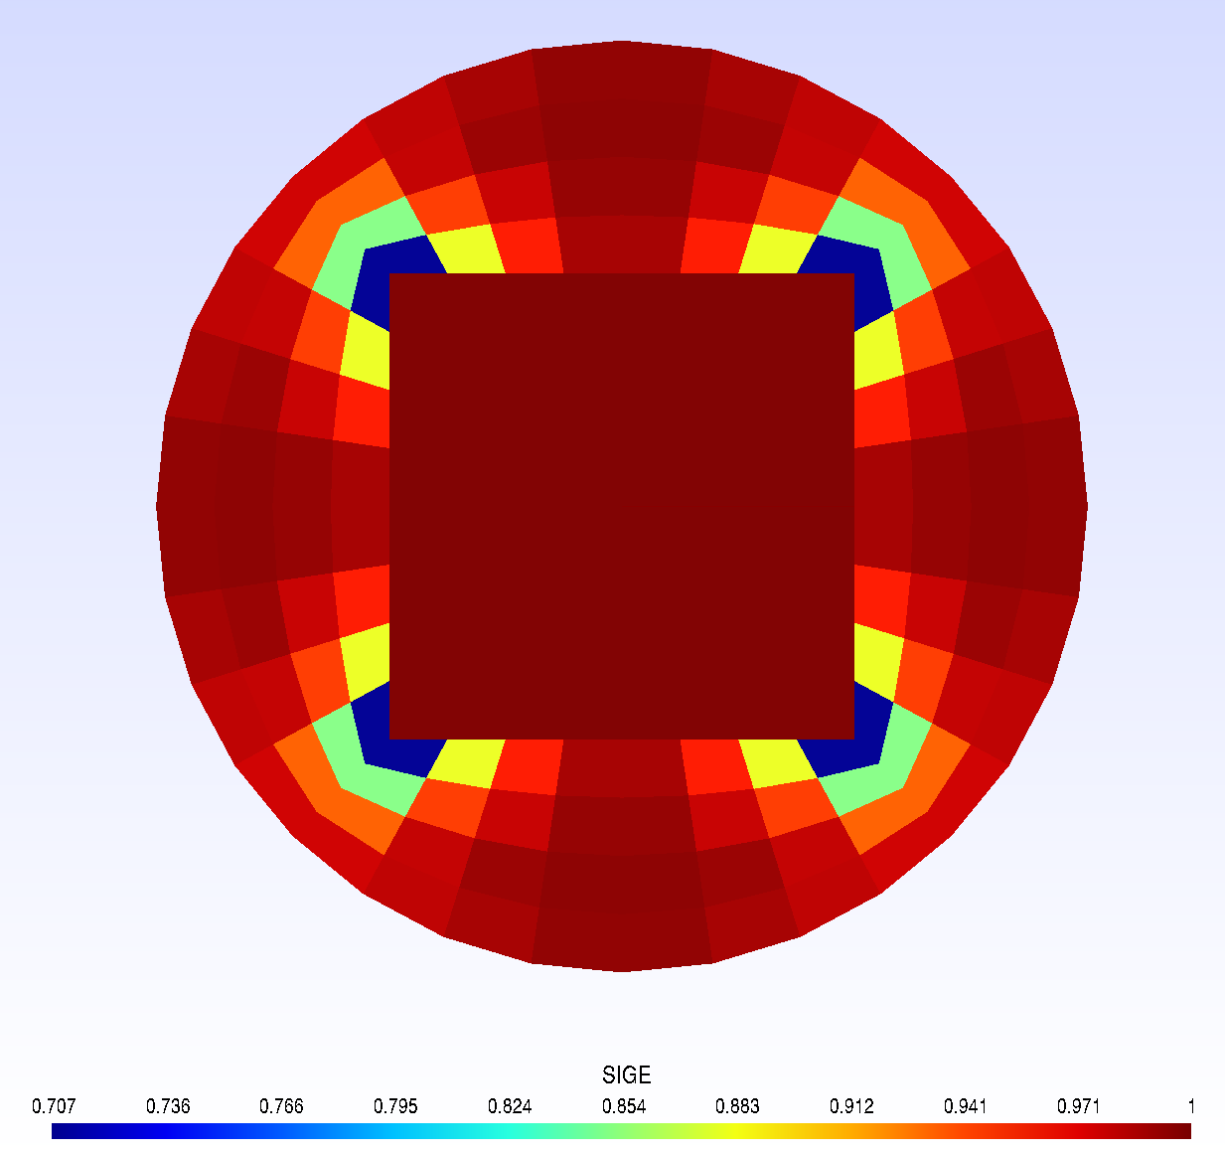
Assessing Mesh Quality in GMSH
The SICN metric will show you the quality of the surface elements in the 3D view, so you need to apply a clipping plane (Tools→ Plugins→ CuttingPlane) to see the inside of the mesh
Clearly, the sharp corners are creating some lower-quality elements, and this doesn’t show us the lack of wall-resolution

Slide 14
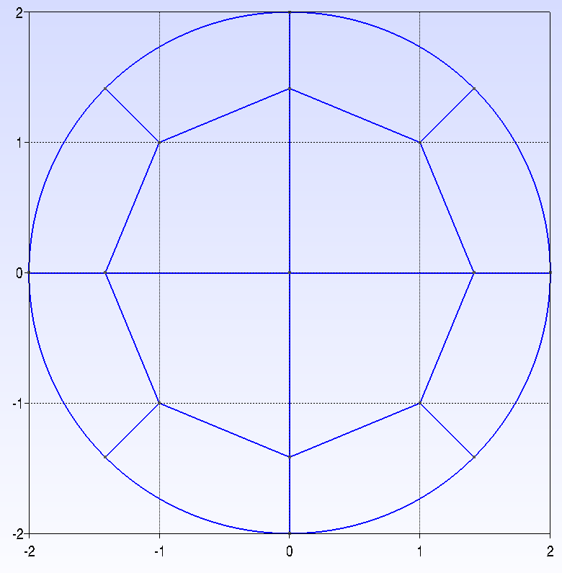
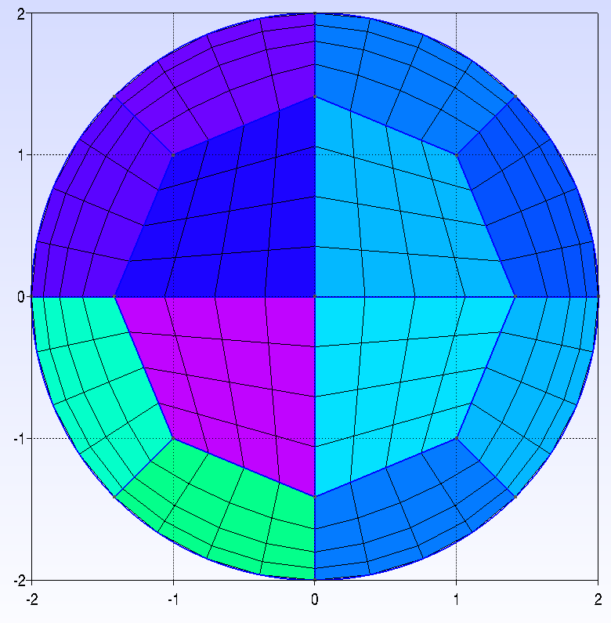
Making a Higher-Quality O-Grid
First, let’s even out the distance of the inner grid to the walls:
  Point(1) = {0, 0, 0};
  Point(2) = {0, 1/Cos(Pi/4), 0};
  Point(3) = {1, 1, 0};
  Point(4) = {1/Cos(Pi/4), 0, 0};
Then, let’s add a progression to our radial discretization to make the grid spacing non-uniform
  Transfinite Curve {1, 2, 3, 4, 6, 8} = dX;
  Transfinite Curve {-5, 7, 9} = dRad Using Progression 1.4;
Now let’s check the mesh quality again
-5 otherwise progression goes opposite way (lines are oriented)

Slide 15
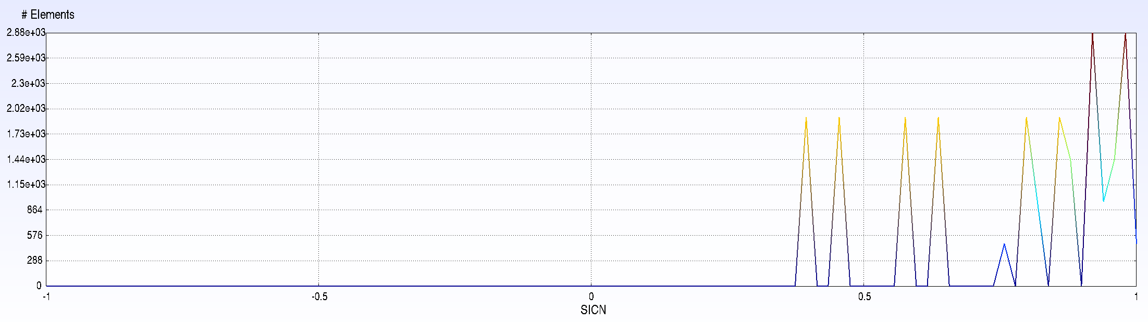
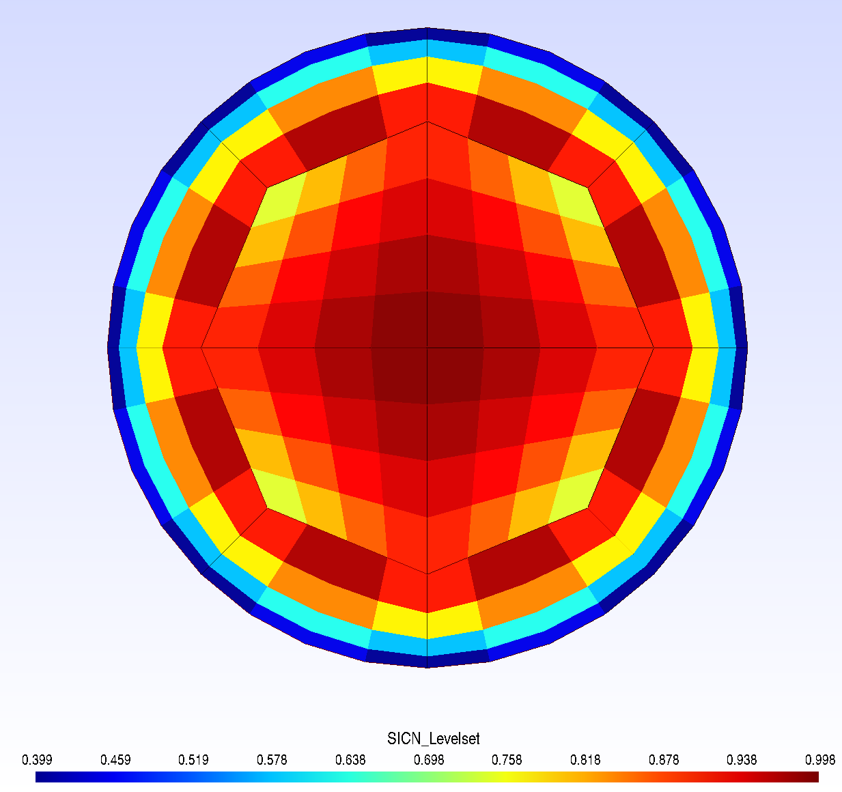
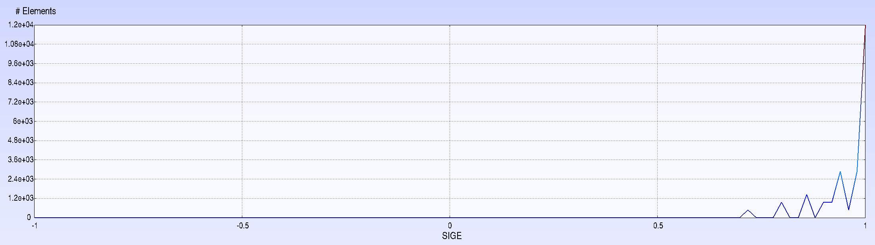
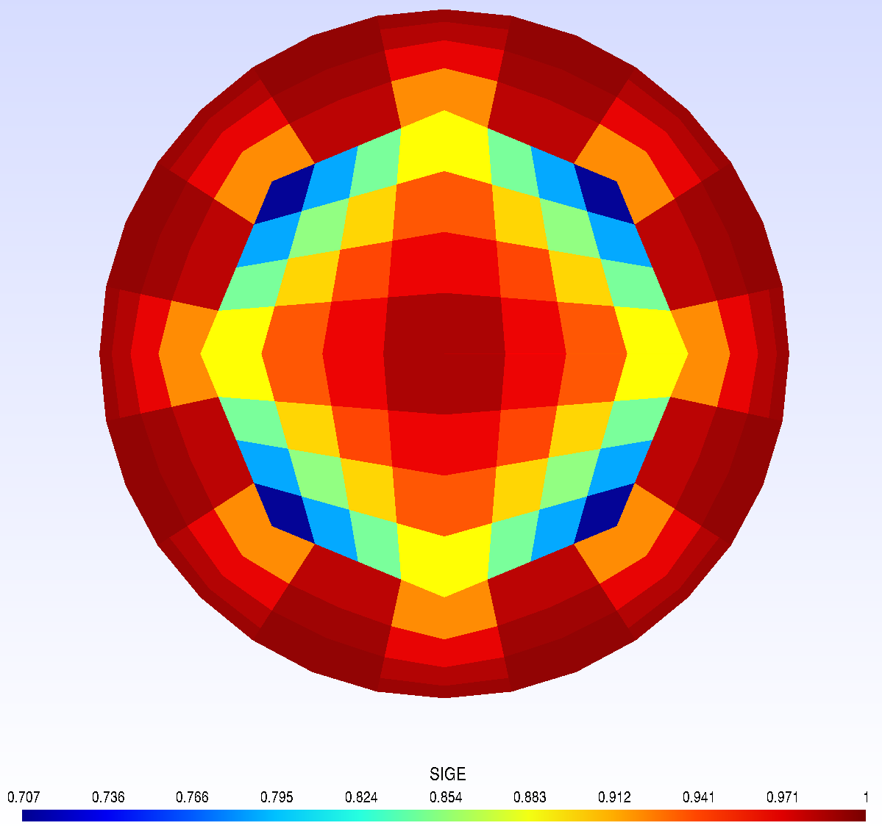
New Mesh Quality
Wait a second! This looks worse than the square mesh! >:(

Slide 16
The (Sometimes) Deceiving Nature of Quality Metrics
In general, quality metrics are reserved for telling you when there is a problem with your mesh
  For example, if a Jacobian of a cell is negative, that cell is invalid and will cause the CFD simulation to diverge
Specific quality metrics are useful for a given solver, but this is highly application-specific
  E.g., high-non-orthogonality in cells may require non-orthogonal corrections in the solver
Quality metrics are generally not good at telling you if a given mesh is better than another (aside from one being invalid, etc.)
To further illustrate this, we will import the mesh to OpenFOAM, check the quality metrics there, and run a simulation and compare the results.

Slide 17
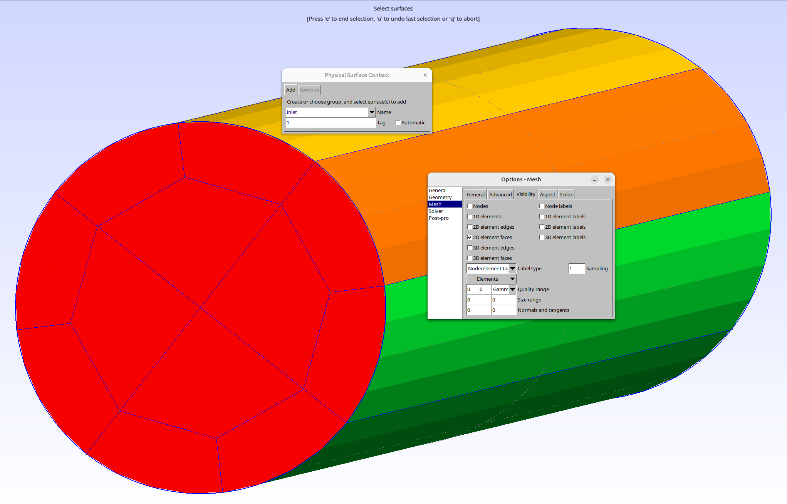
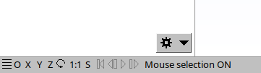
Importing the Mesh
First, we have to define physical surfaces and volumes in Gmsh
  These will become boundary groups and the mesh volume, respectively
  Geometry→ Physical groups → Surface/Volume
  You may have to toggle the visibility of some geometry groups to select the appropriate ones (Tools → Options→ Geometry/Mesh→ Visibility)
  You may have to toggle on the 2D element faces for the physical surface creation, then toggle them off for the volume creation
We will define four groups as follows:
  Physical Surface("Inlet", 1) = {27, 44, 22, 34, 39, 3, 1, 2, 20, 10, 15, 32};
  Physical Surface("Outlet", 2) = {177, 133, 155, 243, 199, 221, 309, 265, 67, 89, 111, 287};
  Physical Surface("Walls", 3) = {164, 146, 230, 80, 278, 98, 296, 212};
  Physical Volume("Pipe", 4) = {8, 9, 7, 12, 5, 10, 4, 11, 6, 1, 3, 2};
  *Note that the numbering of your surfaces/volumes may not be the same, so please select the appropriate ones when you define the physical groups
Make sure mouse selection is off. If the S is red, click it to turn ON mouse selection. Then you will be able to click on the groups to include.

Slide 18
Importing the Mesh
Finally, we will save the mesh. First, type the following anywhere in your .geo file
  Mesh.MshFileVersion = 2.2;
  This will set the file format to v2 ASCII, the only format OpenFOAM can read.
  Save your file and reload the script in the GUI. Finally, go to Mesh then click Save.
Next, we will import the mesh to OpenFOAM
  Move your new .msh file to the folder containing the OpenFOAM case
  Open a terminal and run the command “gmshToFoam [your file].msh”
  Run “checkMesh” to ensure the mesh is free of errors
  Congrats! You are now ready to run your simulation.

Slide 19
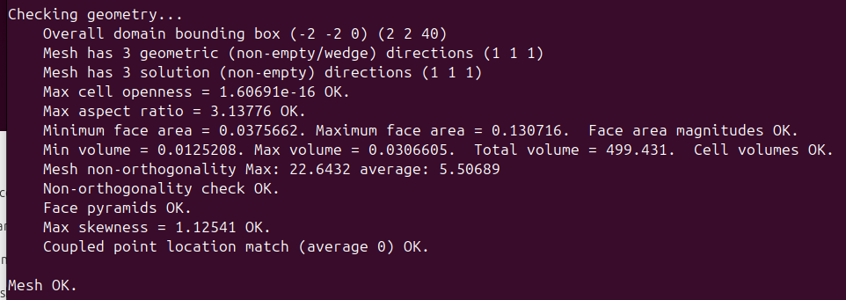
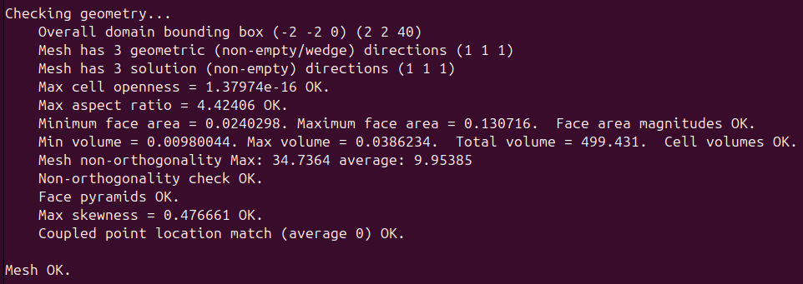
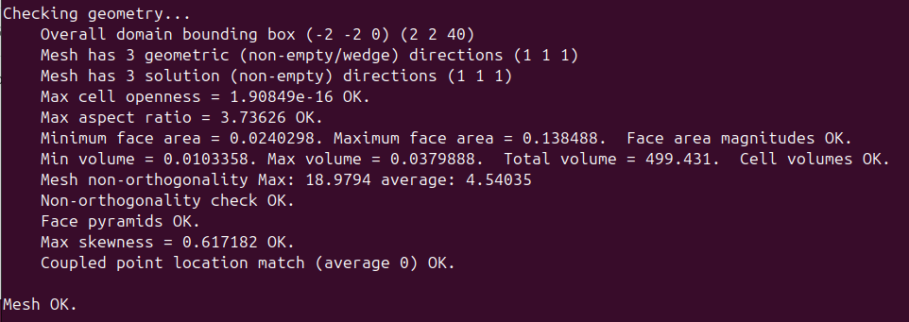
Comparing Meshes in OpenFOAM
Here are some checkMesh outputs for various configurations of the mesh
Square core w/out bias
Square core w/ bias
Octagonal core w/ bias
Save for the max skewness, the octagonal core mesh is worse in every quality metric here.
Let’s see if that holds up to a simple benchmark.

Slide 20
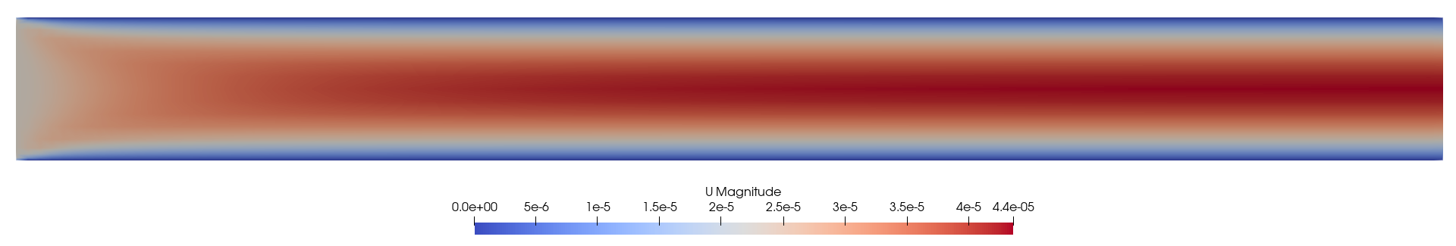
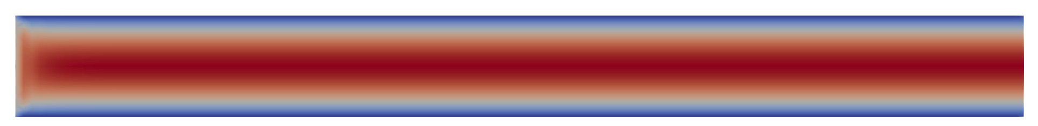
Mesh Benchmark – Developing Laminar Flow
The benchmark we will be using is a simple developing laminar flow simulation at Re= 100 (from an inviscid inlet condition).
The case is already set up. Simply run “foamRun” to execute.
If you run all three geometries, you will obtain the following:
Mesh configuration | Number of iterations required for convergence
Octagonal core w/ bias | 299
Square core w/out bias | 651
Square core w/ bias | 715
Octagonal core w/ bias
Square core w/ or w/out bias (both cases identical)

Slide 21
Mesh Benchmark – Developing Laminar Flow
As we can see, benchmarking reveals that the better mesh is the octagonal core o-grid, despite the mesh metrics indicating the opposite
The square core o-grids even fail to accurately capture the developing region of the flow
In reality, the corners of the square grid are problematic for convergence, and poorer resolution near the wall makes for difficulty capturing steep gradients (as are present in the developing region)
The result is a mesh that causes a “skip” to developed flow and requires more iterations to converge
In short, don’t rely solely on quality metrics!
Octagonal core w/ bias
Square core w/ or w/out bias (both cases identical)

Slide 22
Thank You! :)

