Slide 1
Uganda Karamoja Food Security data analysis

Slide 2
Introduction
Karamoja is the most food-insecure region of Uganda. One of the main reasons is the low productivity level of the crops due to intense droughts as well as pest and disease outbreaks.
In Karamoja, several NGOs provide technical support as well as farm inputs to the farmers experiencing extremely low yield. Though, they lack visibility into the overall state of the region and often need to rely on some very local sources of information to prioritize their activities.To do so, i developed a methodology to remotely measure the yield of the two main staple crops of the region (i.e. sorghum and maize) based on satellite images.

Slide 3
Objectives
1.To develop an interactive visualization tool of the results for this first crop season.
2.To use this tool as a Food Security Monitoring tool
3.To use maps in the dashboard

Slide 4
Research Questions
1. Which District produces the highest and lowest maize and Sorghum
2.Which subcounties produce highest and lowest maize and sorghum
3.How arears are distributed in Uganda map
4. What is the relationship betwen crop yield and population

Slide 5
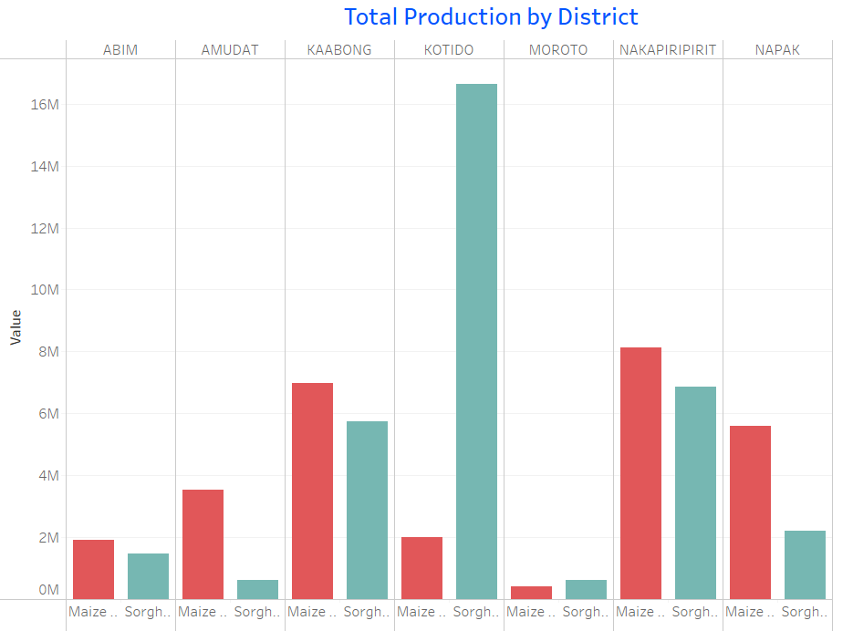
Results
Kotido district produces the highest sosrghum while Nakapiriririt produces the highest maize.
Moroto district produces the the least maize while Moroto produces the lowest sorghum.

Slide 6
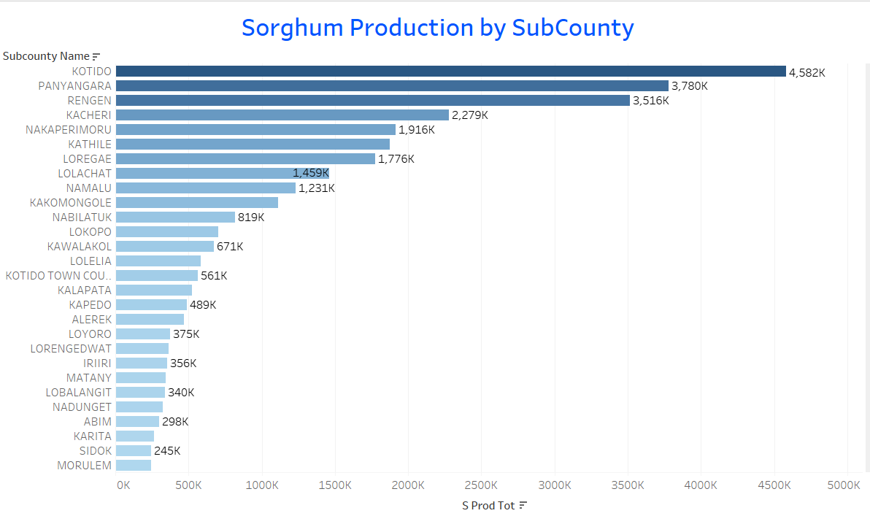
Results
Kotido subcounty is the highest producer of sorghum.
Northern Division sub county is the lowest producer of sorghum.

Slide 7
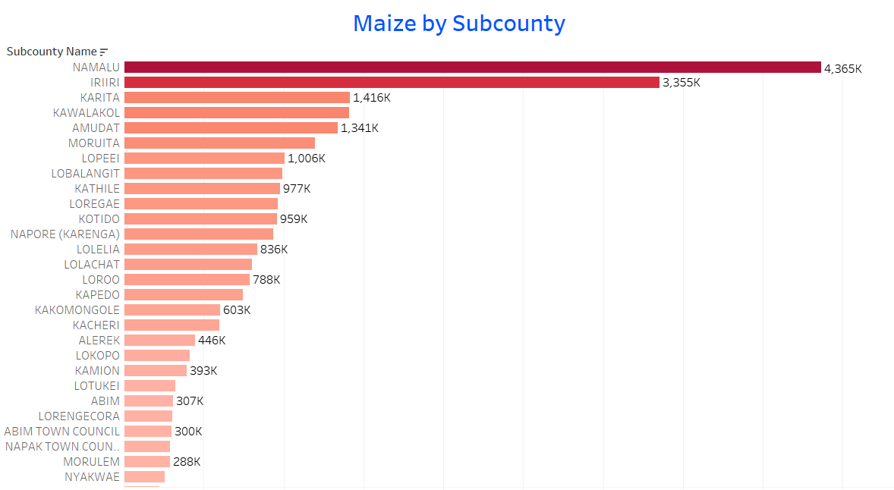
Results
Namalu sub county is the highest producer of maize.
Southern division is the lowest producers of maize.

Slide 8
Recommendation
More effort is need in Southern division and Northern division to increase production of maize and sorghum.
Kitido sub county producing highest sorghum need more farm input to increase yield.
Lolelia is has highest population but produces minimal staple food. More effort need to be put in this area to prevent shortage of food.

Slide 9
Conclusion
To achieve food secure region of the Karamaoja region in Uganda, more effort need to be put to ensure areas producing minimal food are enhanced through provision of farm input.
Most areas have potential to produce maize and sorghum if well handles and guided with farming techniques.

Slide 10
Thank you.!!

