Slide 1







Technological Trends and Analysis Presentation
OHAEGBUNEM, FREDRICK UGO
18th MARCH, 2023

Slide 2



OUTLINE
Executive Summary
Introduction
Methodology
Results
Visualization – Charts
Dashboard
Discussion
Findings & Implications
Conclusion
Appendix

Slide 3

EXECUTIVE SUMMARY
Trends in programming languages and Databases
Demographics survey
Technological gap in countries
Gender gap in jobs

Slide 4

INTRODUCTION
About:
Analyzing the trends in software development
Purpose:
Identify skill requirements for future
What are the top programming languages in demand?
What are the top database skills in demand?
What are the popular IDEs

Slide 5

METHODOLOGY
Data Collection Sources
Stack Overflow Developer 2019 Survey Github Job Postings Programming Languages Annual Salary
Data Exploration
Data Cleaning
Data Visualization
Presentation

Slide 6
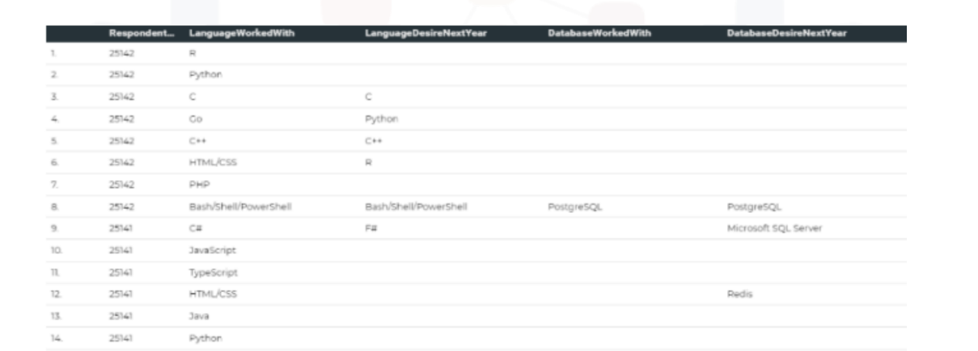
RESULTS

Slide 7
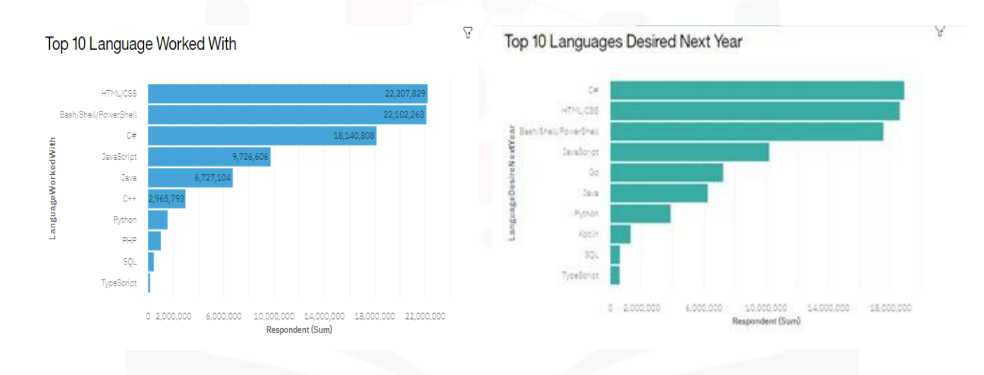
PROGRAMMING LANGUAGE TRENDS

Slide 8
PROGRAMMING LANGUAGE TRENDS - FINDINGS & IMPLICATIONS
Findings
JavaScript, HTML/CSS,SQL are top 3 this year
Python and Typescript becoming popular next year
PowerShell edged out in next year
Implications
Web development are still in high demand
Big Data technology in companies still requires SQL
With AI and ML in rising demand, Python is best choice

Slide 9
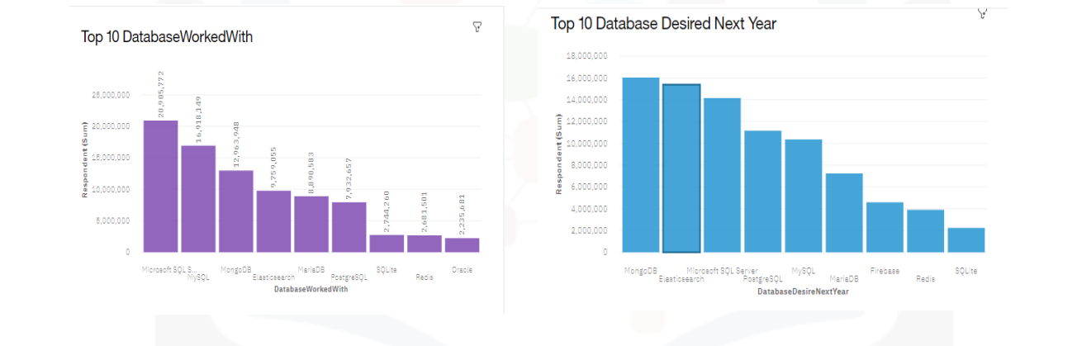
DATABASE TRENDS

Slide 10
DATABASE TRENDS - FINDINGS & IMPLICATIONS
Findings
MySQL most popular • Behind is Microsoft SQL
MongoDB and Redis are upcoming favorites
New kid on the block: Elasticsearch
Implications
Open source database are still preferable in companies
NoSQL databases will make an impact for storing non relational data
Redis supports abstract data types3

Slide 11

DASHBOARD
https://dataplatform.cloud.ibm.com/dashboards/a1f13e14- d695-4a9a-9777- 9f27cd395e11/view/7a12f20506e9759e17d3c4e407987d55 29632d5db7bbd603d28c7b490c622797f03f1196c8791858d e120137a1bf1a08c8

Slide 12
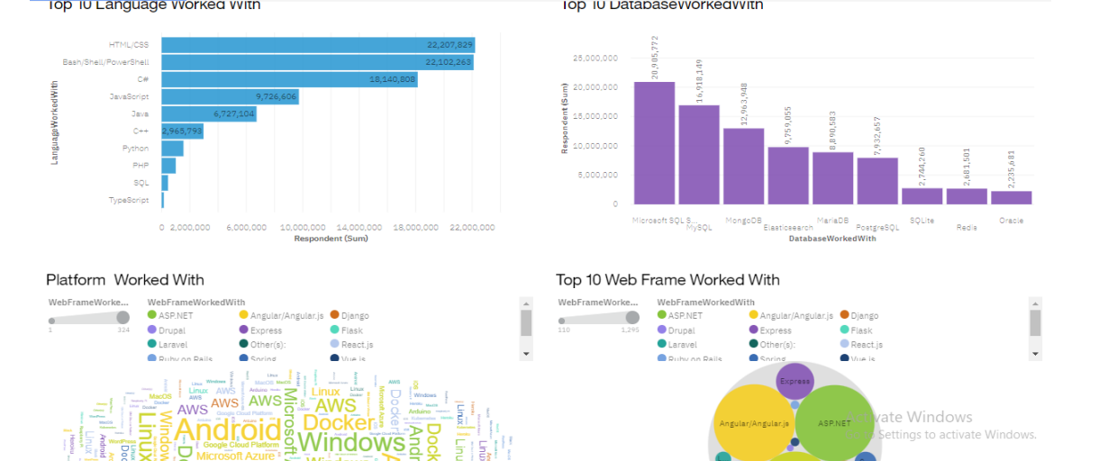
DASHBOARD TAB 1

Slide 13
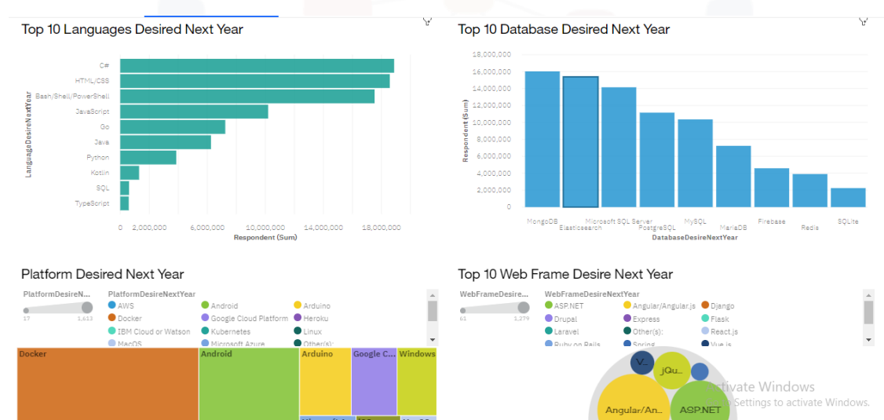
DASHBOARD TAB 2

Slide 14
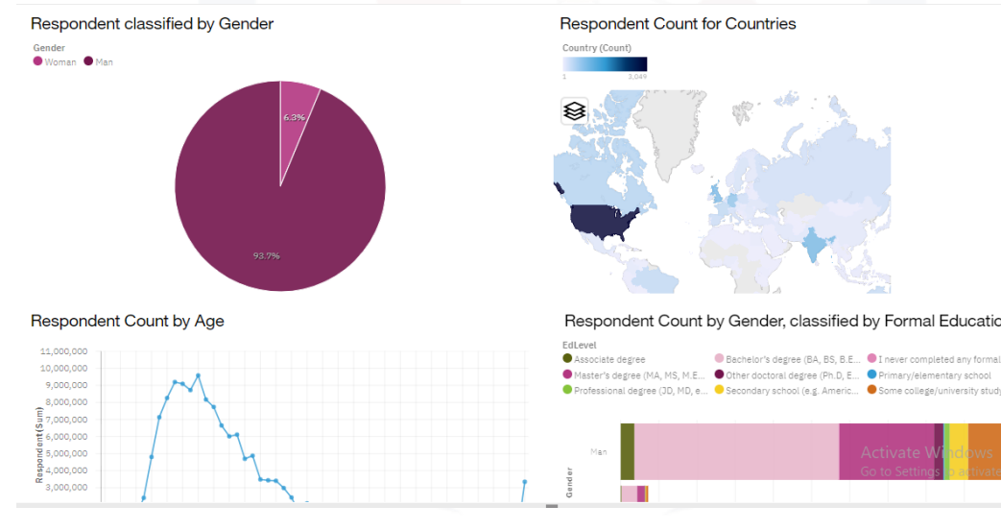
DASHBOARD TAB 3

Slide 15
DISCUSSION
Technology Trends now and future
Training and Reskilling workers
Female participation in Technology field
Eliminate age and education discrimination in employment

Slide 16
OVERALL FINDINGS & IMPLICATIONS
Findings
Fast changing technology every year
Concentration on several countries like USA and India
Gender gap in technology jobs
Implications
Companies need to be flexible and adjust to rapid change
Need to spread technology out to lagging countries
Impact of job hiring's

Slide 17

CONCLUSION
Technology Trends for current and next year
Programming languages, Database and Platform overview
Demographics overview
Actions to be taken

Slide 18

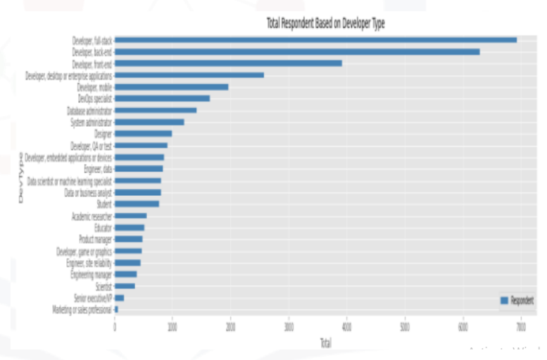
APPENDIX

Slide 19
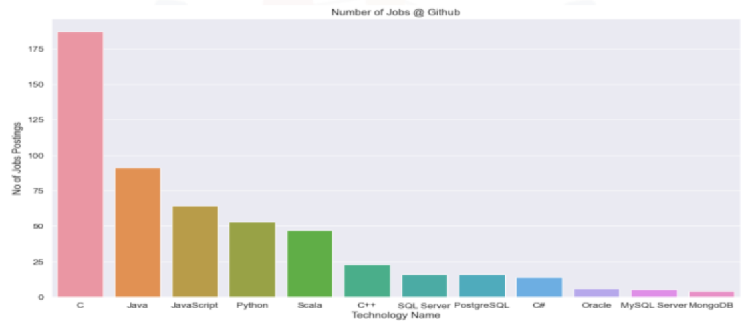
JOB POSTINGS

Slide 20
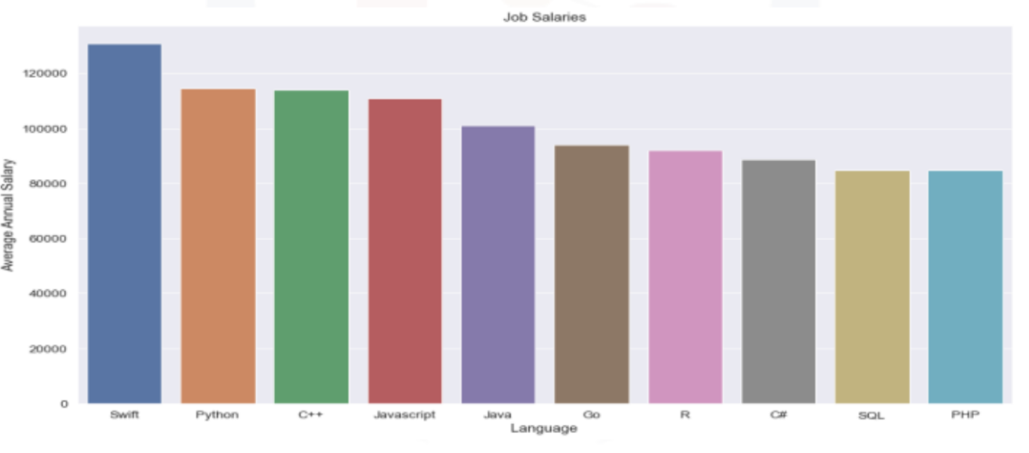
POPULAR LANGUAGES

