Slide 1
Design of a Spread-Spectrum Data Transmission system
Master Project 1
Daniel Pedder
Mahalakshmi Krishnan
Thomas Homm

Slide 2

Content
Motivation
Fundamentals of Spread-Spectrum Communications
Design of the System
Implementation in SpinalHDL
Hardware Demonstration
Outlook and Conclusion

Slide 3
Motivation
Design of a Spread-Spectrum Data Transmission system - Daniel Pedder - Mahalakshmi Krishnan - Thomas Homm

Slide 4
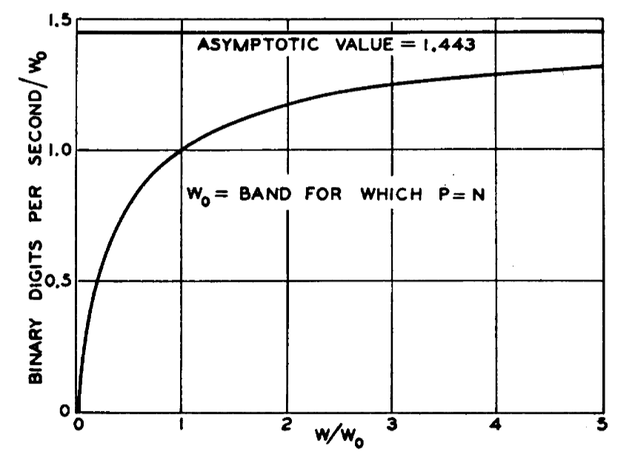
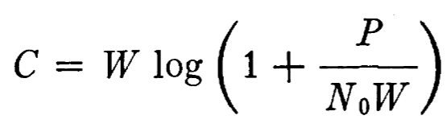
Justification of Spread Spectrum Communication
C. E. Shannon, "Communication in the Presence of Noise," in Proceedings of the IRE, vol. 37, no. 1, pp. 10-21, Jan. 1949, doi: 10.1109/JRPROC.1949.232969.
Design of a Spread-Spectrum Data Transmission system - Daniel Pedder - Mahalakshmi Krishnan - Thomas Homm
Notes:
Shannon Hartley Theorem
Channel Capacity
There exists a code so that:
Increased Bandwidth with FIXED TX power
-> arbitrarily close to theoretical maximum bits/second
-> arbitrarily low TX power/Hz
-> arbitrarily insensitive to band limited interference

Slide 5
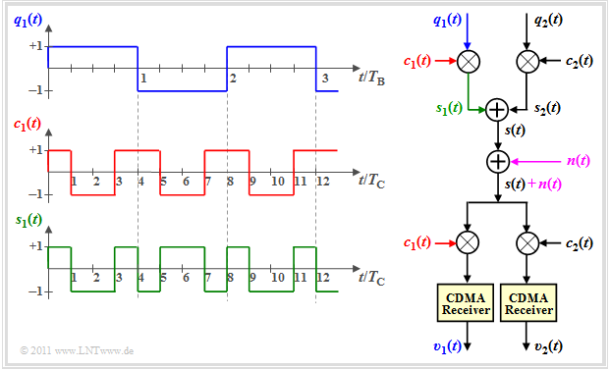
Generating a spread spectrum signal: DSSS
Direct Sequence Spread Spectrum
https://en.lntwww.de/Examples_of_Communication_Systems/Telecommunications_Aspects_of_UMTS
Design of a Spread-Spectrum Data Transmission system - Daniel Pedder - Mahalakshmi Krishnan - Thomas Homm

Slide 6
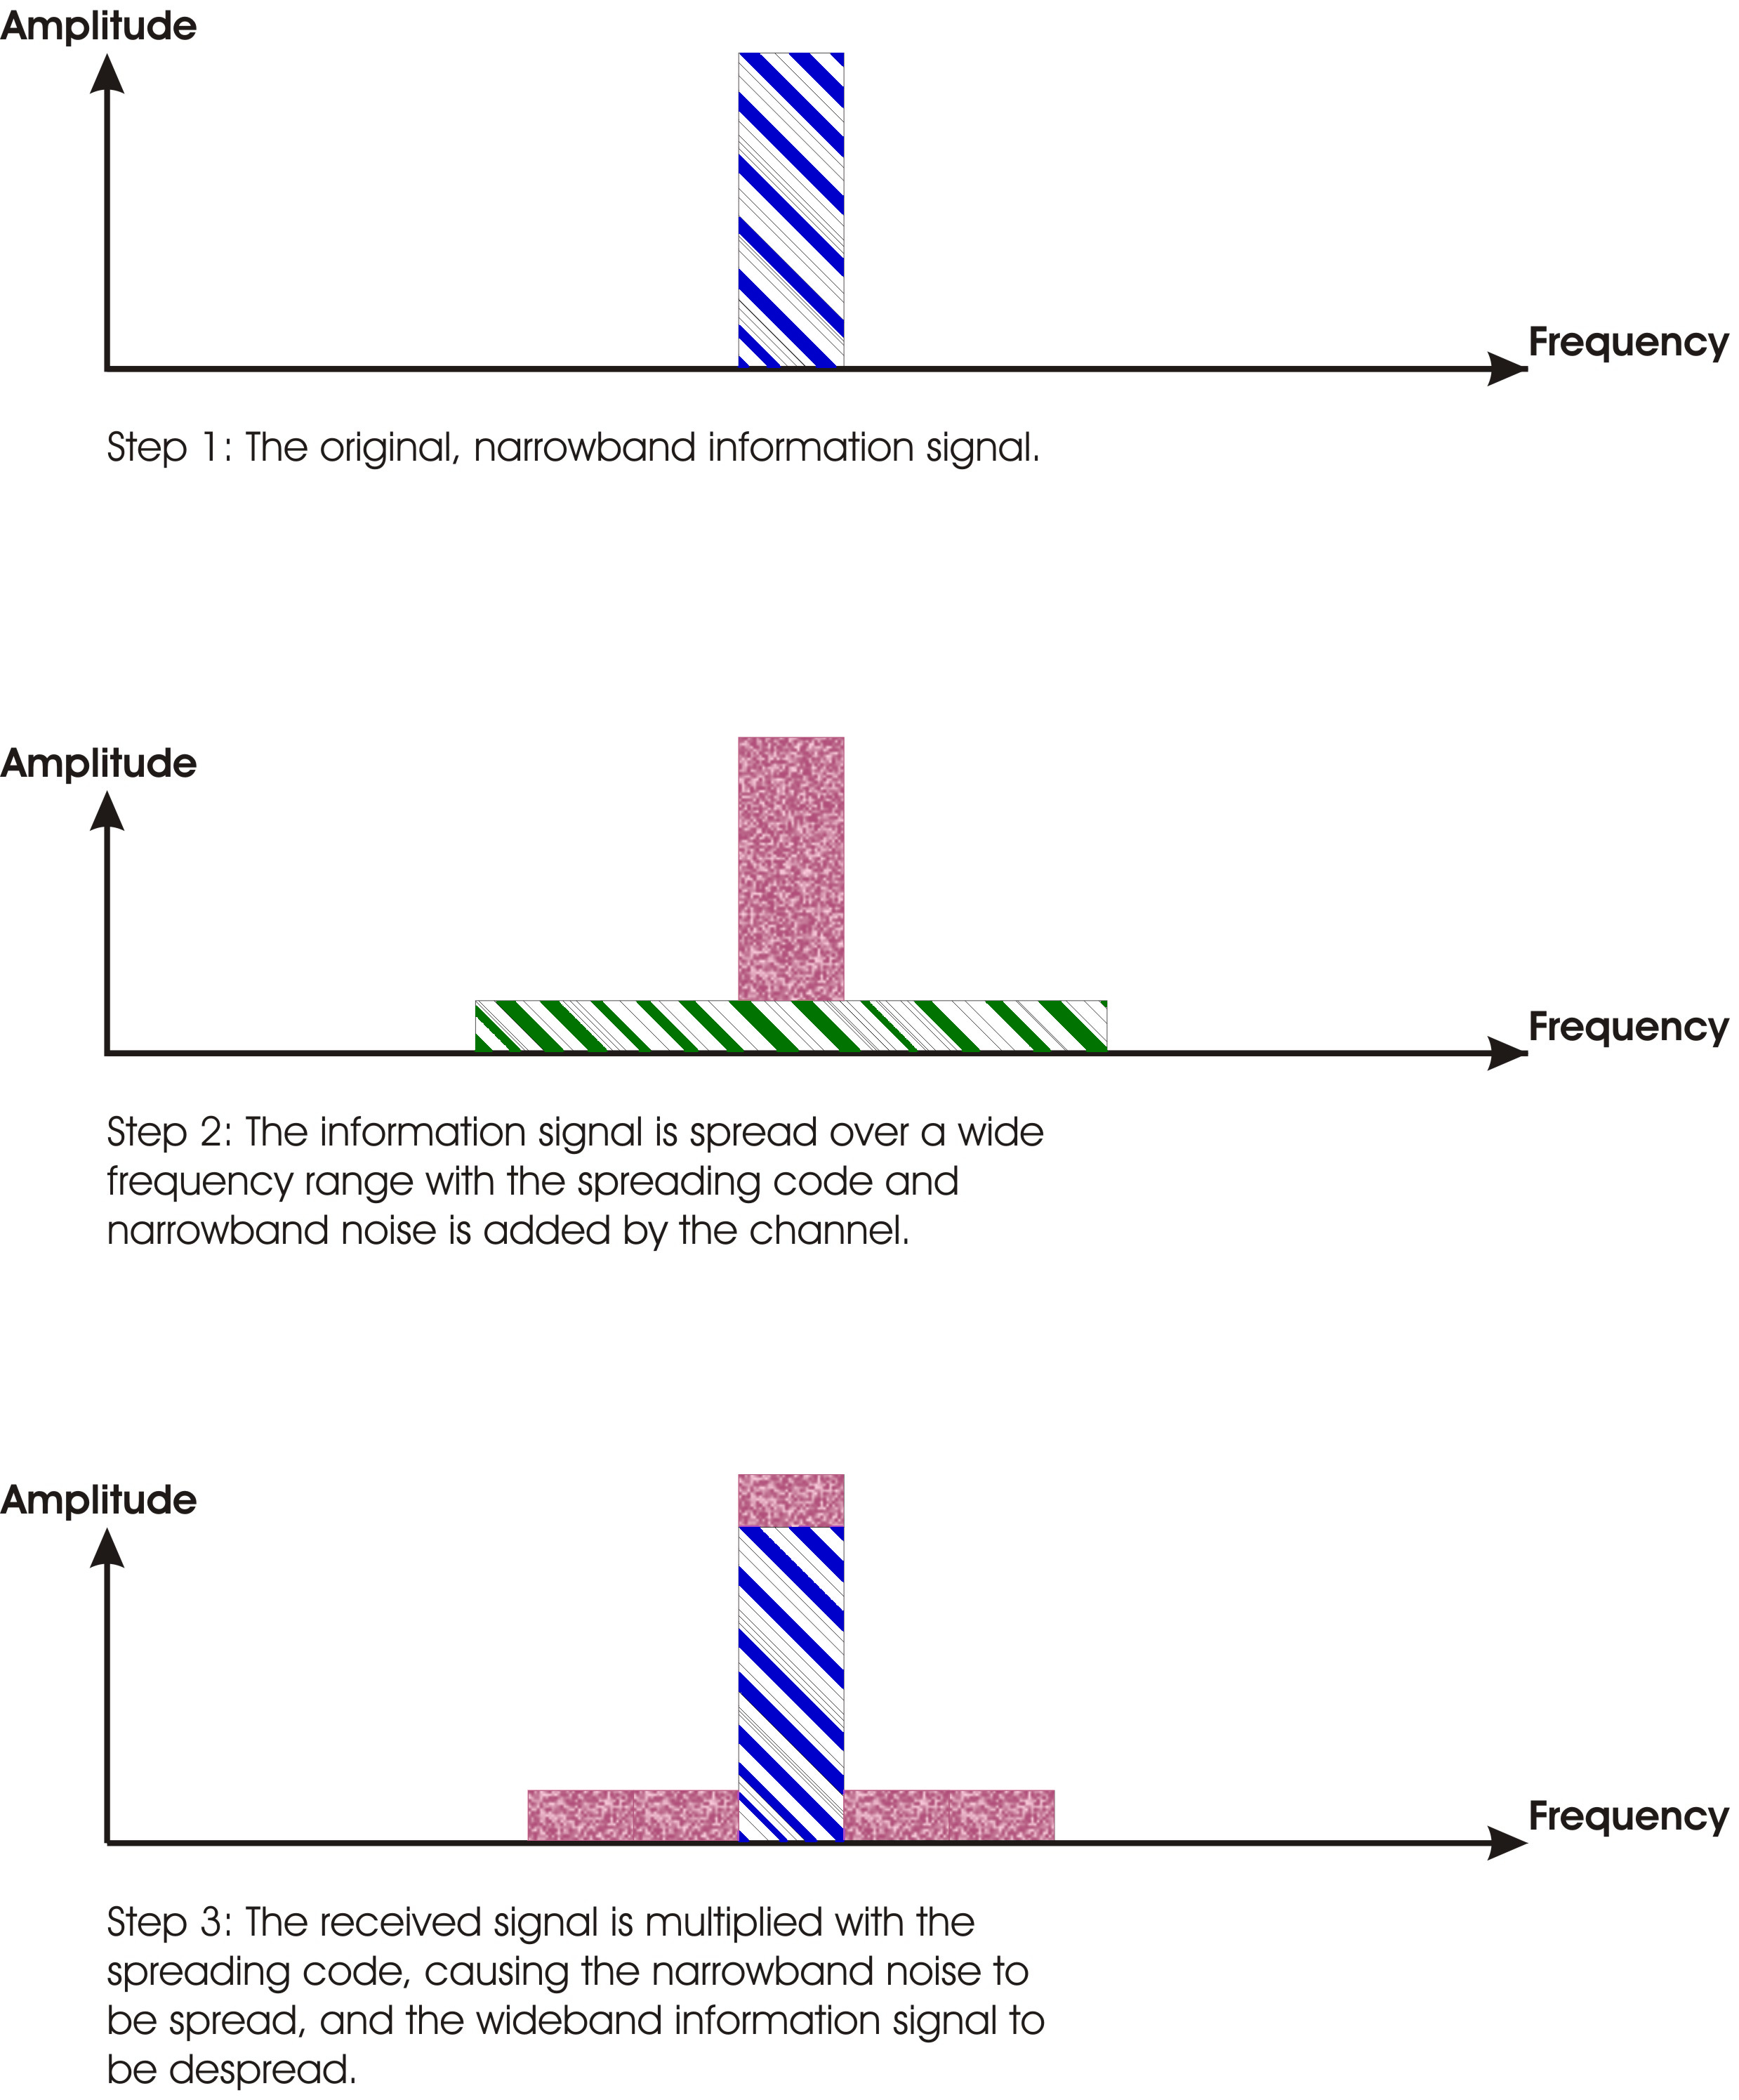
Antijamming communication - DSSS
Direct Sequence Spread Spectrum
https://en.lntwww.de/Examples_of_Communication_Systems/Telecommunications_Aspects_of_UMTS
https://commons.wikimedia.org/wiki/File:Processinggain.jpg
Design of a Spread-Spectrum Data Transmission system - Daniel Pedder - Mahalakshmi Krishnan - Thomas Homm

Slide 7
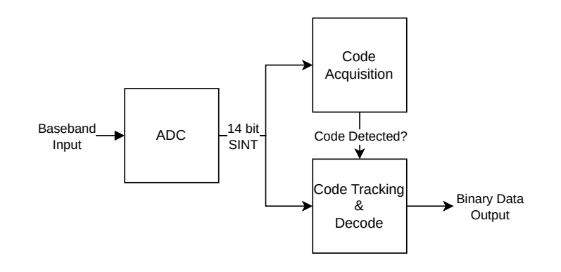
System Design - Receiver
Design of a Spread-Spectrum Data Transmission system - Daniel Pedder - Mahalakshmi Krishnan - Thomas Homm
Notes:
Shannon Hartley Theorem
Channel Capacity
There exists a code so that:
Increased Bandwidth with FIXED TX power
-> arbitrarily close to theoretical maximum bits/second
-> arbitrarily low TX power/Hz
-> arbitrarily insensitive to band limited interference

Slide 8
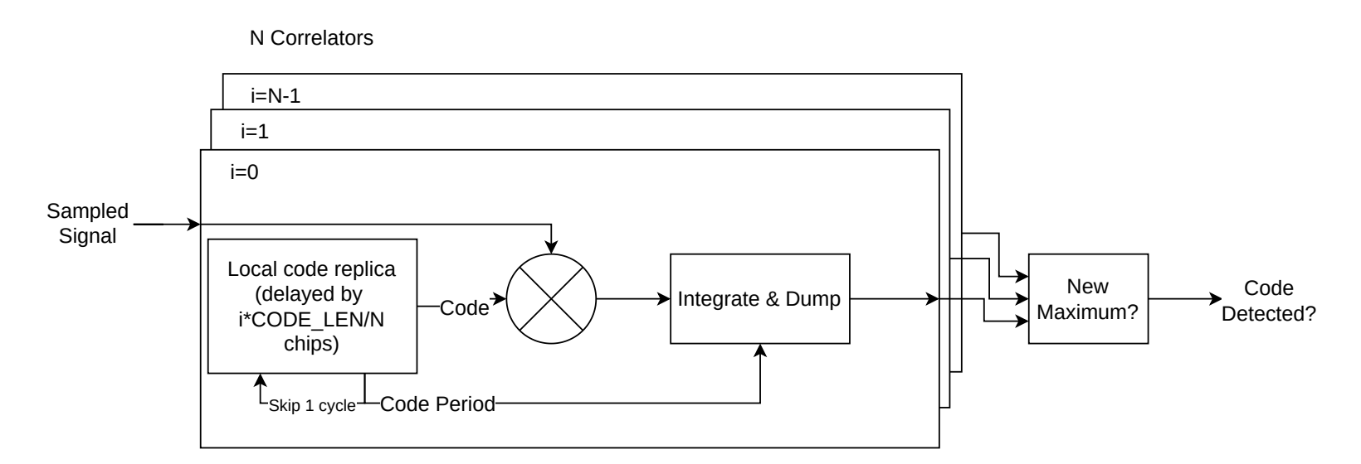
System Design - Receiver
Design of a Spread-Spectrum Data Transmission system - Daniel Pedder - Mahalakshmi Krishnan - Thomas Homm
Notes:
Shannon Hartley Theorem
Channel Capacity
There exists a code so that:
Increased Bandwidth with FIXED TX power
-> arbitrarily close to theoretical maximum bits/second
-> arbitrarily low TX power/Hz
-> arbitrarily insensitive to band limited interference

Slide 9
Thank you for your Attention!
Notes:
1. Which other drone jamming techniques could you imagine?
2. How do modern communication techniques prevent themselves fRom Jamming and interference?
3. why is simultaneous sending and receiving generally a problem in radio communication?
4. How else could you protect a UAV from jamming

