Slide 1
DESIGN OF A SPREAD-SPECTRUM DATA TRANSMISSION SYSTEM
Master Project 1
Daniel Pedder
Mahalakshmi Krishnan
Thomas Homm

Slide 2
CONTENT
Motivation
Fundamentals of Spread-Spectrum Communications
Design of the System
Implementation in SpinalHDL
Hardware Demonstration
Outlook and Conclusion
Design of a Spread-Spectrum Data Transmission system - Daniel Pedder - Mahalakshmi Krishnan - Thomas Homm
07/14/2026

Slide 3
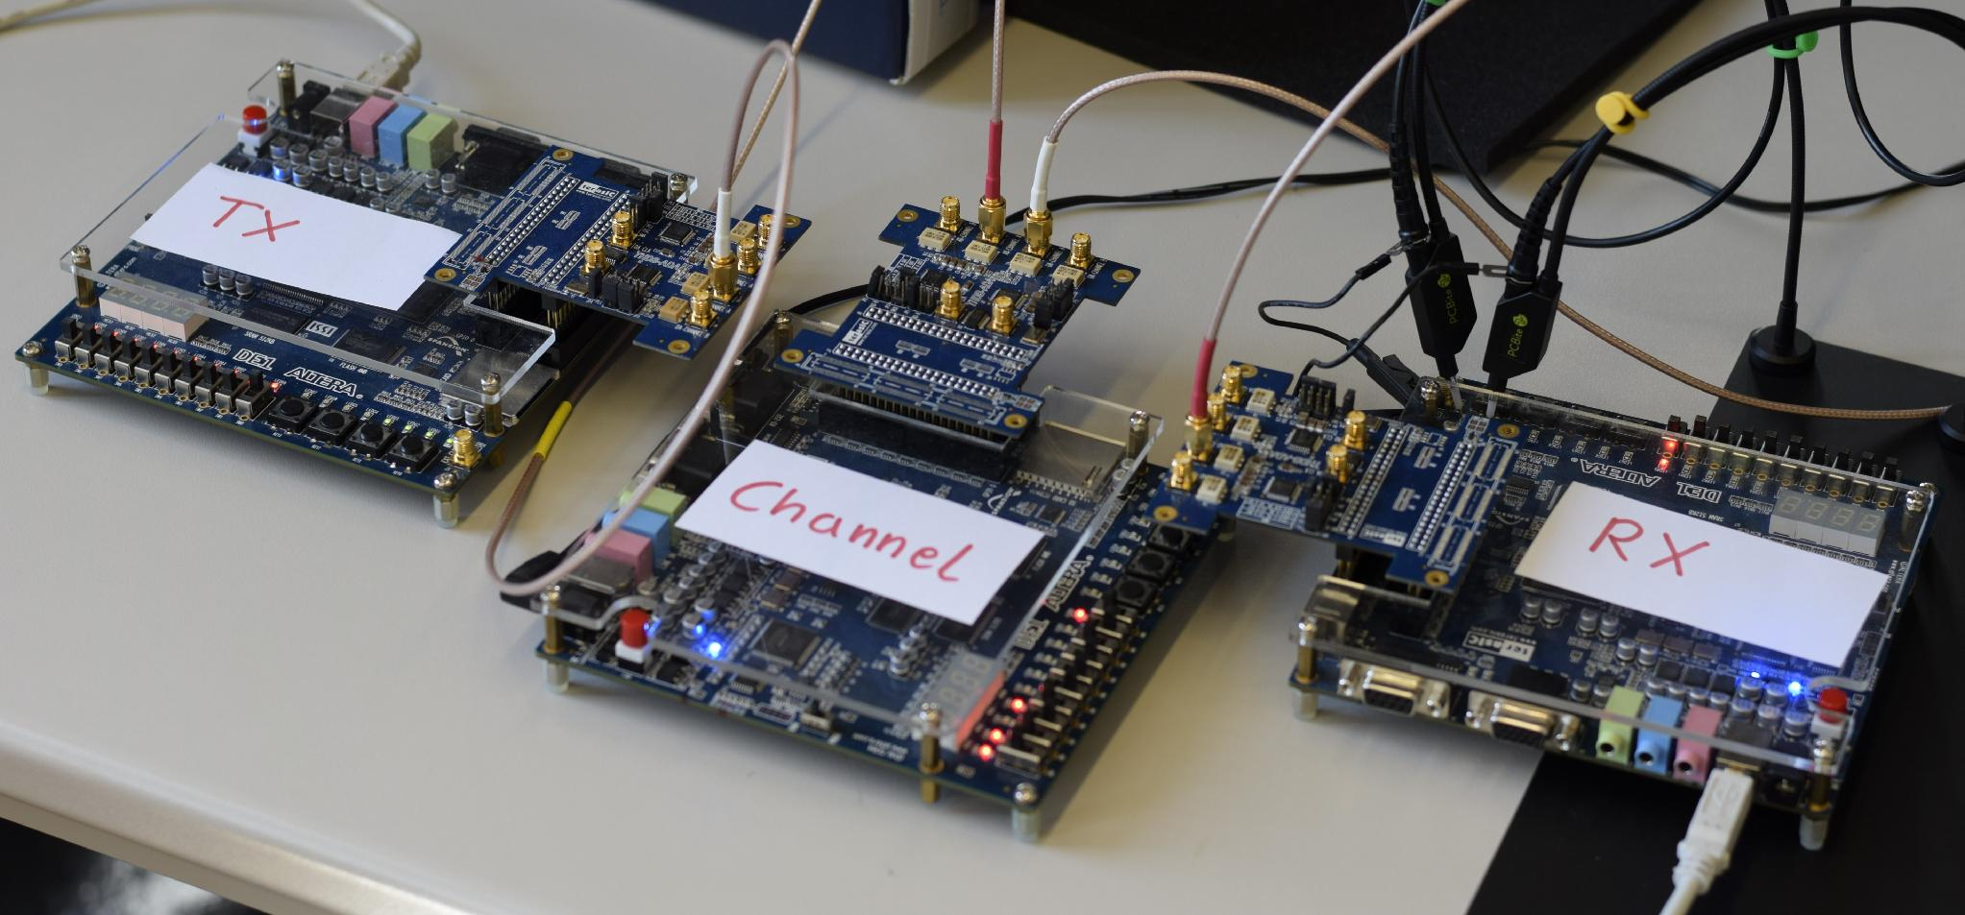
MOTIVATION
Build a spread-spectrum digital communication system entirely in hardware using SpinalHDL
Three main components: transmitter, noise channel emulator, and receiver
Used as a real test of SpinalHDL on a DSP-heavy design
Design of a Spread-Spectrum Data Transmission system - Daniel Pedder - Mahalakshmi Krishnan - Thomas Homm
07/14/2026

Slide 4
PROJECT GOALS
Build a working DSSS transmitter + receiver on real FPGA hardware
Specifically solve acquisition and tracking under real constraints (50 MHz clock, no floating-point)
Evaluate SpinalHDL as the implementation language.

Slide 5
TAKEAWAYS FROM THIS PROJECT
Why spread signal exists at all: spreading a signal wider doesn't cost transmit power - Shannon-Hartley
What DSSS mechanically is: spreads one data bit into many chips using a LFSR-generated code
Why it's worth the the payoff: wider spread - resistant to narrowband interference, and multiple users can share the same band (CDMA)

Slide 6

Content
Motivation
Fundamentals of Spread-Spectrum Communications
Design of the System
Implementation in SpinalHDL
Hardware Demonstration
Outlook and Conclusion

Slide 7
KEY LESSONS
Why Spread Spectrum?
What is Spread Spectrum?
Toolchain
Design of the System
Implementation in SpinalHDL
Hardware Demonstration
Outlook and Conclusion
Design of a Spread-Spectrum Data Transmission system - Daniel Pedder - Mahalakshmi Krishnan - Thomas Homm
07/14/2026

Slide 8
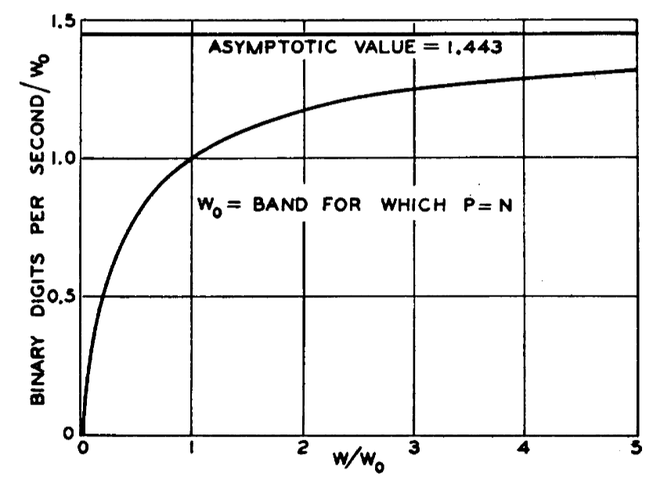
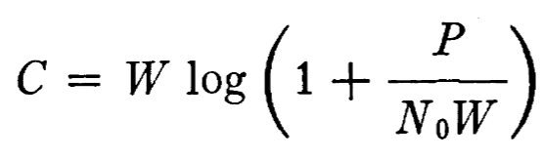
JUSTIFICATION OF SPREAD SPECTRUM COMMUNICATION
C. E. Shannon, "Communication in the Presence of Noise," in Proceedings of the IRE, vol. 37, no. 1, pp. 10-21, Jan. 1949, doi: 10.1109/JRPROC.1949.232969.
Design of a Spread-Spectrum Data Transmission system - Daniel Pedder - Mahalakshmi Krishnan - Thomas Homm
07/14/2026
Notes:
Shannon Hartley Theorem
Channel Capacity
There exists a code so that:
Increased Bandwidth with FIXED TX power
-> arbitrarily close to theoretical maximum bits/second
-> arbitrarily low TX power/Hz
-> arbitrarily insensitive to band limited interference

Slide 9
JUSTIFICATION OF SPREAD SPECTRUM COMMUNICATION
Shannon-Hartley theorem: channel capacity C grows with bandwidth W, even at fixed transmit power P
A signal can be spread across a wider bandwidth without increasing transmit power, even though total noise power increases
With increased bandwidth at fixed TX power, you get arbitrarily close to the theoretical maximum bits/second, arbitrarily low TX power per Hz, arbitrarily insensitive to band-limited interference
This is the theoretical basis DSSS exploits
Design of a Spread-Spectrum Data Transmission system - Daniel Pedder - Mahalakshmi Krishnan - Thomas Homm
07/14/2026
Notes:
Shannon Hartley Theorem
Channel Capacity
There exists a code so that:
Increased Bandwidth with FIXED TX power
-> arbitrarily close to theoretical maximum bits/second
-> arbitrarily low TX power/Hz
-> arbitrarily insensitive to band limited interference

Slide 10
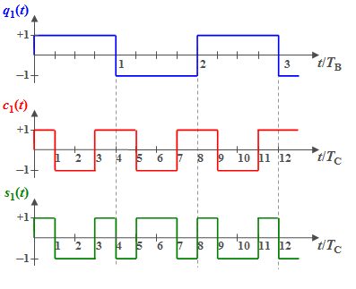
GENERATING A SPREAD SPECTRUM SIGNAL: DSSS
Direct Sequence Spread Spectrum
https://en.lntwww.de/Examples_of_Communication_Systems/Telecommunications_Aspects_of_UMTS
Design of a Spread-Spectrum Data Transmission system - Daniel Pedder - Mahalakshmi Krishnan - Thomas Homm
07/14/2026

Slide 11
GENERATING A SPREAD SPECTRUM SIGNAL: DSSS
Direct Sequence Spread Spectrum
A single data bit b∈{+1,−1}is held constant for one bit period Tb
It's multiplied by a PN chip sequence c[n] running at a much higher rate. It spreads one bit into many chips.
In hardware: implemented as an XOR between the data bit and the LFSR-generated chip (equivalent to ±1 multiplication)
PN sequence generated by a Linear Feedback Shift Register (LFSR), based on a fixed polynomial
Receiver needs the same polynomial to despread and recover the data, without it just sees noise
1023 chips per data bit, from a 10-bit LFSR
https://en.lntwww.de/Examples_of_Communication_Systems/Telecommunications_Aspects_of_UMTS
Design of a Spread-Spectrum Data Transmission system - Daniel Pedder - Mahalakshmi Krishnan - Thomas Homm
07/14/2026

Slide 12
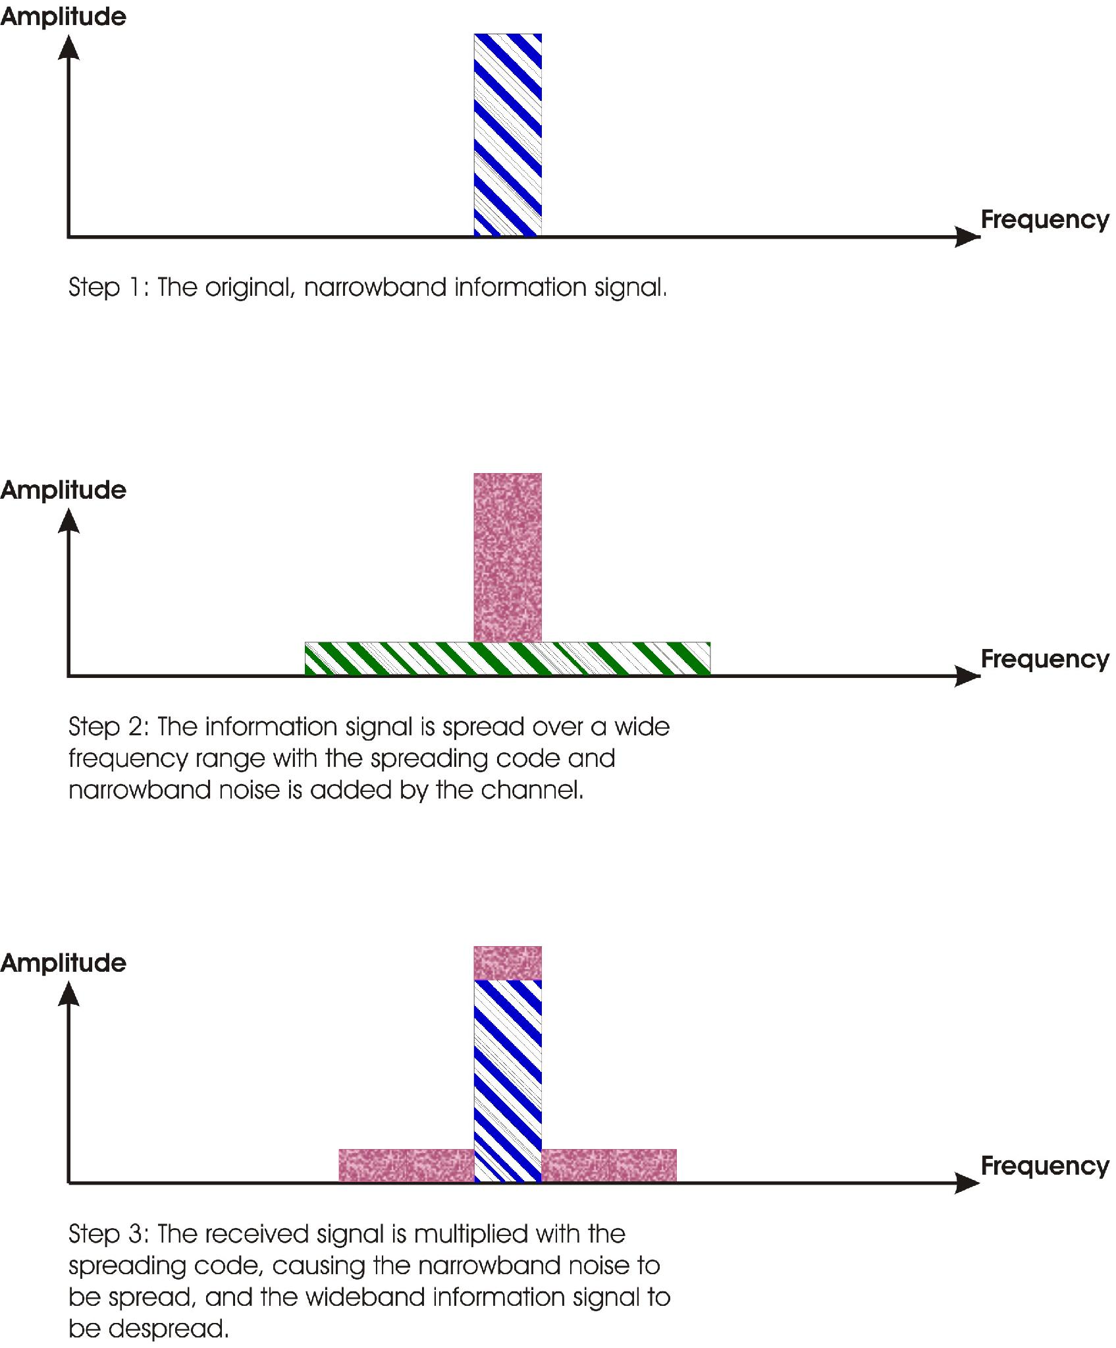
DIRECT SEQUENCE SPREAD SPECTRUM
https://en.lntwww.de/Examples_of_Communication_Systems/Telecommunications_Aspects_of_UMTS
https://commons.wikimedia.org/wiki/File:Processinggain.jpg
Design of a Spread-Spectrum Data Transmission system - Daniel Pedder - Mahalakshmi Krishnan - Thomas Homm
07/14/2026

Slide 13
ANTI-JAMMING COMMUNICATION - DSSS
Direct Sequence Spread Spectrum
Spreading pushes the signal across a wide frequency band, resistant to narrow-band interference and background noise
To meaningfully degrade the signal, an interference source would need to inject power across the entire spread bandwidth, not just a narrow slice
This resilience is quantified by the processing gain: G=Ws/W
Despreading at the receiver reverses the effect: narrowband noise/interference gets spread out, while the wanted signal is coherently reconstructed
Because different users' codes have low cross-correlation, multiple DSSS transmissions can share the same band simultaneously (CDMA) each receiver's correlator suppresses the others as pseudo-noise
if an interferer power is much larger than the desired signal's, residual cross-correlation can still swamp the peak
Design of a Spread-Spectrum Data Transmission system - Daniel Pedder - Mahalakshmi Krishnan - Thomas Homm
07/14/2026

Slide 14
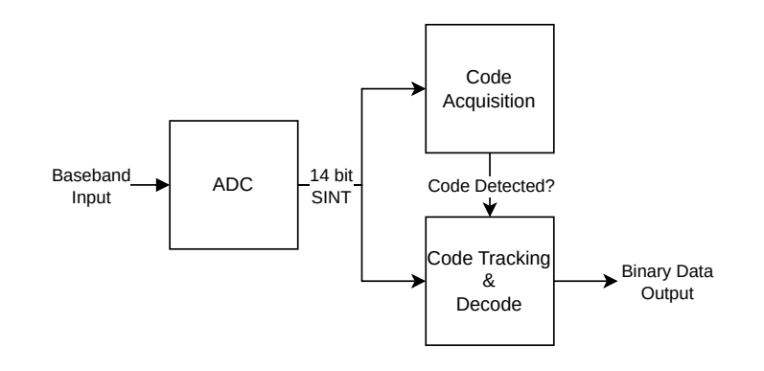
SYSTEM DESIGN - RECEIVER
Design of a Spread-Spectrum Data Transmission system - Daniel Pedder - Mahalakshmi Krishnan - Thomas Homm
07/14/2026
Notes:
Shannon Hartley Theorem
Channel Capacity
There exists a code so that:
Increased Bandwidth with FIXED TX power
-> arbitrarily close to theoretical maximum bits/second
-> arbitrarily low TX power/Hz
-> arbitrarily insensitive to band limited interference

Slide 15
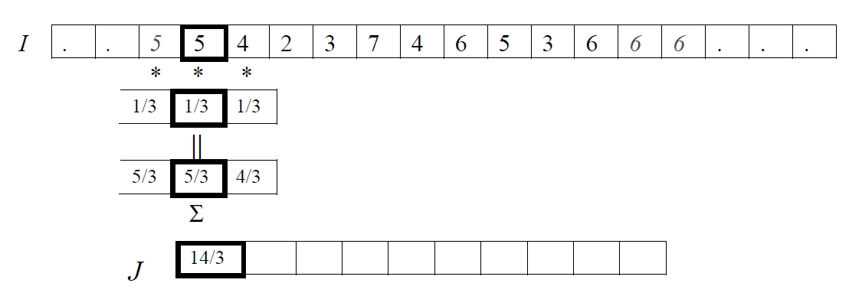
CROSS CORRELATION
https://towardsdatascience.com/convolution-vs-correlation-af868b6b4fb5/
Design of a Spread-Spectrum Data Transmission system - Daniel Pedder - Mahalakshmi Krishnan - Thomas Homm
07/14/2026

Slide 16
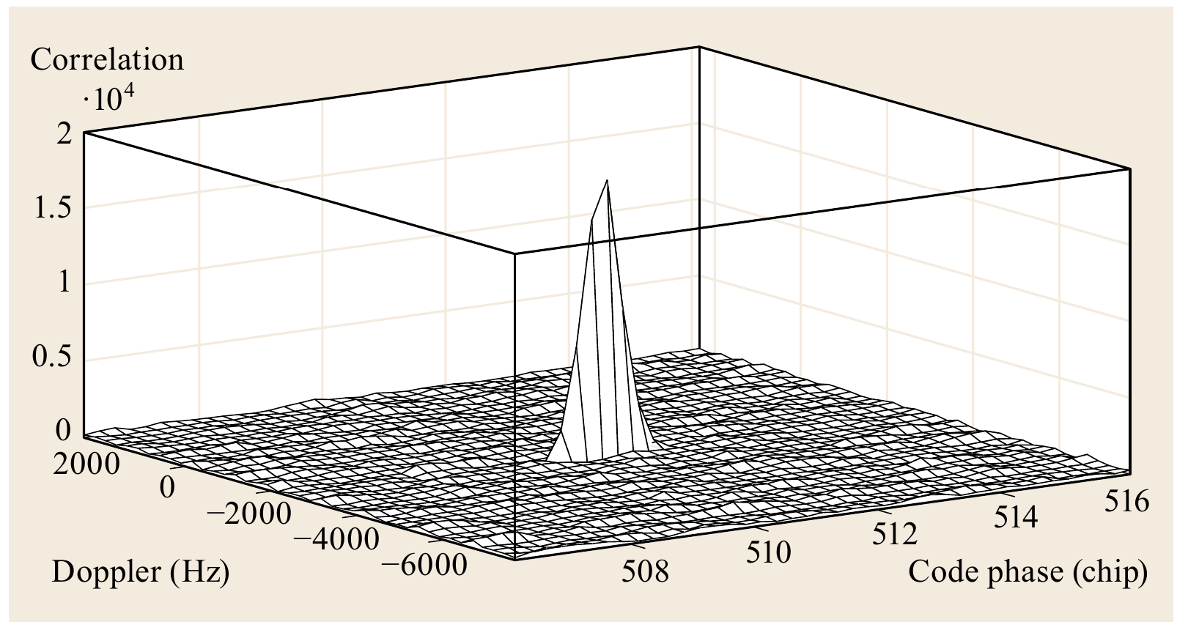
CODE ACQUISITION
T. Pany and J.-H. Won, “Springer Handbook of Global Navigation Satellite Systems - Signal Processing,” 2017, pp. 401–440. doi: 10.1007/978-3-319-42928-1_14.
Design of a Spread-Spectrum Data Transmission system - Daniel Pedder - Mahalakshmi Krishnan - Thomas Homm
07/14/2026

Slide 17
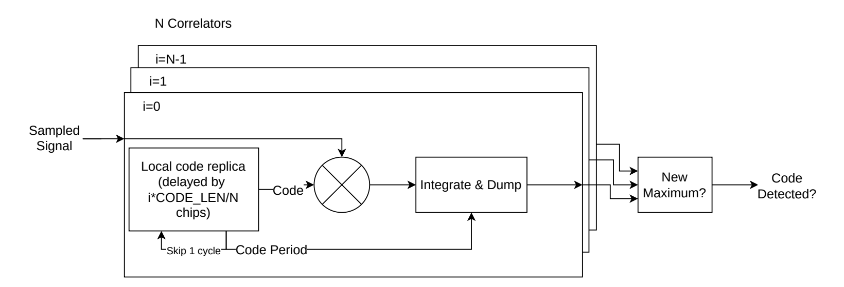
CODE ACQUISITION
Design of a Spread-Spectrum Data Transmission system - Daniel Pedder - Mahalakshmi Krishnan - Thomas Homm
07/14/2026
Notes:
Shannon Hartley Theorem
Channel Capacity
There exists a code so that:
Increased Bandwidth with FIXED TX power
-> arbitrarily close to theoretical maximum bits/second
-> arbitrarily low TX power/Hz
-> arbitrarily insensitive to band limited interference

Slide 18
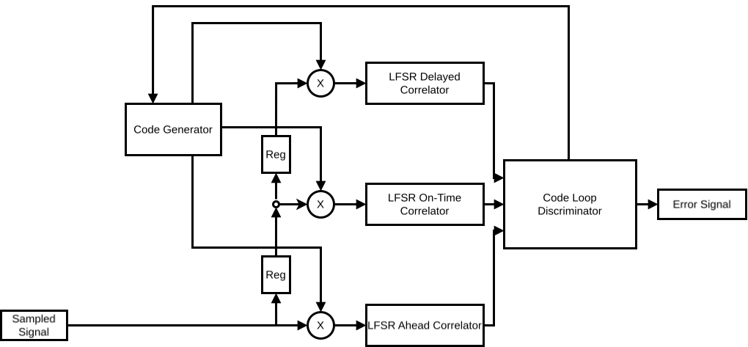
CODE TRACKING
Design of a Spread-Spectrum Data Transmission system - Daniel Pedder - Mahalakshmi Krishnan - Thomas Homm
07/14/2026
Notes:
Shannon Hartley Theorem
Channel Capacity
There exists a code so that:
Increased Bandwidth with FIXED TX power
-> arbitrarily close to theoretical maximum bits/second
-> arbitrarily low TX power/Hz
-> arbitrarily insensitive to band limited interference

Slide 19
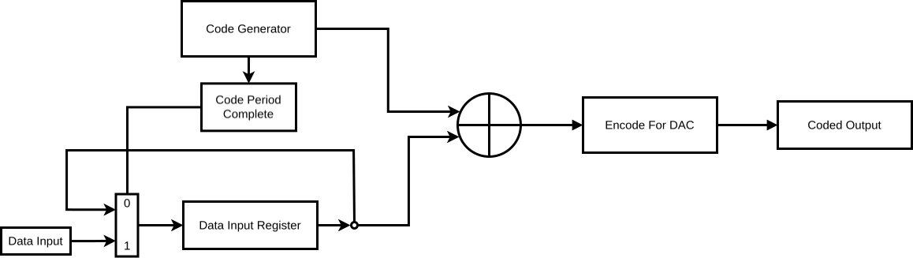
SYSTEM DESIGN - TRANSMITTER
Design of a Spread-Spectrum Data Transmission system - Daniel Pedder - Mahalakshmi Krishnan - Thomas Homm
07/14/2026
Notes:
Shannon Hartley Theorem
Channel Capacity
There exists a code so that:
Increased Bandwidth with FIXED TX power
-> arbitrarily close to theoretical maximum bits/second
-> arbitrarily low TX power/Hz
-> arbitrarily insensitive to band limited interference

Slide 20
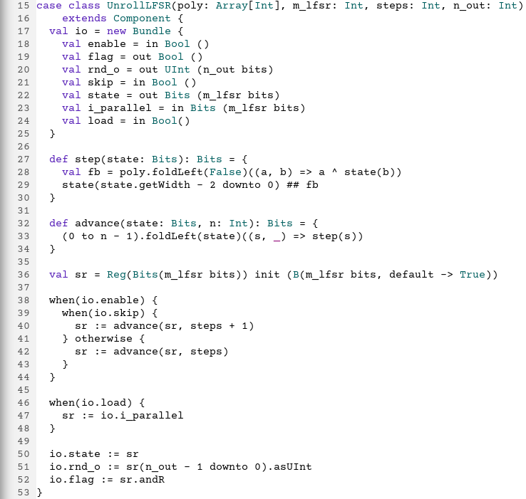
IMPLEMENTATION IN SPINALHDL – WHY SPINALHDL?
Hardware described in the Scala Progamming Language
All the known programming syntax benefits, like loops, generics, collections, classes and parametrization
Compiles into VHDL/Verilog
Design of a Spread-Spectrum Data Transmission system - Daniel Pedder - Mahalakshmi Krishnan - Thomas Homm
07/14/2026
Notes:
Shannon Hartley Theorem
Channel Capacity
There exists a code so that:
Increased Bandwidth with FIXED TX power
-> arbitrarily close to theoretical maximum bits/second
-> arbitrarily low TX power/Hz
-> arbitrarily insensitive to band limited interference

Slide 21
IMPLEMENTATION IN SPINALHDL – WHY SPINALHDL?
Design of a Spread-Spectrum Data Transmission system - Daniel Pedder - Mahalakshmi Krishnan - Thomas Homm
07/14/2026
Notes:
Shannon Hartley Theorem
Channel Capacity
There exists a code so that:
Increased Bandwidth with FIXED TX power
-> arbitrarily close to theoretical maximum bits/second
-> arbitrarily low TX power/Hz
-> arbitrarily insensitive to band limited interference

Slide 22
IMPLEMENTATION IN SPINALHDL – WHY SPINALHDL?
Design of a Spread-Spectrum Data Transmission system - Daniel Pedder - Mahalakshmi Krishnan - Thomas Homm
07/14/2026
Notes:
Shannon Hartley Theorem
Channel Capacity
There exists a code so that:
Increased Bandwidth with FIXED TX power
-> arbitrarily close to theoretical maximum bits/second
-> arbitrarily low TX power/Hz
-> arbitrarily insensitive to band limited interference

Slide 23
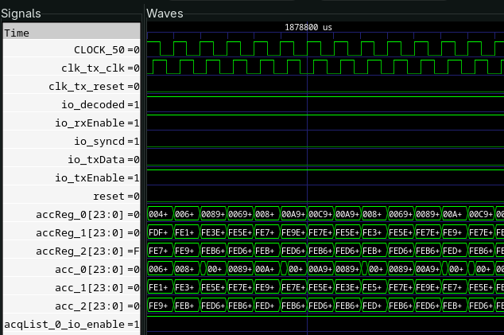
IMPLEMENTATION IN SPINALHDL – VERIFICATION IN SPINALHDL
The whole simulation is written in SpinalHDL
No separate VHDL/SystemVerilog testbench
GTK Wave then gives us a proper simulation waveform, like seen in the example image
Design of a Spread-Spectrum Data Transmission system - Daniel Pedder - Mahalakshmi Krishnan - Thomas Homm
07/14/2026
Notes:
Shannon Hartley Theorem
Channel Capacity
There exists a code so that:
Increased Bandwidth with FIXED TX power
-> arbitrarily close to theoretical maximum bits/second
-> arbitrarily low TX power/Hz
-> arbitrarily insensitive to band limited interference

Slide 24
IMPLEMENTATION IN SPINALHDL – SIMULATION FLOW OVERVIEW
SpinalHDL Code
Verilog RTL Code
Verilator Binary
Simulation/Waveform
Design of a Spread-Spectrum Data Transmission system - Daniel Pedder - Mahalakshmi Krishnan - Thomas Homm
07/14/2026
Notes:
Shannon Hartley Theorem
Channel Capacity
There exists a code so that:
Increased Bandwidth with FIXED TX power
-> arbitrarily close to theoretical maximum bits/second
-> arbitrarily low TX power/Hz
-> arbitrarily insensitive to band limited interference

Slide 25
CHALLENGES
Slow Design Iteration
Slow Simulation
Design of a Spread-Spectrum Data Transmission system - Daniel Pedder - Mahalakshmi Krishnan - Thomas Homm
07/14/2026
Notes:
Shannon Hartley Theorem
Channel Capacity
There exists a code so that:
Increased Bandwidth with FIXED TX power
-> arbitrarily close to theoretical maximum bits/second
-> arbitrarily low TX power/Hz
-> arbitrarily insensitive to band limited interference

Slide 26
HARDWARE DEMONSTRATION – SETUP EXPLANATION
3 FPGA Boards used
Transmitter → Channel (adds noise) → Receiver
The output is seen as a LED on the Receiver
Amount of noise controllable via switches
Design of a Spread-Spectrum Data Transmission system - Daniel Pedder - Mahalakshmi Krishnan - Thomas Homm
07/14/2026
Notes:
Shannon Hartley Theorem
Channel Capacity
There exists a code so that:
Increased Bandwidth with FIXED TX power
-> arbitrarily close to theoretical maximum bits/second
-> arbitrarily low TX power/Hz
-> arbitrarily insensitive to band limited interference

Slide 27
HARDWARE DEMONSTRATION – HARDWARE FLOW EXPLANATION
Step 1:
SpinalHDL Code
Design of a Spread-Spectrum Data Transmission system - Daniel Pedder - Mahalakshmi Krishnan - Thomas Homm
07/14/2026
Notes:
Shannon Hartley Theorem
Channel Capacity
There exists a code so that:
Increased Bandwidth with FIXED TX power
-> arbitrarily close to theoretical maximum bits/second
-> arbitrarily low TX power/Hz
-> arbitrarily insensitive to band limited interference

Slide 28
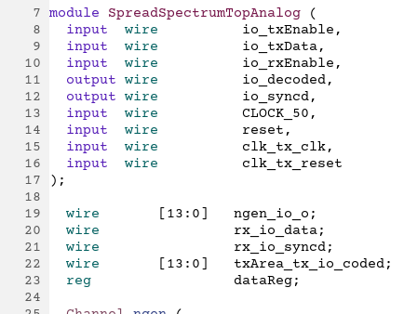
HARDWARE DEMONSTRATION – HARDWARE FLOW EXPLANATION
Step 2:
Compile to Verilog
Design of a Spread-Spectrum Data Transmission system - Daniel Pedder - Mahalakshmi Krishnan - Thomas Homm
07/14/2026
Notes:
Shannon Hartley Theorem
Channel Capacity
There exists a code so that:
Increased Bandwidth with FIXED TX power
-> arbitrarily close to theoretical maximum bits/second
-> arbitrarily low TX power/Hz
-> arbitrarily insensitive to band limited interference

Slide 29
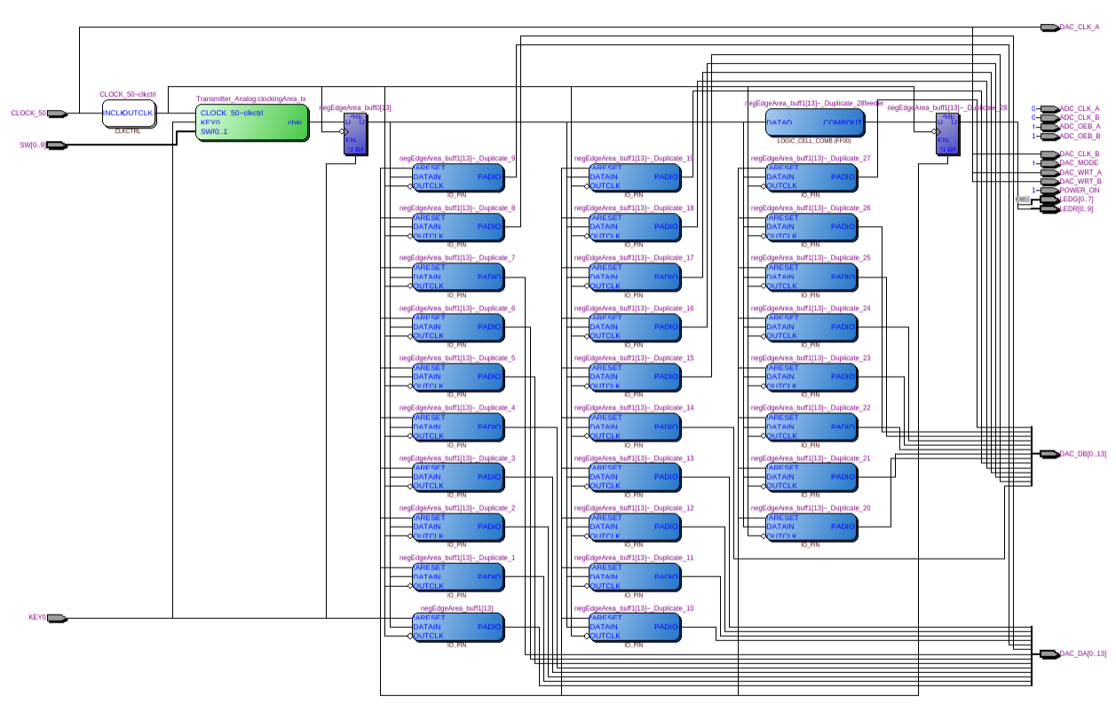
HARDWARE DEMONSTRATION – HARDWARE FLOW EXPLANATION
Step 3:
Synthesize using Quartus
Design of a Spread-Spectrum Data Transmission system - Daniel Pedder - Mahalakshmi Krishnan - Thomas Homm
07/14/2026
Notes:
Shannon Hartley Theorem
Channel Capacity
There exists a code so that:
Increased Bandwidth with FIXED TX power
-> arbitrarily close to theoretical maximum bits/second
-> arbitrarily low TX power/Hz
-> arbitrarily insensitive to band limited interference

Slide 30
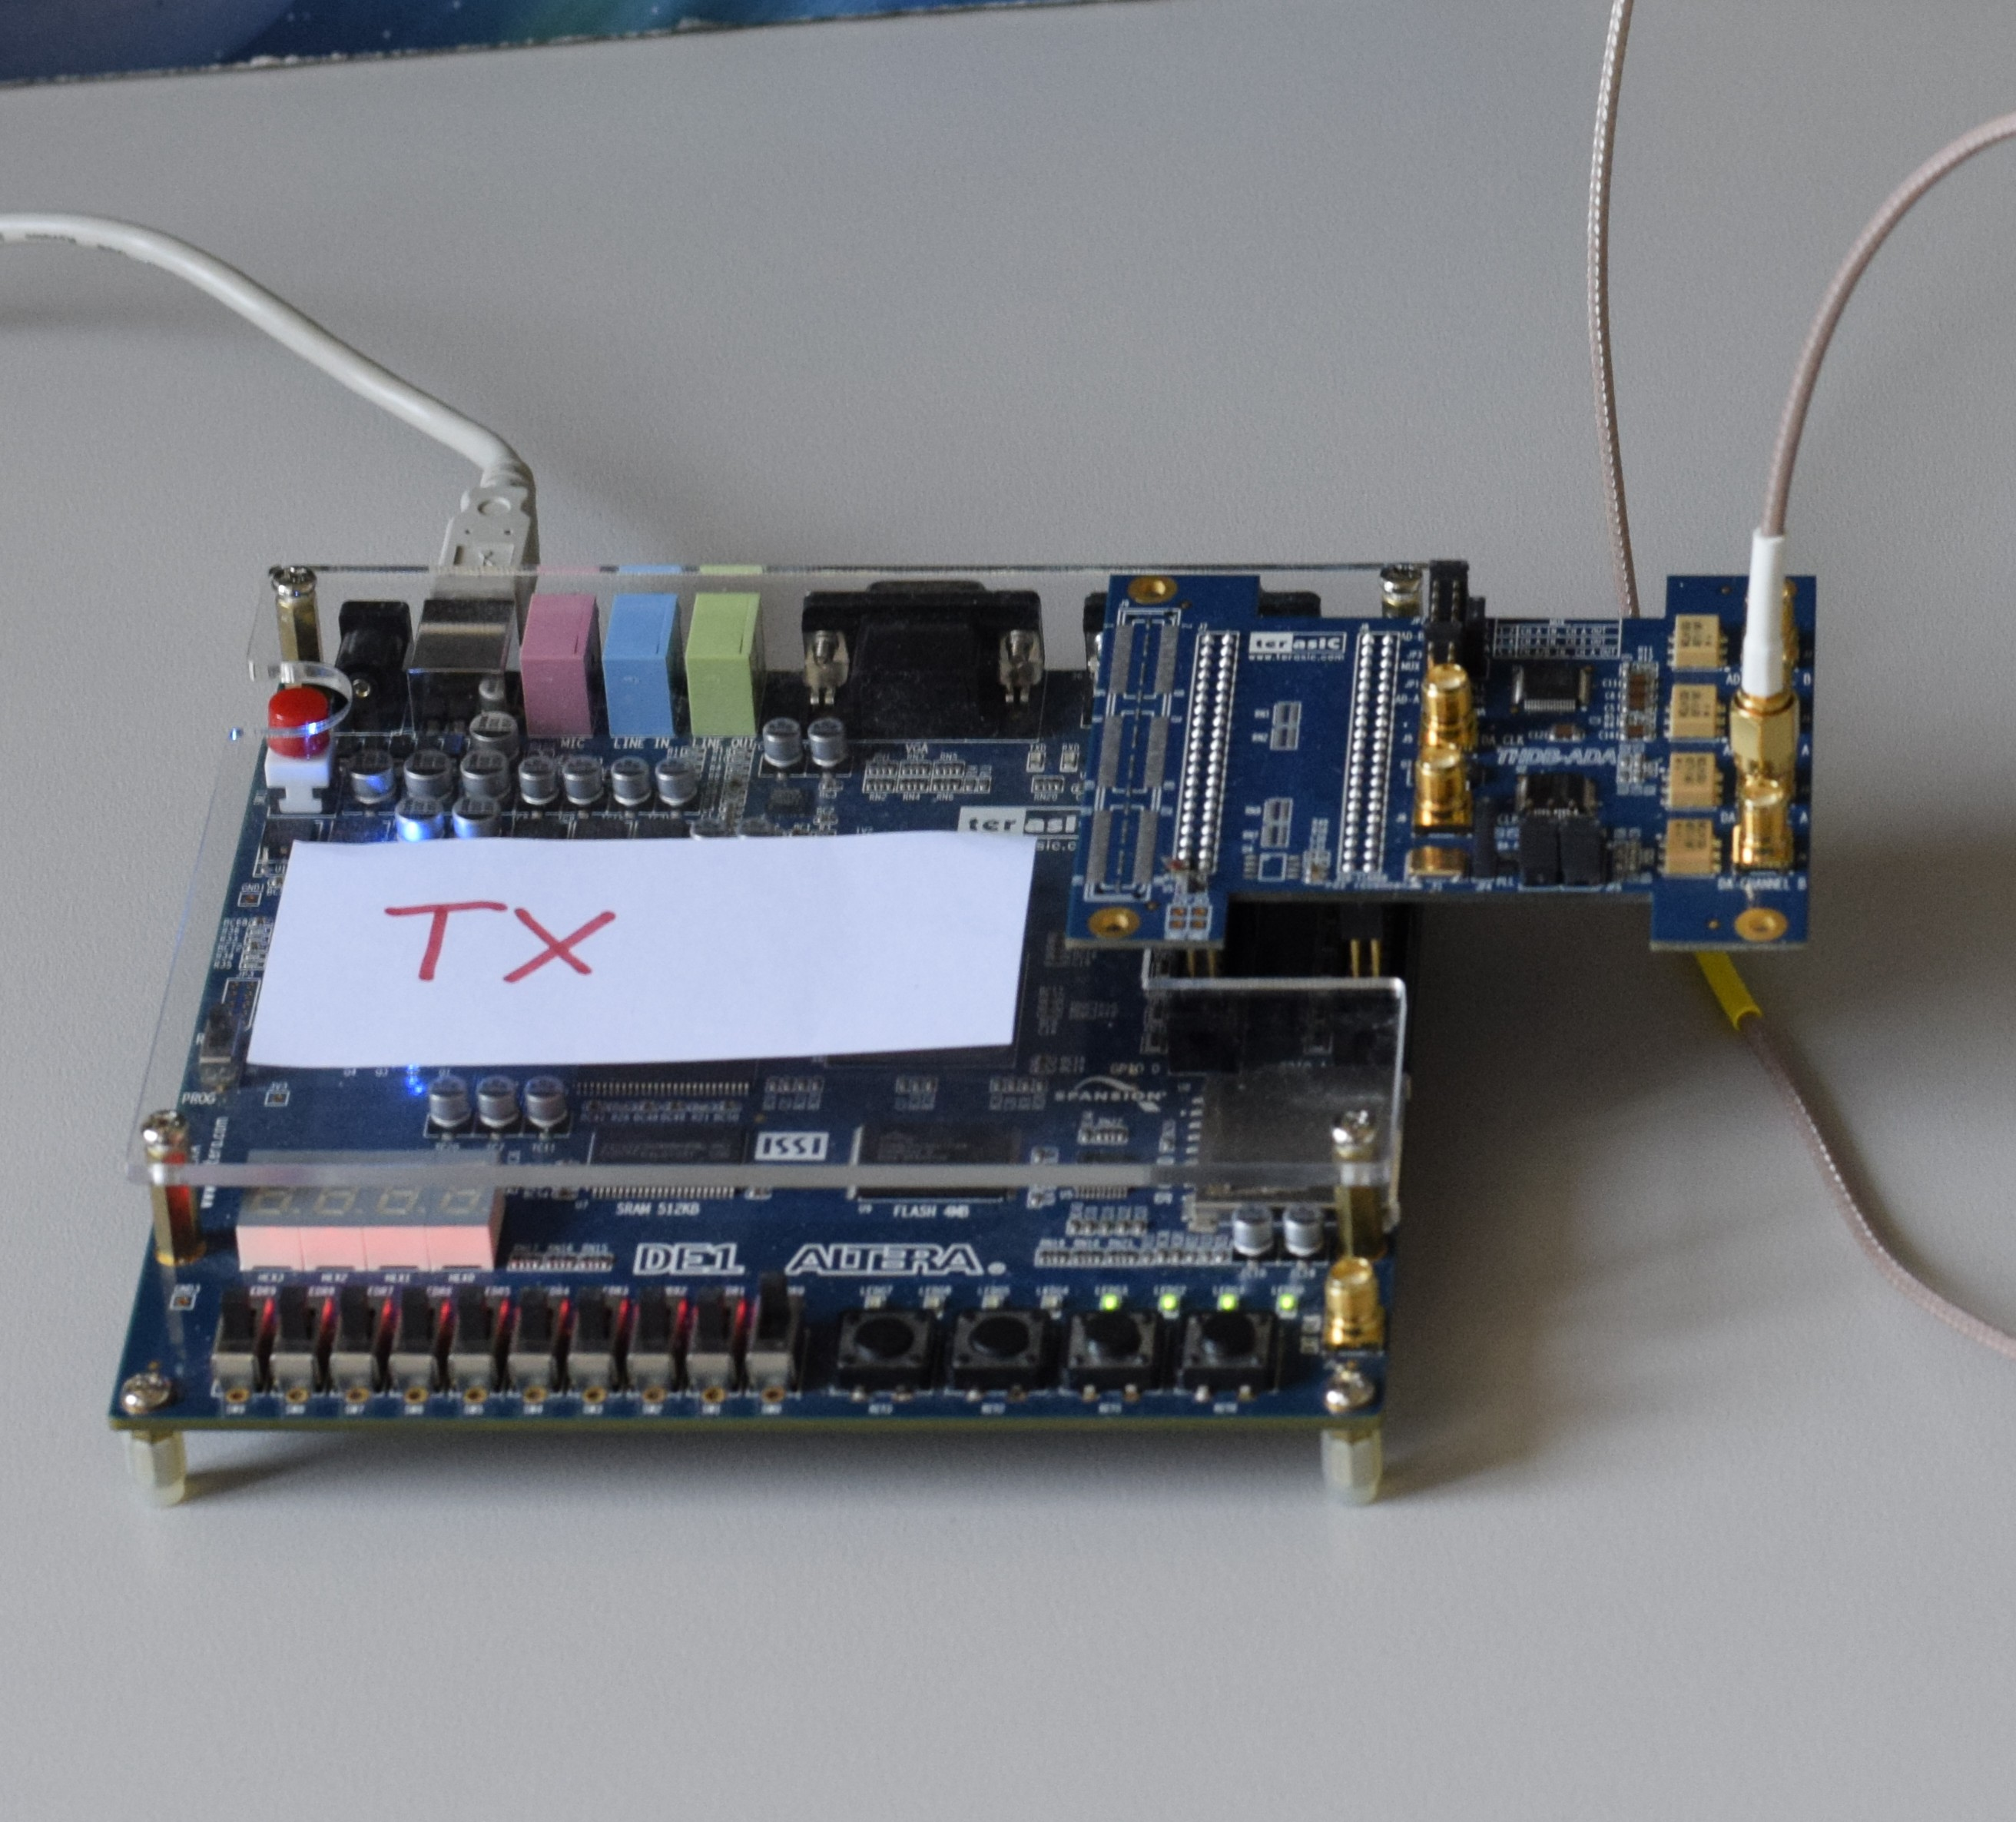
HARDWARE DEMONSTRATION – HARDWARE FLOW EXPLANATION
Step 4:
Programm FPGA using Quartus
Design of a Spread-Spectrum Data Transmission system - Daniel Pedder - Mahalakshmi Krishnan - Thomas Homm
07/14/2026
Notes:
Shannon Hartley Theorem
Channel Capacity
There exists a code so that:
Increased Bandwidth with FIXED TX power
-> arbitrarily close to theoretical maximum bits/second
-> arbitrarily low TX power/Hz
-> arbitrarily insensitive to band limited interference

Slide 31
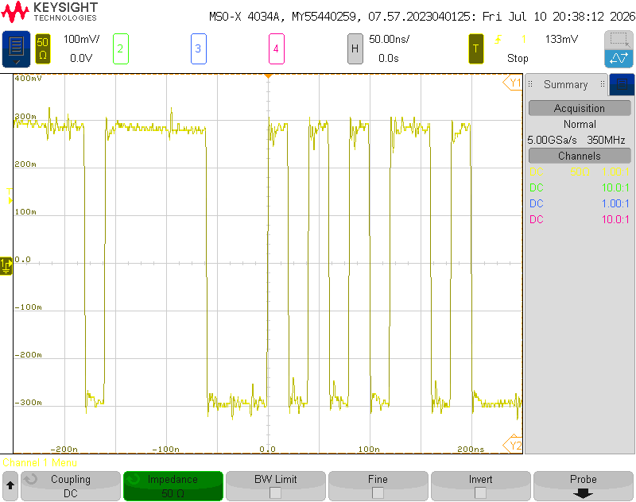
HARDWARE DEMONSTRATION – TX SIGNAL
Design of a Spread-Spectrum Data Transmission system - Daniel Pedder - Mahalakshmi Krishnan - Thomas Homm
07/14/2026
Notes:
Shannon Hartley Theorem
Channel Capacity
There exists a code so that:
Increased Bandwidth with FIXED TX power
-> arbitrarily close to theoretical maximum bits/second
-> arbitrarily low TX power/Hz
-> arbitrarily insensitive to band limited interference

Slide 32
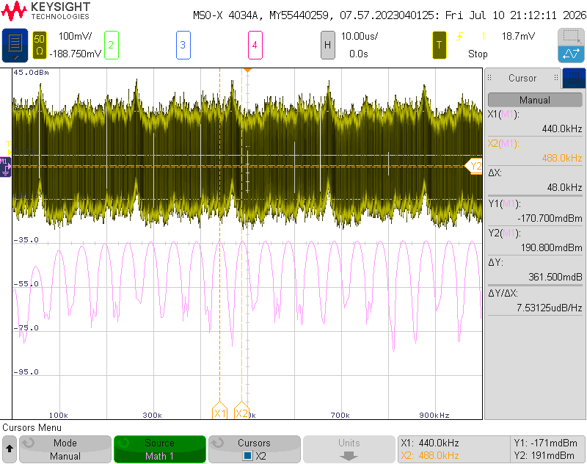
HARDWARE DEMONSTRATION – FFT OF TX SIGNAL
Design of a Spread-Spectrum Data Transmission system - Daniel Pedder - Mahalakshmi Krishnan - Thomas Homm
07/14/2026
Notes:
Shannon Hartley Theorem
Channel Capacity
There exists a code so that:
Increased Bandwidth with FIXED TX power
-> arbitrarily close to theoretical maximum bits/second
-> arbitrarily low TX power/Hz
-> arbitrarily insensitive to band limited interference

Slide 33
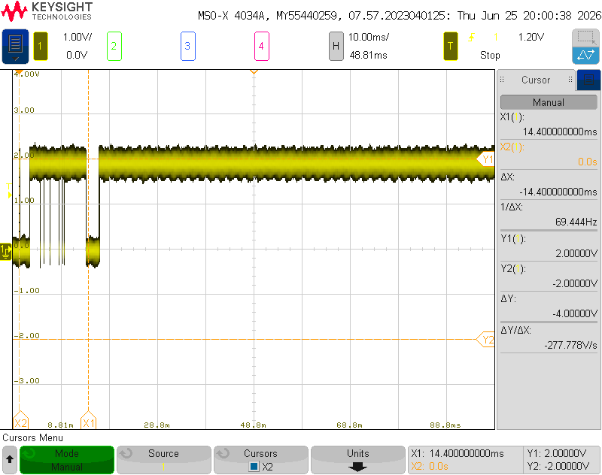
HARDWARE DEMONSTRATION – CODE ACQUISITION
Design of a Spread-Spectrum Data Transmission system - Daniel Pedder - Mahalakshmi Krishnan - Thomas Homm
07/14/2026
Notes:
Shannon Hartley Theorem
Channel Capacity
There exists a code so that:
Increased Bandwidth with FIXED TX power
-> arbitrarily close to theoretical maximum bits/second
-> arbitrarily low TX power/Hz
-> arbitrarily insensitive to band limited interference

Slide 34
OUTLOOK & CONCLUSION
Design of a Spread-Spectrum Data Transmission system - Daniel Pedder - Mahalakshmi Krishnan - Thomas Homm
07/14/2026
Notes:
Shannon Hartley Theorem
Channel Capacity
There exists a code so that:
Increased Bandwidth with FIXED TX power
-> arbitrarily close to theoretical maximum bits/second
-> arbitrarily low TX power/Hz
-> arbitrarily insensitive to band limited interference

Slide 35
Thank you for your Attention!
Notes:
1. Which other drone jamming techniques could you imagine?
2. How do modern communication techniques prevent themselves fRom Jamming and interference?
3. why is simultaneous sending and receiving generally a problem in radio communication?
4. How else could you protect a UAV from jamming

Slide 36
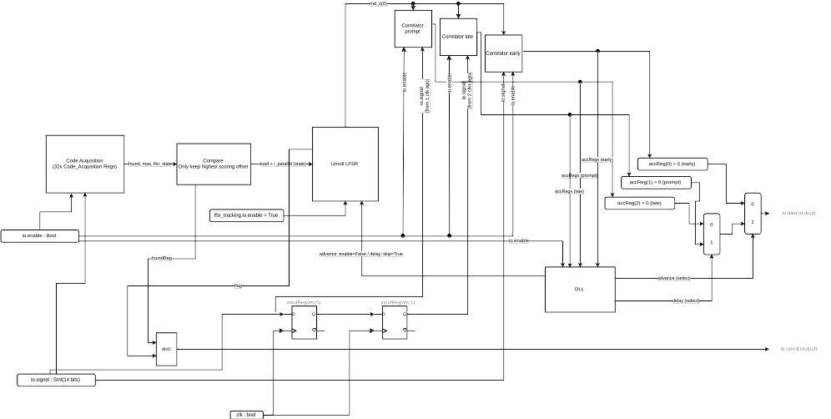
SYSTEM DESIGN - RECEIVER
Design of a Spread-Spectrum Data Transmission system - Daniel Pedder - Mahalakshmi Krishnan - Thomas Homm
07/14/2026
Notes:
Shannon Hartley Theorem
Channel Capacity
There exists a code so that:
Increased Bandwidth with FIXED TX power
-> arbitrarily close to theoretical maximum bits/second
-> arbitrarily low TX power/Hz
-> arbitrarily insensitive to band limited interference

