Slide 1
Design of a Spread-Spectrum Data Transmission system
Master Project 1
Daniel Pedder Mahalakshmi Krishnan Thomas Homm

Slide 2

Content
Motivation
Fundamentals of Spread-Spectrum Communications
Design of the System
Implementation in SpinalHDL
Hardware Demonstration
Outlook and Conclusion

Slide 3
Motivation
Design of a Spread-Spectrum Data Transmission system - Daniel Pedder - Mahalakshmi Krishnan - Thomas Homm

Slide 4
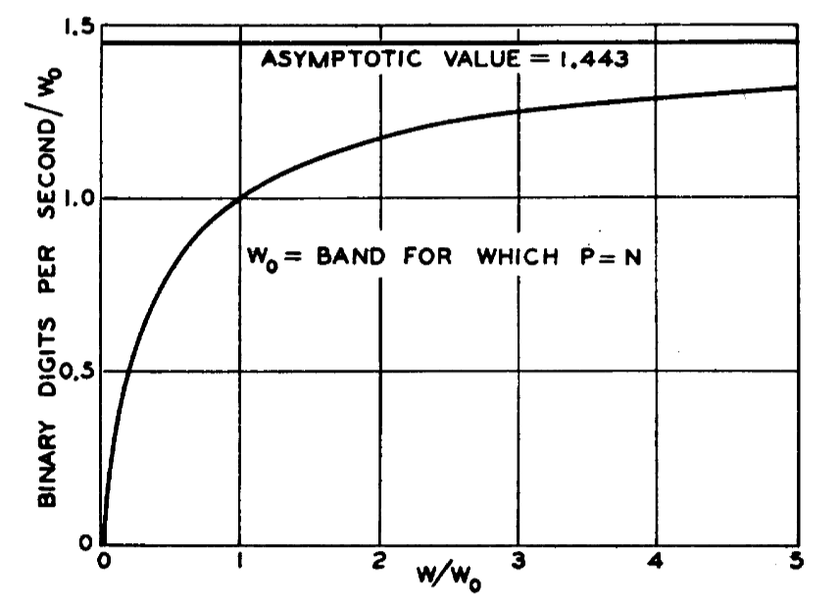
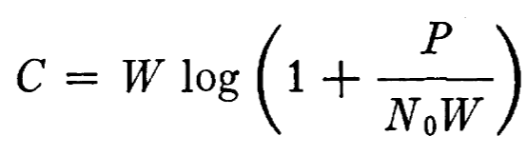
Justification of Spread Spectrum Communication
C. E. Shannon, "Communication in the Presence of Noise," in Proceedings of the IRE, vol. 37, no. 1, pp. 10-21, Jan. 1949, doi: 10.1109/JRPROC.1949.232969.
Design of a Spread-Spectrum Data Transmission system - Daniel Pedder - Mahalakshmi Krishnan - Thomas Homm
Notes:
Shannon Hartley Theorem
Channel Capacity
There exists a code so that:
Increased Bandwidth with FIXED TX power
-> arbitrarily close to theoretical maximum bits/second
-> arbitrarily low TX power/Hz
-> arbitrarily insensitive to band limited interference

Slide 5
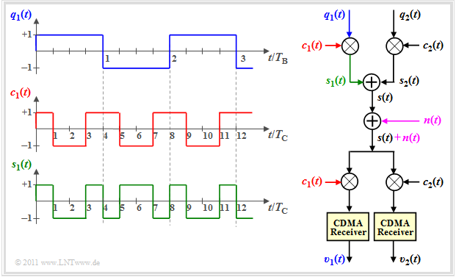
Generating a spread spectrum signal: DSSS
Direct Sequence Spread Spectrum
https://en.lntwww.de/Examples_of_Communication_Systems/Telecommunications_Aspects_of_UMTS
Design of a Spread-Spectrum Data Transmission system - Daniel Pedder - Mahalakshmi Krishnan - Thomas Homm

Slide 6
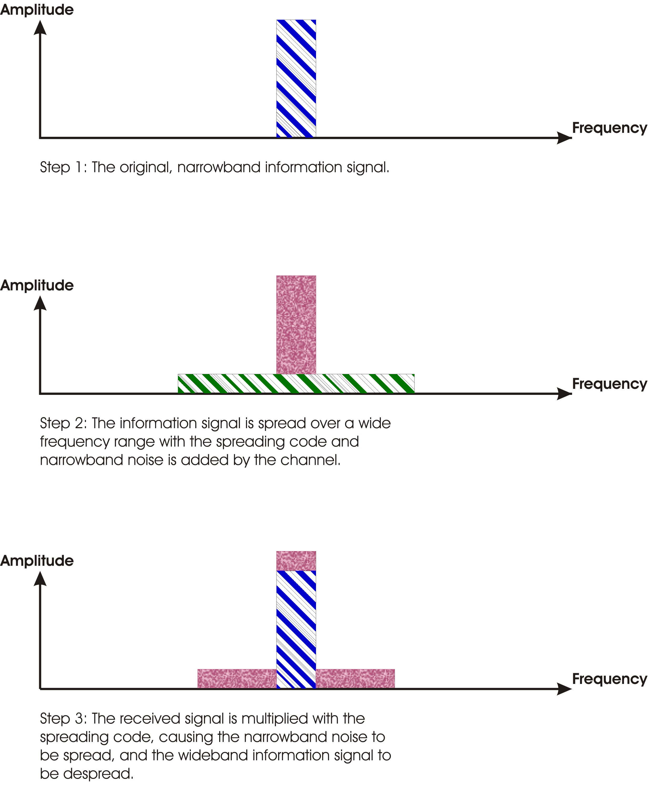
Antijamming communication - DSSS
Direct Sequence Spread Spectrum
https://en.lntwww.de/Examples_of_Communication_Systems/Telecommunications_Aspects_of_UMTS
https://commons.wikimedia.org/wiki/File:Processinggain.jpg
Design of a Spread-Spectrum Data Transmission system - Daniel Pedder - Mahalakshmi Krishnan - Thomas Homm

Slide 7
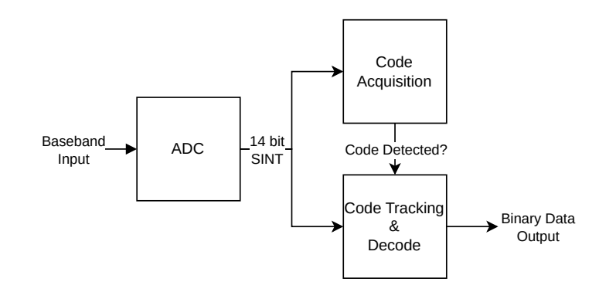
System Design - Receiver: Acquisition
Receiver does not know the transmitter’s code phase at power-on — it must search for it before any data can be recovered
32 parallel correlators run simultaneously, each testing a different code-phase offset of the local LFSR
Each correlator multiplies its delayed code replica with the sampled signal and integrates over one code period (“Integrate & Dump”)
The correlator with the highest correlation peak wins; its LFSR state is loaded into the main tracking LFSR
Acquisition time: ~16 ms with a single correlator (≈750 correlations) → <1 ms with 32 parallel correlators
Design of a Spread-Spectrum Data Transmission system - Daniel Pedder - Mahalakshmi Krishnan - Thomas Homm
Notes:
Code Acquisition
Receiver has no idea of the transmitter's code phase at power-on.
32 correlators run in parallel, each locked to a different candidate offset of the 1023-chip LFSR sequence.
Each integrates (local code x sampled signal) over one full code period.
Whichever correlator reports the highest peak wins -> its LFSR state seeds the main tracking LFSR.
Single correlator: ~16ms / ~750 correlations to acquire. With 32 parallel correlators: under 1ms.
Trade-off: more correlators = faster acquisition, but more FPGA logic (35 correlators total incl. tracking, each n_adc+m_lfsr bits wide).

Slide 8
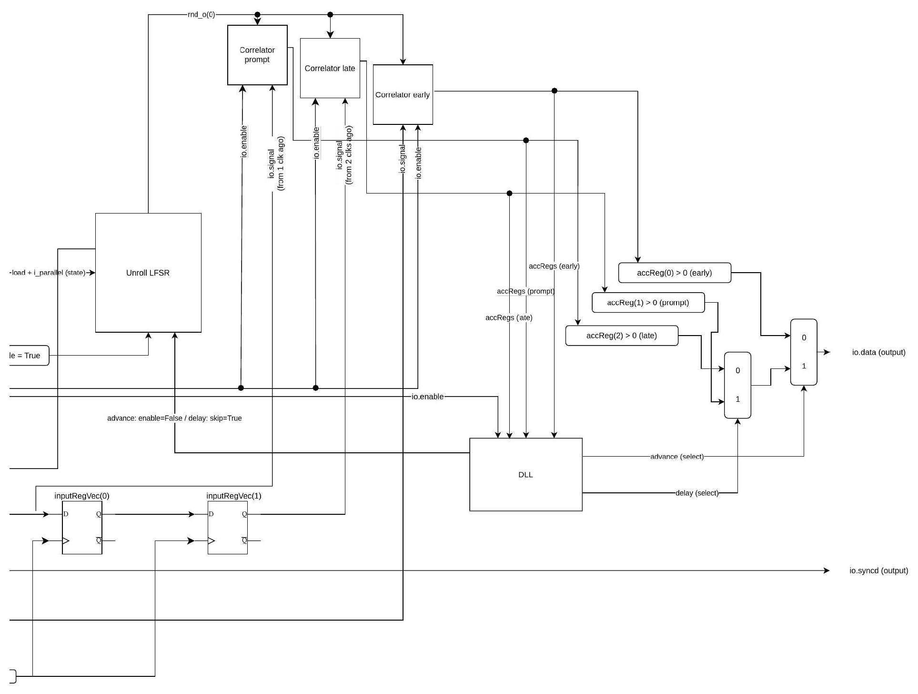
System Design - Receiver: Tracking
Once synchronized, the receiver must continuously correct for clock drift between transmitter and receiver
Three parallel correlators run on the incoming signal: Early, Prompt, and Late (delayed by 0, 1, and 2 cycles)
A Delay-Locked Loop (DLL) compares the Early and Late accumulator magnitudes against the Prompt value
If the error register exceeds a threshold, the DLL issues an advance or delay command, shifting the tracking LFSR by one chip
Decoded data bit is read from the sign of the Prompt accumulator
Uncorrected clock offsets of 5–10 ppm are enough to cause loss of lock
Design of a Spread-Spectrum Data Transmission system - Daniel Pedder - Mahalakshmi Krishnan - Thomas Homm
Notes:
Code Tracking (Delay-Locked Loop)
After acquisition, clock drift between TX and RX means the code phase slowly walks away over time.
Three correlators run simultaneously: Early, Prompt, Late (signal delayed by 0/1/2 clock cycles).
DLL compares |Early| and |Late| accumulator magnitudes against a threshold (hardcoded at 20 on the error register).
If one side consistently dominates, DLL issues advance (pause LFSR one cycle) or delay (skip LFSR forward one cycle).
Demodulated data bit = sign of the Prompt accumulator.
Uncorrected offsets of 5-10ppm were enough to lose lock in testing -> tuning this loop was the most time-consuming part of the receiver.

Slide 9
Thank you for your Attention!
Notes:
1. Which other drone jamming techniques could you imagine? 2. How do modern communication techniques prevent themselves fRom Jamming and interference? 3. why is simultaneous sending and receiving generally a problem in radio communication?
4. How else could you protect a UAV from jamming

