Slide 1
Evaluating the Use of Graded Readings with Chinese Language Beginners
Written by: Dr. Ko-Yin Sung and Frederick J Poole
Presented by: Frederick J Poole

Slide 2
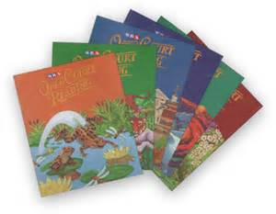

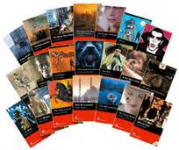
Graded Reading
Limited vocabulary and grammatical structures. (Nation & Wang, 1999)
Goal is to eventually enable a learner to read native-level texts fluently.
Helps reading fluency and accuracy, builds vocabulary knowledge. (Waring, 1997)

Slide 3
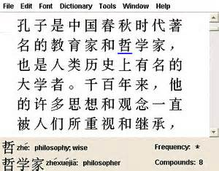
Reading in Chinese
Chinese written language is a non-alphabetic language.
Chinese does not contain reliable phonetic cues.
To become proficient readers, learners must be able to recognize characters accurately and quickly as well as develop segmentation skills.
Complexity of Chinese script leads to higher levels of anxiety.

Slide 4

Literature Review
Horst (2005)
Two graded readers/week for six weeks.
Gained knowledge of more than half of the new vocabulary identified in the books that they read.
Pigada and Schmitt (2006)
One reader per week for four weeks.
Knowledge of 65% of the vocabulary words was enhanced partially or fully.
Hafiz and Tudor (1989)
60 hour graded reading program
Significant gains in both reading and writing
Studies on the effect of graded readings for the development of non-alphabetic languages are lacking.

Slide 5

Research Questions
How effective is the use of graded readings in a beginning Chinese class?
Does the use of graded readings help learners acquire class materials?
Does the use of graded readings help learners gain language knowledge taught in the readings?
What are learner’s perceptions of using graded readings?

Slide 6
The Graded Readings Used in This Study
20 readings
Each reading divided into four sections
Pre-reading
Writing
Reading text
Task completion
Readings began with around 30 characters and slowly increased to 150 characters.
Story follows a family who discovers their father is stealing from his workplace.
Characters used in readings were taken from top 800 most commonly used characters. (Steering Committee for the Test of Proficiency – Huayu, 2008)

Slide 7
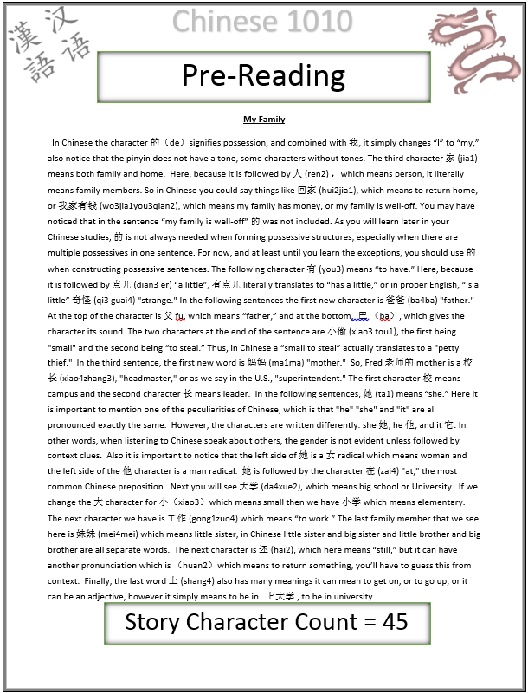
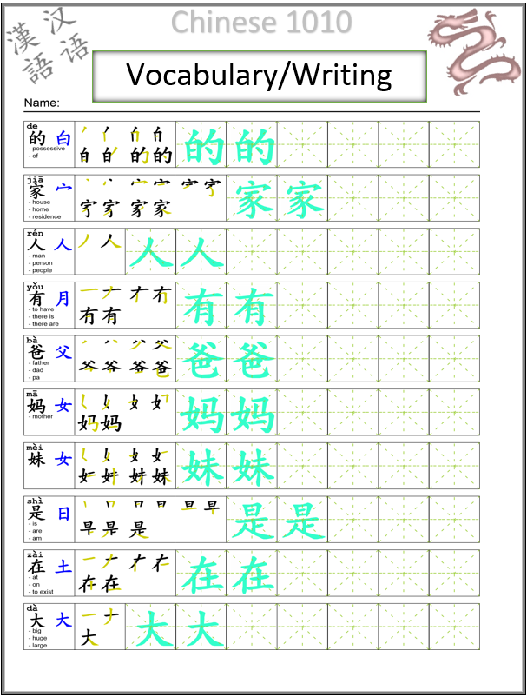

Slide 8
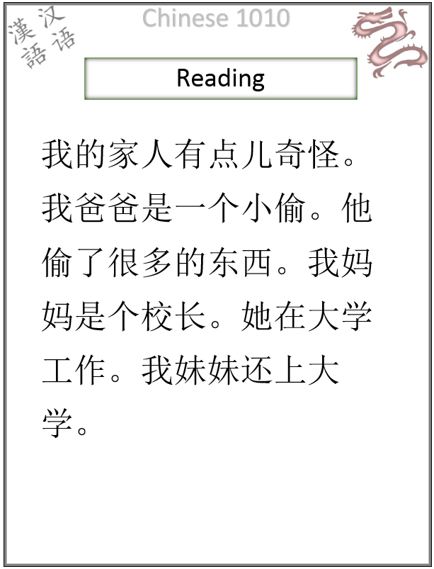
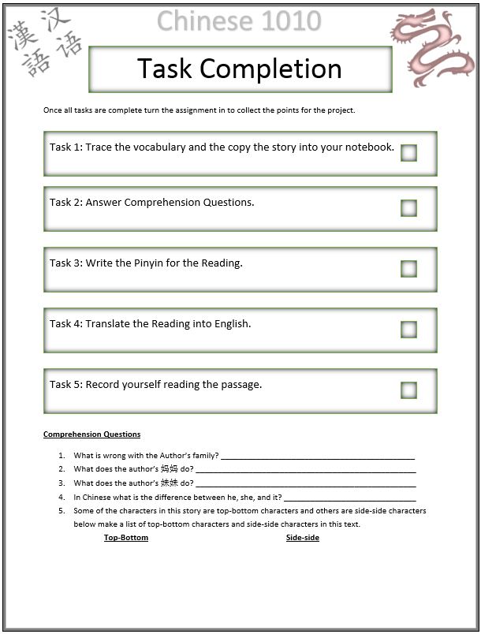

Slide 9

Participants
28 students in a first-year Chinese course
14 participants from section 001 / 14 participants from section 002
19 males / 9 females
18-29 years old
All were native English speakers

Slide 10

Data Collection and Procedure
20 graded readings were assigned over a 15 week period.
Assessment tools for both sections (only in-class material tested)
Character naming test (140 characters)
Vocabulary test (92 words)
Reading Comprehension (2 short stories, ~100 characters each)
Assessment tool for graded reading section
Character naming test (189 characters)
Vocabulary test (160 words)
Reading comprehension (2 short stories, ~100 characters each)
Questionnaire

Slide 11
Results: In-class material
 |  | Number of participants | Average points or minutes received | Percentage of points received
Characters answered correctly | non-reader group | 14 | 85 points | 60.70%
 | reader group | 14 | 65 points | 46.43%
Character speed | non-reader group | 14 | 11.72 minutes | N/A
 | reader group | 14 | 7.86 minutes | N/A
Vocabulary answered correctly | non-reader group | 14 | 180 points | 65.22%
 | reader group | 14 | 193 points | 69.93%
Reading questions answered correctly | non-reader group | 14 | 8.14 points | 80.14%
 | reader group | 14 | 7.68 points | 76.80%

Slide 12

Results: extra tests
Accurately named 30 characters (16%)
Average time to name characters was 10.55 minutes or 3.5 seconds / character
Vocabulary test showed that out of 160 words learned in the readings, the participants had partial and full knowledge of approximately 40% of the words.
Reading comprehension showed that on average participants answered 7 out of 10 questions accurately.

Slide 13
Learner’s Perceptions of Using Graded Readers
Pre-reading section
Radical knowledge
Character etymology
Writing section
Time consuming, but helpful
Reading section
Learned new sentence structures
Vocabulary in context
Task completion section
Helpful in reviewing
Comprehension questions most valuable
Story
Interesting/funny
Surreal
More Chinese culture
More relevant to in-class material

Slide 14

Conclusion
Most significant finding was naming speed
40% of vocabulary gained partial and/or full knowledge。
Overall perception was positive
Adjustments include adding cultural elements to story and including graded readers to in-class discussion.
Design of graded readers was not typical, but it allowed for independent reading at the beginning learning stage.

Slide 15
Limitations
Number of participants
Length of time
Future studies need to observe long-term effects of using graded readings
Need to compare multiple designs of graded readings

Slide 16

Questions

Slide 17
References
Day, R., & Bamford, J. (1998). Extensive reading in the second language classroom. Cambridge: Cambridge University Press.
Elley, W. B., & Mangubhai, F. (1983). The impact of reading on second language learning. Reading Research Quarterly, 19, 53-67.
Fan, K. Y., Gao, J. Y., & Ao, X. P. (1984). Pronunciation principles of the Chinese character and alphabetic writing scripts. Chinese character reform, 3, 23-27.
Feldman, L. B., and Siok, W.T. (1999). Semantic Radicals Contribute to the Visual Identification of Chinese Characters. Journal of Memory and Language, 40, 559- 576.
Hafiz, F. M., & Tudor, I. (1989). Extensive reading and the development of language skills in an L2. English Language Teaching Journal, 43, 4-13.
Hafiz, F. M., & Tudor, I. (1990). Graded readers as an input medium in L2 learning. System, 18(1), 4-13. Hill, D. (1997). Survey review: Graded readers. English Language Teaching Journal, 51(1), 57-81 Hill, D. (2008). Graded readers in English. English Language Teaching Journal, 62(2), 184-204.
Horst, M., (2005). Learning L2 vocabulary through extensive reading: A measurement study. The Canadian Modern Language Review, 61, 355-382.
Krashen, S. (2002a). The comprehension hypothesis and its rivals. Paper presented at the eleventh International Symposium on English Teaching/Fourth Pan Asian Conference, Taipei, Taiwan. Retrieved from http://www.finchpark.com/courses/tkt/Unit_10/comprehension.pdf
Krashen, S. (2002b). Foreign language teaching: The easy way. Taipei: Crane.
Morano, R. (2004). Simplified readers as comprehensible input in the EFL classroom. Academic Journal of Kang-Ning, 6, 225-250.
Nation, P. (1997). The language learning benefits of extensive reading. The Language Teacher 21(5), 13-16.
Nation, P. and Wang, K. (1999) Graded readers and vocabulary. Reading in a Foreign Language 12(2), 355-380.
Pigada, M., & Schmitt, N. (2006). Vocabulary acquisition from extensive reading: A case study. Reading in a Foreign Language, 18(1). Retrieved from http://nflrc.hawaii.edu/rfl/April2006/pigada/pigada.html
Shen, H., & Jiang, X. (2013). Character reading fluency, word segmentation accuracy, and reading comprehension in L2 Chinese. Reading in a Foreign Language, 25(1), 1-25.
Steering Committee for the test of proficiency - Huayu (2008). The 800 basic vocabulary. Retrieved from http://www.sc-top.org.tw/download/800Words_Beginners.pdf
Sims, J. (1996). A comparative study of improvements in reading comprehension of skill- based instruction and extensive reading for pleasure with Taiwanese freshman university students (Doctoral dissertation). Florida State University, Tallahassee, FL.
Tan, L. H., Spinks, J. A., Eden, G., Perfetti, C. A., & Siok, W. T. (2005). Reading depends on writing, in Chinese. Proceedings of the National Academy of Sciences of the United States of America, 102, 8781-8785. Tsang, W. K. (1996). Comparing the effects of reading and writing on writing performance. Applied Linguistics, 17(2), 210-233.
Waring, R. (1997). Graded and extensive reading -- questions and answers. The Language Teacher, 21(5). Retrieved from
http://jalt-publications.org/tlt/articles/2133-graded-and-extensive-reading- questions-and-answers

