Slide 1
Ideas on Integrating Reading into the Communicative Classroom
Fred Poole

Slide 2


Slide 3
Should reading be done in the classroom or outside of the classroom?

Slide 4
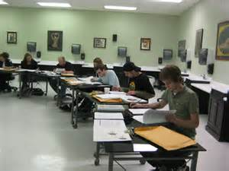
Importance of Reading IN the classroom
Monitor student reading
Assist students
Teach reading skills
* Pair work

Slide 5
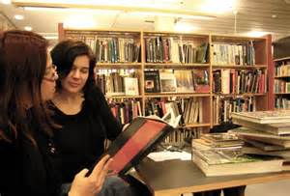
Reading in Pairs allows for
Discussion on the text
Summarizing exercises
Expanding on the reading
“discussions afforded students a higher level of participation, stimulated student interest in the reading materials, and increased aural input and oral output opportunities for students” (Chio, 2009)

Slide 6
Why do teachers often avoid reading in the classroom?

Slide 7
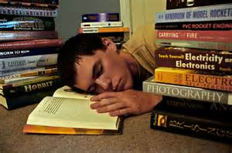
Common problems in teaching reading
Reading is boring
Reading is irrelevant
Reading is too long/hard
Students want to speak
Limited materials

Slide 8

“Top Ten List” Reading

Slide 9

Why use “Top Ten Readings?”
Interesting information
Extremes are easy to remember
Inexhaustible resource
Short and simple
Lots of room for student interaction
Summary
Opinion
Analysis
Comparison

Slide 10

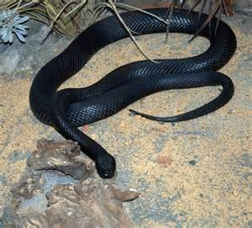
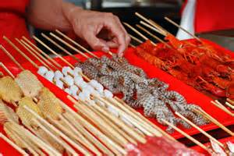
Sample Top Ten Topics
Top ten strange wars
Top ten stupid criminals
Top ten dangerous animals
Top ten expensive houses
Top ten exotic foods

Slide 11

Sample Reading
Top Ten Stupid Criminals
1. Lottery Thief Sets Himself on Fire
ROME, GA June 2 A convenience-store thief got away, but the video from the security camera told a strange, strange tale. A man broke into the store overnight, and tried to cover his tracks by burning the place down. He threw charcoal lighter fluid around, but by the time he ignited it, the fumes had permeated the store, and he set himself on fire. While in flames, he grabbed a roll of lottery tickets and fled. At the time of the story, police were looking for a man with facial, neck, and possibly wrist burns.

Slide 12
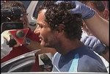
Sample Reading
Top Ten Stupid Criminals
2. Ten Hours Stuck in Restaurant Vent
HILLSBOROUGH COUNTY, FL June 8 An employee of the Lucky Buffet noticed a strange sight on arriving at the restaurant. There were legs hanging out of a vent over the grill! 45-year-old Billy Jordan had tried to enter the restaurant the night before by climbing through the ductwork, but became stuck and stayed there for ten hours. Hillsborough County Fire Rescue workers used a rope to pull Jordan back out through the roof, after which he was arrested for burglary.

Slide 13
Top Ten Reading = Step One
Pre reading discussion
Top Ten Stupid Criminals
What types of crimes are there? Example murder， theft.. What else?
What are some recent crimes that you have heard about?
Are there any famous crimes in your culture?
How do criminals usually get caught?
Is crime a problem in your city?
“When you are unable to bring personal knowledge and understanding of a topic to a text, you are effectively robbed of the ability to make use of a key resource for reading: what you already know.” (Gibbons, 2002)

Slide 14
Top ten reading = Step Two
Read in Pairs
Why read in Pairs
Negotiation of Meaning
Helps students remember new vocabulary
Students become teachers
Students are more interested
Words we don’t know | Guess #1 | Guess #2 | Actual Meaning

Slide 15
Top ten reading = Step Three
Summarize
Each pair will get 5 minutes to retell the story in their own words.
Think of these questions when summarizing your story:
What was the intended crime?
Was it successful?
What problems did the criminal have?
What should the criminal have done?
Questions will vary depending on skill you want to develop
Scanning
Analysis
Inferences
Etc.
“The summary tasks were generally more likely than the comprehension question tasks to make unknown words salient to the learners and lower learners’ tendency to ignore new l2 words.” (Chio, 2009)

Slide 16
Top ten reading = Step Four
Re-tell your story to other groups
Other groups take notes/ask three questions
If you don’t know the answer, first skim the article, if the article doesn’t have the answer then take a guess.
 | Group 1 | Group 2
Who was the criminal?
What did the criminal try to do?
What went wrong in the story?
If the criminal got caught, how did he/she get caught?
Your own question #1
Your own question #2
Your own question #3

Slide 17
Top Ten Reading = Step Five
Look at the stories you just heard, now pick the three worst criminals.
Be ready to support your opinion.
Ranking | Reasons
#1
#2
#3

Slide 18
Top Ten Reading = Step Six
Homework
Do research about silly criminals in your own country. Write a one page summary of the story.
Write one page about how you would have done the crime differently.

Slide 19
What did you like? What didn’t you like? What would you change to improve this activity?

Slide 20
Strange News Reading
Keal Pontin's 23 Goats Were Stolen Using Duct Tape
Naked Man Jumps In Pool With Children, Breaks Officer's Arm
Wis. College Student Helps Pay Tuition by Eating
http://www.huffingtonpost.com/weird-news/

Slide 21

Strange News: Step One
One pair of students read the article
Other pair looks at headlines and writes questions

Slide 22
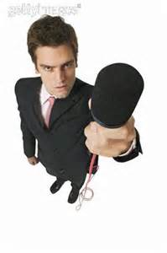
Strange News: Step Two
Reporters (students who wrote the questions) will ask questions regarding the headlines
Eyewitnesses (students who read the articles) will answer the questions according to the article, if the article does not have an answer the eyewitness should infer what they might have happened.

Slide 23
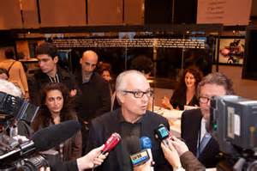
Strange News: Step Three
Reporters will report back to the class what happened in the story.

Slide 24
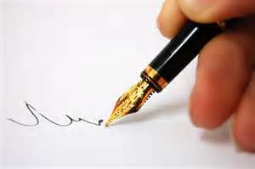
Strange News: Step Four
Homework: Reporters will write a page news article on the strange story.
Optional: next day compare the news story to the original story.

Slide 25
What did you like? What didn’t you like? What would you change to improve this activity?

Slide 26

Culture Comparison

Slide 27
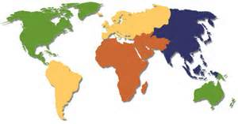
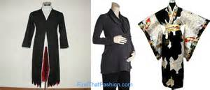


Sample Readings
Compare and contrast superstitions
Compare and contrast religions
Compare and contrast color’s abstract meaning
Compare and contrast folktales
Compare and contrast common hobbies

Slide 28
Sample Readings
Common Chinese Superstitions
Chinese superstitions still rule the hearts and minds of the majority of the Chinese people. They appear so westernized and modernized at first glance, but still, many of their larger decisions, they will seek help from a soothsayer, choose auspicious numbers, or hire a feng shui expert for their opinion.
The wonderful world of Russian superstition
When I accidentally stepped on a Russian friend’s foot for the first time, he returned the favour within seconds. After being questioned on the “rapid” reaction, he said it was to ensure that the two of us don’t get into a fight in the future! This was my entry into the world of Russian superstition. This “rationalist” insisted that he lost many a friend simply because he stepped on their feet at some point or the other. Coming from a country where people’s superstitious beliefs can drive a “real rationalist” insane, I laughed at his belief that a 5-year long friendship could be broken because of me stepping on his foot. Such types of superstitious beliefs are common in Russia.

Slide 29
Culture Comparison: Step One
Discuss your own culture in this context
What do you think you know of other cultures?
What superstitions exist in your culture?
Where did they come from?
Are you superstitious? Why or why not?
Do you know any other superstitions from other countries?

Slide 30
Culture Comparison= Step two
In pairs read about other cultures superstitions. Take notes as you go.
What is the superstition? | Details

Slide 31
Culture Comparison= Step three
Pairs rotate between stations, each station has two groups of people they must fill out the following chart together.
Chinese Culture | Both | Russian Culture

Slide 32
Culture Comparison: Step Four
Homework: Write one page comparing and contrasting superstitions from two cultures that you learned about today. You cannot use your own culture or the culture that you read.

Slide 33
What did you like? What didn’t you like? What would you change to improve this activity?

Slide 34

Questions?

