Slide 1

Using a Story-Driven Game in the Chinese Dual Language Immersion Classroom
Frederick J Poole
Doctoral Student
Instructional Technology and Learning Sciences

Slide 2
Today’s Agenda
Game Design
Inspiration for the game
Demo Game
Classroom Implementation
Successes.
Challenges.
Future Changes
Game Adjustments
Goal.
Lessons learned
Twine Tutorial

Slide 3
Our Goal
Design a fun and interactive digital game with meaningful choices to help young DLI learners develop reading skills and increase vocabulary knowledge.

Slide 4

HyperText Fiction / Interactive Fiction

Slide 5
HyperText Fiction
Engaging
Interactive
Meaningful
Unique Stories
Instant Feedback
Notes:
Engaging – exciting to see what will happen next
Interactive – story changes based on your actions.
Meaningful – your actions matter… must read carefully
Unique Stories — unique stories for in-class discussion
Instant Feedback – choices will provide instant feedback on learner’s understanding

Slide 6
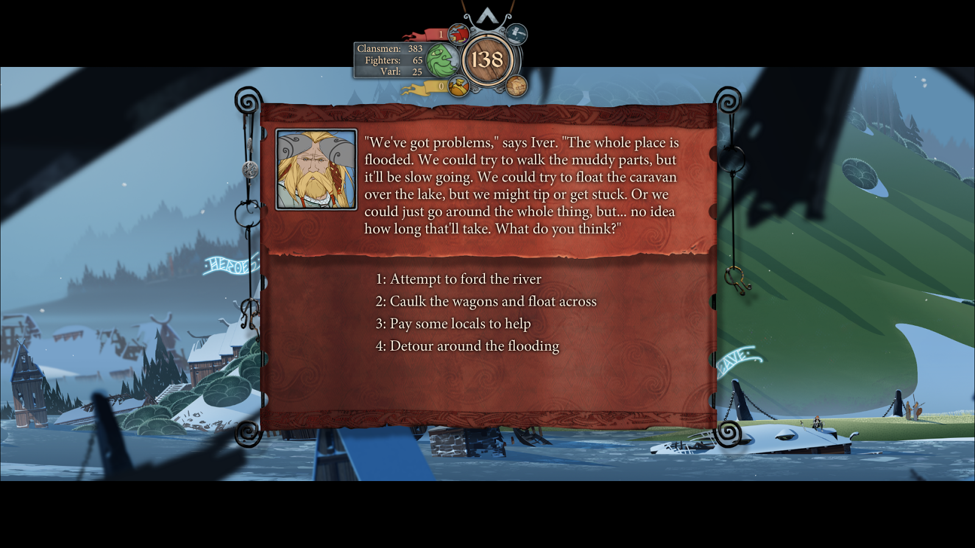
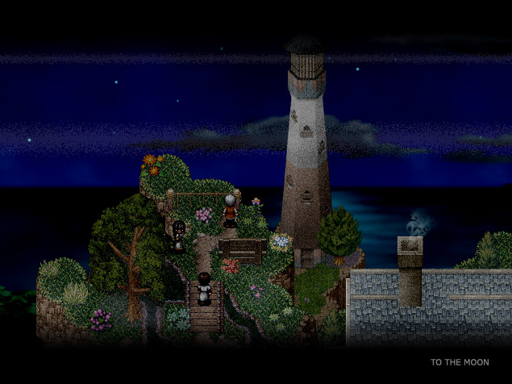
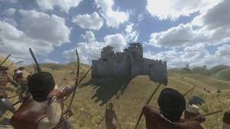
Inspiration for the Game
SDG
The Banner Saga
Mount & Blade Warband
To the moon
Notes:
The Banner Saga – Leader of a band of nomads fleeing an ominous black cloud mindless warriors.
To the Moon – Doctors who explore a patients memories to bring them peace before they die.
Mount & Blade Warband – A single warrior who can eventually be a king him/herself.

Slide 7
A Chinese Adventure: DEMO Game
Notes:
In this section I will explain how to play our game.

Slide 8
Student Reactions
Pros
Students excited by game
Cons
Learning Curve Large for some students
Learned game mechanics rather quickly
Wanted to read more
Learned some vocabulary
Relied on Audio
Too much text
Students didn’t use notebook

Slide 9
Lessons Learned
Reduce Audio
More Explicit Feedback
Create play space between texts
Simplify Notebook

Slide 10
Twine Tutorial

Slide 11
Practical Applications
Review stories
Assessment
Creative Student Projects
Ongoing Projects
Ideas??

