Slide 1
DDSAnalytics Attrition and Income Case Study
Fred Poon
12/5/2019

Slide 2
Introduction
Given the data provided by DDSAnalytics, we as Data Scientists have a goal of analyzing attrition(turnover) and income for the individuals that work for the company.
We also look to predict attrition and monthly income given the dataset. We’ll use the dataset to train our models and apply predictions to a test set.

Slide 3
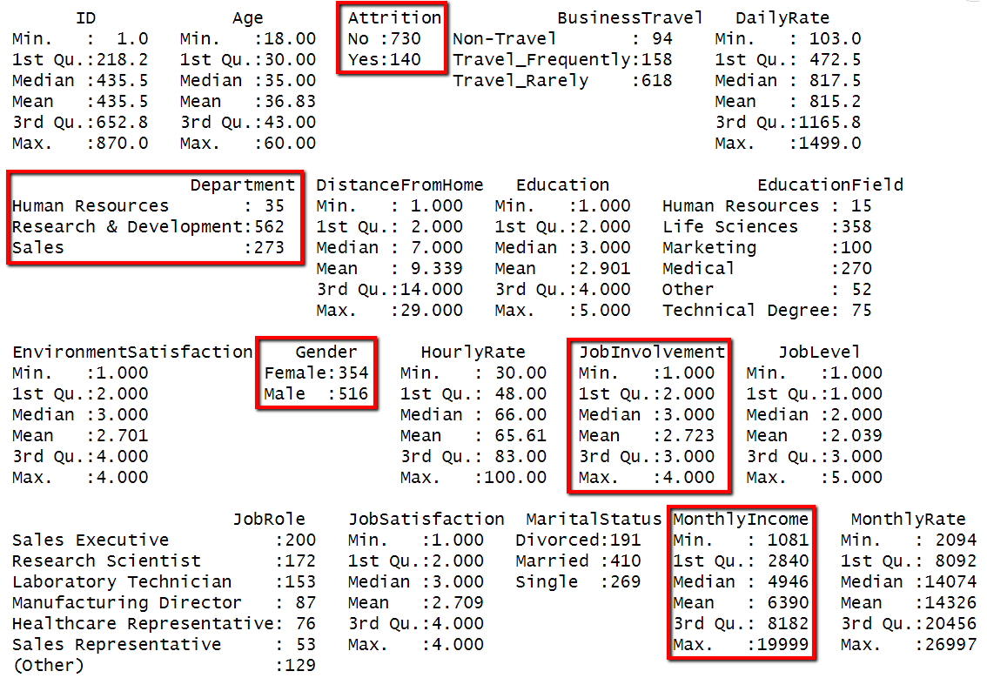
The data..
Here’s a nice overview of the data provided. At first glance, we have a few ways we can break apart the data
- Categorical, rating, measured/numeric.

Slide 4
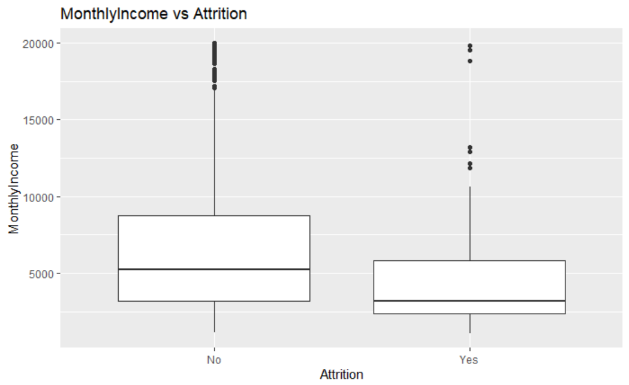
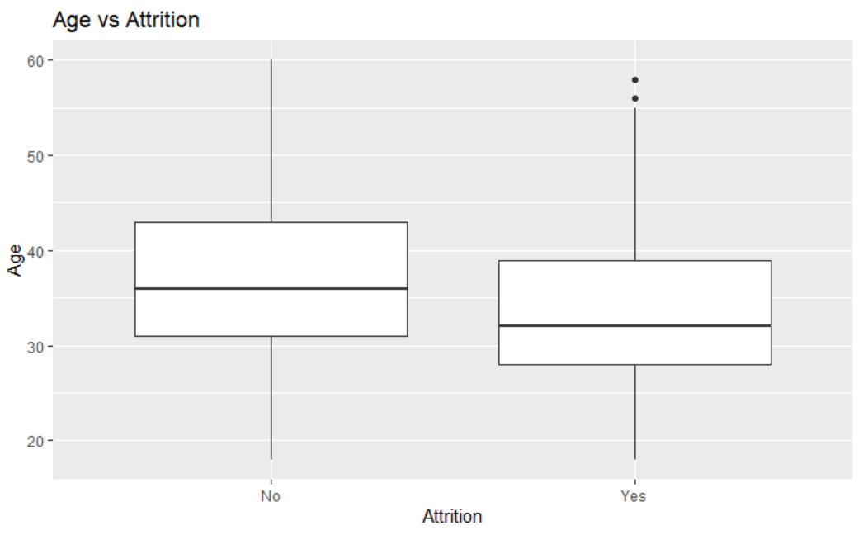
Attrition vs Others
From the boxplots, we can see relationships especially in the following categories:
Age, MonthlyIncome, TotalWorkingYears, YearsAtCompany, YearsInCurrentRole,

Slide 5
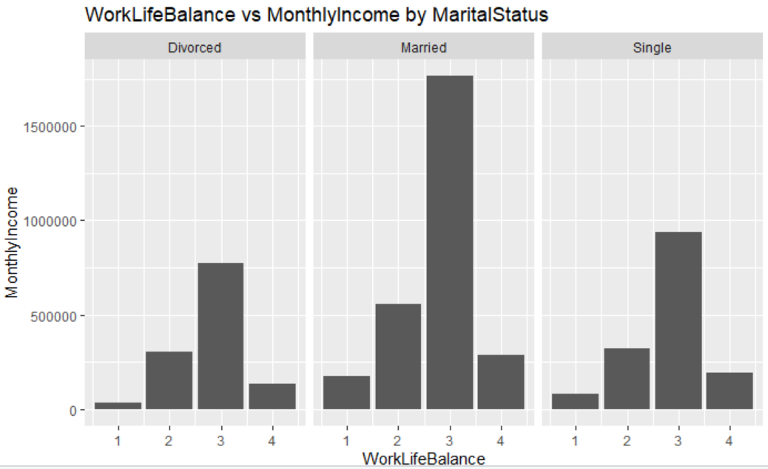
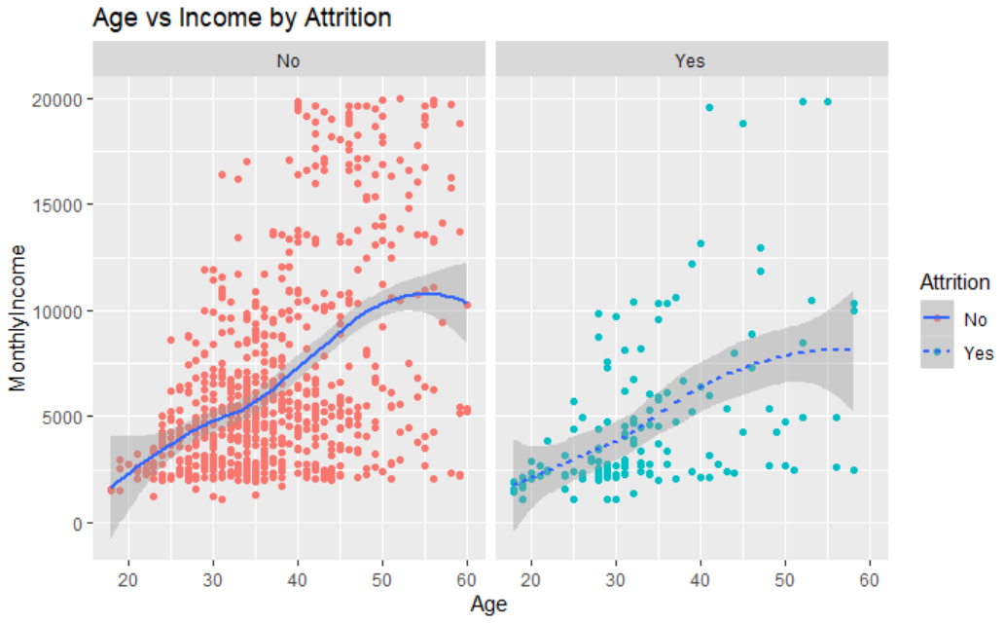
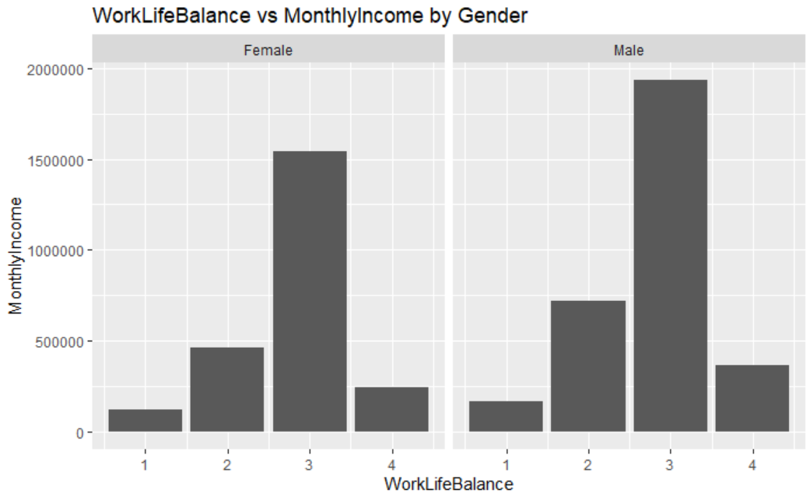
Monthly Income compared
Monthly Income can be affected by multiple factors in the dataset.
With the given dataset, there’s a very strong opportunity to foresee employee growth and financial opportunity.

Slide 6
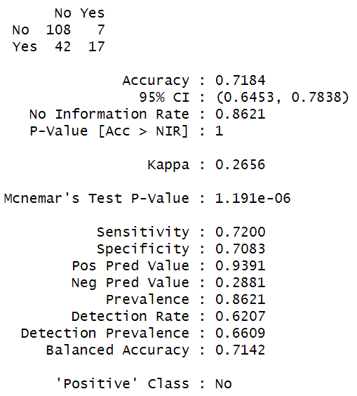
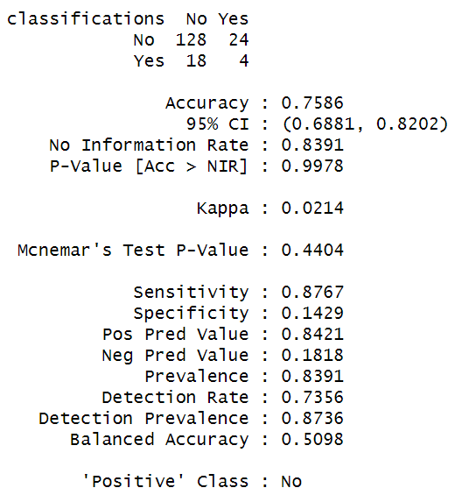
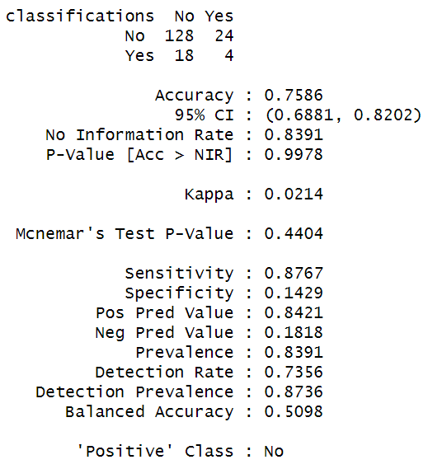
Attrition Prediction
NaïveBayes
K-NN
K-NN (transformed)

Slide 7
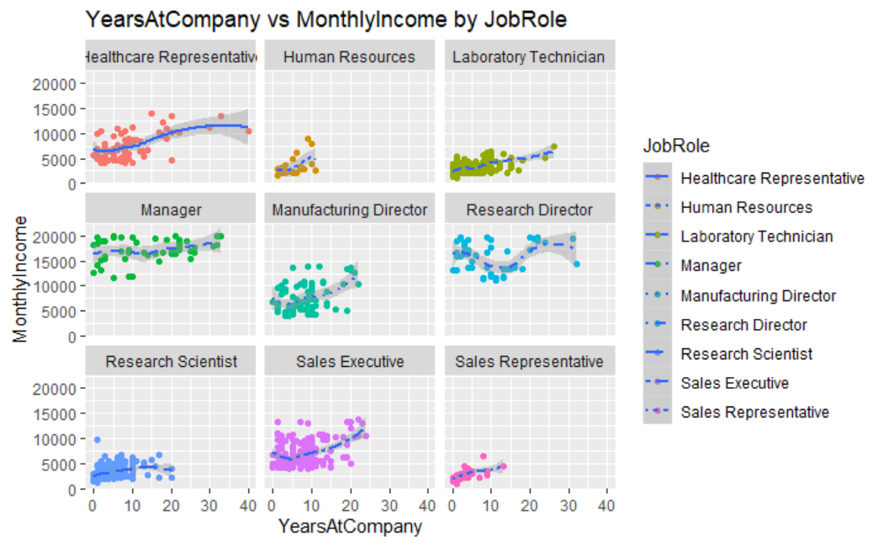
Income Prediction

Slide 8
Conclusion
We can forecast employee attrition and predict employee growth given the provided data set. Using basic techniques produced surprisingly well models that can contribute to your organization. We can further improve upon the techniques displayed here. And hopefully lower employee attrition and improve organizational efficiency.

