Slide 1
US Craft Beer and Brewery Analysis
Presented to Carlos Brito, CEO and Felipe Dutra, CFO Fred Poon, Laura Lazarescou

Slide 2
Beer Data: Quality and Consistency
Approximately half of the beer data does not include IBU values (1005/2410) values.
IBU is not a true predictor of taste.
Buyers do not base decisions on IBU and consumers don’t care.
ABV was not reported for 64 beers but they also lacked IBU so we omitted them.

Slide 3
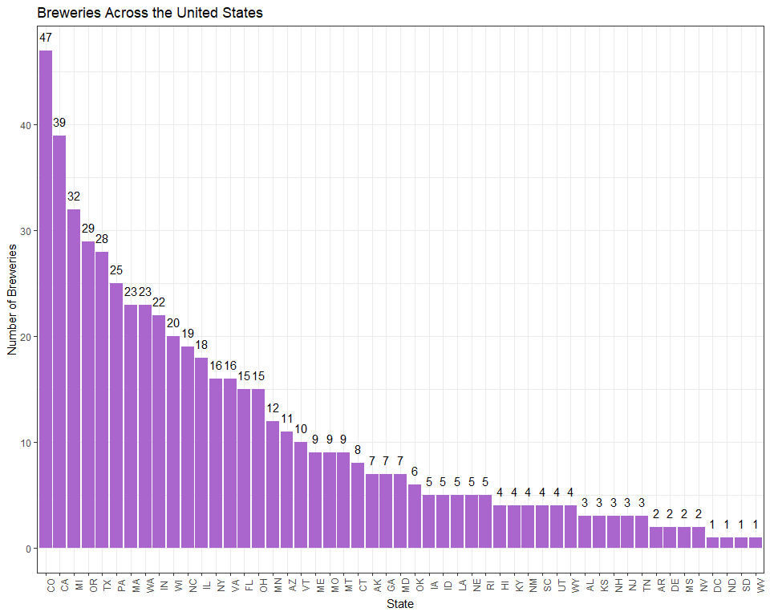
Breweries Across the United States

Slide 4
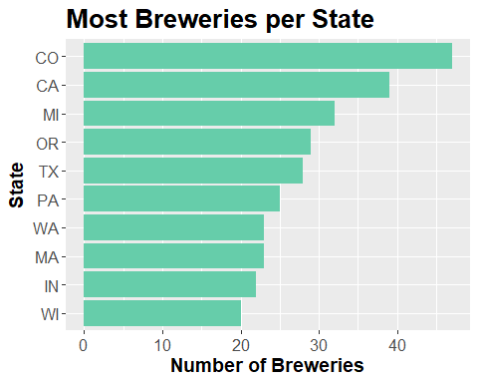
Top 10 States for Brewing

Slide 5
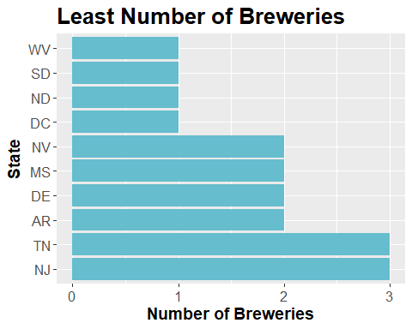
States with the Least Number of Breweries

Slide 6
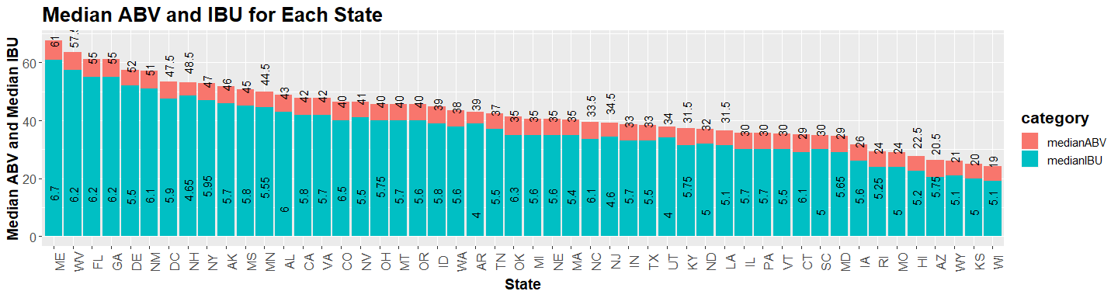
Median Alcohol (ABV) and Bitterness (IBU) for Each State

Slide 7
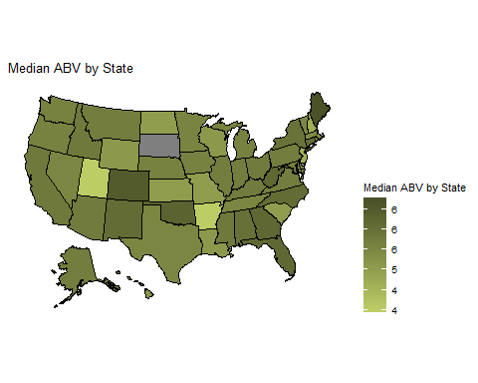
Median Alcohol (ABV) by State

Slide 8
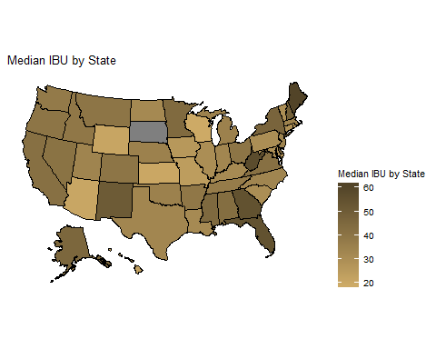
Median Bitterness (IBV) by State

Slide 9
State with Beer having Highest Alcohol by Volume (ABV)
## State ABV ## 1 CO 0.128

Slide 10
State with the Most Bitter Beer
## State IBU ## 1 OR 138

Slide 11
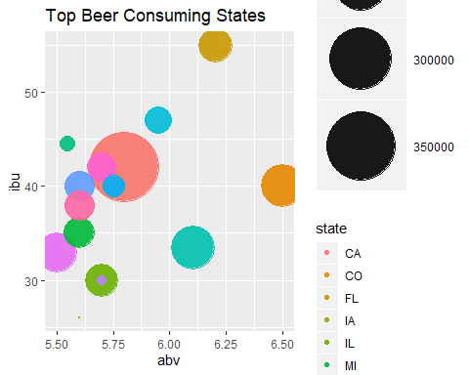
Top Beer Consuming States

Slide 12
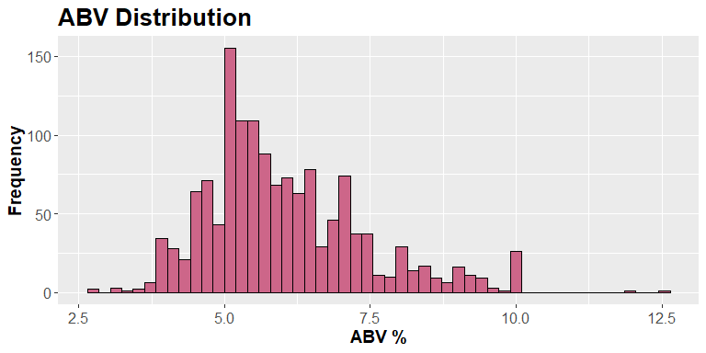
ABV Distribution

Slide 13
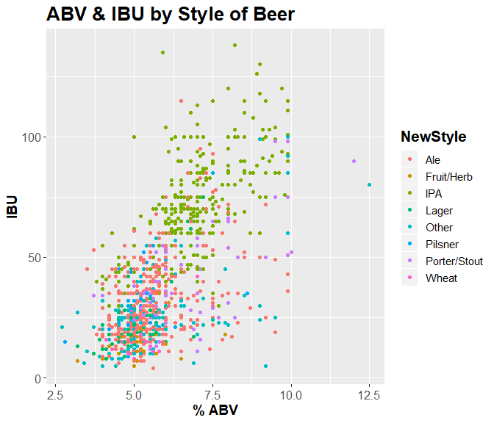
ABV & IBU by Style of Beer

Slide 14
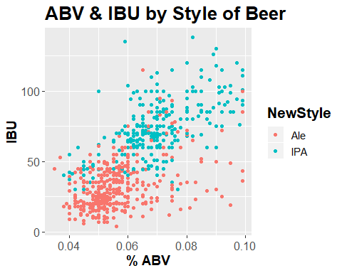
KNN

Slide 15
## Confusion Matrix and Statistics ## ## classifications ## Ale IPA ## Ale 119 20 ## IPA 19 78 ## ## Accuracy : 0.8347 ## 95% CI : (0.7811, 0.8798) ## No Information Rate : 0.5847 ## P-Value [Acc > NIR] : <2e-16 ## ## Kappa : 0.6592 ## ## Mcnemar's Test P-Value : 1 ## ## Sensitivity : 0.8623 ## Specificity : 0.7959 ## Pos Pred Value : 0.8561 ## Neg Pred Value : 0.8041 ## Prevalence : 0.5847 ## Detection Rate : 0.5042 ## Detection Prevalence : 0.5890 ## Balanced Accuracy : 0.8291 ## ## 'Positive' Class : Ale ##

