Slide 1
PiBot
Building and programming

Slide 2
Process
Unpack all components
Component check
Voltage Divider on PCB
Power rails
Positive +5V
Negative – common throughout
I2C rails
SDA
SCL

Slide 3
I2C Setup
sudo raspi-config
I2C enable
Reboot
lsmod | grep i2c
Check if two files are listed
sudo apt-get install i2c-tools
i2cdetect –y 1
Check for any I2c addresses and take note
sudo apt-get install libi2c-dev
sudo pip3 installsmbus2

Slide 4
Using LCD with i2c

Slide 5
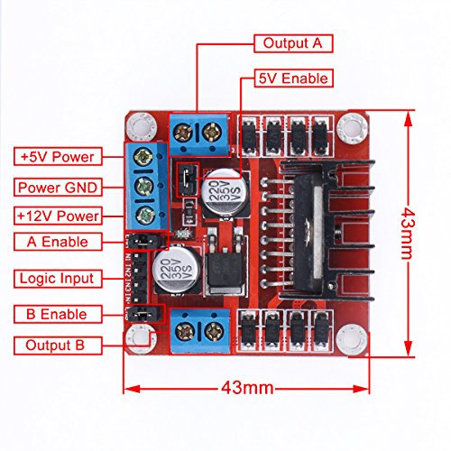
Motor Driver

Slide 6
In 1 = GPIO14 (8)
In 2 = GPIO15 (10)
EnA = GPIO18 (12)
In3 = GPIO23 (16)
In 4 = GPIO24 (18)
EnB = GPIO25 (22)

Slide 7
Motor Driver Tasks
Make Motor A turn
Fwd, Rev and change speed L, M, H.
Add second Motor B
Make both run: Fwd, Rev, speed, L, M, H
Make Motor A and Motor B turn in opposite directions.
i.e. Add two options turn robot left and turn robot right
On the LCD
Display the action of the motor
Display speed of motors.

Slide 8
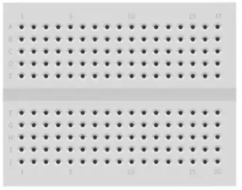
5v
Gnd
SDA
SCL

