Slide 1
Health Management System
hms
Abayie Fredrick
Supervisor: MR. Aelaf Dafla
Applied project

Slide 2
Outline
Project Description
Motivation
Background
Requirement Analysis
Implementation Technologies
Demo
Work done
Challenges
Work to be done

Slide 3
Project Description
Health Management System (HMS) is a system for managing the resources at a health center or a pharmacy.
Development of an HMS to aid hospitals and pharmacies keep appropriate records of patient details and health records.

Slide 4
Motivation
Misdiagnosis of patients diseases
History of patients diagnosis
Hospitals and pharmacies having an updated record of a patient
Eliminate pen and paper record keeping
Notes:
Held accountable,
electronic records,
pharmacy and clinic can communicate

Slide 5
Background
Ohene-Bonsu, K. G. (2015). CENTRALIZED HOSPITAL MANAGEMENT SYSTEM FOR HEALTH CENTERS IN GHANA. Ashesi University College

Slide 6
Work Done
Database
HMS database created
Migrations and seeds
Objects
Models and Controllers created for objects
Views
Creating views (Still in development)

Slide 7
Challenges
CHMS – Central Health Management System
Less documentation of source code
Design Pattern
Laravel Versions
Differences in the folder structures
But I Love Laravel

Slide 8
Requirement Analysis
HMS
Database
Store data
Store data
Retrieve data
Retrieve data
HMS
Pharmacy
HMS
Hospital
View Drugs
PC
PC
HMS
Patient
Phone
Notes:
Show that the application is hosted on the server

Slide 9
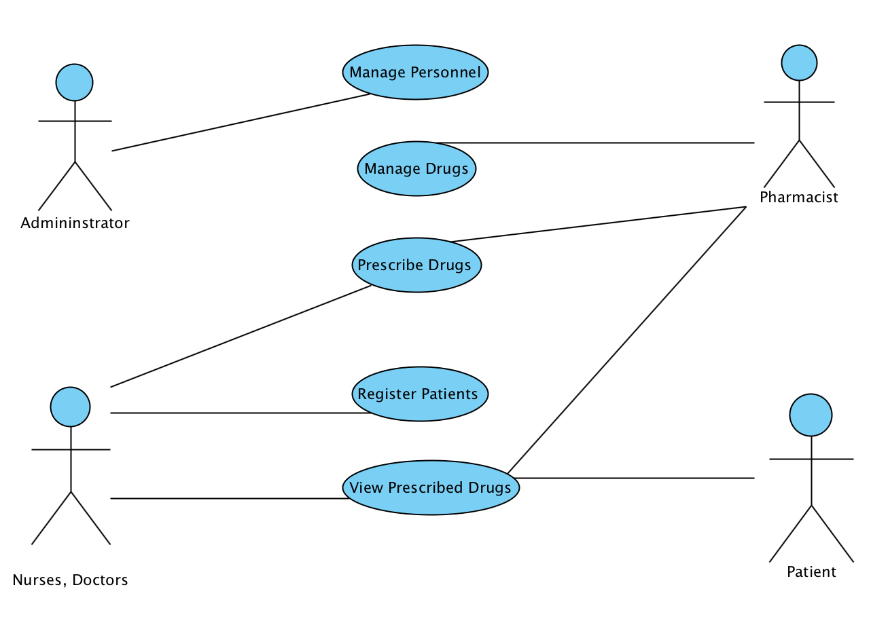
Use Case

Slide 10
Implementation Technologies
Framework
Laravel 5.2 (PHP)
Web Notification
Jquery (Notify.js)
Mobile Notification
SMSGH Api (PHP)

Slide 11
DEMO

Slide 12
Work To Be Done
Mobile Side
Start implementation for HMS mobile
Image Upload
Upload the picture of a patient for identification
Write-up
Dedicate more time to the 40 pages
Involve users to the implementation process

Slide 13
☺ Thank You ☺

