Slide 1
GROUP MEMBERS
 | NAME | REG.NO | PROGRAM
1 | SALIMU ZAHORO | T21-03-13042 | Bsc.IS
2 | ATUONEKISYE MAPUNDA | T21-03-14807 | Bsc.IS
3 | GLORIA HILARY | T21-03-09255 | Bsc.IS
4 | SOPHIA RAULENT | T21-03-10293 | Bsc.IS
5 | MAJALIWA PIUS | T21-03-11318 | Bsc.IS

Slide 2
DESIGNING AND IMPLEMENTATION OF DECISION SUPPORT SYSTEM TO SUPPORT REMOTE TEACHING AND LEARNING IN HIGHER EDUCATION.

Slide 3
INTRODUCTION
Due to the eruption of COVID-19, there were difficulties in educational institutions for the higher management on deciding what to do against the interruptions so as to attain smooth teaching and learning routines accordingly.
This situation triggered us to come up with the idea of “designing and implementing decision support system to support remote teaching and learning in higher education.

Slide 4
PROBLEM STATEMENT
Due to development of information technology, higher learning institutions should have intelligent decision support systems to simplify and speed up the decision making process.
In reality, higher education boards face numerous challenges in decision making. They don't have a unified system to quickly get the information they need to make decisions.
Intelligent decision support system will enable them to make decisions on how they will proceed with teaching and learning despite the outbreak of interruptions.

Slide 5
MAIN OBJECTIVE OF THE PROJECT
To design and implement a system that facilitates and enhances decision making to support remote teaching and learning in higher education.

Slide 6
SPECIFIC OBJECTIVES
To identify and gather challenges and requirements of remote teaching and learning in higher education.
To develop a detailed system design that includes the architecture, features, and functionalities.
To create user-friendly interface for the decision support system.
To establish mechanisms for efficient data collection, aggregation, and integration from various sources relevant to remote education.

Slide 7
METHODOLOGY
This project adopts agile methodology
Agile methodology is a project management approach that allow continuous improvement of the system.
Agile methodology divides projects into smaller phases and guides teams through cycles of planning, execution, and evaluation.
Method to be used is mixed-method approach due to the use of both qualitative and quantitative methods.
.

Slide 8
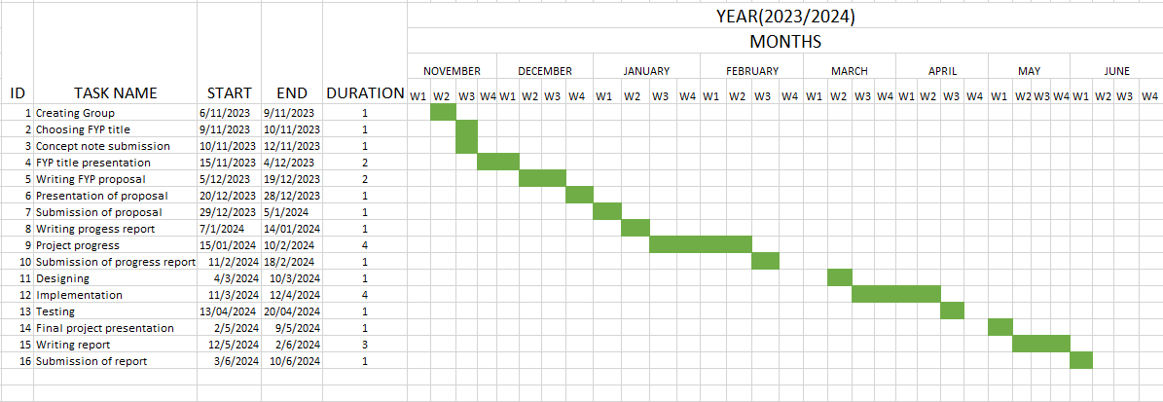
PROJECT TIMELINE

