Slide 1

CP 313: Mobile Application Development Android Fragments Lecture # 4

Slide 2

Fragments
Fragment represents a behavior or a portion of UI in an Activity.
It is a kind of sub-activity.
Multiple fragments can be combined in a single activity to build a multi-pane UI and reuse a fragment in multiple activities.
You can add or remove fragments in an activity while activity is running.

Slide 3
Fragments
An activity can contain any number of fragments.
Fragment life cycle is closely related to lifecycle of its host activity
This means when activity is paused, all fragments available in activity will also be stopped.

Slide 4
Fragments
Fragments were added to Android API in Honeycomb (3.0) version of Android which API version 11.
Earlier we had a limitation because we can show only a single activity on screen at one given point in time. So we were not able to divide device screen and control different parts separately.

Slide 5
Fragments
But with fragment we got more flexibility and removed limitation of having a single activity on screen at a time. Fragments will have their own layout, events and complete lifecycle.
You create fragments by extending Fragment class and you can insert a fragment into your activity layout by declaring fragment in activity's layout file, as a <fragment> element.

Slide 6
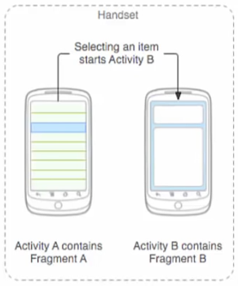
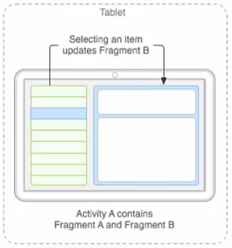
Fragments

Slide 7
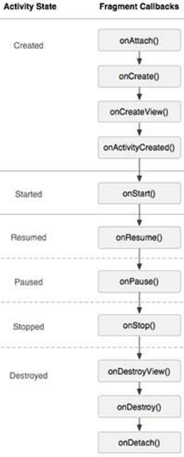
Fragment Lifecycle

Slide 8
Fragment Lifecycle
Phase I: When a fragment gets created, it goes through following states:
onAttach() // when a frag is attached to its hosting activity
onCreate() //frag is initialized, but no UI
onCreateView() //frag sets up and returns its UI. This view is given to hosting activity afterwards.
onActivityCreated() // Now frag’s life cycle is depending upon its hosting activity’s life cycle

Slide 9
Fragment Lifecycle
Phase II: When fragment becomes visible, it goes through these states:
onStart() //hosting activity is about to become visible
onResume() // hosting activity is about to become visible and ready for user interaction

Slide 10
Fragment Lifecycle
Phase III: When fragment goes into background mode, it goes through this states.
onPaused() //hosting activity is visible, but another activity is in the foreground and has focus
onStop() // When hosting activity is not visible

Slide 11
Fragment Lifecycle
Phase IV: When fragment is destroyed, it goes through following states:
onPaused() • onStop()
onDestroyView() //hosting activity is about to be destroyed any frag that it is hosting also has to be shut down
onDestroy() //release frag resources
onDetach() //null out references to hosting activity

Slide 12
Adding Fragments to Activities
Two general ways
First,
Fragment can be statically added to the activity’s layout file.
It is then used in a call to setContentView method.
Second,
Add it programmatically (dynamicaaly) using FragmentManager

Slide 13
How to use Fragments?
This involves number of simple steps to create Fragments.
First of all decide how many fragments you want to use in an activity.
For example let's we want to use two fragments to handle landscape and portrait modes of the device.
Next based on number of fragments, create classes which will extend the Fragment class.
Fragment class has above mentioned callback functions.
You can override any of the functions based on your requirements.

Slide 14
How to use Fragments?
Corresponding to each fragment, you will need to create layout files in XML file.
These files will have layout for the defined fragments.
Finally modify activity file to define actual logic of replacing fragments based on your requirement.
A Useful Trick!
Press Ctrl and click on keyword of java in Android Studio. You will get complete definitions of that keyword.

Slide 15
ADDING Fragment dynamically to an activity
STEP ONE
Create the fragment

Slide 16
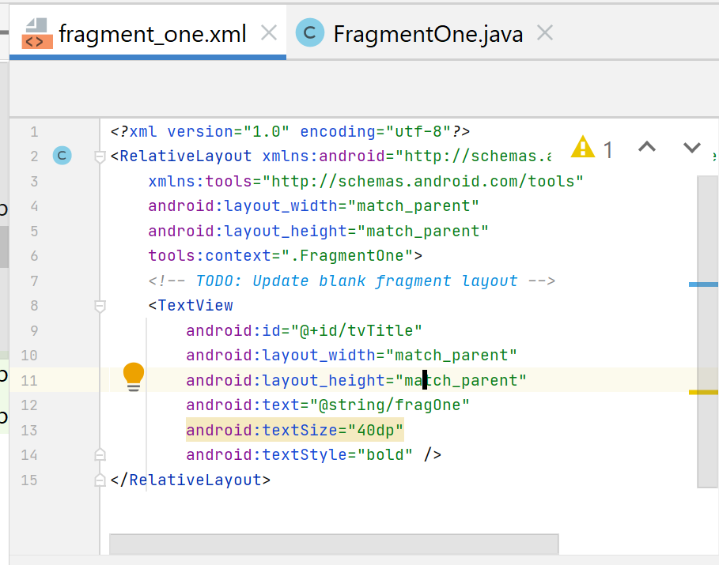
ADDING Fragment dynamically to an activity

Slide 17
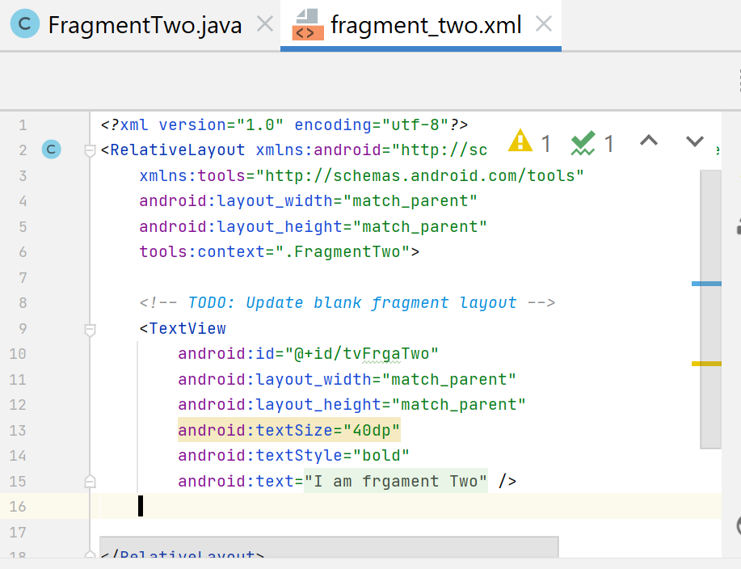
ADDING Fragment dynamically to an activity

Slide 18
ADDING Fragment dynamically to an activity
STEP TWO
Define the activity to host the fragment

Slide 19
ADDING Fragment dynamically to an activity
<?xml version="1.0" encoding="utf-8"?> <RelativeLayout xmlns:android="http://schemas.android.com/apk/res/android" xmlns:app="http://schemas.android.com/apk/res-auto" xmlns:tools="http://schemas.android.com/tools" android:layout_width="match_parent" android:layout_height="match_parent" tools:context=".MainActivity"> <TextView android:id="@+id/tvTitle" android:layout_width="match_parent" android:layout_height="wrap_content" android:text="Fragment Title" android:textSize="40dp" android:gravity="center"> </TextView>

Slide 20
ADDING Fragment dynamically to an activity
<Button android:id="@+id/btnFirstFragment" android:layout_width="match_parent" android:layout_height="wrap_content" android:text="Fragment One" android:textSize="40dp" android:layout_below="@id/tvTitle" android:gravity="center"></Button> <Button android:id="@+id/btnSecondFragment" android:layout_width="match_parent" android:layout_height="wrap_content" android:text="Fragment Two" android:textSize="40dp" android:layout_below="@id/btnFirstFragment" android:gravity="center"></Button>

Slide 21
ADDING Fragment dynamically to an activity
<LinearLayout android:id="@+id/fragMentCOntainer" android:orientation="vertical" android:layout_width="match_parent" android:layout_below="@id/btnSecondFragment" android:layout_margin="30dp" android:layout_height="wrap_content"> android:la </LinearLayout> </RelativeLayout>

Slide 22
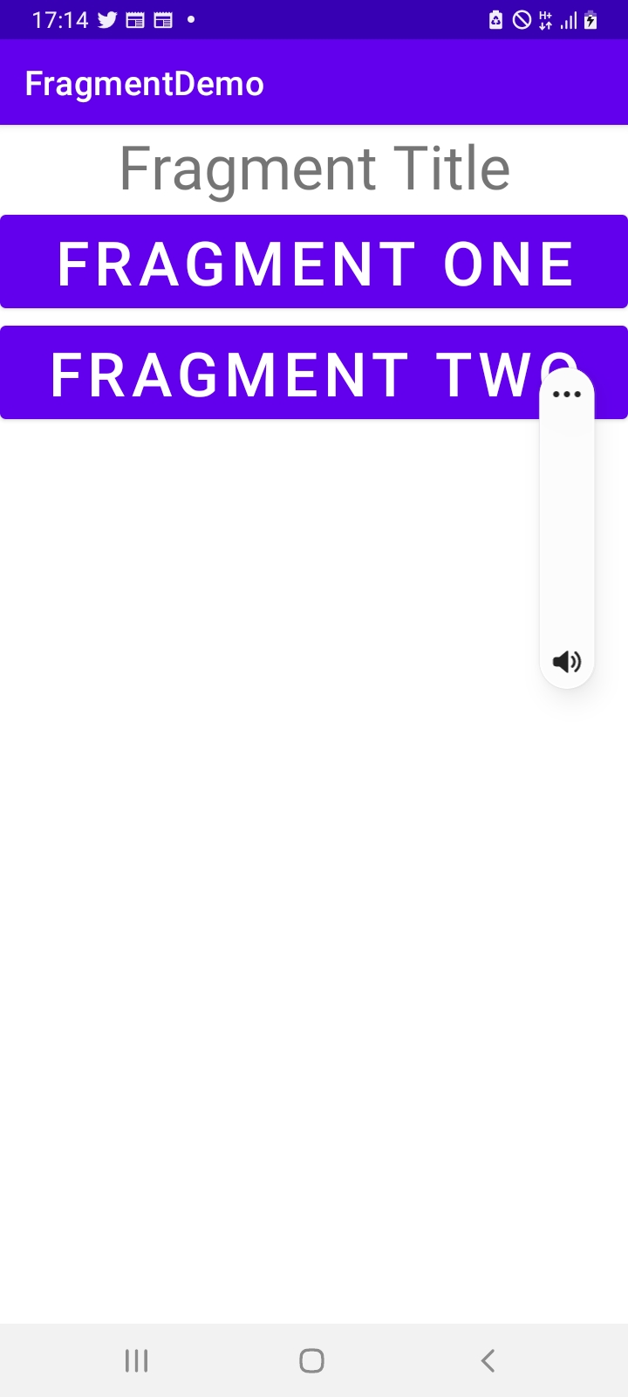
ADDING Fragment dynamically to an activity

Slide 23
ADDING Fragment dynamically to an activity
Step Three
Add the fragment in the activity you have created

Slide 24
ADDING Fragment dynamically to an activity
public class MainActivity extends AppCompatActivity { Button fragOne, fragTwo; @Override protected void onCreate(Bundle savedInstanceState) { super.onCreate(savedInstanceState); setContentView(R.layout.activity_main); fragOne=(Button) findViewById(R.id.btnFirstFragment); fragTwo=(Button) findViewById(R.id.btnSecondFragment);

Slide 25
ADDING Fragment dynamically to an activity
fragOne.setOnClickListener(new View.OnClickListener() { @Override public void onClick(View v) { Fragment frag1=new FragmentOne(); FragmentTransaction ft=getSupportFragmentManager().beginTransaction(); ft.replace(R.id.fragMentCOntainer,frag1); ft.addToBackStack(null); ft.commit(); } });

Slide 26
ADDING Fragment dynamically to an activity
fragTwo.setOnClickListener(new View.OnClickListener() { @Override public void onClick(View v) { Fragment frag2=new FragmentTwo(); FragmentTransaction ft = getSupportFragmentManager().beginTransaction(); ft.replace(R.id.fragMentCOntainer,frag2); ft.addToBackStack(null); ft.commit(); } });

