Slide 1
CP 313: Mobile Apps Development
Services, Broadcast Receivers and Notifications

Slide 2
Contents
Services
Broadcast Receivers
Notifications

Slide 3
Services
A Service is an application component that can perform long-running operations in the background.
It does not provide a user interface.
Once started, a service might continue running for some time, even after the user switches to another application.

Slide 4
Services
Additionally, a component can bind to a service to interact with it and even perform interprocess communication (IPC).
For example, a service can handle network transactions, play music, perform file I/O, or interact with a content provider, all from the background.

Slide 5
Characteristics of a services
Services starts with an Intent
Can stay running when the user switches the applications
Services have life cycle
Runs in the main thread of its hosting process

Slide 6
Types of Services (There are three types of services:)
Foreground Services
A foreground service performs some operation that is noticeable to the user.
For example, an audio app would use a foreground service to play an audio track.
Foreground services must display a Notification.
Foreground services continue running even when the user isn't interacting with the app.

Slide 7
Types of Services (There are three types of services:)
Foreground Services
When you use a foreground service, you must display a notification so that users are actively aware that the service is running.
This notification cannot be dismissed unless the service is either stopped or removed from the foreground.

Slide 8
Types of Services (There are three types of services:)
Background
A background service performs an operation that isn't directly noticed by the user.
For example, if an app used a service to compact its storage, that would usually be a background service.

Slide 9
Types of Services (There are three types of services:)
Bound
A service is bound when an application component binds to it by calling bindService().
A bound service offers a client-server interface that allows components to interact with the service, send requests, receive results, and even do so across processes with interprocess communication (IPC).
A bound service runs only as long as another application component is bound to it.
Multiple components can bind to the service at once, but when all of them unbind, the service is destroyed.

Slide 10
Services life cycle
In android, services have Two (2) possible paths to complete its life cycle namely Started and Bounded.
Started Service (Unbounded Service):
By following this path, a service will initiate when an application component calls the startService() method.
Once initiated, the service can run continuously in the background even if the component is destroyed which was responsible for the start of the service.

Slide 11
Services life cycle
To create a service, you must create a subclass of Service or use one of its existing subclasses.
In your implementation, you must override some callback methods that handle key aspects of the service lifecycle and provide a mechanism that allows the components to bind to the service, if appropriate.
These are the most important callback methods that you should override:

Slide 12
Services life cycle
onStartCommand()
The system invokes this method by calling startService() when another component (such as an activity) requests that the service be started.
When this method executes, the service is started and can run in the background indefinitely.

Slide 13
Services life cycle
If you implement this, it is your responsibility to stop the service when its work is complete by calling stopSelf() or stopService().
If you only want to provide binding, you don't need to implement this method.

Slide 14
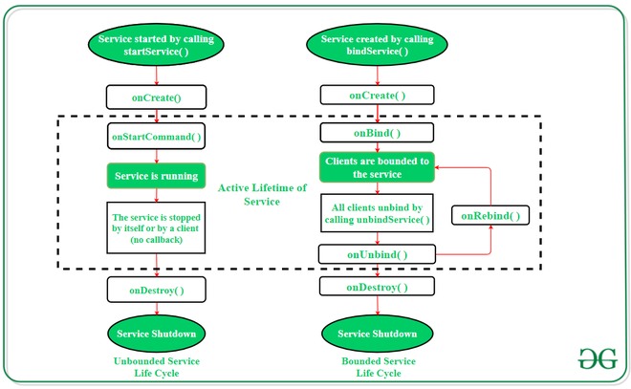
Services life cycle

Slide 15
Services life cycle
Bounded Service:
It can be treated as a server in a client-server interface.
By following this path, android application components can send requests to the service and can fetch results.
A service is termed as bounded when an application component binds itself with a service by calling bindService() method.
To stop the execution of this service, all the components must unbind themselves from the service by using unbindService() method.

Slide 16
Services life cycle
onBind()
The system invokes this method by calling bindService() when another component wants to bind with the service (such as to perform RPC).
In your implementation of this method, you must provide an interface that clients use to communicate with the service by returning an IBinder.
You must always implement this method; however, if you don't want to allow binding, you should return null.

Slide 17
Services life cycle
onCreate()
The system invokes this method to perform one-time setup procedures when the service is initially created (before it calls either onStartCommand() or onBind()).
If the service is already running, this method is not called.

Slide 18
Services life cycle
onDestroy()
The system invokes this method when the service is no longer used and is being destroyed.
Your service should implement this to clean up any resources such as threads, registered listeners, or receivers.
This is the last call that the service receives.

Slide 19
Declaring a service in the manifest
You must declare all services in your application's manifest file, just as you do for activities and other components.
To declare your service, add a <service> element as a child of the <application> element. Below is an example:
<manifest ... >
...
<application ... >
<service android:name=".ExampleService" />
...
</application>
</manifest>

Slide 20
Creating a started service
A started service is one that another component starts by calling startService(), which results in a call to the service's onStartCommand() method.
When a service is started, it has a lifecycle that's independent of the component that started it.
The service can run in the background indefinitely, even if the component that started it is destroyed.
As such, the service should stop itself when its job is complete by calling stopSelf(), or another component can stop it by calling stopService().

Slide 21
Creating a started service
An application component such as an activity can start the service by calling startService() and passing an Intent that specifies the service and includes any data for the service to use.
The service receives this Intent in the onStartCommand() method.
The Service class is the base class for all services.
When you extend this class, it's important to create a new thread in which the service can complete all of its work; the service uses your application's main thread by default, which can slow the performance of any activity that your application is running.

Slide 22
Creating a started service (Interface)
<?xml version="1.0" encoding="utf-8"?> <RelativeLayout xmlns:android="http://schemas.android.com/apk/res/android" xmlns:app="http://schemas.android.com/apk/res-auto" xmlns:tools="http://schemas.android.com/tools" android:layout_width="match_parent" android:layout_height="match_parent" tools:context=".MainActivity"> <TextView android:id="@+id/tvTitle" android:layout_width="match_parent" android:layout_height="wrap_content" android:text="Service App" android:textStyle="bold" android:textSize="40dp" android:textColor="@color/teal_200" android:gravity="center"> </TextView>

Slide 23
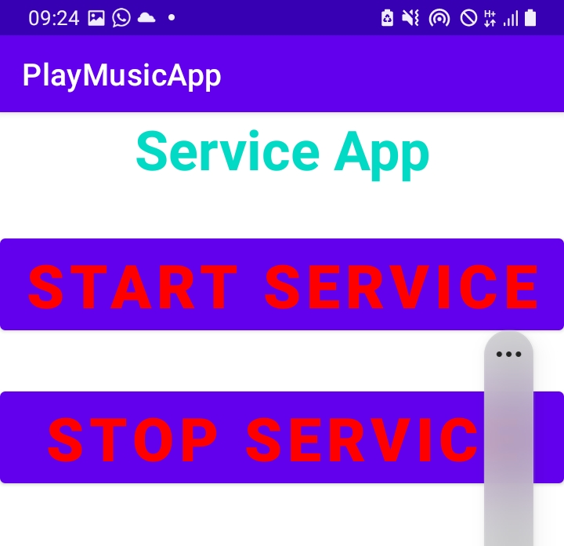
Creating a started service (Interface)
<Button
android:id="@+id/btnStartService"
android:layout_width="match_parent"
android:layout_height="wrap_content"
android:layout_below="@+id/tvTitle"
android:layout_marginTop="30sp"
android:text="Start Service"
android:textSize="40sp"
android:textStyle="bold"
android:textColor="@color/Red"
android:gravity="center">
</Button>
<Button
android:id="@+id/btnStopService"
android:layout_width="match_parent"
android:layout_height="wrap_content"
android:layout_below="@+id/btnStartService"
android:layout_marginTop="30sp"
android:text="Stop Service"
android:textSize="40sp"
android:textStyle="bold"
android:textColor="@color/Red"
android:gravity="center">
</Button>

Slide 24
Creating a Service by extending a service class.
package com.example.myapplication;
import android.app.Service;
import android.content.Intent;
import android.os.IBinder;
public class Service_one extends Service {
public Service_one() {
}

Slide 25
Overriding onCreate(), onSstartCOmmand() and onDestroy() methods
@Override
public void onCreate() {
super.onCreate();
}
@Override
public int onStartCommand(Intent intent, int flags, int startId) {
return super.onStartCommand(intent, flags, startId);
}
@Override
public void onDestroy() {
super.onDestroy();
}

Slide 26
Link the Interface with the service
public class MainActivity extends AppCompatActivity {
Button startService, stopService;
@Override
protected void onCreate(Bundle savedInstanceState) {
super.onCreate(savedInstanceState);
setContentView(R.layout.activity_main);
startService=(Button) findViewById(R.id.btnStartService);
stopService=(Button) findViewById(R.id.btnStopService);
startService.setOnClickListener(new View.OnClickListener() {
@Override
public void onClick(View v) {
Intent myIntent=new Intent(MainActivity.this,Service_one.class);
startService(myIntent);
}
});
stopService.setOnClickListener(new View.OnClickListener() {
@Override
public void onClick(View v) {
Intent i=new Intent(MainActivity.this, Service_one.class);
stopService(i);
}
});
}

Slide 27
MediaPlayer Class
public int onStartCommand(Intent intent, int flags, int startId) {
myPlayer=MediaPlayer.create(Service_one.this, Settings.System.DEFAULT_RINGTONE_URI);
myPlayer.setLooping(true);
myPlayer.start();
return START_STICKY;
}
@Override
public void onDestroy() {
super.onDestroy();
myPlayer.stop();
}
}

Slide 28
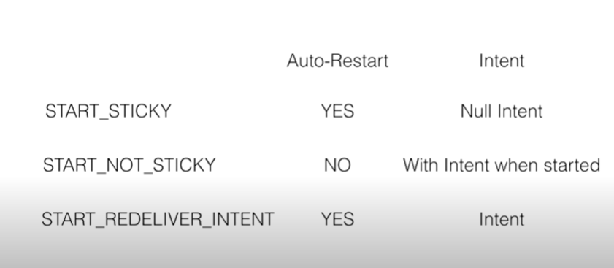
Services Behaviors

Slide 29
Services Behaviors
START_STICKY
Services that are explicit managed and long running ie. Your starting your services and you are stopping your services using startService() and stopService() methods.
The advantage of START_STICKY is if the service get killed, it will automatically get started.
But when it get restarted, it will not get the intent values, so the intent value will be NULL ie. It will not remember what was the previous calculated value in the intent.
Music service is a good example here. You don’t your music to get started automatic on your ears in unexpected time.

Slide 30
Services Behaviors
START_NOT_STICKY
You are not starting the service but the intent is triggered you will start it.
Here the services are running periodically and get self stop.
If the service get stopped, it will not automatically restarted. If the service get killed, and intent is triggered, then the service will start.
Tasks that runs periodically in the background are examples of START_NOT_STICKY
Alarm service is an example of such a service.

Slide 31
Services Behaviors
START_REDELIVER_INTENT
Here The services will always get restated and it will get the previous intent values.
Good example is a file download.
If the file stopped due to internet connection, when the internet connection is available, then the file has to restated automatically and it has to continue where it ended when the internet connection get lost.

Slide 32
Bound Services
A bound service is the server in a client-server interface.
A bound service allows components (such as activities) to bind to the service, send requests, receive responses, and even perform interprocess communication (IPC).
A bound service typically lives only while it serves another application component and does not run in the background indefinitely.

Slide 33
Bound Services
A bound service is an implementation of the Service class that allows other applications to bind to it and interact with it.
To provide binding for a service, you must implement the onBind() callback method.
This method returns an IBinder object that defines the programming interface that clients can use to interact with the service.

Slide 34
Bound Services
A client can bind to the service by calling bindService().
When it does, it must provide an implementation of ServiceConnection, which monitors the connection with the service.
The bindService() method returns immediately without a value, but when the Android system creates the connection between the client and service, it calls onServiceConnected() on the ServiceConnection, to deliver the IBinder that the client can use to communicate with the service.

Slide 35
Bound Services
Multiple clients can connect to the service at once.
However, the system calls your service's onBind() method to retrieve the IBinder only when the first client binds.
The system then delivers the same IBinder to any additional clients that bind, without calling onBind() again.
When the last client unbinds from the service, the system destroys the service (unless the service was also started by startService()).

Slide 36
Creating a Bound Service
When you implement your bound service, the most important part is defining the interface that your onBind() callback method returns.
When creating a service that provides binding, you must provide an IBinder that provides the programming interface that clients can use to interact with the service.
There are three ways you can define the interface:

Slide 37
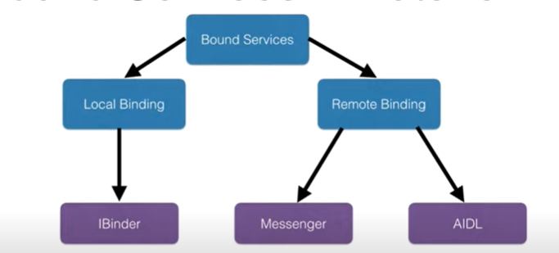
Creating a Bound Service

Slide 38
Creating a Bound Service
Extending the Binder class
If your service is private to your own application and runs in the same process as the client (which is common), you should create your interface by extending the Binder class and returning an instance of it from onBind().
The client receives the Binder and can use it to directly access public methods available in either the Binder implementation or even the Service.

Slide 39
Creating a Bound Service
Using a Messenger
If you need your interface to work across different processes, you can create an interface for the service with a Messenger.
Using AIDL
AIDL (Android Interface Definition Language) performs all the work to decompose objects into primitives that the operating system can understand and marshall them across processes to perform IPC.
The previous technique, using a Messenger, is actually based on AIDL as its underlying structure

Slide 40
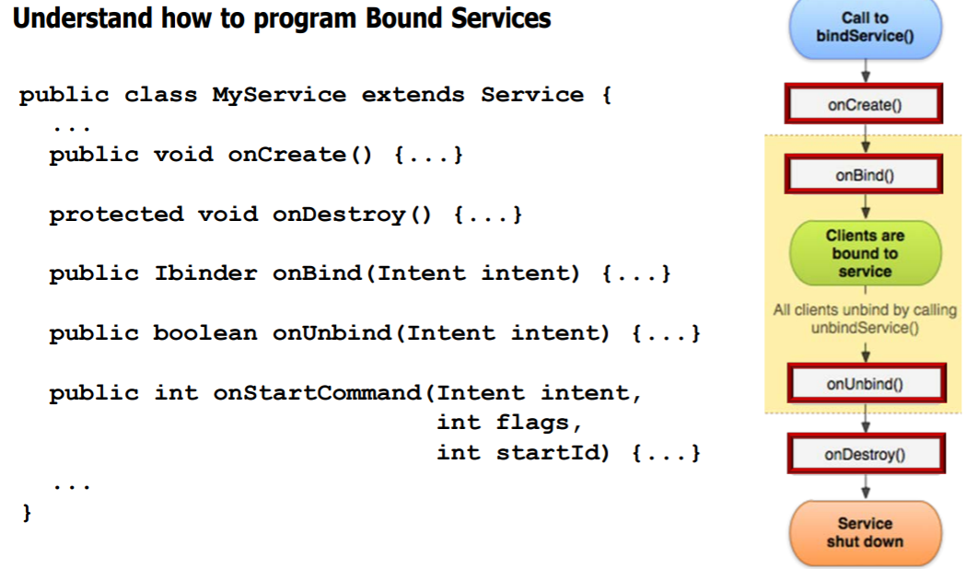
Creating a bound Service

Slide 41
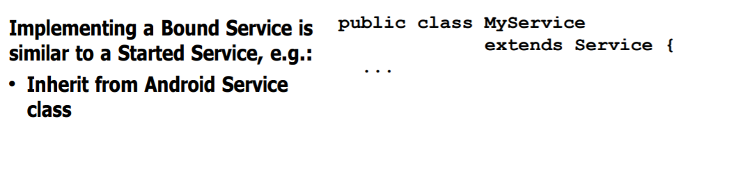
Creating a bound Service

Slide 42
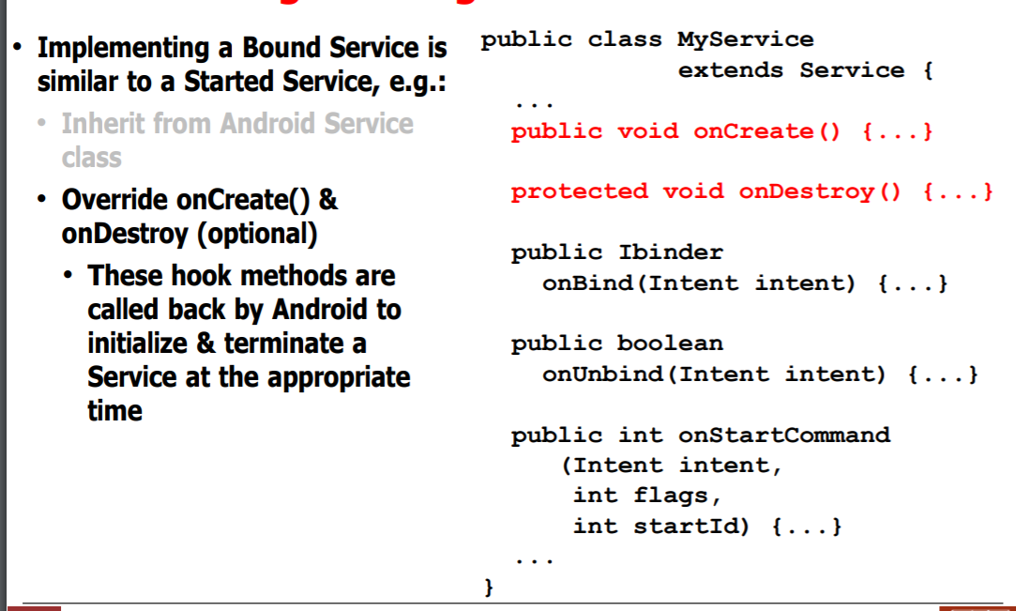
Creating a bound Service

Slide 43
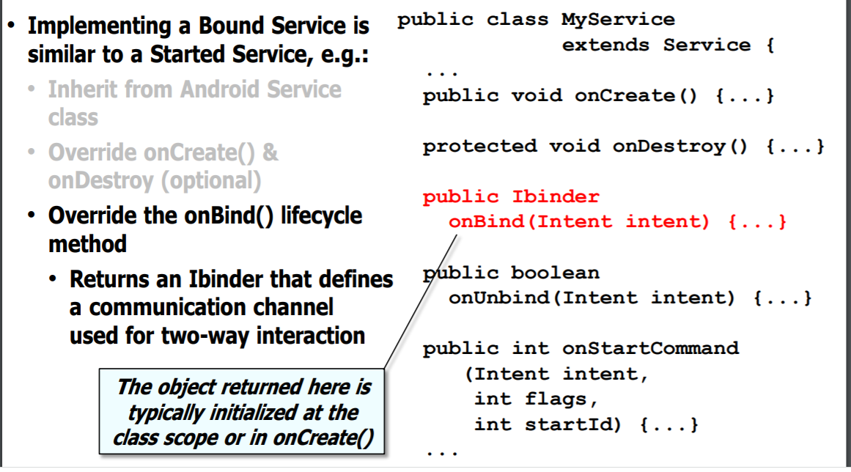
Creating a bound Service

Slide 44
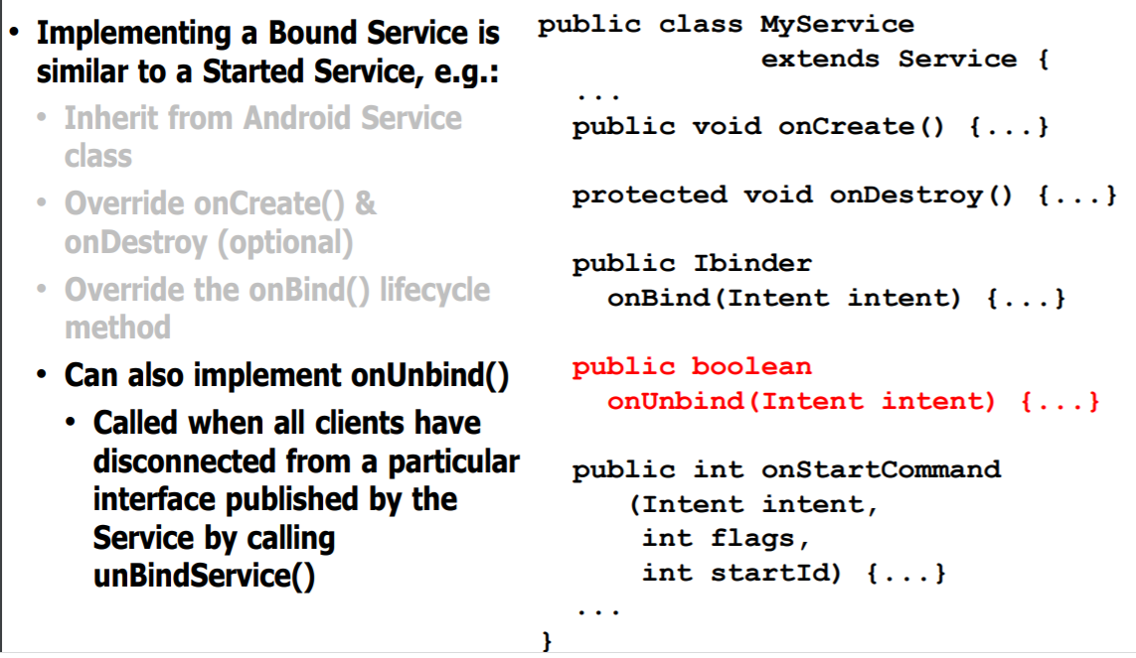
Creating a bound Service

Slide 45
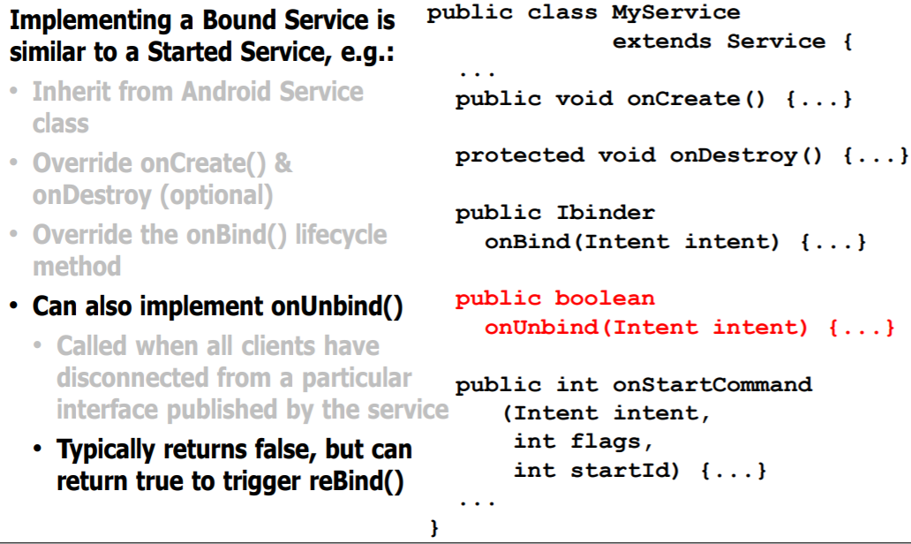
Creating a bound Service

Slide 46
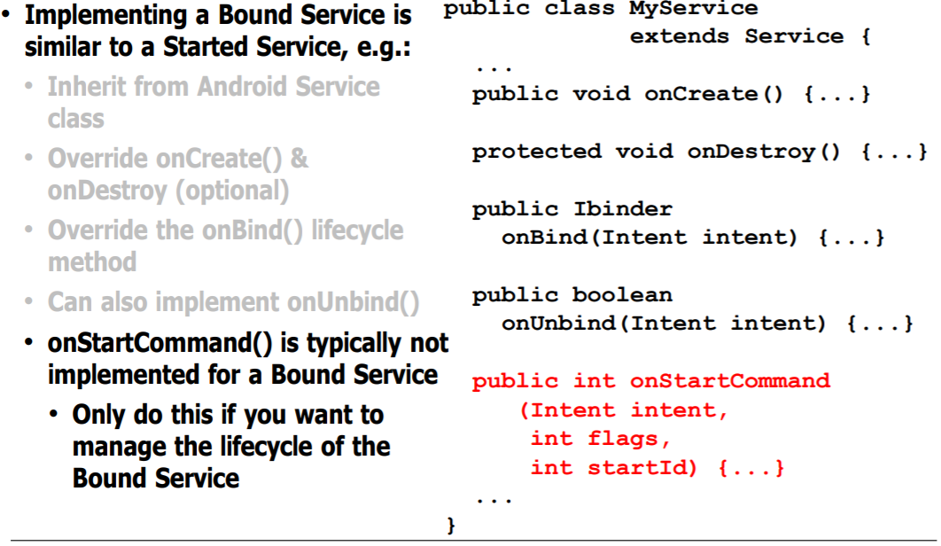
Creating a bound Service

Slide 47
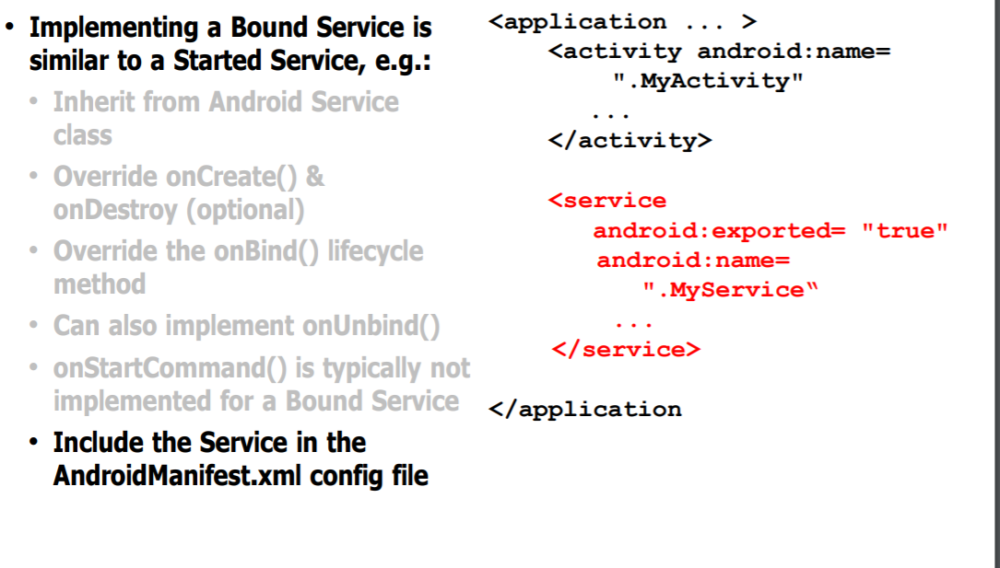
Creating a bound Service

Slide 48
BROADCAST RECEIVERS

Slide 49
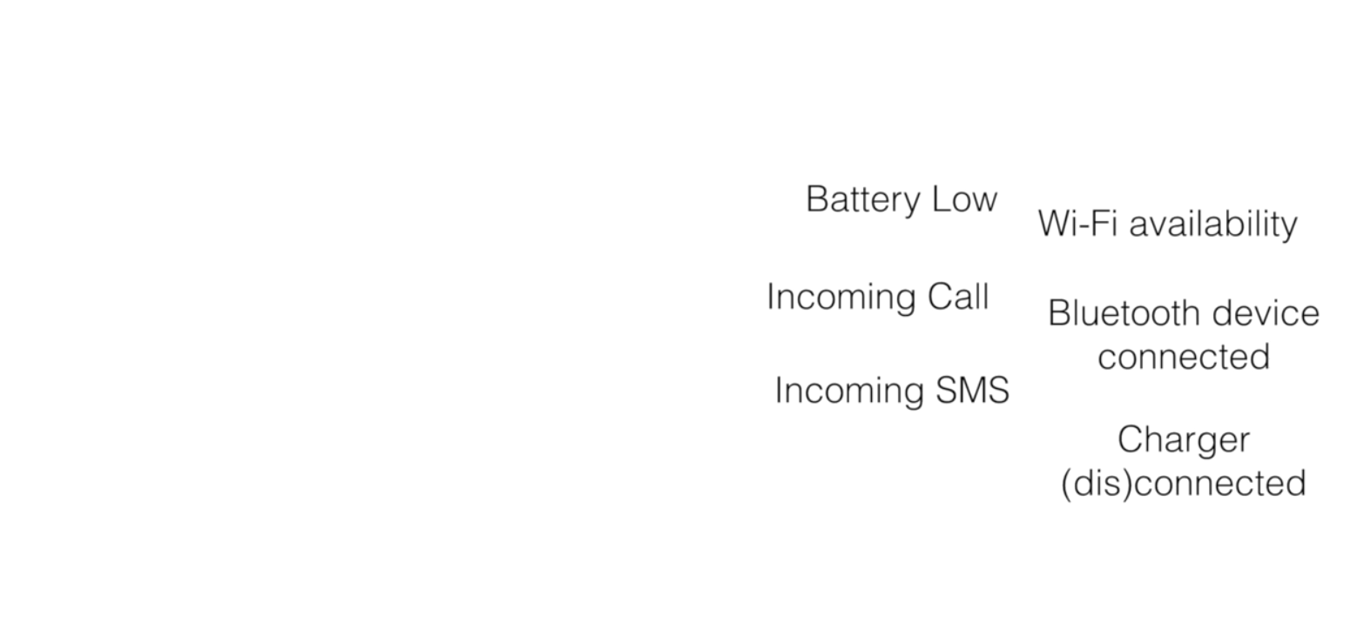
Examples Events occurring in android

Slide 50
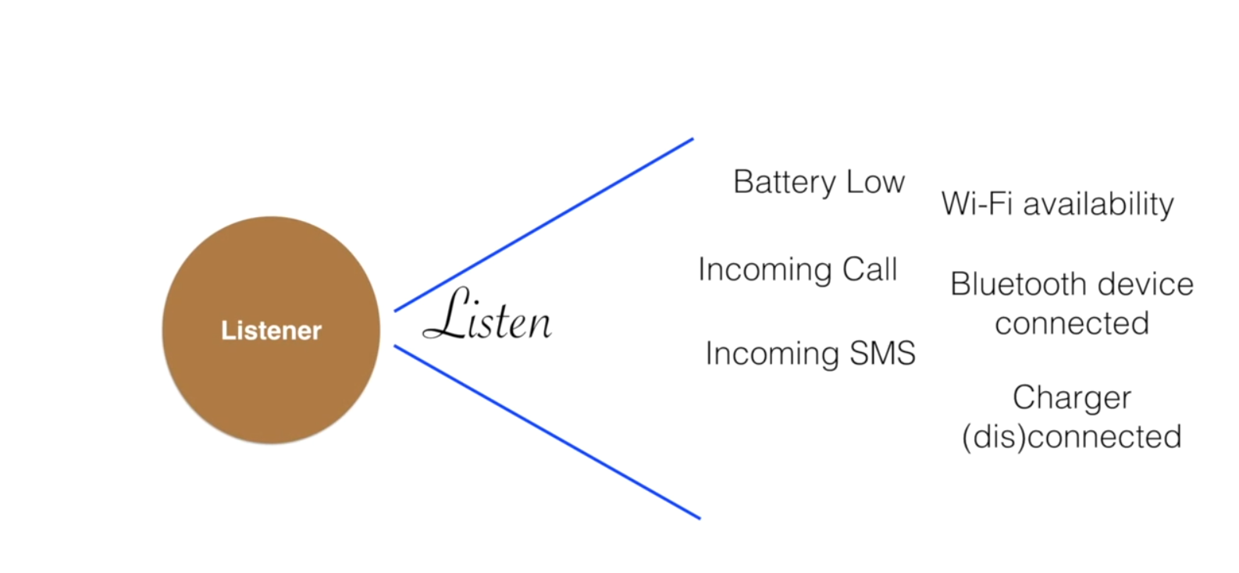

Slide 51
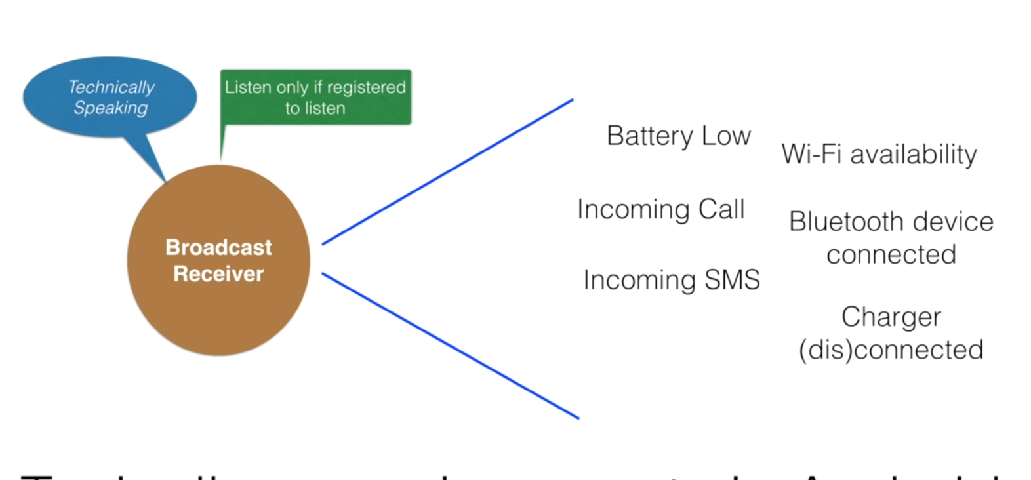

Slide 52
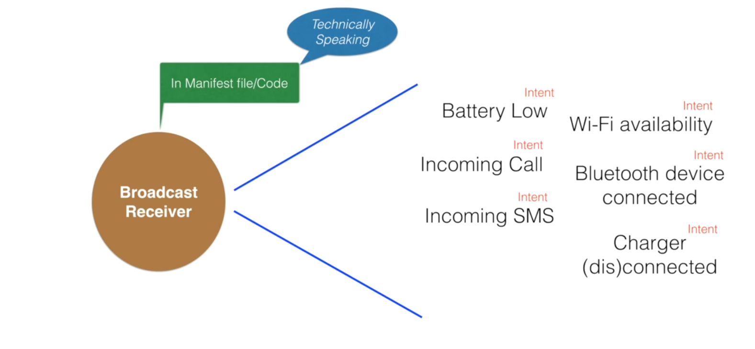
Register events in manifest file (static) or in code(dynamically)

Slide 53


Slide 54
Step One: Creating a Java class that extends Broadcast Receiver
package com.example.myapplication; import android.content.BroadcastReceiver; import android.content.Context; import android.content.Intent; import android.widget.Toast; public class BroadCastReceiver extends BroadcastReceiver { @Override public void onReceive(Context context, Intent intent) { Toast.makeText(context, "Incoming SMS", Toast.LENGTH_LONG).show(); } }

Slide 55
Step Two: Register the Broadcast Receiver
<?xml version="1.0" encoding="utf-8"?> <manifest xmlns:android="http://schemas.android.com/apk/res/android" package="com.example.myapplication"> <uses-permission android:name="android.permission.RECEIVE_SMS"></uses-permission> <application android:allowBackup="true" android:icon="@mipmap/ic_launcher" android:label="@string/app_name" android:roundIcon="@mipmap/ic_launcher_round" android:supportsRtl="true" android:theme="@style/Theme.MyApplication"> <activity android:name=".MainActivity" android:exported="true"> <intent-filter> <action android:name="android.intent.action.MAIN" /> <category android:name="android.intent.category.LAUNCHER" /> </intent-filter> </activity> <receiver android:name=".BroadCastReceiver" android:exported="true"> <intent-filter> <action android:name="android.provider.Telephony.SMS_RECEIVED"></action> </intent-filter></receiver> </application></manifest>

Slide 56
Your Turn
Learn how to register broadcast receiver in a code instead of manifest file
Android Notifications

Slide 57
END

