Slide 1
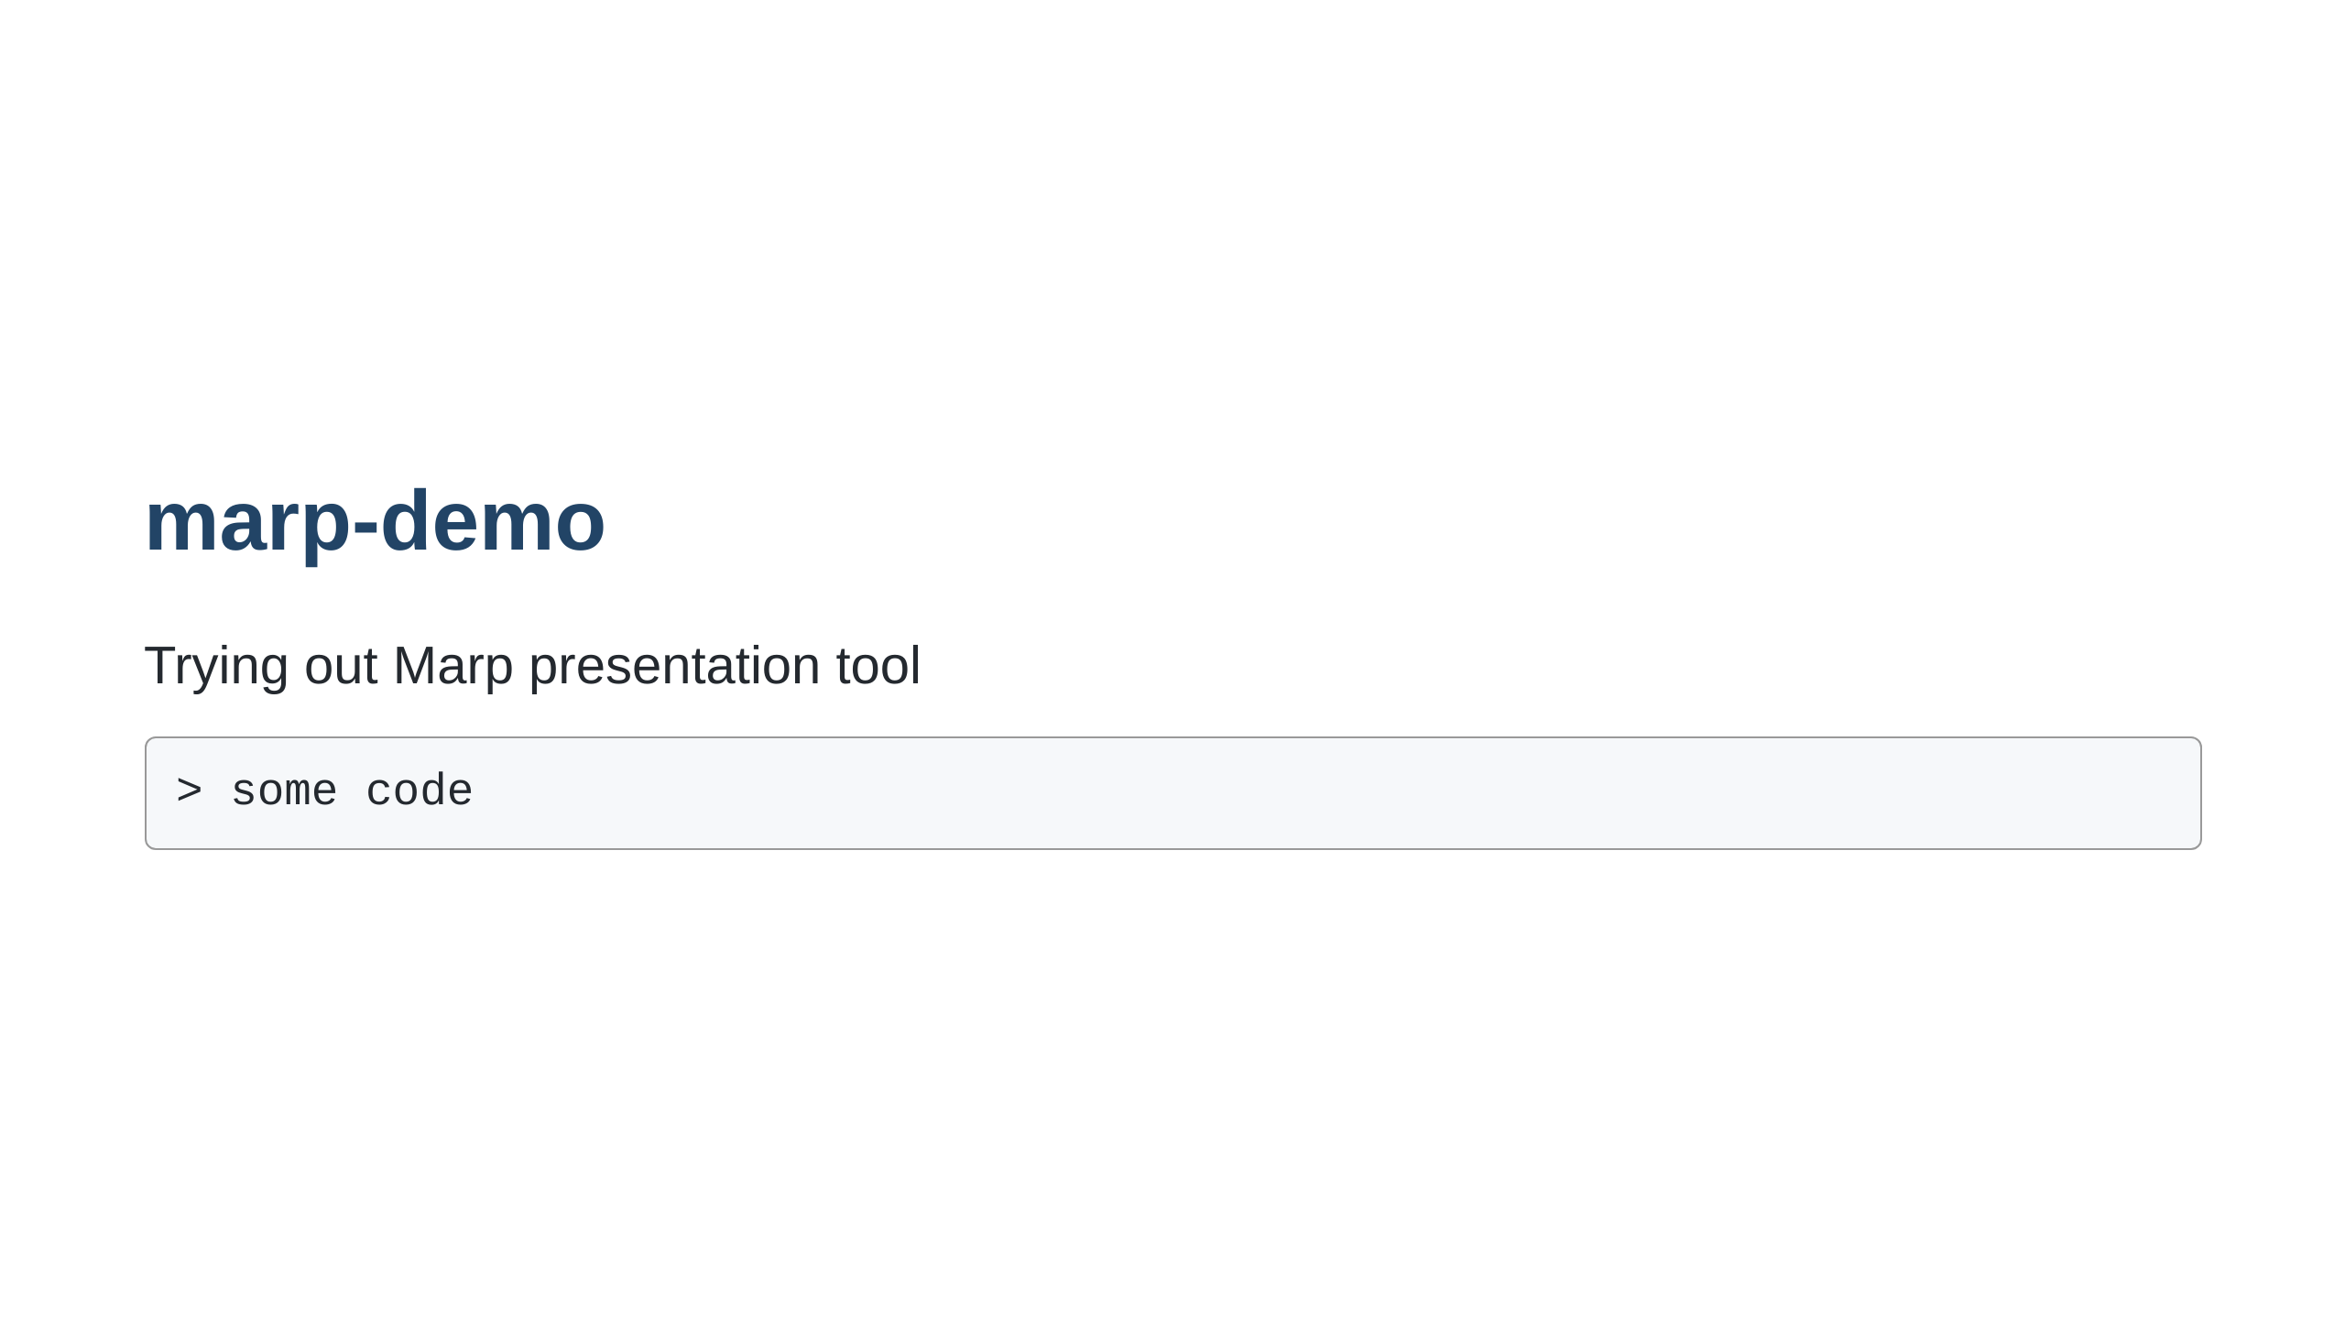
Notes:
Slide notes go here

Slide 2
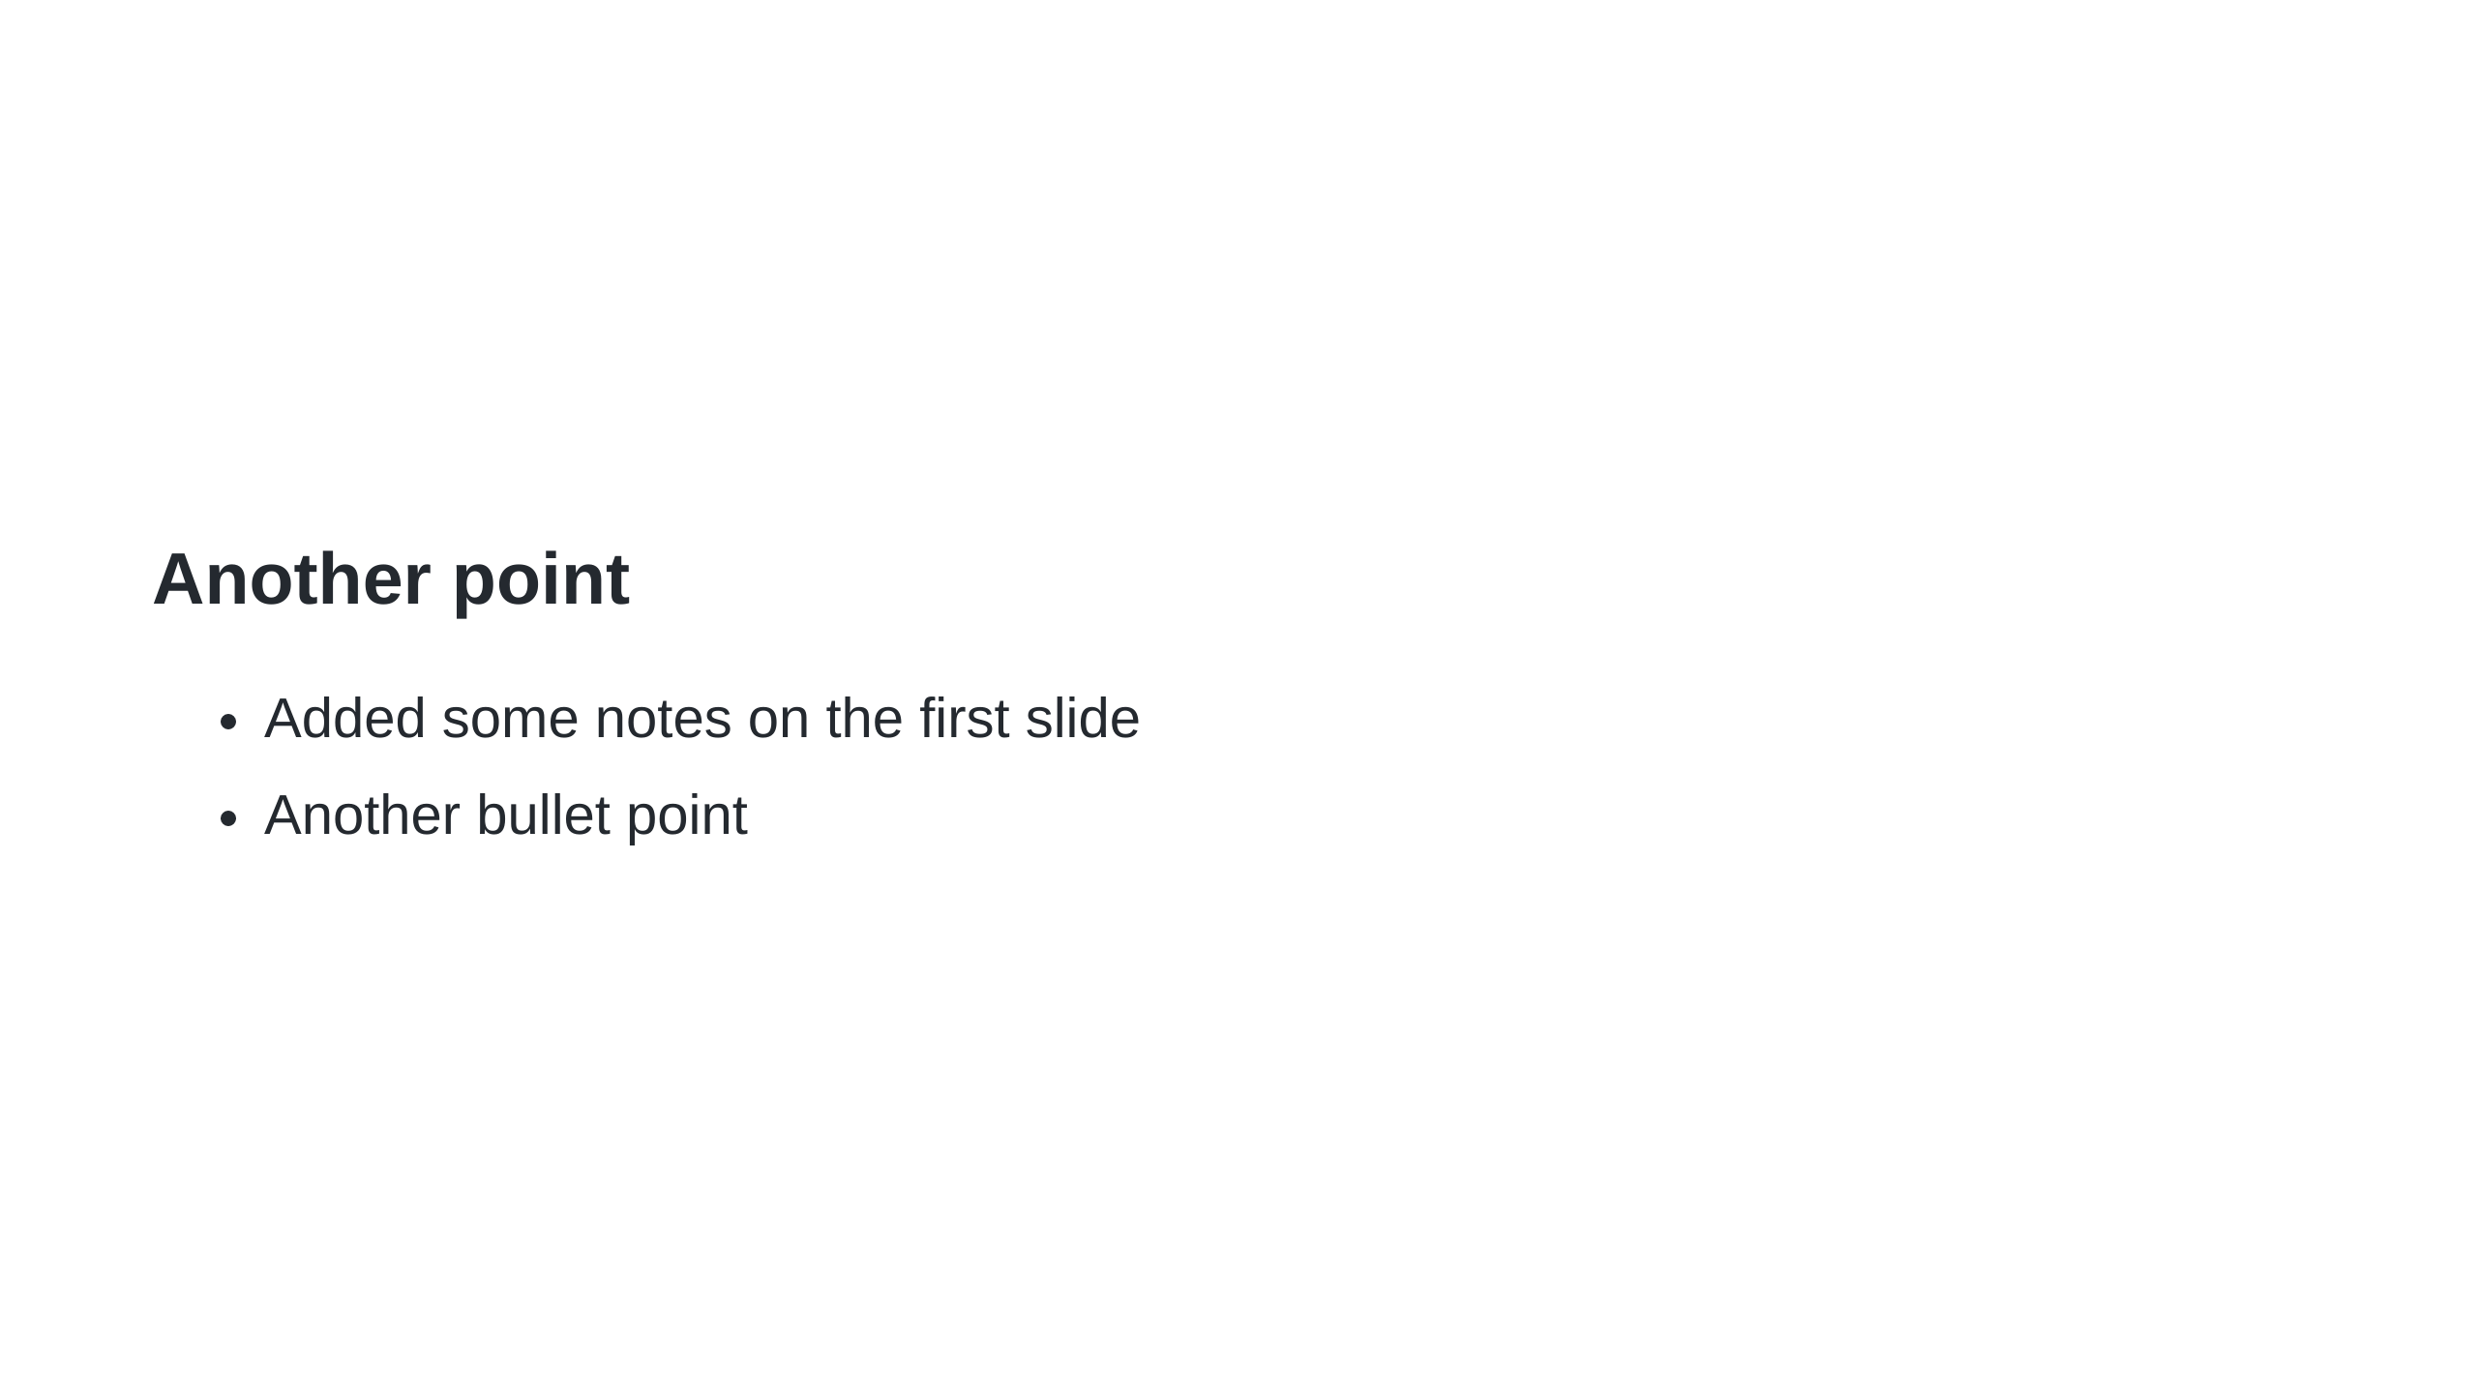
Notes:
HTML comment will recognize as presenter notes.

