Slide 1
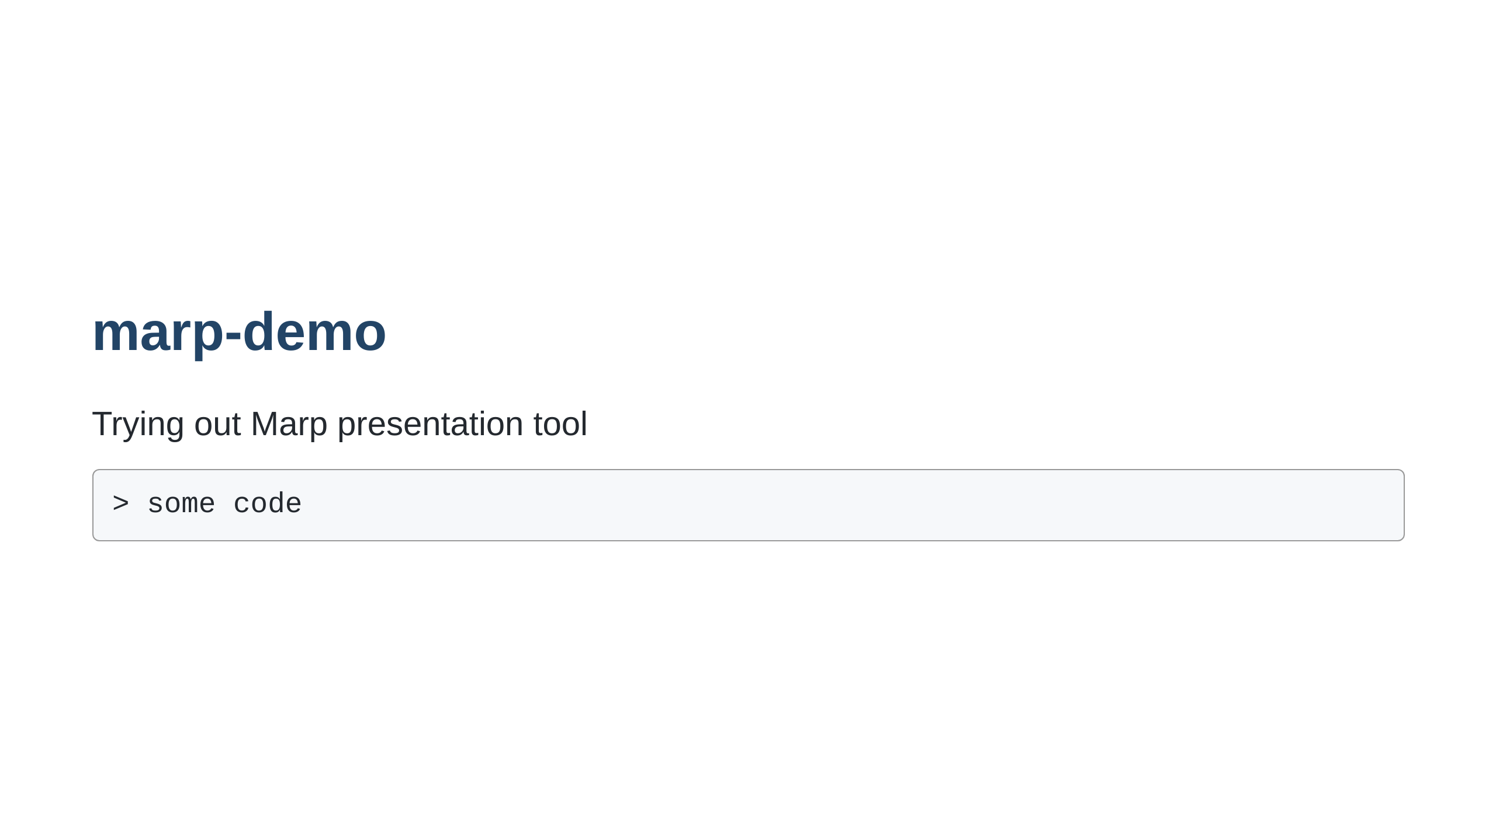
Notes:
Slide notes go here

Slide 2
