Slide 1
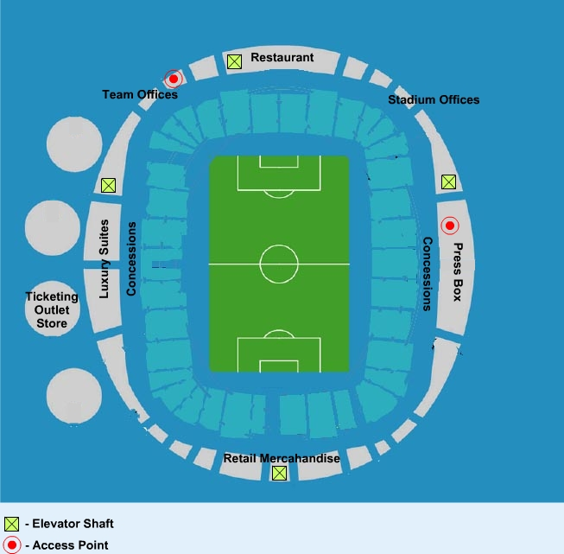
Restaurant
Suites
Press
Team offices & team areas
(lower levels)
offices
(lower levels)
Luxury Suites
Luxury Suites
Wireless AP
Concessions
Elevators
Notes:
Flash Designer Notes:
- This graphic will correspond with the “Access Points” button
- Please re-create the stadium drawing using standard Discovery colors

Slide 2
Restaurant
Suites
Press
Team offices & team areas
(lower levels)
offices
(lower levels)
Luxury Suites
Luxury Suites
Wireless AP
Concessions
Elevators
Notes:
Flash Designer Notes:
- This graphic will correspond with the “Interference” button
- Please re-create the stadium drawing using standard Discovery colors (using orange to highlight). Make orange areas less defined, with rounded edges.

