Slide 1
CHAPTER 5 · FOR PHYSIOTHERAPY
When the vessel breaks
Pathophysiology of non-traumatic intracerebral haemorrhage
Oxford Textbook of Stroke & Cerebrovascular Disease, OUP 2014
Chapter authors: Constanza Rossi & Charlotte Cordonnier
Notes:
[20 seconds. Do not start talking until you are standing still at the centre.]
Good evening. My chapter is Chapter 5 of the Oxford Textbook of Stroke: the pathophysiology of non-traumatic intracerebral haemorrhage.
Tonight I want to read it as physiotherapists: what the mechanism tells us about the patient in front of us.
But I want to start with one person.
[NEXT]

Slide 2
10 December 1996
7 a.m. · Jill Bolte Taylor, neuroanatomist, aged 37
“I woke up to a pounding pain behind my left eye.”
Source: Jill Bolte Taylor, "My stroke of insight", TED 2008.
Notes:
[About 35 seconds. Slow. This is a story, not a lecture.]
10 December 1996. Seven in the morning.
A 37-year-old scientist wakes up with a pounding pain behind her left eye. She thinks it's a headache. She climbs onto her exercise machine anyway.
Her name is Jill Bolte Taylor. She is a neuroanatomist at Harvard. She studies the brain for a living.
[PAUSE]
[NEXT]

Slide 3
10 December 1996
7 a.m. · Jill Bolte Taylor, neuroanatomist, aged 37
Within four hours she could not walk, talk, read or write.
Source: Jill Bolte Taylor, "My stroke of insight", TED 2008.
Notes:
[About 35 seconds. Let the red circle grow on screen before you speak.]
Over the next four hours, she watches her own brain fail. First her balance goes. Then her right arm. Then her speech. She tries to call for help, and the numbers on the phone look like squiggles.
A blood vessel had burst in the left side of her brain.
[ASK] Quick show of hands: who here has treated someone in the first week after a bleed like this?
[Look at the hands and say what you see: "Most of us" or "About half the room".]
Tonight is about what happened inside Jill's head, hour by hour.

Slide 4

WHY IT MATTERS
Systematic review · 36 studies · n = 8145
40%
die within a month of an intracerebral haemorrhage
No improvement from 1980 to 2008.
van Asch et al., Lancet Neurol 2010 (36 population studies, 8145 patients): median 1-month case fatality 40.4%.
Chapter 5 · Intracerebral haemorrhage
Vessel
Hours
Days
Bedside
4
Notes:
[About 40 seconds.]
Here is why it matters.
[PAUSE, point to the number]
Forty percent. That is how many people die within a month of an intracerebral haemorrhage.
And that number did not move between 1980 and 2008. In the same years, treatment for ischaemic stroke was transformed. For bleeds, outcomes stood still.
Part of the problem is how we think about a bleed. We treat it as one moment. The vessel bursts, the damage is done, and we wait.
[IF CHALLENGED: van Asch pooled 36 population-based studies up to 2008. Later registries show modest gains. Part of the old figure may be a self-fulfilling prophecy: early withdrawal of care (Becker, Neurology 2001).]

Slide 5
THE BIG IDEA
ICH is a process, not a moment
3
2
1
The vessel
The first hours
The days after
Each stage is a window to act.
Chapter 5 · Intracerebral haemorrhage
Vessel
Hours
Days
Bedside
5
Notes:
[About 45 seconds. This is your headline. Say the title slowly, then pause.]
Chapter 5 gives us a different view.
ICH is a process, not a moment.
[PAUSE]
It unfolds in three stages. The vessel decides where it bleeds. The first hours decide how big it gets. And over the following days, the blood itself keeps injuring the brain.
Watch the red circles grow. That is the bleed getting bigger with each stage.
Each stage is a window where we can act. We'll take them one at a time, then finish at the bedside.

Slide 6
TONIGHT
Four things you will be able to do
Explain
why a bleed keeps injuring the brain
Two ways to listen
Predict
the impairment and the risk of decline
THE TITLE
is the message. New to stroke? Hold on to it.
Appraise
the strength of each claim
THE TAG
Cohort · n = 1013
is the evidence. Experienced? Challenge it.
Apply
time and pace therapy to the stage
Chapter 5 · Intracerebral haemorrhage
Vessel
Hours
Days
Bedside
6
Notes:
[About 40 seconds.]
By the end of tonight you should be able to do four things.
Explain why a bleed keeps injuring the brain long after the vessel has burst.
Predict, from where the bleed is and how big it is, what impairments you'll see and when the patient is most likely to get worse.
Appraise how strong the evidence is behind each claim, mine included.
And apply it: time and pace your therapy to the stage the bleed is in.
[Point to the dark card.] There are two ways to listen tonight. Every slide title is the take-home message. If you're new to stroke, hold on to the titles. Many slides also carry a grey tag in the top corner: the study design and its main limit. If you've been doing this for years, challenge the tags. I'll take those challenges at the end.

Slide 7
01
The vessel
Why does a small artery give way?
Notes:
[5 seconds.]
Stage one. The vessel. Why does a small artery give way?

Slide 8
01 · THE VESSEL
Cohort · n = 1013 · one centre
Hypertension and amyloid cause over half
55%
two small-vessel diseases
SMASH-U: Meretoja et al., Stroke 2012 (n = 1013, Helsinki). Full breakdown on the handout.
Chapter 5 · Intracerebral haemorrhage
Vessel
Hours
Days
Bedside
8
Notes:
[About 45 seconds. Point, pause, explain.]
[Point to the two red bars. Say nothing for two seconds.]
This comes from the SMASH-U study: just over a thousand patients in Helsinki, each sorted by cause.
Two diseases stand out. Hypertension explained 35 percent. Amyloid angiopathy explained 20. Together, that is more than half of all bleeds. Both are diseases of small vessels.
Look at the grey bar second from the top. One in five bleeds had no clear cause, even after a full work-up. We still have gaps.
Why should a physiotherapist care about the cause? Because the cause predicts where it bleeds, and where it bleeds predicts what we'll see.
[IF CHALLENGED: one centre in Helsinki. "Undetermined" depends on how hard you look, so the categories shift with the work-up.]

Slide 9
01 · THE VESSEL
Two diseases, two sets of vessels
Healthy
Hypertension
Amyloid angiopathy
Thin wall, wide channel
Deep arteries: thick, brittle wall
Surface arteries: amyloid replaces muscle
Chapter 5 · Intracerebral haemorrhage
Vessel
Hours
Days
Bedside
9
Notes:
[About 60 seconds. Walk the audience left to right: look, see, imagine.]
Here is what those two diseases do to a small artery.
On the left is a healthy one: a thin wall and a wide channel.
In the middle is hypertension. It attacks the tiny perforating arteries deep in the brain. Years of high pressure make the wall thick and glassy, but also brittle. The little bulge at the top is a Charcot–Bouchard microaneurysm, first described in 1868. Whether these are the true point of rupture is still debated.
On the right is amyloid angiopathy. The dark dots are beta-amyloid. It builds up in arteries on the surface of the brain and replaces the muscle in the wall. The vessel loses its strength. This is mostly a disease of people over 55.
In plain words: high blood pressure makes the deep arteries stiff and brittle. Amyloid makes the surface arteries weak.

Slide 10
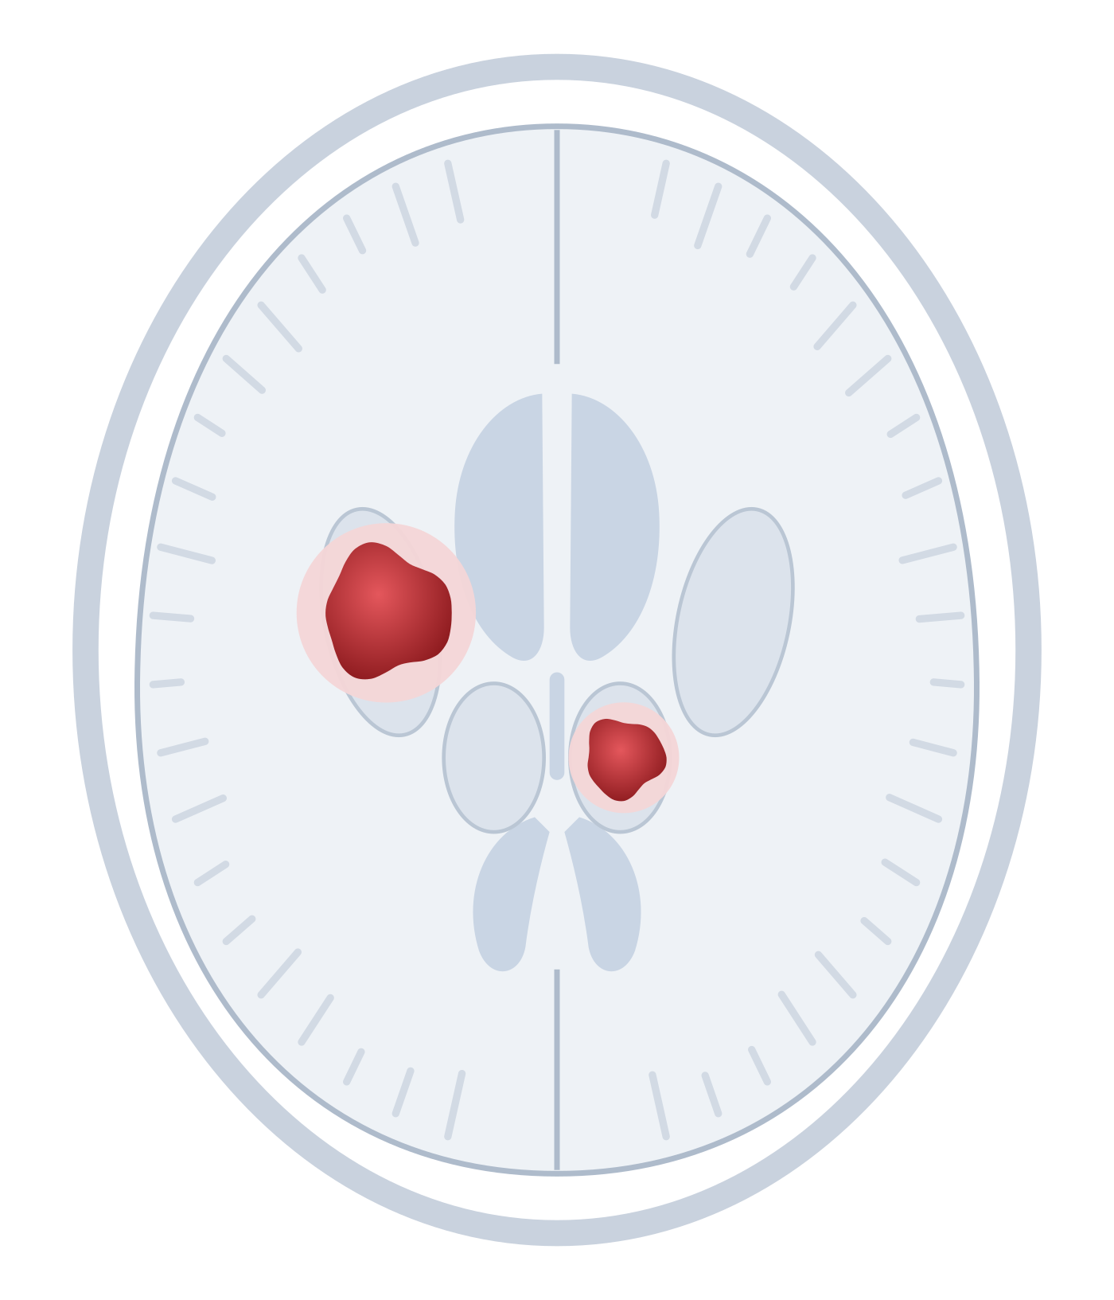
01 · THE VESSEL
Where it bleeds tells you why
Deep
→ hypertension
putamen · thalamus · pons · cerebellum
Schematic axial slice. The pons and cerebellum sit below this level.
Chapter 5 · Intracerebral haemorrhage
Vessel
Hours
Days
Bedside
10
Notes:
[About 30 seconds.]
That gives us a rule you can use tomorrow. Where it bleeds tells you why.
[Point to the two deep bleeds.]
These two are deep: the putamen and the thalamus. The pons and cerebellum count too. These are the territories of the perforating arteries. They branch at right angles off big, high-pressure trunks, so they take the full force of the blood pressure. Deep bleed: think hypertension.
[NEXT]

Slide 11
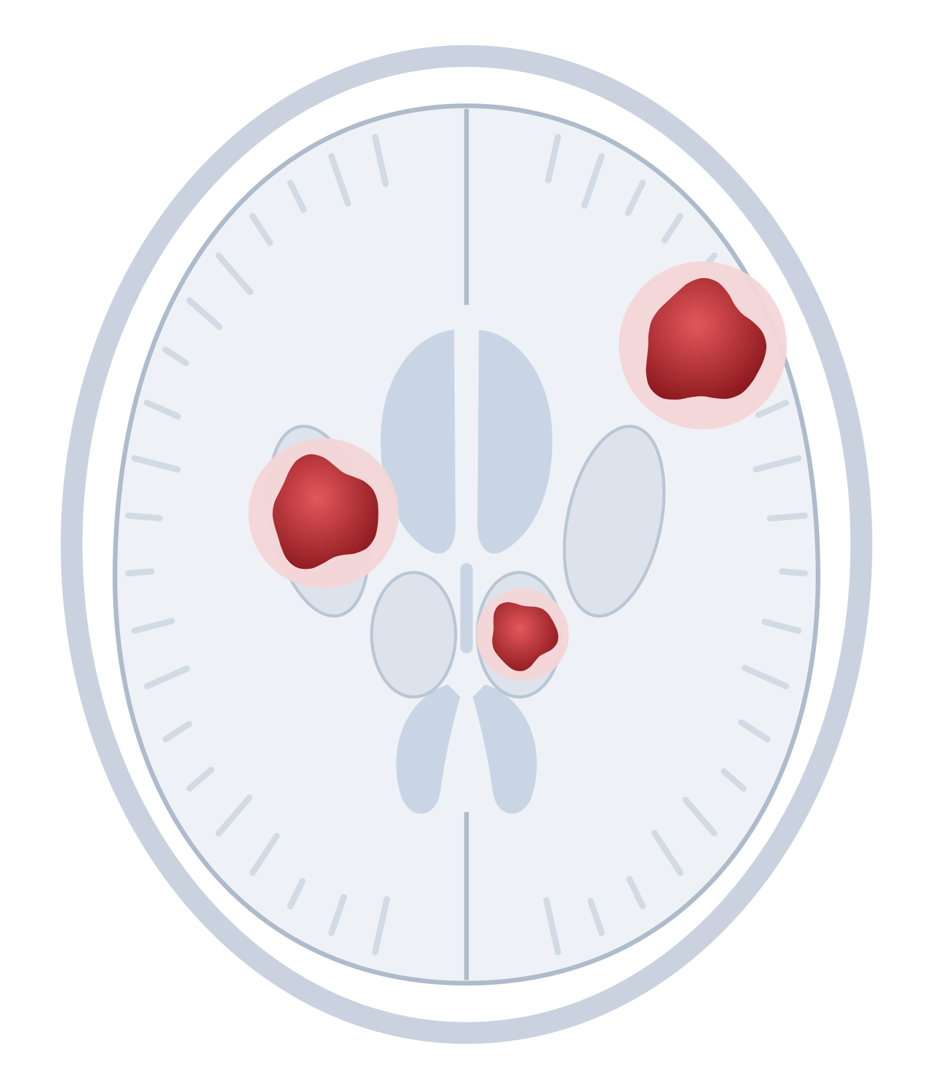
01 · THE VESSEL
Where it bleeds tells you why
Deep
→ hypertension
putamen · thalamus · pons · cerebellum
Lobar
→ amyloid (older adults)
Young or atypical? Look for a lesion.
Schematic axial slice. The pons and cerebellum sit below this level.
Chapter 5 · Intracerebral haemorrhage
Vessel
Hours
Days
Bedside
11
Notes:
[About 30 seconds. The new bleed appears near the surface.]
Now look near the surface. This one is lobar: in the cortex and the white matter just beneath it.
In an older adult, a lobar bleed points to amyloid angiopathy.
In a younger person, or when something looks unusual, it should make us suspicious. Keep that thought. We'll come back to Jill in a moment.
But first: what does location mean for us?

Slide 12
01 · THE VESSEL · WHAT YOU WILL SEE
PLIC: 3 imaging cohorts · n = 43–305
Location predicts the impairment
Putamen, internal capsule
Opposite-side weakness. Clot on the PLIC: worse motor outcome.
Thalamus
Opposite-side sensory loss, ataxia; later, central pain
Cerebellum
Same-side ataxia, truncal sway. Drowsy = emergency.
Pons
Often severe: four-limb weakness, cranial nerve signs
Lobar
By lobe: weakness, neglect, aphasia, field loss; seizures
Chapter 5 · Intracerebral haemorrhage
Vessel
Hours
Days
Bedside
12
Notes:
[About 60 seconds. The most practical slide for a physiotherapist. Go row by row.]
Location doesn't just tell you the cause. It predicts what you'll see on assessment.
Putamen and internal capsule: weakness on the opposite side. Look at the scan for the posterior limb of the internal capsule, the PLIC, where the motor fibres run. If the clot sits on it, the motor outcome tends to be worse.
Thalamus: sensory loss and ataxia on the opposite side, and sometimes, weeks later, central post-stroke pain.
Cerebellum: ataxia on the same side and truncal instability. This is also the bleed that can block CSF and press on the brainstem, so a cerebellar patient who becomes drowsy is an emergency.
Pons: often severe, with weakness in all four limbs and cranial nerve signs.
Lobar: it depends on the lobe: weakness, neglect, aphasia or field loss. Lobar bleeds also cause more seizures, because they involve the cortex.
[IF CHALLENGED: the PLIC evidence is three imaging cohorts. Puig 2019, n = 43: PLIC involvement plus a motor score above 6 gave an AUC of 0.89 (PPV 65%, NPV 92%). Murray 2025, 98 MISTIE III scans: PLIC overlap on routine CT predicted worse motor outcome, but agreement between readers was only moderate (kappa 0.45). Gupta 2025, n = 305, held up in a second cohort. A predictor, not a sentence.]

Slide 13
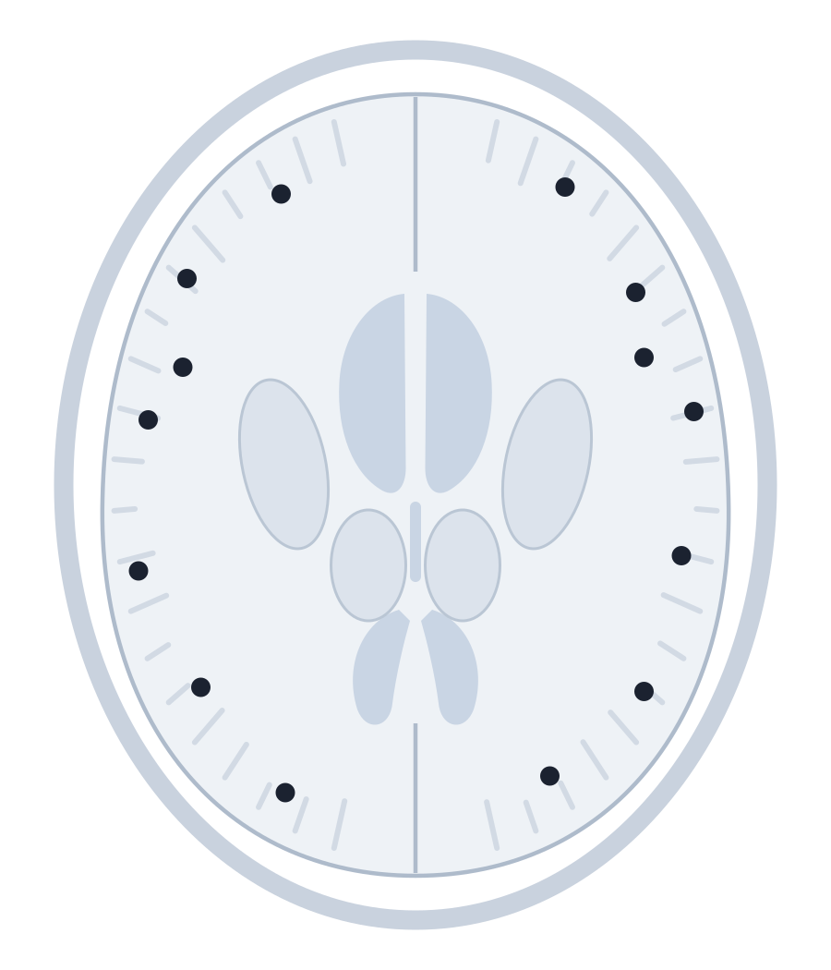
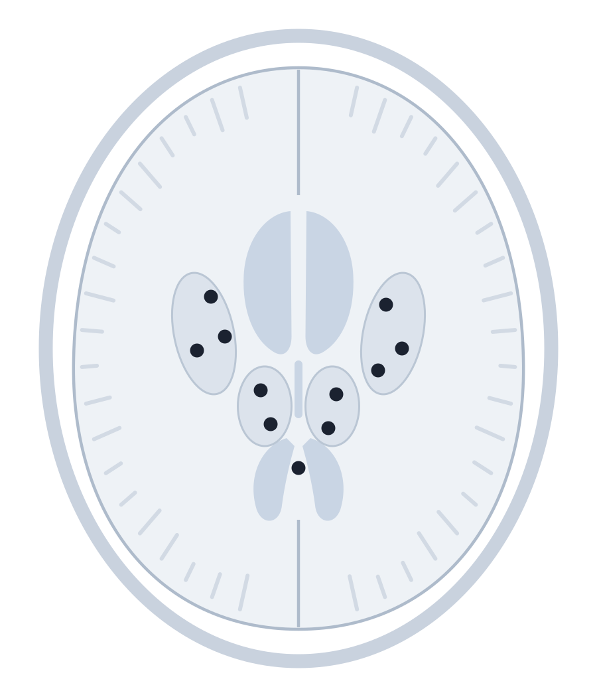
01 · THE VESSEL
Systematic review · mixed MRI methods
Microbleeds are the footprints
60%
of people with ICH have microbleeds on MRI
Surface
→ amyloid
Deep
→ hypertension
Healthy adults: 5%
Cordonnier, Al-Shahi Salman & Wardlaw, Brain 2007 (systematic review). Boston criteria on the handout.
Chapter 5 · Intracerebral haemorrhage
Vessel
Hours
Days
Bedside
13
Notes:
[About 40 seconds.]
MRI lets us see the footprints of these diseases. Microbleeds are tiny old leaks of blood. They show up as black dots.
Their pattern mirrors the big bleeds. Dots near the surface point to amyloid. Dots deep inside point to hypertension.
A systematic review led by Charlotte Cordonnier, one of this chapter's authors, found microbleeds in 60 percent of people with ICH. In healthy adults it was 5 percent.
The handout has the Boston criteria, which use these dots to diagnose amyloid angiopathy in a living patient.
[IF CHALLENGED: the 60% pools studies with different MRI sequences and field strengths. Newer sequences find more microbleeds, so the figure depends on the scanner.]

Slide 14



YOUR TURN · 30 SECONDS WITH YOUR NEIGHBOUR
Jill: primary or secondary?
37 years old
No hypertension
Lobar bleed
?
Chapter 5 · Intracerebral haemorrhage
Vessel
Hours
Days
Bedside
14
Notes:
[About 45 seconds. This is soft break 1, at about minute 6. Stop talking and let them work.]
Your turn.
Jill was 37. She had no history of high blood pressure. Her bleed was lobar.
[ASK] Primary small-vessel disease, or a secondary cause? Turn to the person next to you. Thirty seconds.
[Count to 30 in your head. Then ask two people for their answer.]
[NEXT]

Slide 15
YOUR TURN · 30 SECONDS WITH YOUR NEIGHBOUR
Prospective · n = 206 · one centre
Secondary: an arteriovenous malformation
37 years old
No hypertension
Lobar bleed
65%
0%
of patients like Jill had a lesion on angiography
if over 45, hypertensive, with a deep bleed
Zhu et al., Stroke 1997 (prospective; 206 patients, all had catheter angiography). Other secondary causes on the handout.
Chapter 5 · Intracerebral haemorrhage
Vessel
Hours
Days
Bedside
15
Notes:
[About 45 seconds.]
Secondary. Jill was born with an arteriovenous malformation, a tangle of vessels with no capillaries in between. That morning it ruptured.
Her profile was a textbook warning sign. In a prospective study of 206 patients who all had angiography, 65 percent of young, normotensive patients with a lobar bleed had a vascular lesion.
Now flip it. Over 45, hypertensive, with a deep bleed: the yield was zero.
Same test, completely different result. The patient's story tells you where to look. The handout lists the other secondary causes.
[IF CHALLENGED: one centre in Hong Kong, 1997, with catheter angiography for everyone. CT angiography has since changed how we screen, but the pattern still holds.]

Slide 16
02
The first hours
Rupture, growth and pressure
Notes:
[5 seconds.]
Stage two. The first hours. Jill had four of them. Let's see what happens in that time.

Slide 17
02 · THE FIRST HOURS
Autopsy series · mechanism, not frequency
One rupture can trigger more
›
›
›
1
Rupture
2
Haematoma
3
Avalanche
4
Tamponade
Fisher CM, J Neuropathol Exp Neurol 1971: secondary bleeding points at the edge of the haematoma.
Chapter 5 · Intracerebral haemorrhage
Vessel
Hours
Days
Bedside
17
Notes:
[About 45 seconds. Move left to right.]
One: a diseased vessel ruptures, with arterial pressure behind it.
Two: blood splits the tissue and a haematoma forms.
Three is the surprise. In 1971, Miller Fisher looked at these bleeds under the microscope. He found extra bleeding points around the edge. The growing clot stretches and tears the vessels around it, and they bleed too. He called it an avalanche.
Four: the bleeding stops when the pressure in the tissue and the clotting system finally win.
[IF CHALLENGED: Fisher's evidence is autopsy. It shows a mechanism, not how often it happens. The CT data on the next slide show how often.]
So how often does the bleeding keep going?

Slide 18
YOUR TURN · HANDS UP
How many bleeds keep growing?
5 in 100
A
15 in 100
B
40 in 100
C
Each dot = one patient, scanned within 3 hours of onset
Chapter 5 · Intracerebral haemorrhage
Vessel
Hours
Days
Bedside
18
Notes:
[About 30 seconds. Soft break 2, at about minute 9.]
[ASK] Here are 100 patients, all scanned within three hours of onset.
How many of their bleeds keep growing?
Hands up for A, five. [pause] B, fifteen. [pause] C, forty.
[Say what you see: "Most of you went for B."]
[NEXT]

Slide 19
YOUR TURN · HANDS UP
Prospective · n = 103 · within 3 h
38 in 100 keep growing
26 grew within the first hour
12 more grew within 20 hours
62 did not grow substantially
Jill: four hours
from headache to losing her speech
Each dot = one patient, scanned within 3 hours of onset
Brott et al., Stroke 1997 (n = 103; growth > 33%). Every 10% of growth: +5% hazard of death (Davis et al., Neurology 2006).
Chapter 5 · Intracerebral haemorrhage
Vessel
Hours
Days
Bedside
19
Notes:
[About 45 seconds. Wait for the dots to finish colouring before you speak.]
[PAUSE]
Thirty-eight.
In Brott's study, 26 bleeds grew by more than a third within one hour of the first scan. Another 12 grew within twenty hours. That's 38 in 100, and the growth went with neurological decline.
This is Jill's four hours. The damage kept spreading because the bleed kept growing.
It also changes outcomes. In a later analysis, every 10 percent of growth raised the risk of death by 5 percent. Those at highest risk were people scanned early, those with large bleeds, those on anticoagulants, and those with a spot sign on CT angiography.
For us, this is why neuro observations come before any handling in the first day.
[IF CHALLENGED: Brott enrolled 103 patients within 3 hours and defined growth as more than a third. Later studies often use 6 mL or 33%, so rates vary with the definition and with how early the first scan is.]

Slide 20

02 · THE FIRST HOURS
Cohort · n = 188 · 1990s care
Jill's clot was the size of a golf ball
A golf ball ≈ 40 mL
60 mL
60 mL + GCS ≤ 8: 91% predicted 30-day mortality
A clot that grows by a third looks only 10% wider on a scan.
Volume: Broderick et al., Stroke 1993 (Cincinnati, n = 188). A regulation golf ball is 42.7 mm across (about 40.7 mL).
Chapter 5 · Intracerebral haemorrhage
Vessel
Hours
Days
Bedside
20
Notes:
[About 60 seconds. THE PROP MOMENT. Take the golf ball out of your pocket before you say anything. Hold it up. Let them look.]
[PROP] Jill's surgeons removed a clot this size. A golf ball.
A golf ball holds about 40 millilitres.
[Point to the dashed circle.] Now grow it to 60 millilitres. That's the dashed line. It barely looks bigger, does it?
Here is the thing nobody tells you. A clot that grows by a third looks only about 10 percent wider on a scan. Growth that small is easy to miss by eye. The patient still feels every millilitre.
At 60 millilitres, with a Glasgow Coma Scale of 8 or less, the Cincinnati study predicted a 30-day mortality of 91 percent.
[Put the ball down where everyone can still see it.]
[IF CHALLENGED: these figures come from 1990s care, when early withdrawal of support was common, so a prognostic score can become a self-fulfilling prophecy (Becker 2001). Use scores to inform, never to decide.]

Slide 21
02 · THE FIRST HOURS
Review of cohort data
The skull is a closed box
Shift and herniation
≈45%
Raised pressure
Compression
The clot
break into the ventricles
→ hydrocephalus, worse outcome
Hanley, Stroke 2009.
Chapter 5 · Intracerebral haemorrhage
Vessel
Hours
Days
Bedside
21
Notes:
[About 45 seconds.]
Why does volume matter so much? Because the skull is a closed box.
[Trace the rings from the centre outwards.] The clot compresses the tissue around it. As the volume grows, the pressure inside the skull rises. If it keeps rising, the brain shifts and can herniate.
Then there are the ventricles. About 45 percent of bleeds break into them. Blood there can block the flow of cerebrospinal fluid and cause hydrocephalus. It also predicts a worse outcome on its own.
At the bedside, hydrocephalus looks like drowsiness, headache and vomiting. Hold that thought.

Slide 22
03
The days after
When the blood becomes a toxin
Notes:
[5 seconds.]
Stage three. The bleeding has stopped. The injury has not.

Slide 23
03 · THE DAYS AFTER
Serial CT · hyperacute ICH
Oedema builds in waves
Hours
Days 1–2
Day 3+
Weeks
Clot retracts
Thrombin
Iron
Clearance
+75% oedema in the first 24 hours
Jill: surgery 17 days later
Xi, Keep & Hoff, Lancet Neurol 2006; Gebel et al., Stroke 2002.
Chapter 5 · Intracerebral haemorrhage
Vessel
Hours
Days
Bedside
23
Notes:
[About 55 seconds. Move along the timeline.]
Swelling around the clot builds in waves.
In the first hours, the clot retracts, like a blood sample settling in a tube, and squeezes serum into the tissue.
Over the first two days, the clotting cascade makes thrombin. Thrombin opens the blood-brain barrier.
From about day three, the red cells break down and release iron.
Over the following weeks, scavenger cells clear the clot and leave a cavity behind.
In one study, oedema grew by about 75 percent in the first 24 hours alone. It can keep building into the second week.
Jill's surgery came 17 days later. Her clot was still pressing on her language centres.
So the days after are not a safe plateau. The tissue around the clot is still under attack.

Slide 24



03 · THE DAYS AFTER
Mostly animal models · not yet a treatment
Three toxins, one result
Thrombin
Iron
Inflammation
Leaky barrier → more oedema → neuronal death
Xi, Keep & Hoff, Lancet Neurol 2006. The deferoxamine trial i-DEF (Selim, Lancet Neurol 2019) was neutral.
Chapter 5 · Intracerebral haemorrhage
Vessel
Hours
Days
Bedside
24
Notes:
[About 45 seconds.]
Three toxins drive this second wave of injury. In plain words: the blood itself is toxic. Most of what we know comes from animal studies, well summarised by Xi, Keep and Hoff.
Thrombin comes first. We need it to stop the bleed, but at high levels it damages the barrier and kills cells.
Iron comes later. Once the red cells burst, iron is released and fuels free radicals.
Inflammation runs through the whole period. Immune cells arrive within hours and stay for days.
[Point to the dark bar.] All three end in the same place: a leaky barrier, more swelling and more dead neurons. That is why patients can get worse days after the bleeding stopped.
[IF CHALLENGED: this is mostly rat and pig data. The best human test so far, i-DEF with deferoxamine (2019), was neutral. Mechanism is not yet treatment.]

Slide 25
YOUR TURN · TRUE OR FALSE?
True or false?
“The rim around the clot is starving tissue.”
Chapter 5 · Intracerebral haemorrhage
Vessel
Hours
Days
Bedside
25
Notes:
[About 30 seconds. Soft break 3, at about minute 14.]
[ASK] True or false?
The dark rim around the clot is starving tissue, like the penumbra in an ischaemic stroke.
Hands up for true.
[Count the hands. Say what you see.]
This matters, because for years people worried that lowering blood pressure would starve that rim.
[NEXT]

Slide 26
YOUR TURN · TRUE OR FALSE?
PET n = 19, then RCT n = 75
False: the rim is resting, not starving
“The rim around the clot is starving tissue.”
Rim vs the same area on the other side (PET)
Lowering BP below 150 did not reduce flow around the clot (ICH ADAPT).
Zazulia et al., J Cereb Blood Flow Metab 2001 (n = 19, 5–22 h after onset); Butcher et al., Stroke 2013.
Chapter 5 · Intracerebral haemorrhage
Vessel
Hours
Days
Bedside
26
Notes:
[About 40 seconds. Point, pause, explain.]
False.
Zazulia and colleagues scanned 19 patients with PET, 5 to 22 hours after onset. [Point to the first pair of bars.] Blood flow in the rim was low, at 56 percent of the other side. [Point to the second pair.] But oxygen use was even lower, at 48 percent. The tissue is resting, not starving.
The practical proof came in the ICH ADAPT trial. Lowering systolic pressure below 150 did not reduce blood flow around the clot.
For us: follow the medical team's blood pressure targets during activity. The rim isn't starving, but pressure still matters for growth.
[IF CHALLENGED: PET in 19 patients shows a mechanism. ICH ADAPT (n = 75) then tested it in a trial, but its endpoint was blood flow on CT perfusion, not function.]

Slide 27
04
At the bedside
What it means for physiotherapy
Notes:
[5 seconds.]
So what does all this mean for physiotherapy? Let's follow the patient through time: the first hours, the days after, and the months of recovery.

Slide 28
04 · AT THE BEDSIDE · WHEN TO START
RCTs · mostly small · low certainty
Early helps; very early and intense may not
AVERT 2015 · RCT · n = 2104 · infarcts and bleeds
High dose within 24 h: fewer good outcomes (46% vs 50%)
Liu 2014 · RCT · n = 243 · ICH
Rehab started within 48 h: better MBI, fewer deaths
Yen 2019 · RCT · n = 60 · mild to moderate ICH
Out of bed at 24–72 h: better FIM-motor and walking
0 h
24 h
48 h
72 h
Short and frequent did better than long sessions (AVERT dose analysis)
Certainty: low (17 RCTs, Kan 2026)
Bernhardt, Lancet 2015 and Neurology 2016 · Liu, Stroke 2014 · Yen, Neurorehabil Neural Repair 2019 · Kan, Medicine 2026.
Chapter 5 · Intracerebral haemorrhage
Vessel
Hours
Days
Bedside
28
Notes:
[About 60 seconds. This is a timeline of when therapy started. Point to each bar.]
When should we start? Three trials, three time windows.
[Point to the red bar.] AVERT, the biggest: over 2000 patients, infarcts and bleeds. High-dose mobilisation within the first 24 hours led to fewer good outcomes: 46 percent against 50.
[Point to the second bar.] Liu: 243 patients with ICH in China. Rehabilitation started within 48 hours improved function at six months, and fewer patients died.
[Point to the third bar.] Yen: 60 patients with mild to moderate ICH. Getting them out of bed between 24 and 72 hours improved motor function and walking, and it did not destabilise blood pressure.
[Point to the dark bar.] Two lessons. Within AVERT, shorter, more frequent sessions did better than longer ones. And a 2026 meta-analysis of 17 trials rated the certainty as low.
So: early, short and frequent, once the team says the patient is stable. Not big, and not in the first hours.
[IF CHALLENGED: Liu's hazard ratio of 4.44 has a 95% confidence interval from 1.24 to 15.87. Few deaths, so read it as a signal, not an effect size. AVERT's ICH subgroup leaned towards usual care, but the interaction was not significant. The dose analysis is observational within the trial (Class III). In Kan 2026, safety outcomes such as rebleeding and falls were too poorly reported to pool.]

Slide 29
YOUR TURN · CLINICAL REASONING
Day 4: drowsier than yesterday
MR K, 68 · A COMPOSITE CASE
TODAY, 9 A.M.
Left putaminal bleed, 22 mL
GCS 13
New headache
Long-standing hypertension
Vomited once
BP 184/98
Yesterday: sat out 20 min, GCS 15
Planned: sit-to-stand practice. What do you do?
A
Go ahead, but shorter
B
Bed-level work only
C
Hold and escalate
Chapter 5 · Intracerebral haemorrhage
Vessel
Hours
Days
Bedside
29
Notes:
[About 50 seconds. Soft break 4, at about minute 17. Read the case slowly.]
Let's put it together. Mr K is 68, with long-standing hypertension. He has a left putaminal bleed of 22 millilitres: about half a golf ball. Yesterday he sat out for 20 minutes with a GCS of 15.
Today, at 9 a.m., his GCS is 13. He has a new headache. He's vomited once. His blood pressure is 184 over 98.
You'd planned sit-to-stand practice.
[ASK] A: go ahead, but shorter. B: bed-level work only. C: hold the session and escalate. Hands up, or type it in the chat.
[Say what you see.]

Slide 30
YOUR TURN · CLINICAL REASONING
C: hold the session and escalate
1
2
3
4
Notice
›
Interpret
›
Act
›
Reflect
GCS down 2. New headache, vomiting, BP up.
Day 4: oedema still building. Or growth? Hydrocephalus?
Stop. Tell the medical team now. Repeat neuro obs.
The timeline predicted this. Screen before every session.
Repeat before every session
Reasoning cycle adapted from Levett-Jones et al., Nurse Educ Today 2010. A fall of 2+ GCS points is a common research definition of deterioration.
Chapter 5 · Intracerebral haemorrhage
Vessel
Hours
Days
Bedside
30
Notes:
[About 50 seconds. Walk the loop left to right.]
C. Hold and escalate.
Here is the reasoning, using the clinical reasoning cycle.
Notice: his GCS has dropped two points, and he has a new headache, vomiting and higher blood pressure. A drop of two GCS points is a common research definition of neurological deterioration.
Interpret: this is day 4. Oedema is still building. It could also be growth, or hydrocephalus, the closed box from earlier. Working out which is the medical team's job, not ours.
Act: stop, tell the medical team now, and repeat the neuro obs.
Reflect: the timeline predicted this. That's why we screen before every session, every day, and why "not today" is a clinical decision, not a failure.
[If a junior asks "what if it's subtle?": same answer. If you're unsure, don't start; ask.]

Slide 31
PROGNOSIS · DO BLEEDS RECOVER BETTER?
Observational · confounded by severity
It depends what you match
ICH worse
No difference
ICH better
Kelly 2003 · n = 1064
unmatched
MATCH ON THE DEFICIT
ICH looks better
Paolucci 2003 · n = 270
matched on the deficit
More of the deficit is pressure, and pressure resolves.
Salvadori 2020 · n = 229
unmatched
MATCH ON THE LESION
Oosterveer 2022 · n = 360
unmatched
ICH looks worse
Balk 2026 · n = 194
matched on lesion size and site
The blood itself is toxic.
Each dot shows the direction of the main finding, not its size. Full citations on the reference slides.
Chapter 5 · Intracerebral haemorrhage
Vessel
Hours
Days
Bedside
31
Notes:
[About 60 seconds. Point, pause, explain.]
Families ask us this: do bleeds recover better than strokes from a clot? You'll hear "yes" on the ward. The evidence says: it depends what you match.
[Point to the grey dots.] Unmatched studies disagree. Kelly found bleeds gained more. Two newer studies found no difference.
[Point to the dark dot.] Paolucci matched patients on how severe the deficit was. Bleeds did better: two and a half times the odds of a big gain.
[Point to the red dot.] Balk, this year, matched on lesion size and location instead. Bleeds did worse.
Both fit Chapter 5. Match on the deficit, and more of a bleed's deficit is pressure, which can resolve as the clot clears. Match on the lesion, and the blood itself is toxic, so the same-sized lesion does more harm.
For your patient: don't promise a better recovery because it's a bleed, and don't set a ceiling early. A 2026 systematic review found a severe early motor deficit after a deep bleed is not a fixed ceiling. In severe putaminal bleeds, most gains came in the first four months.
[IF CHALLENGED: all observational. Survivors only, because about 40% die. ICH patients start lower, so they have more room to gain on Barthel and FIM, which have ceiling effects. Paolucci OR 2.48 (95% CI 1.19–5.20); Balk mRS shift OR 1.69 (1.02–2.79) favouring infarct.]

Slide 32


04 · AT THE BEDSIDE
Every stage is a window to act
The vessel
Know the cause. Check BP before, during and after activity.
Before and after
The first hours
Neuro obs first. Short, gentle sessions; nothing intense.
First 24–72 hours
The days after
Screen every session. Expect ups and downs. Drowsy: escalate.
Days to weeks
The months after
No early ceiling. Target what the location predicts.
Weeks to months
Chapter 5 · Intracerebral haemorrhage
Vessel
Hours
Days
Bedside
32
Notes:
[About 55 seconds. The heart of the talk. Slow down.]
So every stage is a window, and each one gives us a physiotherapy job.
The vessel: know the cause, because it predicts where the bleed is and the risk of another one. Check blood pressure before, during and after activity.
The first hours: neuro obs before you move anyone. Short, gentle sessions. Nothing intense in the first 24 hours.
The days after: screen before every session. Expect fluctuation. New drowsiness means stop and escalate.
The months after: don't set a ceiling early. Use the location, and the internal capsule, to target your therapy.

Slide 33
SUMMARY
If you remember three things
1
The vessel decides where it bleeds.
2
The first hours decide how big it gets.
3
The blood keeps injuring the brain for days.
Chapter 5 · Intracerebral haemorrhage
Vessel
Hours
Days
Bedside
33
Notes:
[About 30 seconds. Read each line slowly. Pause between them.]
If you remember three things from tonight:
The vessel decides where it bleeds.
The first hours decide how big it gets.
The blood keeps injuring the brain for days.

Slide 34
EIGHT YEARS LATER
Jill walked onto the TED stage holding a human brain.
ICH is a process,
not a moment.
Which claim would you challenge?
Notes:
[About 45 seconds, then questions. Bookend: return to Jill.]
Back to Jill.
It took her eight years to recover. Then, in 2008, she walked onto the TED stage holding a real human brain and told millions of people what it felt like from the inside.
Her bleed was not a moment. It was a process, and so was her recovery.
ICH is a process, not a moment.
[PAUSE for three full seconds.]
Thank you. Which claim tonight would you challenge?
[If the room is quiet, wait five seconds. Then ask: "Which of these windows do we meet most often, and are we timing our assessments around it?"]

Slide 35
SOURCES
References: the chapter story
1. Rossi C, Cordonnier C. Pathophysiology of non-traumatic intracerebral haemorrhage. In: Norrving B, ed. Oxford Textbook of Stroke and Cerebrovascular Disease. OUP; 2014: ch. 5.
2. Taylor JB. My stroke of insight. TED 2008; and My Stroke of Insight (book), 2006.
3. van Asch CJ, et al. Lancet Neurol 2010;9:167–176.
4. Meretoja A, et al. SMASH-U. Stroke 2012;43:2592–2597.
5. Cordonnier C, Al-Shahi Salman R, Wardlaw J. Brain 2007;130:1988–2003.
6. Zhu XL, Chan MS, Poon WS. Stroke 1997;28:1406–1409.
7. Fisher CM. J Neuropathol Exp Neurol 1971;30:536–550.
8. Brott T, et al. Stroke 1997;28:1–5.
9. Davis SM, et al. Neurology 2006;66:1175–1181.
10. Broderick JP, et al. Stroke 1993;24:987–993.
11. Hanley DF. Stroke 2009;40:1533–1538.
12. Gebel JM, et al. Stroke 2002;33:2631–2635.
13. Xi G, Keep RF, Hoff JT. Lancet Neurol 2006;5:53–63.
14. Zazulia AR, et al. J Cereb Blood Flow Metab 2001;21:804–810.
15. Butcher KS, et al. (ICH ADAPT). Stroke 2013;44:620–626.
Notes:
[Leave this up during questions if people want the sources. Everything is also on the handout.]

Slide 36
SOURCES
References: physiotherapy evidence
1. Bernhardt J, et al. AVERT. Lancet 2015. doi:10.1016/S0140-6736(15)60690-0
2. Bernhardt J, et al. AVERT dose–response. Neurology 2016. doi:10.1212/WNL.0000000000002459
3. Liu N, et al. Stroke 2014. doi:10.1161/STROKEAHA.114.005661
4. Yen HC, et al. Neurorehabil Neural Repair 2019. doi:10.1177/1545968319893294
5. Yen HC, et al. Medicine 2021. doi:10.1097/MD.0000000000026128
6. Kan TQ, et al. Medicine 2026. doi:10.1097/MD.0000000000050253
7. Kelly PJ, et al. Arch Phys Med Rehabil 2003. doi:10.1016/S0003-9993(03)00040-6
8. Paolucci S, et al. Stroke 2003. doi:10.1161/01.STR.0000102902.39759.D3
9. Salvadori E, et al. Diagnostics 2020. doi:10.3390/diagnostics11010038
10. Oosterveer DM, et al. J Stroke Cerebrovasc Dis 2022. doi:10.1016/j.jstrokecerebrovasdis.2021.106294
11. Balk S, et al. Neurol Res Pract 2026. doi:10.1186/s42466-026-00456-w
12. Puig J, et al. AJNR Am J Neuroradiol 2019. doi:10.3174/ajnr.A6038
13. Murray ON, et al. Eur Stroke J 2025. doi:10.1177/23969873251332769
14. Gupta S, et al. Front Neurol 2025. doi:10.3389/fneur.2024.1475444
15. Yoo HD, et al. Severe early motor deficit and recovery ceiling. Cerebrovasc Dis 2026.
16. Selim M, et al. i-DEF. Lancet Neurol 2019;18:428–438.
17. Becker KJ, et al. Neurology 2001;56:766–772.
18. Levett-Jones T, et al. Nurse Educ Today 2010;30:515–520.
Notes:
[The physiotherapy evidence, with DOIs. Go here if someone asks for a source during questions.]

Slide 37






BACKUP · IF ASKED
Other causes of a secondary bleed
Vascular malformations
Antithrombotic drugs
Tumours
Venous thrombosis
Haemorrhagic transformation
Drugs, vasculitis, RCVS, moyamoya
Chapter 5 · Intracerebral haemorrhage
Vessel
Hours
Days
Bedside
37
Notes:
[Backup, hidden. Type its slide number and press Enter to jump here if someone asks about other causes.]
With every bleed, ask whether something else caused it. Vascular malformations like Jill's AVM. Antithrombotic drugs, which make bleeds bigger and longer-lasting. Tumours. Venous thrombosis. Haemorrhagic transformation of an infarct. And a mixed group: cocaine, amphetamines, vasculitis, reversible vasoconstriction, moyamoya and clotting disorders.

Slide 38
BACKUP · BEYOND THE 2014 CHAPTER
What has changed since the book
2022
Boston criteria v2.0
2023
INTERACT3
White-matter MRI markers added
Care bundle improved 6-month function
2024
ENRICH
2024
ANNEXA-I
Early minimally invasive surgery helped lobar bleeds
Andexanet: better haemostasis, more thrombosis
Charidimou, Lancet Neurol 2022 · Ma, Lancet 2023 · Pradilla, NEJM 2024 · Connolly, NEJM 2024.
Chapter 5 · Intracerebral haemorrhage
Vessel
Hours
Days
Bedside
38
Notes:
[Backup, hidden. Show only if someone asks what has changed since the book came out in 2014.]
Four updates. In 2022 the Boston criteria moved to version 2.0 and added white-matter MRI markers. In 2023, INTERACT3 showed that a care bundle of early blood pressure lowering, glucose and fever control, and anticoagulant reversal improved function at six months. In 2024, ENRICH showed that early minimally invasive clot removal helped, mainly for lobar bleeds. Also in 2024, ANNEXA-I found andexanet improved haemostasis in factor Xa inhibitor bleeds, but with more thrombotic events.

