Slide 1
CHAPTER 5 REVIEW
When the vessel breaks
Pathophysiology of non-traumatic intracerebral haemorrhage
Oxford Textbook of Stroke & Cerebrovascular Disease, OUP 2014
Chapter authors: Constanza Rossi & Charlotte Cordonnier
Notes:
[20 seconds. Do not start talking until you are standing still at the centre.]
Good evening. My chapter is Chapter 5 of the Oxford Textbook of Stroke: the pathophysiology of non-traumatic intracerebral haemorrhage.
I want to start with one person.
[NEXT]

Slide 2
10 December 1996
7 a.m. · Jill Bolte Taylor, neuroanatomist, aged 37
“I woke up to a pounding pain behind my left eye.”
Source: Jill Bolte Taylor, "My stroke of insight", TED 2008.
Notes:
[About 35 seconds. Slow. This is a story, not a lecture.]
10 December 1996. Seven in the morning.
A 37-year-old scientist wakes up with a pounding pain behind her left eye. She thinks it's a headache. She climbs onto her exercise machine anyway.
Her name is Jill Bolte Taylor. She is a neuroanatomist at Harvard. She studies the brain for a living.
[PAUSE]
[NEXT]

Slide 3
10 December 1996
7 a.m. · Jill Bolte Taylor, neuroanatomist, aged 37
Within four hours she could not walk, talk, read or write.
Source: Jill Bolte Taylor, "My stroke of insight", TED 2008.
Notes:
[About 35 seconds. Let the red circle grow on screen before you speak.]
Over the next four hours, she watches her own brain fail. First her balance goes. Then her right arm. Then her speech. She tries to call for help, and the numbers on the phone look like squiggles.
A blood vessel had burst in the left side of her brain.
[ASK] Quick show of hands: who here has looked after someone with a bleed like this?
[Look at the hands and say what you see: "Most of us" or "About half the room".]
Tonight is about what happened inside Jill's head, hour by hour.

Slide 4
WHY IT MATTERS
40%
die within a month of an intracerebral haemorrhage
No improvement from 1980 to 2008.
van Asch et al., Lancet Neurol 2010 (36 population studies, 8145 patients): median 1-month case fatality 40.4%.
Chapter 5 · Intracerebral haemorrhage
Vessel
Hours
Days
Bedside
4
Notes:
[About 40 seconds.]
Here is why it matters.
[PAUSE, point to the number]
Forty percent. That is how many people die within a month of an intracerebral haemorrhage.
And that number did not move between 1980 and 2008. In the same years, treatment for ischaemic stroke was transformed. For bleeds, outcomes stood still.
Part of the problem is how we think about a bleed. We treat it as one moment. The vessel bursts, the damage is done, and we wait.

Slide 5
THE BIG IDEA
ICH is a process, not a moment
3
2
1
The vessel
The first hours
The days after
Each stage is a window to act.
Chapter 5 · Intracerebral haemorrhage
Vessel
Hours
Days
Bedside
5
Notes:
[About 45 seconds. This is your headline. Say the title slowly, then pause.]
Chapter 5 gives us a different view.
ICH is a process, not a moment.
[PAUSE]
It unfolds in three stages. The vessel decides where it bleeds. The first hours decide how big it gets. And over the following days, the blood itself keeps injuring the brain.
Watch the red circles grow. That is the bleed getting bigger with each stage.
Each stage is a window where we can act. We'll take them one at a time, then finish at the bedside.

Slide 6
01
The vessel
Why does a small artery give way?
Notes:
[5 seconds.]
Stage one. The vessel. Why does a small artery give way?

Slide 7
01 · THE VESSEL
Hypertension and amyloid cause over half
55%
two small-vessel diseases
SMASH-U: Meretoja et al., Stroke 2012 (n = 1013, Helsinki). Full breakdown on the handout.
Chapter 5 · Intracerebral haemorrhage
Vessel
Hours
Days
Bedside
7
Notes:
[About 45 seconds. Point, pause, explain.]
[Point to the two red bars. Say nothing for two seconds.]
This comes from the SMASH-U study: just over a thousand patients in Helsinki, each sorted by cause.
Two diseases stand out. Hypertension explained 35 percent. Amyloid angiopathy explained 20. Together, that is more than half of all bleeds. Both are diseases of small vessels.
Look at the grey bar second from the top. One in five bleeds had no clear cause, even after a full work-up. We still have gaps.

Slide 8
01 · THE VESSEL
Two diseases, two sets of vessels
Healthy
Hypertension
Amyloid angiopathy
Thin wall, wide channel
Deep arteries: thick, brittle wall
Surface arteries: amyloid replaces muscle
Chapter 5 · Intracerebral haemorrhage
Vessel
Hours
Days
Bedside
8
Notes:
[About 60 seconds. Walk the audience left to right: look, see, imagine.]
Here is what those two diseases do to a small artery.
On the left is a healthy one: a thin wall and a wide channel.
In the middle is hypertension. It attacks the tiny perforating arteries deep in the brain. Years of high pressure make the wall thick and glassy, but also brittle. The little bulge at the top is a Charcot–Bouchard microaneurysm, first described in 1868. Whether these are the true point of rupture is still debated.
On the right is amyloid angiopathy. The dark dots are beta-amyloid. It builds up in arteries on the surface of the brain and replaces the muscle in the wall. The vessel loses its strength. This is mostly a disease of people over 55.

Slide 9
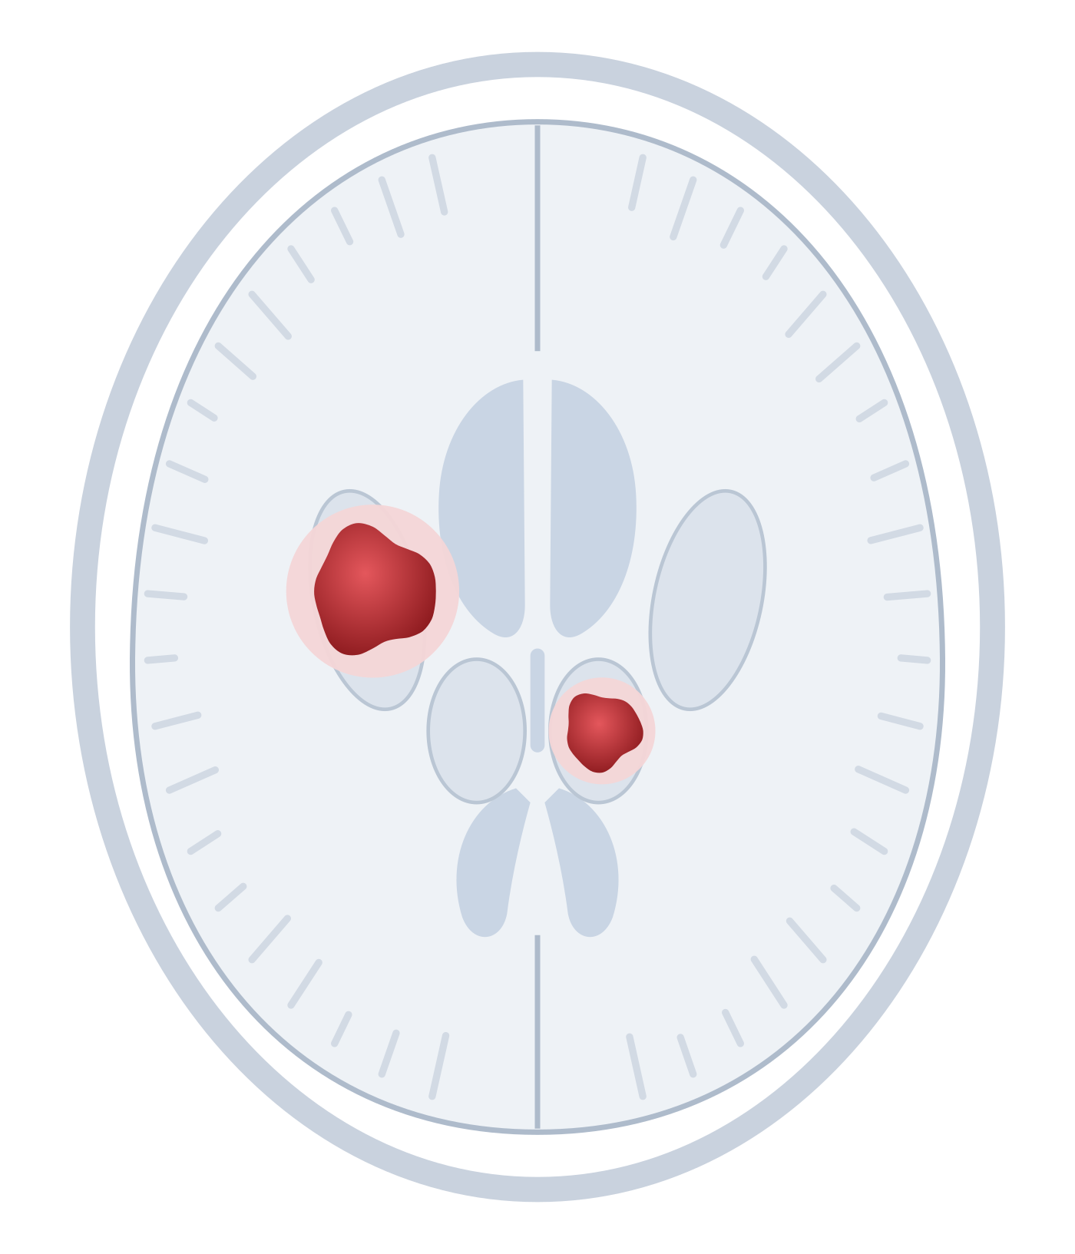
01 · THE VESSEL
Where it bleeds tells you why
Deep
→ hypertension
putamen · thalamus · pons · cerebellum
Schematic axial slice. The pons and cerebellum sit below this level.
Chapter 5 · Intracerebral haemorrhage
Vessel
Hours
Days
Bedside
9
Notes:
[About 30 seconds.]
That gives us a rule you can use tomorrow. Where it bleeds tells you why.
[Point to the two deep bleeds.]
These two are deep: the putamen and the thalamus. The pons and cerebellum count too. These are the territories of the perforating arteries. They branch at right angles off big, high-pressure trunks, so they take the full force of the blood pressure. Deep bleed: think hypertension.
[NEXT]

Slide 10
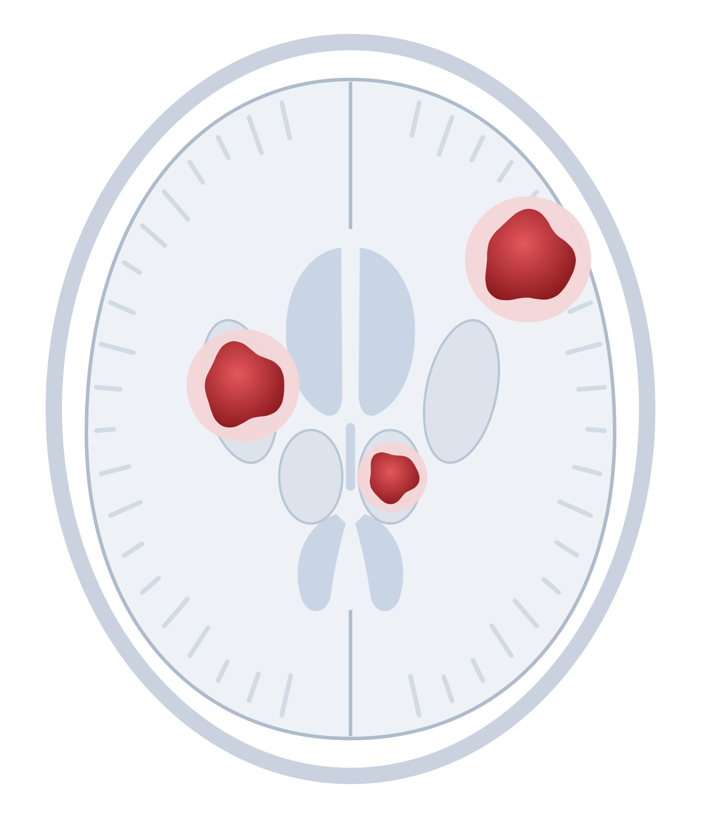
01 · THE VESSEL
Where it bleeds tells you why
Deep
→ hypertension
putamen · thalamus · pons · cerebellum
Lobar
→ amyloid (older adults)
Young or atypical? Look for a lesion.
Schematic axial slice. The pons and cerebellum sit below this level.
Chapter 5 · Intracerebral haemorrhage
Vessel
Hours
Days
Bedside
10
Notes:
[About 30 seconds. The new bleed appears near the surface.]
Now look near the surface. This one is lobar: in the cortex and the white matter just beneath it.
In an older adult, a lobar bleed points to amyloid angiopathy.
In a younger person, or when something looks unusual, it should make us suspicious. Keep that thought. We'll come back to Jill in a moment.

Slide 11
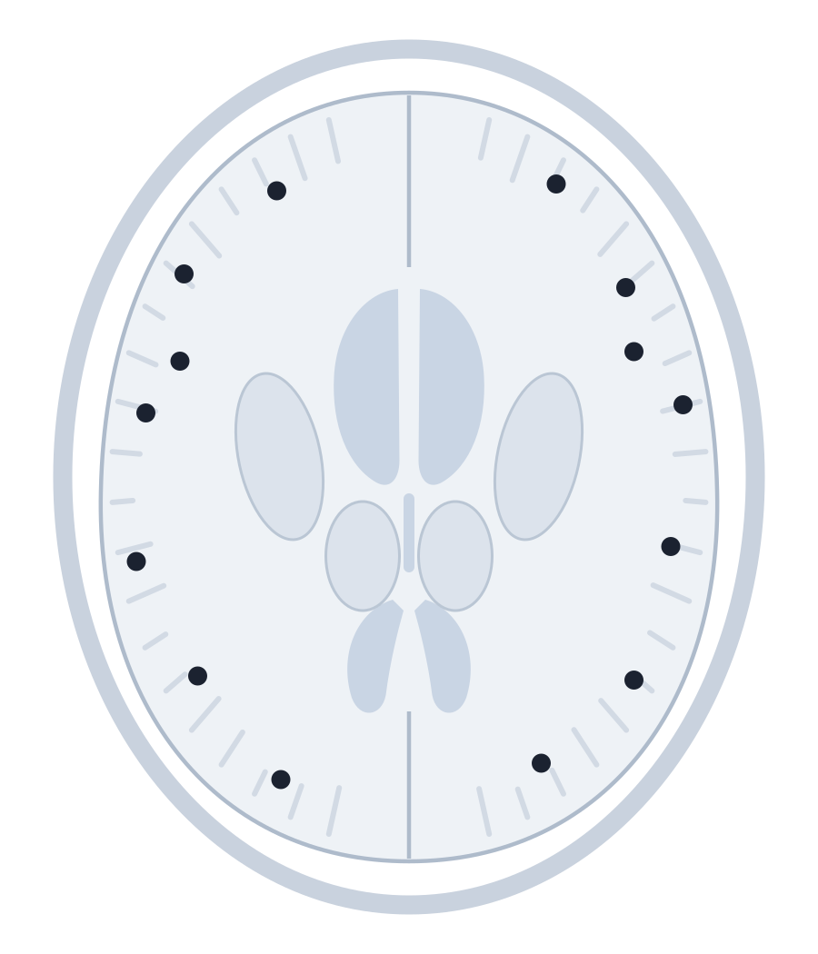
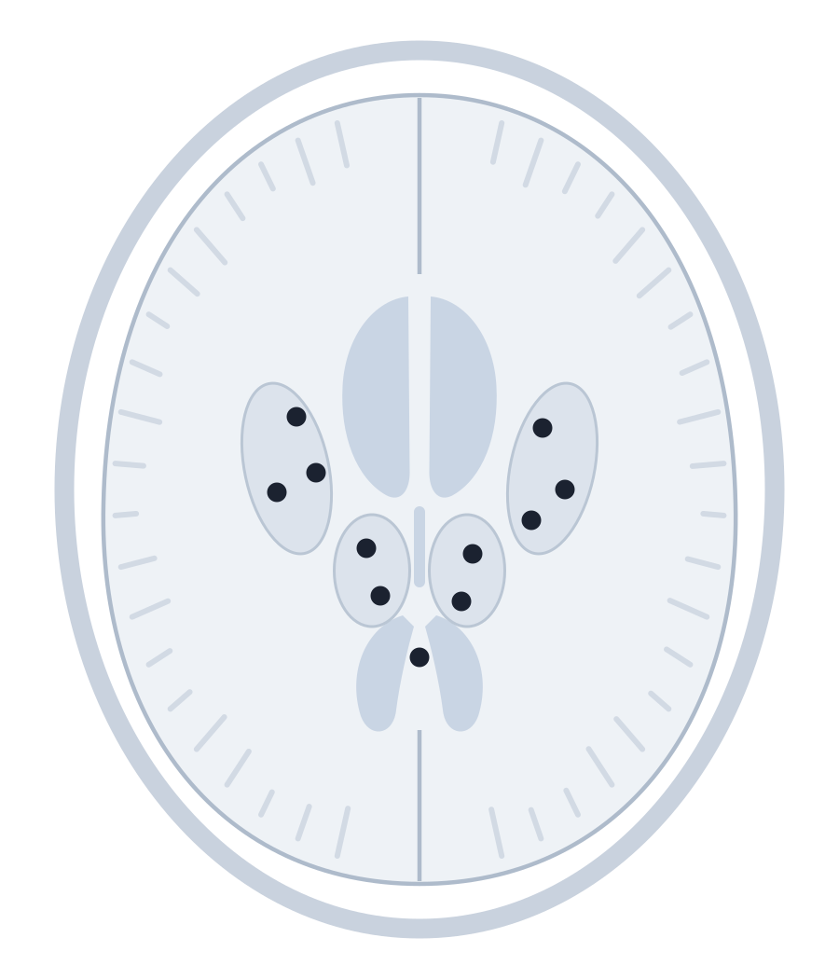
01 · THE VESSEL
Microbleeds are the footprints
60%
of people with ICH have microbleeds on MRI
Surface
→ amyloid
Deep
→ hypertension
Healthy adults: 5%
Cordonnier, Al-Shahi Salman & Wardlaw, Brain 2007 (systematic review). Boston criteria on the handout.
Chapter 5 · Intracerebral haemorrhage
Vessel
Hours
Days
Bedside
11
Notes:
[About 40 seconds.]
MRI lets us see the footprints of these diseases. Microbleeds are tiny old leaks of blood. They show up as black dots.
Their pattern mirrors the big bleeds. Dots near the surface point to amyloid. Dots deep inside point to hypertension.
A systematic review led by Charlotte Cordonnier, one of this chapter's authors, found microbleeds in 60 percent of people with ICH. In healthy adults it was 5 percent.
The handout has the Boston criteria, which use these dots to diagnose amyloid angiopathy in a living patient.

Slide 12



YOUR TURN · 30 SECONDS WITH YOUR NEIGHBOUR
Jill: primary or secondary?
37 years old
No hypertension
Lobar bleed
?
Chapter 5 · Intracerebral haemorrhage
Vessel
Hours
Days
Bedside
12
Notes:
[About 45 seconds. This is soft break 1, at about minute 6. Stop talking and let them work.]
Your turn.
Jill was 37. She had no history of high blood pressure. Her bleed was lobar.
[ASK] Primary small-vessel disease, or a secondary cause? Turn to the person next to you. Thirty seconds.
[Count to 30 in your head. Then ask two people for their answer.]
[NEXT]

Slide 13
YOUR TURN · 30 SECONDS WITH YOUR NEIGHBOUR
Secondary: an arteriovenous malformation
37 years old
No hypertension
Lobar bleed
65%
0%
of patients like Jill had a lesion on angiography
if over 45, hypertensive, with a deep bleed
Zhu et al., Stroke 1997 (prospective; 206 patients, all had catheter angiography). Other secondary causes on the handout.
Chapter 5 · Intracerebral haemorrhage
Vessel
Hours
Days
Bedside
13
Notes:
[About 45 seconds.]
Secondary. Jill was born with an arteriovenous malformation, a tangle of vessels with no capillaries in between. That morning it ruptured.
Her profile was a textbook warning sign. In a prospective study of 206 patients who all had angiography, 65 percent of young, normotensive patients with a lobar bleed had a vascular lesion.
Now flip it. Over 45, hypertensive, with a deep bleed: the yield was zero.
Same test, completely different result. The patient's story tells you where to look. The handout lists the other secondary causes.

Slide 14
02
The first hours
Rupture, growth and pressure
Notes:
[5 seconds.]
Stage two. The first hours. Jill had four of them. Let's see what happens in that time.

Slide 15
02 · THE FIRST HOURS
One rupture can trigger more
›
›
›
1
Rupture
2
Haematoma
3
Avalanche
4
Tamponade
Fisher CM, J Neuropathol Exp Neurol 1971: secondary bleeding points at the edge of the haematoma.
Chapter 5 · Intracerebral haemorrhage
Vessel
Hours
Days
Bedside
15
Notes:
[About 45 seconds. Move left to right.]
One: a diseased vessel ruptures, with arterial pressure behind it.
Two: blood splits the tissue and a haematoma forms.
Three is the surprise. In 1971, Miller Fisher looked at these bleeds under the microscope. He found extra bleeding points around the edge. The growing clot stretches and tears the vessels around it, and they bleed too. He called it an avalanche.
Four: the bleeding stops when the pressure in the tissue and the clotting system finally win.
So how often does the bleeding keep going?

Slide 16
YOUR TURN · HANDS UP
How many bleeds keep growing?
5 in 100
A
15 in 100
B
40 in 100
C
Each dot = one patient, scanned within 3 hours of onset
Chapter 5 · Intracerebral haemorrhage
Vessel
Hours
Days
Bedside
16
Notes:
[About 30 seconds. Soft break 2, at about minute 9.]
[ASK] Here are 100 patients, all scanned within three hours of onset.
How many of their bleeds keep growing?
Hands up for A, five. [pause] B, fifteen. [pause] C, forty.
[Say what you see: "Most of you went for B."]
[NEXT]

Slide 17
YOUR TURN · HANDS UP
38 in 100 keep growing
26 grew within the first hour
12 more grew within 20 hours
62 did not grow substantially
Jill: four hours
from headache to losing her speech
Each dot = one patient, scanned within 3 hours of onset
Brott et al., Stroke 1997 (n = 103; growth > 33%). Every 10% of growth: +5% hazard of death (Davis et al., Neurology 2006).
Chapter 5 · Intracerebral haemorrhage
Vessel
Hours
Days
Bedside
17
Notes:
[About 45 seconds. Wait for the dots to finish colouring before you speak.]
[PAUSE]
Thirty-eight.
In Brott's study, 26 bleeds grew by more than a third within one hour of the first scan. Another 12 grew within twenty hours. That's 38 in 100, and the growth went with neurological decline.
This is Jill's four hours. The damage kept spreading because the bleed kept growing.
It also changes outcomes. In a later analysis, every 10 percent of growth raised the risk of death by 5 percent. Those at highest risk were people scanned early, those with large bleeds, those on anticoagulants, and those with a spot sign on CT angiography.

Slide 18
02 · THE FIRST HOURS
Jill's clot was the size of a golf ball
A golf ball ≈ 40 mL
60 mL
60 mL + GCS ≤ 8: 91% predicted 30-day mortality
A clot that grows by a third looks only 10% wider on a scan.
Volume: Broderick et al., Stroke 1993 (Cincinnati, n = 188). A regulation golf ball is 42.7 mm across (about 40.7 mL).
Chapter 5 · Intracerebral haemorrhage
Vessel
Hours
Days
Bedside
18
Notes:
[About 60 seconds. THE PROP MOMENT. Take the golf ball out of your pocket before you say anything. Hold it up. Let them look.]
[PROP] Jill's surgeons removed a clot this size. A golf ball.
A golf ball holds about 40 millilitres.
[Point to the dashed circle.] Now grow it to 60 millilitres. That's the dashed line. It barely looks bigger, does it?
Here is the thing nobody tells you. A clot that grows by a third looks only about 10 percent wider on a scan. Growth that small is easy to miss by eye. The patient still feels every millilitre.
At 60 millilitres, with a Glasgow Coma Scale of 8 or less, the Cincinnati study predicted a 30-day mortality of 91 percent.
[Put the ball down where everyone can still see it.]

Slide 19
02 · THE FIRST HOURS
The skull is a closed box
Shift and herniation
≈45%
Raised pressure
Compression
The clot
break into the ventricles
→ hydrocephalus, worse outcome
Hanley, Stroke 2009.
Chapter 5 · Intracerebral haemorrhage
Vessel
Hours
Days
Bedside
19
Notes:
[About 45 seconds.]
Why does volume matter so much? Because the skull is a closed box.
[Trace the rings from the centre outwards.] The clot compresses the tissue around it. As the volume grows, the pressure inside the skull rises. If it keeps rising, the brain shifts and can herniate.
Then there are the ventricles. About 45 percent of bleeds break into them. Blood there can block the flow of cerebrospinal fluid and cause hydrocephalus. It also predicts a worse outcome on its own.

Slide 20
03
The days after
When the blood becomes a toxin
Notes:
[5 seconds.]
Stage three. The bleeding has stopped. The injury has not.

Slide 21
03 · THE DAYS AFTER
Oedema builds in waves
Hours
Days 1–2
Day 3+
Weeks
Clot retracts
Thrombin
Iron
Clearance
+75% oedema in the first 24 hours
Jill: surgery 17 days later
Xi, Keep & Hoff, Lancet Neurol 2006; Gebel et al., Stroke 2002.
Chapter 5 · Intracerebral haemorrhage
Vessel
Hours
Days
Bedside
21
Notes:
[About 55 seconds. Move along the timeline.]
Swelling around the clot builds in waves.
In the first hours, the clot retracts, like a blood sample settling in a tube, and squeezes serum into the tissue.
Over the first two days, the clotting cascade makes thrombin. Thrombin opens the blood-brain barrier.
From about day three, the red cells break down and release iron.
Over the following weeks, scavenger cells clear the clot and leave a cavity behind.
In one study, oedema grew by about 75 percent in the first 24 hours alone. It can keep building into the second week.
Jill's surgery came 17 days later. Her clot was still pressing on her language centres.

Slide 22



03 · THE DAYS AFTER
Three toxins, one result
Thrombin
Iron
Inflammation
Leaky barrier → more oedema → neuronal death
Xi, Keep & Hoff, Lancet Neurol 2006. Mostly from animal models.
Chapter 5 · Intracerebral haemorrhage
Vessel
Hours
Days
Bedside
22
Notes:
[About 45 seconds.]
Three toxins drive this second wave of injury. Most of what we know comes from animal studies, well summarised by Xi, Keep and Hoff.
Thrombin comes first. We need it to stop the bleed, but at high levels it damages the barrier and kills cells.
Iron comes later. Once the red cells burst, iron is released and fuels free radicals.
Inflammation runs through the whole period. Immune cells arrive within hours and stay for days.
[Point to the dark bar.] All three end in the same place: a leaky barrier, more swelling and more dead neurons. That is why patients can get worse days after the bleeding stopped.

Slide 23
YOUR TURN · TRUE OR FALSE?
True or false?
“The rim around the clot is starving tissue.”
Chapter 5 · Intracerebral haemorrhage
Vessel
Hours
Days
Bedside
23
Notes:
[About 30 seconds. Soft break 3, at about minute 14.]
[ASK] True or false?
The dark rim around the clot is starving tissue, like the penumbra in an ischaemic stroke.
Hands up for true.
[Count the hands. Say what you see.]
This matters, because for years people worried that lowering blood pressure would starve that rim.
[NEXT]

Slide 24
YOUR TURN · TRUE OR FALSE?
False: the rim is resting, not starving
“The rim around the clot is starving tissue.”
Rim vs the same area on the other side (PET)
Lowering BP below 150 did not reduce flow around the clot (ICH ADAPT).
Zazulia et al., J Cereb Blood Flow Metab 2001 (n = 19, 5–22 h after onset); Butcher et al., Stroke 2013.
Chapter 5 · Intracerebral haemorrhage
Vessel
Hours
Days
Bedside
24
Notes:
[About 40 seconds. Point, pause, explain.]
False.
Zazulia and colleagues scanned 19 patients with PET, 5 to 22 hours after onset. [Point to the first pair of bars.] Blood flow in the rim was low, at 56 percent of the other side. [Point to the second pair.] But oxygen use was even lower, at 48 percent. The tissue is resting, not starving.
The practical proof came in the ICH ADAPT trial. Lowering systolic pressure below 150 did not reduce blood flow around the clot.

Slide 25
04
At the bedside
Every stage is a window
Notes:
[5 seconds.]
So what do we do with all this at the bedside?

Slide 26

04 · AT THE BEDSIDE
Every stage is a window to act
The vessel
Control blood pressure. Review antithrombotics.
Before and after
The first hours
Image fast. Reverse anticoagulants. Watch the GCS closely.
First 24 hours
The days after
Expect fluctuation. Escalate new drowsiness. Pace therapy.
Days to weeks
Chapter 5 · Intracerebral haemorrhage
Vessel
Hours
Days
Bedside
26
Notes:
[About 75 seconds. This is the heart of the talk. Slow down.]
Each stage is a window.
The vessel sits before and after the bleed. Blood pressure control is our strongest tool for preventing a first or a second bleed. Antithrombotics need careful review.
The first hours are when the clot grows. That means fast imaging, early blood pressure lowering and urgent reversal of anticoagulants. For every one of us, it means close neuro observations. A falling GCS is not something to watch overnight.
The days after are when the blood is toxic. Expect patients to fluctuate as the swelling peaks. New drowsiness, headache or vomiting means stop and escalate. Reassess before every session and pace therapy to what the brain can handle that day.

Slide 27
SUMMARY
If you remember three things
1
The vessel decides where it bleeds.
2
The first hours decide how big it gets.
3
The blood keeps injuring the brain for days.
Chapter 5 · Intracerebral haemorrhage
Vessel
Hours
Days
Bedside
27
Notes:
[About 30 seconds. Read each line slowly. Pause between them.]
If you remember three things from tonight:
The vessel decides where it bleeds.
The first hours decide how big it gets.
The blood keeps injuring the brain for days.

Slide 28
EIGHT YEARS LATER
Jill walked onto the TED stage holding a human brain.
ICH is a process,
not a moment.
What would you like me to clarify?
Notes:
[About 45 seconds, then questions. Bookend: return to Jill.]
Back to Jill.
It took her eight years to recover. Then, in 2008, she walked onto the TED stage holding a real human brain and told millions of people what it felt like from the inside.
Her bleed was not a moment. It was a process, and so was her recovery.
ICH is a process, not a moment.
[PAUSE for three full seconds.]
Thank you. What would you like me to clarify?
[If the room is quiet, ask the question on the slide and wait five seconds.]

Slide 29
SOURCES
References
1. Rossi C, Cordonnier C. Pathophysiology of non-traumatic intracerebral haemorrhage. In: Norrving B, ed. Oxford Textbook of Stroke and Cerebrovascular Disease. OUP; 2014: ch. 5.
2. Taylor JB. My stroke of insight. TED 2008; and My Stroke of Insight (book), 2006.
3. van Asch CJ, et al. Lancet Neurol 2010;9:167–176.
4. Meretoja A, et al. SMASH-U. Stroke 2012;43:2592–2597.
5. Cordonnier C, Al-Shahi Salman R, Wardlaw J. Brain 2007;130:1988–2003.
6. Zhu XL, Chan MS, Poon WS. Stroke 1997;28:1406–1409.
7. Fisher CM. J Neuropathol Exp Neurol 1971;30:536–550.
8. Brott T, et al. Stroke 1997;28:1–5.
9. Davis SM, et al. Neurology 2006;66:1175–1181.
10. Broderick JP, et al. Stroke 1993;24:987–993.
11. Hanley DF. Stroke 2009;40:1533–1538.
12. Gebel JM, et al. Stroke 2002;33:2631–2635.
13. Xi G, Keep RF, Hoff JT. Lancet Neurol 2006;5:53–63.
14. Zazulia AR, et al. J Cereb Blood Flow Metab 2001;21:804–810.
15. Butcher KS, et al. (ICH ADAPT). Stroke 2013;44:620–626.
Notes:
[Leave this up during questions if people want the sources. Everything is also on the handout.]

Slide 30






BACKUP · IF ASKED
Other causes of a secondary bleed
Vascular malformations
Antithrombotic drugs
Tumours
Venous thrombosis
Haemorrhagic transformation
Drugs, vasculitis, RCVS, moyamoya
Chapter 5 · Intracerebral haemorrhage
Vessel
Hours
Days
Bedside
30
Notes:
[Backup, hidden. Type its slide number and press Enter to jump here if someone asks about other causes.]
With every bleed, ask whether something else caused it. Vascular malformations like Jill's AVM. Antithrombotic drugs, which make bleeds bigger and longer-lasting. Tumours. Venous thrombosis. Haemorrhagic transformation of an infarct. And a mixed group: cocaine, amphetamines, vasculitis, reversible vasoconstriction, moyamoya and clotting disorders.

Slide 31
BACKUP · BEYOND THE 2014 CHAPTER
What has changed since the book
2022
Boston criteria v2.0
2023
INTERACT3
White-matter MRI markers added
Care bundle improved 6-month function
2024
ENRICH
2024
ANNEXA-I
Early minimally invasive surgery helped lobar bleeds
Andexanet: better haemostasis, more thrombosis
Charidimou, Lancet Neurol 2022 · Ma, Lancet 2023 · Pradilla, NEJM 2024 · Connolly, NEJM 2024.
Chapter 5 · Intracerebral haemorrhage
Vessel
Hours
Days
Bedside
31
Notes:
[Backup, hidden. Show only if someone asks what has changed since the book came out in 2014.]
Four updates. In 2022 the Boston criteria moved to version 2.0 and added white-matter MRI markers. In 2023, INTERACT3 showed that a care bundle of early blood pressure lowering, glucose and fever control, and anticoagulant reversal improved function at six months. In 2024, ENRICH showed that early minimally invasive clot removal helped, mainly for lobar bleeds. Also in 2024, ANNEXA-I found andexanet improved haemostasis in factor Xa inhibitor bleeds, but with more thrombotic events.

