Slide 1

COVID-19 Cases vs Educational Attainment vs Essential Workers
F. Chang

Slide 2
Intro
In the city of Los Angeles, the COVID-19 pandemic has been very concerning as it was listed as the epicenter of COVID of the world (1). As misinformation continued to spread, the city was inundated with COVID-19 cases. Although there has been some suggestion of literacy levels playing a factor, no specific studies have been performed in Los Angeles (2). We hypothesize that education level also plays a factor in Los Angeles’s pandemic struggles. However, it is unclear how healthy literacy plays a role, and this study will help determine whether to further investigate this topic (health literacy vs misinformation?) and whether we need to work on public education health efforts to combat the Pandemic in Los Angeles.

Slide 3

Data Source:
COVID-19 Cases and Deaths from County of Los Angeles Public Health:
http://publichealth.lacounty.gov/media/coronavirus/locations.htm#top-25
Median Household Income:
http://publichealth.lacounty.gov/ohae/cchp/healthIndicator.htm
Highest Level of Education Attained Among Adults (Ages 25 Years and Older):
http://publichealth.lacounty.gov/ohae/cchp/healthIndicator.htm
FourSquare API - Query

Slide 4
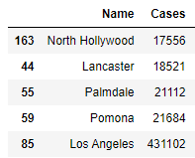
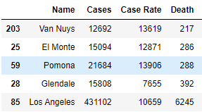
Top 5 Locations Cases and Deaths

Slide 5
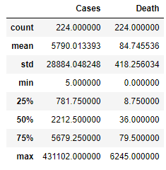
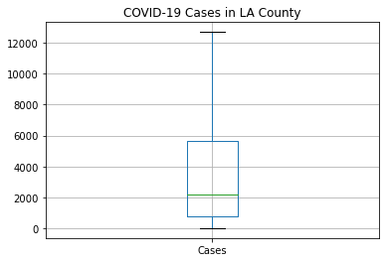
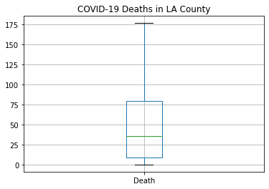
Exploring the Data

Slide 6
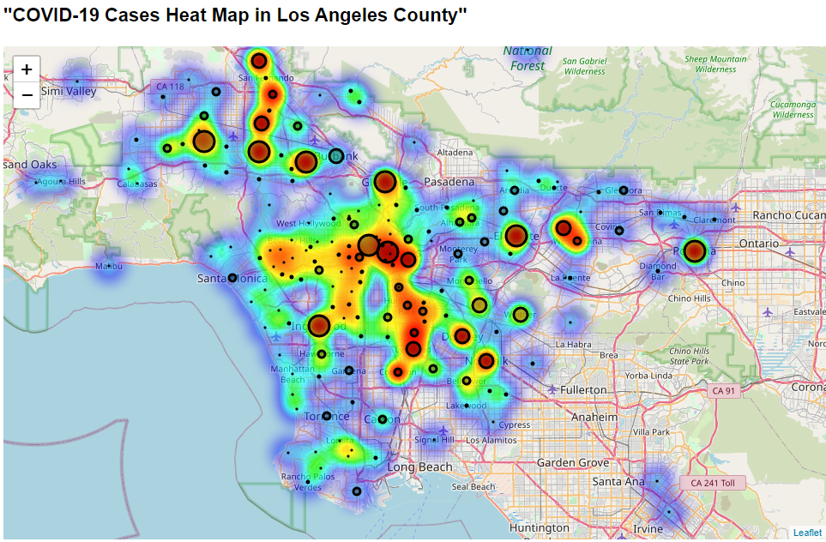

Slide 7
Foursquare Data
Los Angeles County (#1 in Cases/Deaths) - 50 Super Markets returned
Van Nuys (in the top 5) - 8 Super Markets returned
Pacoima (in the bottom 5) - 2 Super Markets returned

Slide 8
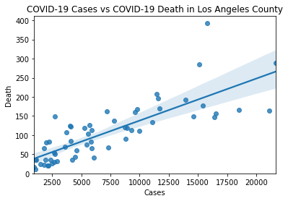
Covid-19 Case vs Deaths
The Pearson Correlation Coefficient is 0.8014773796042758 with a P-value of P = 2.4389547134895833e-14

Slide 9
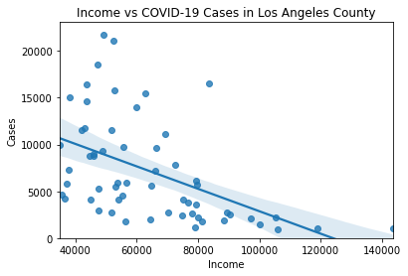
Income vs Cases
The Pearson Correlation Coefficient is -0.4983378396806178 with a P-value of P = 5.904023195599915e-05

Slide 10
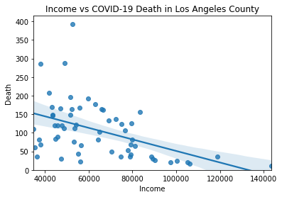
Income vs Death
The Pearson Correlation Coefficient is -0.47172827846729815 with a P-value of P = 0.0001622318484684955

Slide 11
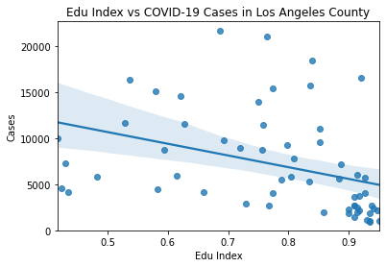
Edu Index vs Cases
The Pearson Correlation Coefficient is -0.36853306682925935 with a P-value of P = 0.004078498019970787

Slide 12
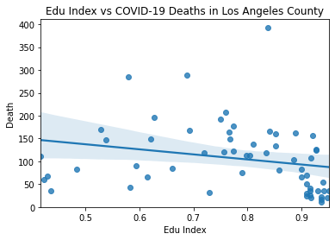
Edu Index vs Deaths
The Pearson Correlation Coefficient is -0.23411668140389894 with a P-value of P = 0.07430970566838907

Slide 13
Discussion
Strong correlation between Cases and Deaths (as expected).
Some correlation between Income and Cases/Deaths (potentially explaining that Essential Workers are doing jobs that causes higher exposure (minimum wage jobs such as working in the grocery store). Further studies needed
Very weak correlation between Edu Index and Cases/Deaths. Further studies should be done on US Census Bureau data to ensure methodology is not flawed and confirmable.

Slide 14
Conclusion
While this study does not demonstrate clear indication of education attainment affecting COVID-19 Cases and Death, further investigation should be done with US Census data to confirm. More ways to obtain Super Market location data could allow for further investigation of the essential workers factor as a cause of cases/death as well.

Slide 15
References
(1)L.A. County on verge of becoming COVID-19 epicenter - Los Angeles Times (latimes.com)
(2) Paakkari L, Okan O. COVID-19: health literacy is an underestimated problem. Lancet Public Health. 2020;5(5):e249-e250. doi:10.1016/S2468-2667(20)30086-4

