Slide 1
J. M. Forbes et al.: New perspectives on thermosphere tides: 2. Penetration to the upper thermosphere
DLR-SO SKP PhD Seminar
December 15, 2021

Slide 2
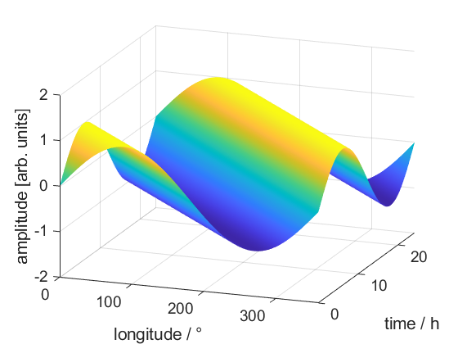
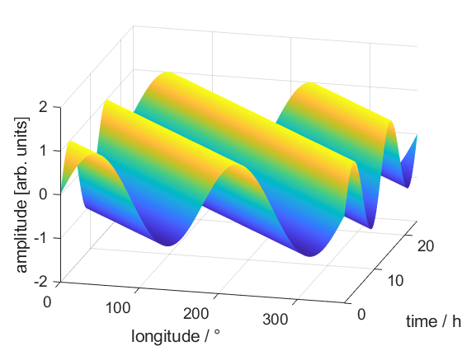
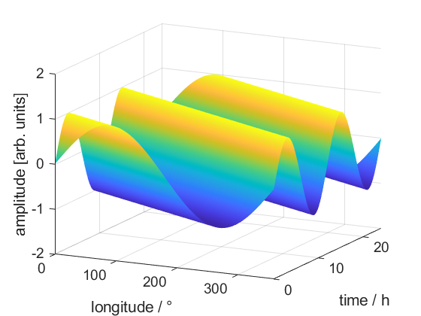
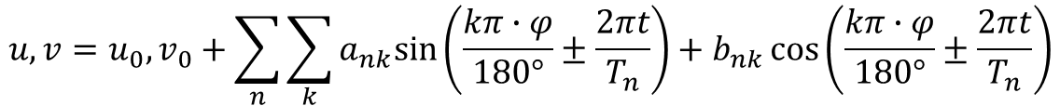
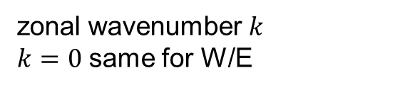
Nomenclature of global atmospheric tides
> Lecture > Author • Document > Date
DW1
D: diurnal
S: semidiurnal
W: westward propagating
E: eastward propagating
zonal wavenumber $k$
$k=0$ same for W/E
$$u,v=u_{0},v_{0}+\sum_{n}{\sum_{k}{a_{nk}sin\left(\frac{kπ∙φ}{180°}±\frac{2πt}{T_{n}}\right)+b_{nk}\cos\left(\frac{kπ∙φ}{180°}±\frac{2πt}{T_{n}}\right)}}$$
DW1
SW2
SW1
Migrating: DW1 and SW2 (sun-synchronous) ↔ Non-migrating: all others

Slide 3
Asked questions
To what degree are atmospheric tides capable to penetrate into higher regions (~400 km) of the ionosphere-thermosphere system?
What is the non-migrating tidal spectrum in the upper thermosphere?
Compare temperature amplitudes and seasonal changes of tidal modes at 110 km and exosphere/thermosphere altitudes:
Similar looking pictures: ➔ propagating tide
Notable differences: ➔ in situ generated tide
Note: For in situ generated ‘tides’ at high altitudes, the term might be confusing since it is generally used for atmospheric winds. Replacing ‘tides’ with ‘oscillations’ or ‘modulations’ seems advisable.

Slide 4
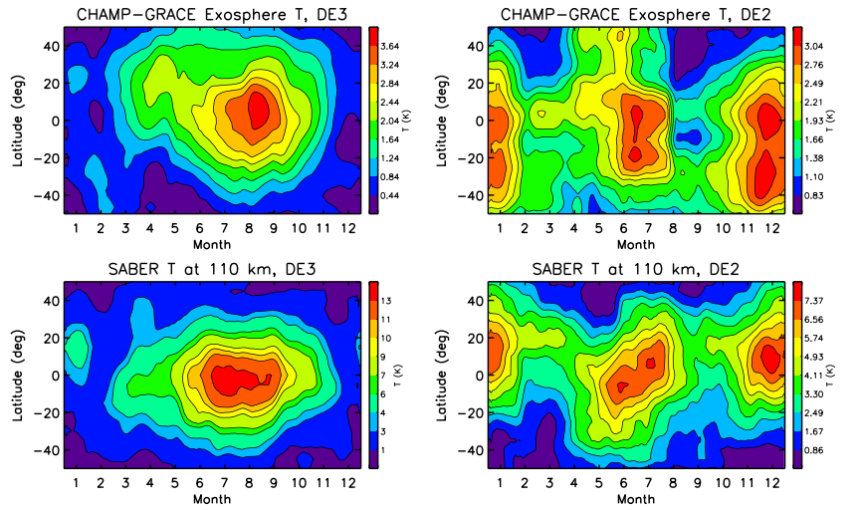
Comparison of SABER and CHAMP-GRACE data

Slide 5
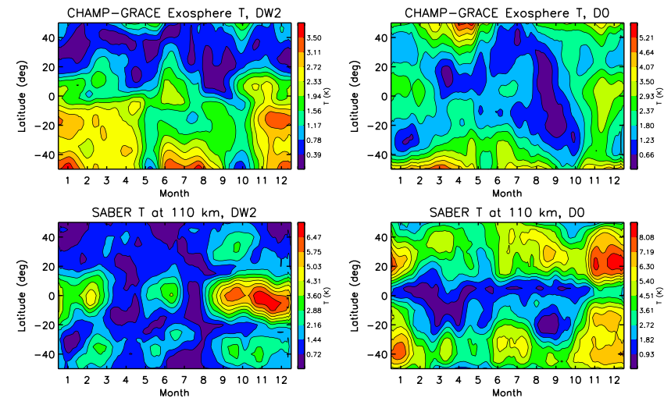
Comparison of SABER and CHAMP-GRACE data

Slide 6
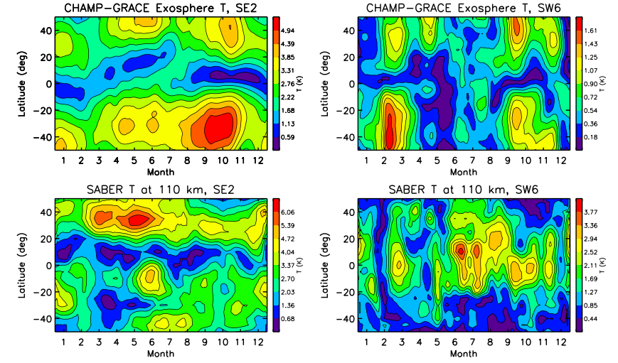
Comparison of SABER and CHAMP-GRACE data

Slide 7
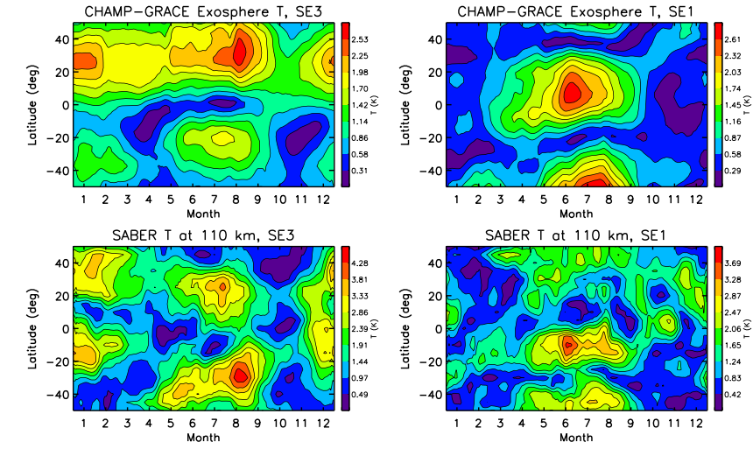
Comparison of SABER and CHAMP-GRACE data

Slide 8
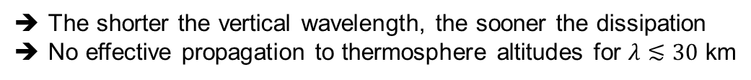
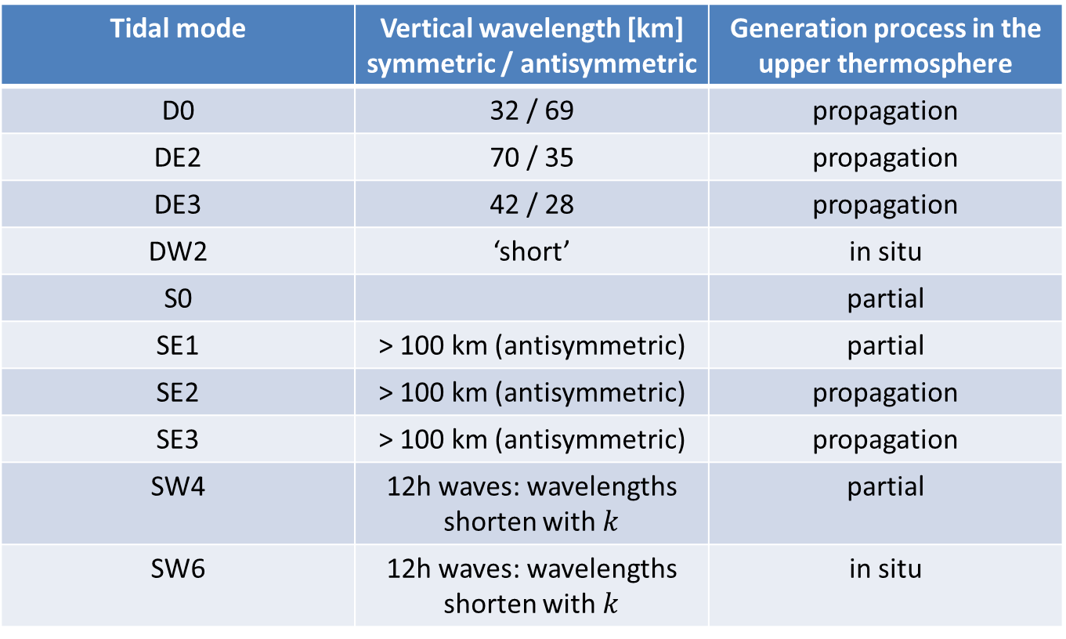
Ability to propagate is associated with vertical wavelength
The shorter the vertical wavelength, the sooner the dissipation
No effective propagation to thermosphere altitudes for $λ≲30$ km
Tidal mode | Vertical wavelength [km] symmetric / antisymmetric | Generation process in the upper thermosphere
D0 | 32 / 69 | propagation
DE2 | 70 / 35 | propagation
DE3 | 42 / 28 | propagation
DW2 | ‘short’ | in situ
S0 |  | partial
SE1 | > 100 km (antisymmetric) | partial
SE2 | > 100 km (antisymmetric) | propagation
SE3 | > 100 km (antisymmetric) | propagation
SW4 | 12h waves: wavelengths shorten with $k$ | partial
SW6 | 12h waves: wavelengths shorten with $k$ | in situ

Slide 9
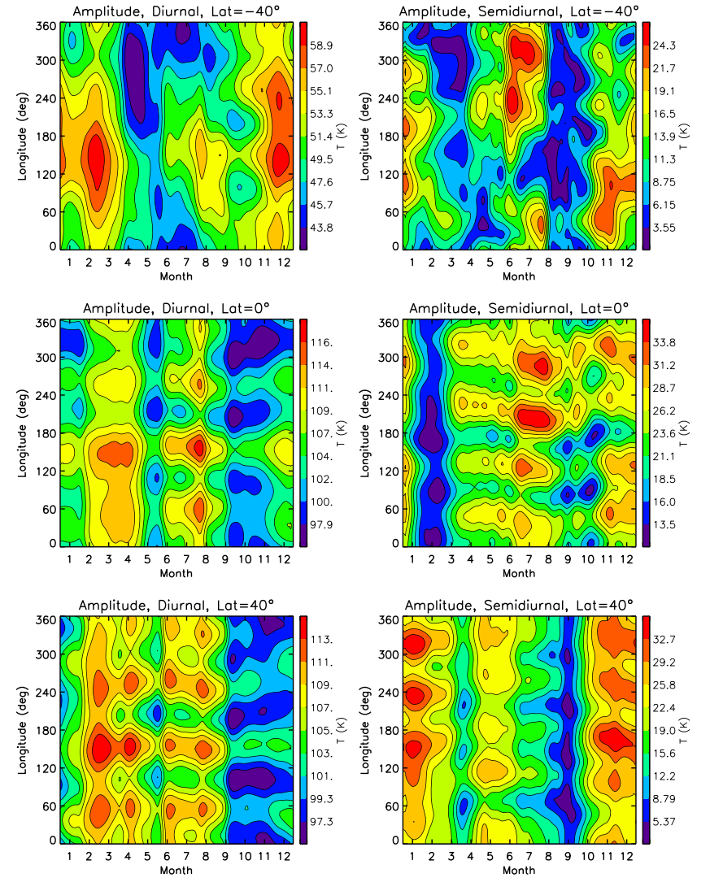
Impact of non-migrating tides ‘weather-like’
non-migrating amplitudes are considerably smaller than migrating tidal amplitudes
added up, non-migrating tides can have significant impact on diurnal and semidiurnal variations
non-migrating tides and other effects (e.g. zonal mean propagation conditions, PW interactions,…) result in variations comparable to ‘weather’

