Slide 1
The Code Hopper
Adam Finer && Katrina Kerrick
&& Runzhi Yang && Fred Zhang

Slide 2
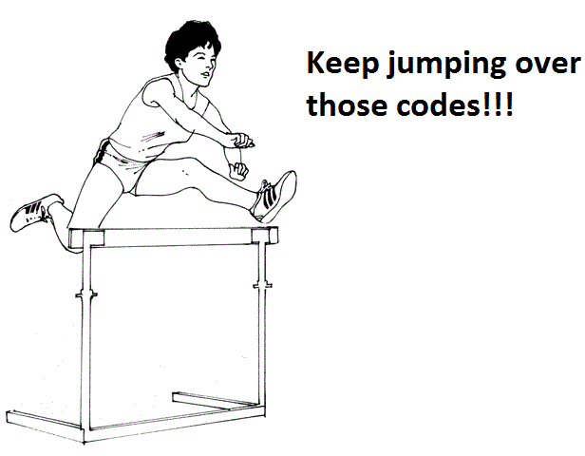
Overview
Load-store
Condition Code -- Jumping!!
Fast Processor!!!
Dual Stack
Verilog
Notes:
Runzhi

Slide 3
Performance Stats
Bytes of code | 82 Bytes
Total Bytes need to run Euclid’s | 92 Bytes
# of Instruction executed for Euclid’s | 51090
# of cycles executed for Euclid’s | 143029
average CPI | 2.7995
Cycle time | 10.770ns
total time | 1.5404ms
Memory | Block memory
For 0x13B0
Notes:
Runzhi

Slide 4
Instruction Types
R-type
I-type
J-type
op(4) | r1(4) | r2(4) | LM(1) | CC(3)
op(4) | r1(4) | imm(8)
op(4) | unused (4) | $ra (4) | jop(1) | CC(3)
address(16)
Notes:
(Katrina)

Slide 5
Condition Code (The heart of HOPPER)
explanation | CC | condition
greater than | 100 | >
greater than or equal | 110 | >=
less than | 001 | <
less than or equal | 011 | <=
equal | 010 | =
not equal | 101 | !=
always execute | 111 | True
while (b != 0) { if (a > b) { a = a - b; } else { b = b - a; }
}
___WHILE
cmp $t0, $t1
sub $t0, $t1, 001
sub $t1, $t0, 110
cmp $t1, $t7
jl WHILE , 101
What about cc=000?
Notes:
Katrina

Slide 6
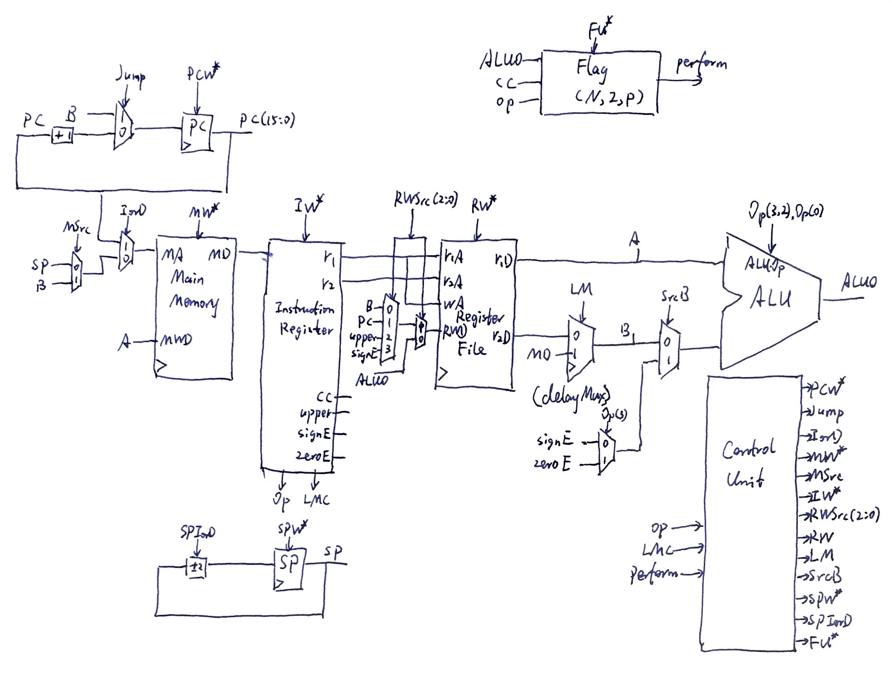
Datapath
Notes:
Fred

Slide 7
Dual Stacks
Procedure Stack Vs Data Stack
$sp Vs $dp
Fast for recursion that does not involve array
Secure for buffer overflow attack
Notes:
Fred

Slide 8
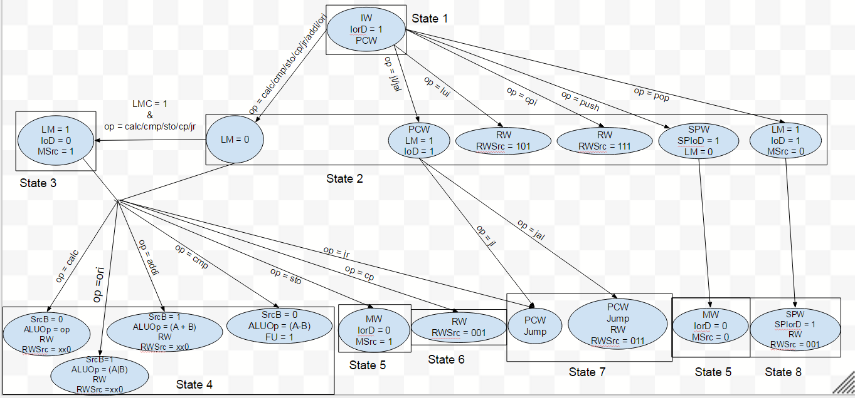
Control Unit

Slide 9
Problems
jr
ori & pseudo instructions:
Before ori: li(big) $r1, (16-bit imm)
lui $r1, (upper big)
cpi $r1, (lower big)
After ori: (replace cpi with ori).
Bubble state
Notes:
Memory in not enough for 16 bits, so we through out 2 (11,10) 0xf3ff (Adam)

Slide 10
What we would have wanted to add:
Simulator
$t, $v, $a in MIPS are actually the same
additional pseudo instructions:
(r-type instruction) $r1, imm($r2)
shifting left
Notes:
Runzhi-shift left
Fred- register
Katrina- simulator (like Spim)
Adam - r-type instructions

Slide 11
Thank you!
Any questions?

