Slide 1
Unit -5
Part-2

Slide 2
Table of Contents
Challenges in Scaling Agile in Enterprises
Creating and Managing Scaled Agile Setup Using Tools
Group Projects Simulating Distributed Agile Teams

Slide 3
Challenges in Scaling Agile in Enterprises
Resistance to change and organizational inertia
Misalignment between teams and leadership
Difficulty in maintaining Agile principles at scale
Tooling and integration complexity across large teams

Slide 4
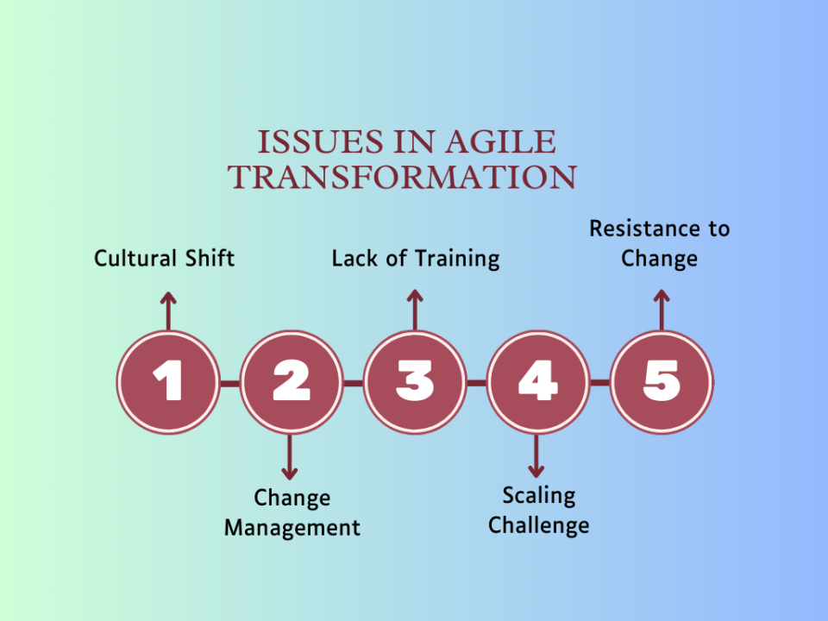

Slide 5
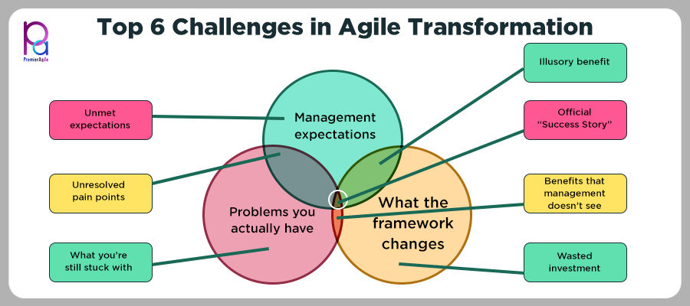

Slide 6
Best Practices for Scaling Agile
Strong executive support and cultural alignment
Clear communication and transparency
Investment in training and Agile coaching
Use of consistent metrics and KPIs across teams

Slide 7
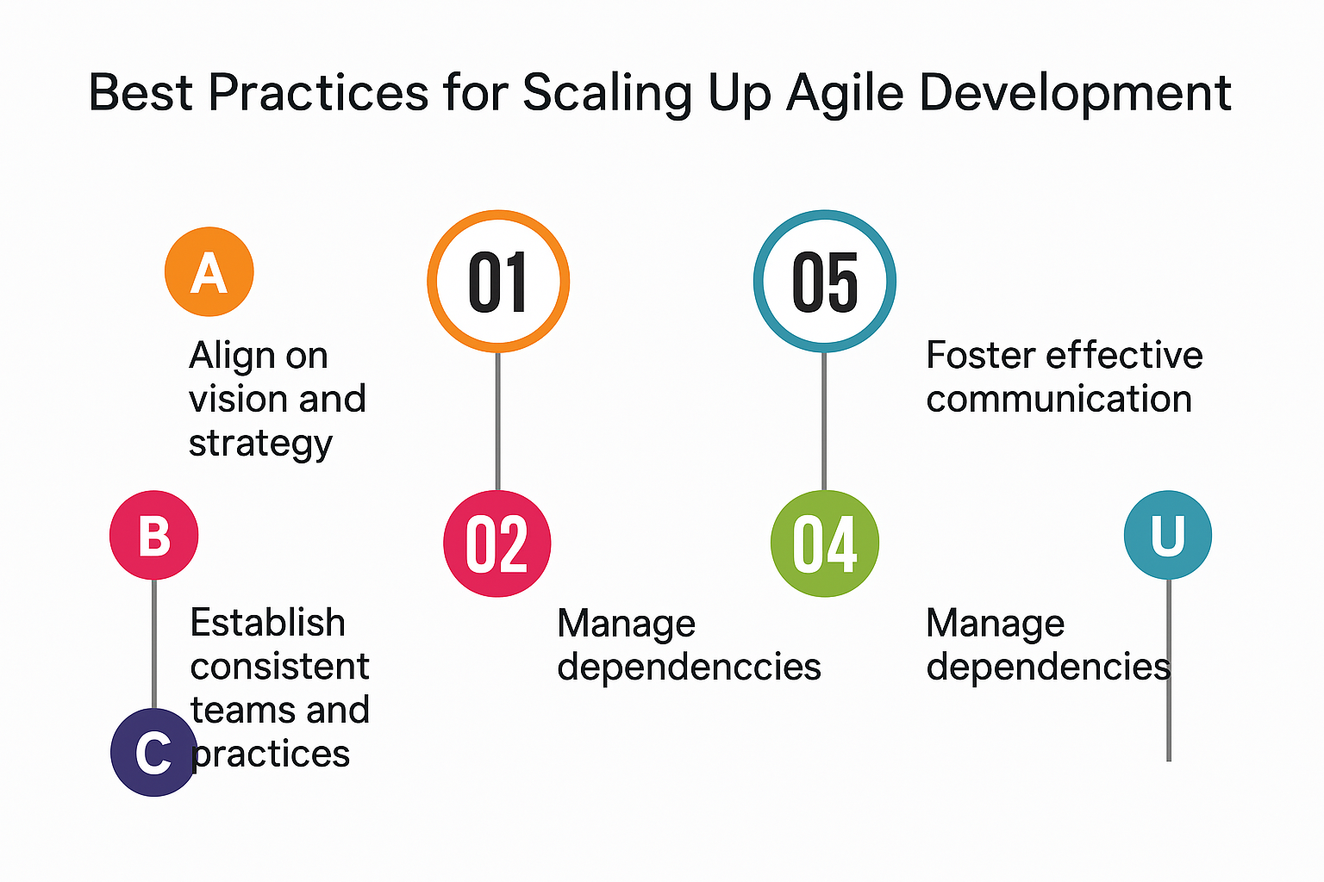

Slide 8
Creating and Managing Scaled Agile Setup Using Tools
Utilize tools like Jira, Rally, or Azure DevOps for managing backlogs and workflows
Implement integrated CI/CD pipelines for continuous delivery
Leverage dashboards for real-time progress tracking and reporting
Maintain centralized documentation and knowledge sharing

Slide 9
Group Projects Simulating Distributed Agile Teams
Assign cross-functional roles in virtual teams
Conduct sprint planning, reviews, and retrospectives remotely
Use communication tools like Zoom, Slack, and Trello for collaboration
Emphasize the importance of time zone coordination and clear documentation

Slide 10
MCQ’s
1. Which of the following is a common challenge when scaling Agile?
A. Too many sprints B. Organizational resistance
C. Lack of developers D. Frequent deployments
2. What supports successful Agile scaling?
A. Executive support B. Isolated teams
C. Waterfall fallback D. Ad hoc planning
3. A key tool for managing scaled Agile backlogs is:
Excel B. Notepad C. Jira D. PowerPoint
4. Distributed Agile teams benefit most from:
A. Same time zones B. No stand-ups
C. Waterfall phases D. Effective communication tools

Slide 11
5. Agile coaching helps with:
A. Increasing code B. Cultural transformation
C. Speeding up sprints D. Replacing Scrum Masters
6. Which tool is used for Agile project tracking?
A. Azure DevOps B. Paint
C. Outlook D. Skype
7. Why are retrospectives important in group Agile projects?
A. Celebrations B. Documentation
C. Continuous improvement D. Planning only
8.Best way to manage time zones in distributed Agile teams?
A. Late night meetings B. Ignore time zones
C. Random calls D. Asynchronous updates

Slide 12
9. Centralized documentation helps in:
A. Shared understanding B. Isolation
C. Micromanagement D. Waterfall conversion
10. Dashboards provide:
A. Code snippets B. Real-time tracking
C. Email alerts D. Test cases
11.Why simulate Agile teams in group projects?
A. Fun B. Theory learning
C. Practical experience D. Exam practice
12. Which tool is used for Agile project tracking?
A. Azure DevOps B. Paint
C. Outlook D. Skype

Slide 13
13.A common mistake in scaling Agile is:
A. Planning sprints B. Ignoring feedback loops
C. Backlog refinement D. Writing user stories
14. Effective collaboration tools include:
A. Slack B. MS Paint
C. Antivirus D. Calculator
15. What enhances transparency in Agile?
A. Private notes B. Long emails
C. Siloed teams D. Daily stand-ups
16.One benefit of Agile group simulations is:
A. Coding only B. Team collaboration skills
C. Solving puzzles D. Avoiding deadlines

Slide 14
17. KPIs in Agile scaling help with:
A. Measuring progress B. Firing employees
C. Adding roles D. Ignoring velocity
18. Which phase focuses on reflection and improvement?
Planning B. Stand-up C. Retrospective D. Review
19 Tool to visualize workflow in Agile:
A. Roadmap B. Gantt Chart
C. Flowchart D. Kanban Board
20. Which factor helps sustain Agile culture?
A. Top-down command B. Leadership buy-in
C. Strict rules D. Code-only focus

Slide 15
MCQ 19
Tool to visualize workflow in Agile:
A. Roadmap
B. Gantt Chart
C. Flowchart
D. Kanban Board
Correct Answer: D. Kanban Board

Slide 16
MCQ 20
Which factor helps sustain Agile culture?
A. Top-down command
B. Leadership buy-in
C. Strict rules
D. Code-only focus
Correct Answer: B. Leadership buy-in

