Slide 1
Polymorphism

Slide 2
Polymorphism
Polymorphism means implementing one thing in many forms(“Poly” means many and “morphs” means forms)
In C++ we have two types:
Compile time polymorphism(or early binding or static binding), Examples: Function overloading and Operator overloading.
2) Run time polymorphism( or late binding or Dynamic binding), achieved with the help of virtual functions/pure virtual functions/abstract classes

Slide 3
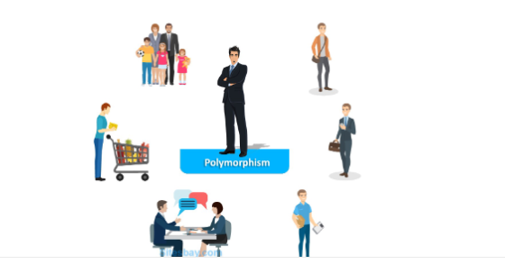

Slide 4
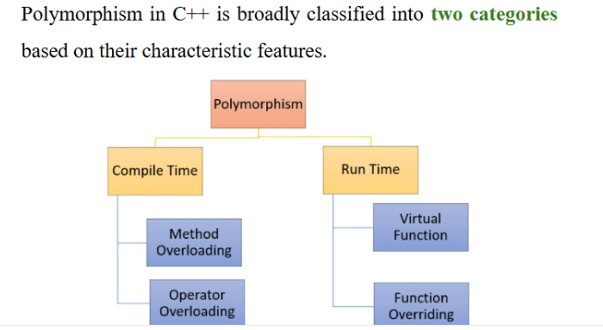

Slide 5
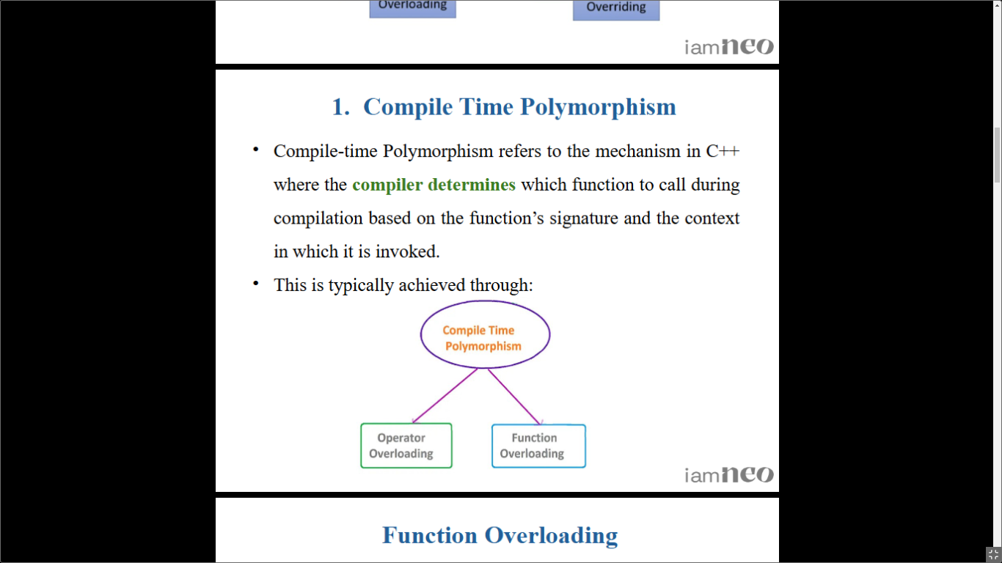

Slide 6
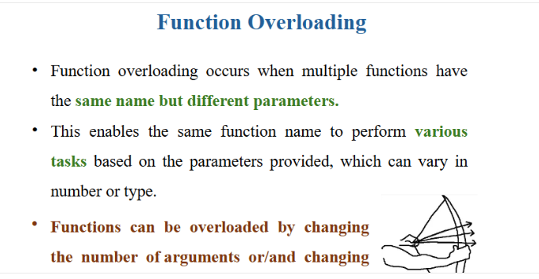

Slide 7
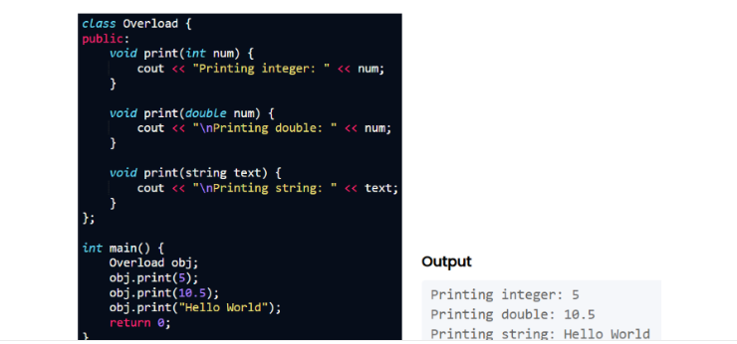

Slide 8
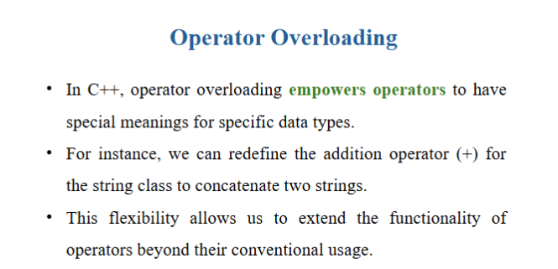

Slide 9
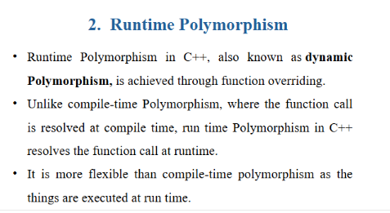

Slide 10
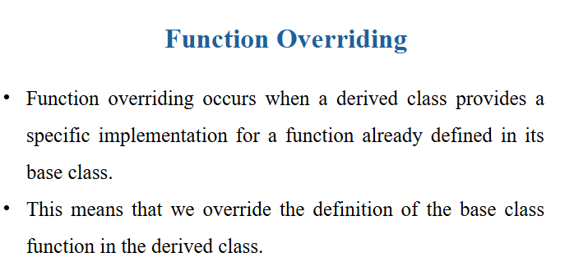

Slide 11
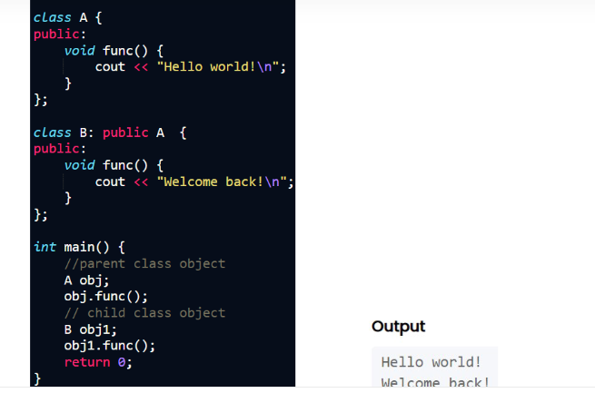

Slide 12
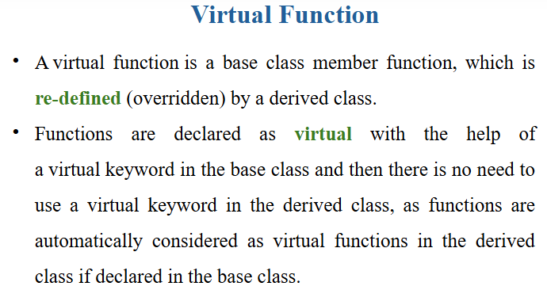

Slide 13
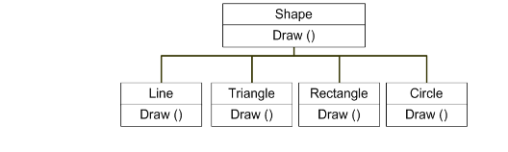

Slide 14
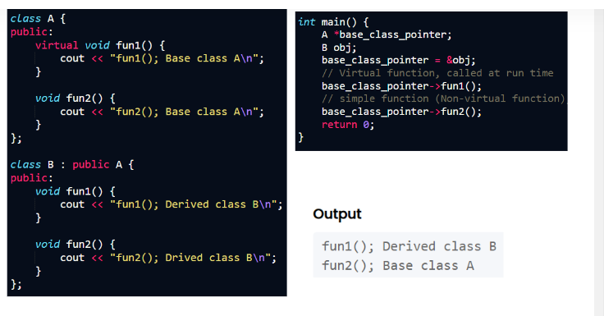

Slide 15
Compile Time Polymorphism
(or Early binding or Static binding)
The concept of binding refers to the linking of function call to the code of the function to be executed in response to the function call.
In compile time polymorphism ,static binding is performed.
In this compiler makes the decision regarding selection of appropriate function to be called in response to function call at compile time.
During early binding, compiler considers the type of pointer only, and a particular function call is decided there only, no concern is there for what type of object’s address is assigned to base pointer
This is because all the address information requires to call a function is known at compile time.

Slide 16
It is also known as early binding as decision of binding is made by the compiler at the earliest possible moment.
Since all the information needed to call a function is available at the compile time, so early binding results in faster execution of a program
The disadvantage is lack of flexibility.
The compile time polymorphism is implemented using function overloading and operator overloading

Slide 17
Run time Polymorphism
(Late binding or Dynamic binding)
In this dynamic binding is performed
In dynamic binding the decision regarding the selection of appropriate function to be called is made by compiler at run time.
In this type of polymorphism, compiler determines the type of object at runtime(or address of what type of object is being assigned to base class pointer), and then binds the function call.
This is because the information pertaining to the selection of appropriate function definition corresponding to a function call is known only at the run time.
It is also called the late binding as the compiler delays the binding decision until run time.

Slide 18
Run time polymorphism offers flexibility as compared to compile time polymorphism as all decisions are taken at run time
A function call is not resolved until runtime, hence this kind of polymorphism results in somewhat slower execution of code
Run time polymorphism can be achieved through virtual functions

Slide 19
Compile time Polymorphism(or Early binding)Example-1
Function overloading
#include<iostream>
#include<conio.h>
using namespace std;
class overloading
{
public:
int area(int side)
{
return (side*side);
}
int area(int length, int breadth)
{
return (length*breadth);
}
float area(float radius)
{
return (3.14*radius*radius);
}
};
int main()
{
overloading obj1;
int square,rectangle;
float circle;
square=obj1.area(5);
cout<<"\n Area of square is:"<<square;
rectangle=obj1.area(3,4);
cout<<"\n Area of rectangle is:"<<rectangle;
circle=obj1.area(3.4f);
cout<<"\n Area of circle is:"<<circle;
return 0;
}

Slide 20
Compile time Polymorphism(or Early binding)Example-2
Operator overloading
#include<iostream>
using namespace std;
class complex1
{
float x,y;
public:
complex1()
{
x=0.0;
y=0.0;
}
complex1(float real,float imag)
{
x=real;
y=imag;
}
complex1 operator+(complex1 obj1)
{
complex1 temp;
temp.x=x+obj1.x;
temp.y=y+obj1.y;
return temp;
}
void show_data()
{
cout<<x<<" +i"<<y<<"\n";
}
};
int main()
{
complex1 o1(2.7,3.6),o2(4.1,5.7),o3;
o3=o1+o2;
//o3=o1.operator+(o2);
o3.show_data();
}

Slide 21
Pointer to Base and Pointer to derived
We can have a pointer to base(Base class pointer) and pointer to derived (Derived class pointer)
Base pointer can point towards base class as well as derived class(i.e. We can assign the address of base class object / or we can assign the address of derived class object to base class pointer)
Although base class pointer can point towards derived class, but it can access only those features of derived class, which are common in both classes(i.e. Inherited features from base), hence base class pointer cannot access the specific features of derived class directly.
If we want to access the specific features of derived class with the help of base class pointer, then we need to typecast it with the derived class pointer
Derived class pointer can point towards derived class only(i.e. We can assign address of only derived class object to derived class pointer), if we try to assign address of base class object to derived class pointer, then error will arise(So, we can say derived class pointer cannot point towards base class)

Slide 22
Program example-Pointer to Base and Pointer to derived
#include<iostream>
using namespace std;
class BC
{
public:
void printBC()
{
cout<<"\nPrinting message in base class"<<endl;
}
void show()
{
cout<<"\nshow() of base class"<<endl;
}
};
class DC:public BC
{
public:
void printDC()
{
cout<<"\nPrinting message in derived class"<<endl;
}
void show()
{
cout<<"\nshow() of derived class"<<endl;
}
};
//Continued to next slide………….

Slide 23
Program example-Pointer to Base and Pointer to derived….Continued
int main()
{
BC *bptr;
BC base;
bptr=&base;//Base pointer can point towards base class
cout<<"bptr points to base objects\n";
bptr->show();
//derived class
DC derived;
bptr=&derived;//Base pointer can point towards derived class
cout<<"bptr now points to derived objects\n";
//bptr->printDC();//Base pointer cannot access specific members of derived directly (error)
bptr->show(); //Base pointer can access the common members in base and derived, show() of
base is called due to early binding
//accessing data using a pointer of type derived class DC//
DC *dptr; //derived type pointer
dptr=&derived;//derived pointer can point towards its own object only
cout<<"dptr is derived type pointer\n";
dptr->show();//derived pointer can access its own members
dptr->printDC();//derived pointer can access its own members
cout<<"using ((DC*)bptr)\n";
((DC*)bptr)->show();//Base pointer can access members of derived through type casting
((DC*)bptr)->printDC();//Base pointer can access members of derived through type casting
//dptr=&base;//Derived pointer cannot point towards base class(error)
return 0;
}

Slide 24
Compile time Polymorphism(or Early binding)Example-3
#include<iostream>
using namespace std;
class BC
{
public:
void show()
{
cout<<"\nshow() of base class"<<endl;
}
};
class DC:public BC
{
public:
void show()
{
cout<<"\nshow() of derived class"<<endl;
}
};
int main()
{
BC *bptr;
BC base;
bptr=&base;
cout<<"\n-----Early Binding------";
cout<<"bptr points to base objects\n";
bptr->show();//Base class show is called
//derived class
DC derived;
bptr=&derived;
cout<<"bptr now points to derived objects\n";
bptr->show(); //Base class show is called
return 0;
}

Slide 25
Explanation of Early binding program in previous slide
In main() function first show() is called for base class, as base pointer is pointing towards base class(address of base class object is assigned to it),but when base pointer is pointing towards derived class object, even then also, show() of base class is called.
This is due to early binding, compiler is just looking at the type of the pointer(i.e. base), it is not looking at, address of what type of object is assigned to the base pointer, hence no matter what type of object’s address is passed, it is always calling the base class’s show(), because it has done early binding after looking at the type of the pointer(i.e. base)
So, this is a sort of problem, which can be resolved using late binding(or runtime polymorphism)[Will be achieved through virtual function]

Slide 26
Virtual function
A virtual function is a member function which is declared within a base class and is re-defined(Overriden) by a derived class.
They are mainly used to achieve Runtime polymorphism
Functions are declared with a virtual keyword in base class(i.e. no need to use virtual keyword again in the derived class, when they are redefined or overridden)
Virtual functions ensure that the correct function is called for an object, regardless of the type of reference (or pointer) used for function call.

Slide 27
Virtual functions continued….
To implement run time polymorphism using virtual function ,it must be invoked through the base class pointer that can contain the address of objects of different derived classes.
When the virtual function is invoked through the base class pointer the compiler chooses the appropriate member function of the derived class at run time depending upon the contents of base class pointer ( or What type of object’s address is assigned to base class pointer) and not the type of pointer.[This is known as late binding/or run time polymorphism)
Thus by making the base class pointer pointing to objects of different classes ,the different versions of virtual functions can be called at run time

Slide 28
Runtime polymorphism(or Late binding)-Program Example
( or Program example of Virtual function)
#include<iostream>
using namespace std;
class BC
{
public:
virtual void show()
{
cout<<"\nshow() of base class"<<endl;
}
};
class DC:public BC
{
public:
void show()
{
cout<<"\nshow() of derived class"<<endl;
}
};
int main()
{
BC *bptr;
BC base;
bptr=&base;
cout<<"\n-----Runtime polymorphism-----";
cout<<"bptr points to base objects\n";
bptr->show();//Base class show is called
//derived class
DC derived;
bptr=&derived;
cout<<"bptr now points to derived objects\n";
bptr->show(); //Derived class show is called
return 0;
}

Slide 29
Rules of Virtual function
Virtual functions cannot be static in nature
Virtual functions should be accessed using pointer or reference of base class type to achieve run time polymorphism.
The prototype of virtual functions should be same in base as well as derived class.
They are always defined in base class and overridden in derived class. It is not mandatory for derived class to override (or re-define the virtual function), in that case base class version of function is used.
It is possible to have a virtual destructor, but virtual constructor is not allowed.

Slide 30
ANSWER IN NEXT 2 SLIDES(SUMMARY OF ALL SLIDES COVERED SO FAR…)
Differentiate Early and Late binding(Or Differentiate Compile time polymorphism and Run time polymorphism) or(Static binding vs Dynamic binding)
Program example to show the difference also

Slide 31
Early binding vs Late binding
Compile time polymorphism(Early binding) | Run time polymorphism(Late binding)
Also known as static binding | Also known as dynamic binding
In this, compiler makes the decision regarding selection of appropriate function to be called in response to function call at compile time. | In dynamic binding the decision regarding the selection of appropriate function to be called is made by compiler at run time.
During early binding, compiler considers the type of pointer, and a particular function call is decided there only(at compile time), no concern is there for what type of object’s address is assigned to base pointer | In this type of polymorphism, compiler determines the type of object at runtime(or address of what type of object is being assigned to base class pointer), and then binds the function call.
All the address information requires to call a function is known at compile time. | Information pertaining to the selection of appropriate function definition corresponding to a function call is known only at the run time.
Lack of flexibility, as all decisions are taken at compile time | It offers flexibility as compared to compile time polymorphism as all decisions are taken at run time
Since all the information needed to call a function is available at the compile time, so early binding results in faster execution of a program | A function call is not resolved until runtime, hence this kind of polymorphism results in somewhat slower execution of code
It is implemented using function overloading and operator overloading | It is achieved through virtual functions/Pure virtual functions/Abstract classes

Slide 32
Early binding vs Late binding(Program example)
class derived : public base {
public:
void print()
{
cout << "print derived class" << endl;
}
void show()
{
cout << "show derived class" << endl;
}
};
int main()
{
base* bptr;
derived d;
bptr = &d;
// virtual function, binded at runtime (Late binding)
bptr->print();
// Non-virtual function, binded at compile time(Early binding)
bptr->show();
}
//Program to show Early and Late binding
#include <iostream>
using namespace std;
class base {
public:
virtual void print()
{
cout << "print base class" << endl;
}
void show()
{
cout << "show base class" << endl;
}
};

Slide 33
Pure virtual function
A pure virtual function (or abstract function) in C++ is a virtual function for which we don’t have implementation( or definition or body) in the base class, we only declare it. A pure virtual function is declared by assigning 0 in declaration.
A pure virtual function is always defined in its derived class
As, it has no definition(or body) in the base class, sometimes it is also known as: do-nothing(or dummy) function.
Following syntax is used:
virtual <return_type><function_name>()=0;
Specific example: virtual void show()=0; or we can also write: void virtual show()=0
It means virtual keyword can be used before/ or after return type
A function is declared as pure virtual function, when we don’t know its implementation in the base class, hence it can be defined with variety of implementations in various derived classes(Main application of pure virtual function)

Slide 34
Abstract class
A class containing at least one pure virtual function is known as abstract class( at least one/ or more than one)
We cannot create object of abstract class
We can create pointer /or reference to abstract class
Abstract class may contain normal member functions(even constructors also) apart from pure virtual functions.
Abstract class is required to be inherited by some derived class, so that pure virtual function can be defined or implemented in that derived class
A derived class which is inheriting abstract class, is required to implement(or define) all pure virtual functions of abstract class, otherwise that derived class will also become abstract in nature.
A derived class which is inheriting abstract class is also known as concrete class

Slide 35
Program example for Pure Virtual function/ or Program example for abstract class
class derived1:public sample
{
public:
void example()
{
cout<<"C++";
}
};
int main()
{
sample *ptr;
derived1 obj1;
ptr=&obj1;
ptr->example();
ptr->show();
}
#include<iostream>
using namespace std;
class sample
{
public:
virtual void example()=0;
void show()
{
cout<<"\nThis is sample abstract class";
}
};

Slide 36
Virtual function vs Pure virtual functions
Virtual function | Pure virtual function
A virtual function is a member function of base class which can be redefined by derived class | A pure virtual function is a member function of base class whose only declaration is provided in base class and must defined in derived class.
Classes having virtual functions are not abstract. | Base class containing pure virtual function becomes abstract.
Syntax : virtual<func_type><func_name>() { // code } | Syntax : virtual<func_type><func_name>()=0;
Definition is given in base class. | No definition is given in base class.
Base class having virtual function can be instantiated i.e. its object can be made. | Base class having pure virtual function becomes abstract i.e. it cannot be instantiated.
If derived class do not redefine virtual function of base class, then it does not affect compilation. | If derived class do not redefine virtual function of base class, then compilation error occurs.
All derived class may or may not redefine virtual function of base class. | All derived class must redefine pure virtual function of base class[ if they are not redefining, then derived class will also become abstract in nature]

