Slide 1
STANDARD TEMPLATE LIBRARY

Slide 2
Standard Template Library
Templates offers us the feature of generic programming with the help of generic functions and classes( we can create user defined function and class templates).
C++ also offers us inbuilt template library to provide predefined function and class templates
The main purpose of this library is to help the user in generic programming, so a set of general purpose templatized classes (Data structures) and functions (algorithms) are there that could be used as a standard approach for storing and processing data.
The collection of these classes and functions is called Standard Template Library (STL).

Slide 3
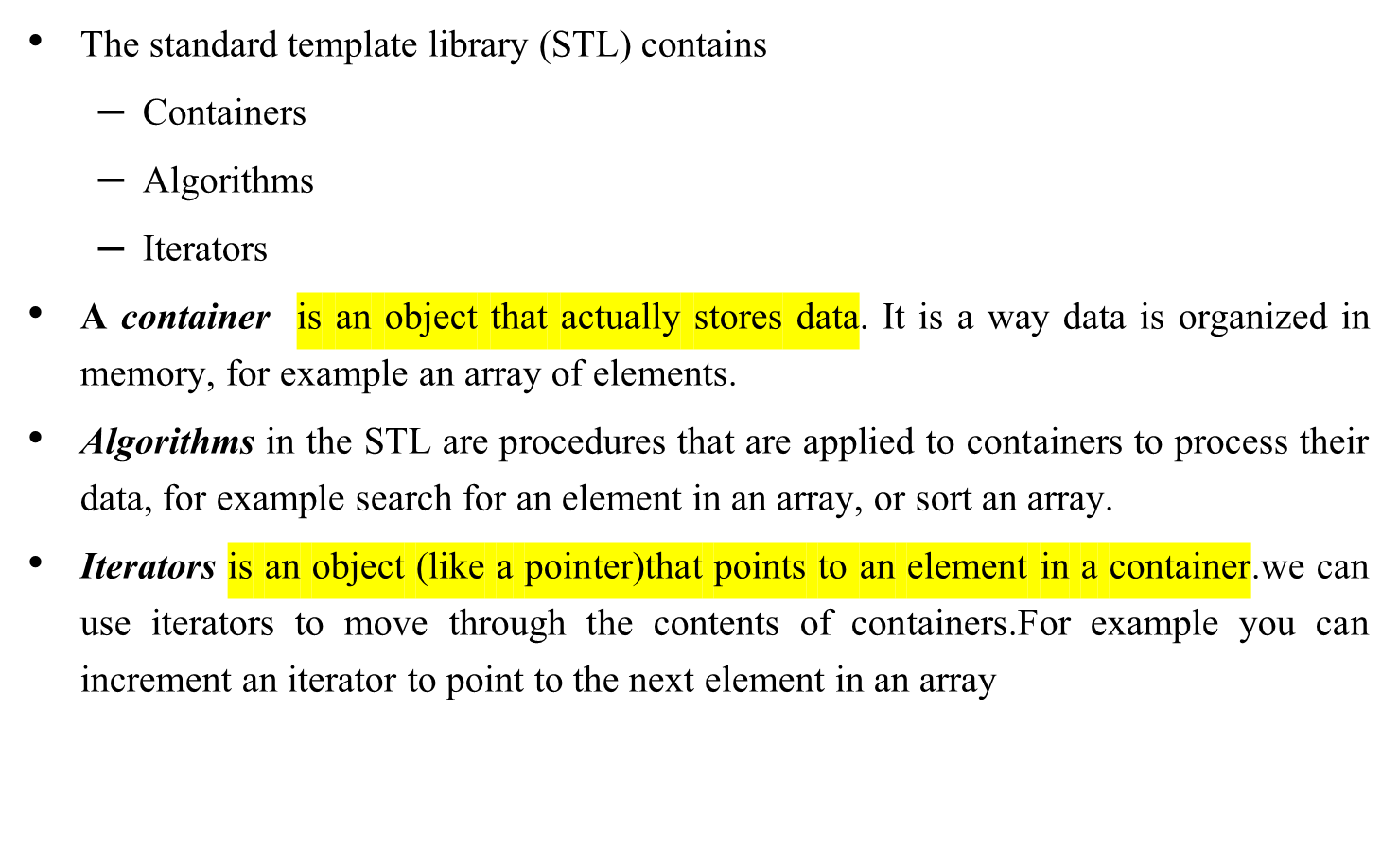
Standard Template Library

Slide 4
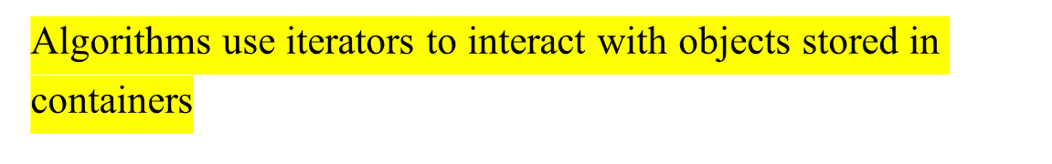
Containers, Iterators, Algorithms
Container
Container
Iterator
Algorithm
Objects
Iterator
Algorithm
Iterator
Iterator
Algorithm

Slide 5
Containers
A container is a way to store data, either built-in data types like int and float, or class objects
The STL provides several basic kinds of containers
  <vector> : one-dimensional array
  <list> : double linked list
  <deque> : double-ended queue
  <queue> : queue
  <stack> : stack
  <set> : set
  <map> : associative array

Slide 6
Containers
Types of containers
Sequence container
Associative container
Derived container

Slide 7
Sequence Containers
A sequence container- stores a set of elements in sequence, in other words each element (except for the first and last one) is preceded by one specific element and followed by another,
  <vector>
  <list>
  <deque>

Slide 8
Sequence Containers
<vector> is an expandable array (dynamic array) that can shrink or grow in size, but still has the disadvantage of inserting or deleting elements in the middle. Allows insertions and deletions at back.
<list> is a double linked list (each element has points to its successor and predecessor), it is quick to insert or delete elements but has slow random access.
<deque> is a double-ended queue, that means one can insert and delete elements from both ends, it is a kind of combination between a stack (last in first out) and a queue (first in first out) and constitutes a compromise between a <vector> and a <list>

Slide 9
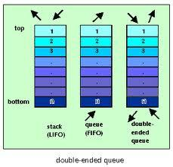
Deque

Slide 10
Difference between Array and Vector
Vector is template class and is C++ only construct whereas arrays are built-in language construct and present in both C and C++.
Size of arrays are fixed whereas the vectors are resizable i.e. they can grow and shrink as vectors are allocated on heap memory.
Arrays have to be deallocated explicitly if defined dynamically whereas vectors are automatically de-allocated from heap memory.
When arrays are passed to a function, a separate parameter for size is also passed whereas in case of passing a vector to a function, there is no such need as vector maintains variables which keeps track of size of container at all times.
When array becomes full and new elements are inserted; no reallocation is done implicitly whereas When vector becomes larger than its capacity, reallocation is done implicitly.

Slide 11
Difference between Vector and List
Insertion and Deletion
Insertion and Deletion in List is very efficient as compared to vector because to insert an element in list at start, end or middle, internally just a couple of pointers are swapped.
Whereas, in vector insertion and deletion at start or middle will make all elements to shift by one. Also, if there is insufficient contiguous memory in vector at the time of insertion, then a new contiguous memory will be allocated and all elements will be copied there.
So, insertion and deletion in list is much efficient than vector in C++.
Random Access:
As List is internally implemented as doubly linked list, therefore no random access is possible in List. It means, to access 15th element in list we need to iterate through first 14 elements in list one by one.
Whereas, vector stores elements at contiguous memory locations like an array. Therefore, in vector random access is possible i.e. we can directly access the 15th element in vector using operator []

Slide 12
Program example 1-vector
#include<iostream>
#include<vector>
using namespace std;
int main()
{
vector<int> v1(10);
//vector<int>v1; //Zero size vector
cout<<"size is\t"<<v1.size()<<"\n";
for(int i=0;i<=9;i++)
{
v1[i]=i;
}
for(int i=10;i<=19;i++)
{
v1.push_back(i);
}
cout<<"size is\t"<<v1.size()<<"\n";
for(int i=0;i<=19;i++)
{
cout<<v1[i]<<"\t";
}
v1.pop_back();
v1.pop_back();
cout<<"\n New size of the vector:"<<v1.size();
// use iterator to access the values
vector<int>::iterator v = v1.begin();
while( v != v1.end())
{
cout << "\nvalue of v = " << *v;
v++;
}
return 0;
}

Slide 13
Member functions of vector
size(): It will give total number of elements in the vector
erase(): It is used to delete some specific element/ or range of elements
begin(): It gives the reference of beginning of vector
end(): It gives the reference after the last element of vector
clear():It is used to delete all elements of vector at once
pop_back(): It is used to delete element from the last only
push_back():It is used to insert element at the last only
insert(): It is used to insert element at any given position in the vector

Slide 14
Program example 2-vector
#include<iostream>
#include<vector>
using namespace std;
int main()
{
vector<int> v1(10);
cout<<"size is\t"<<v1.size()<<"\n";
for(int i=0;i<=9;i++)
{
v1[i]=i;
}
vector<int>:: iterator i=v1.begin();
i=i+3;
v1.insert(i,100);
//v1.erase(v1.begin());
v1.erase(v1.begin()+1,v1.begin()+5);
for(int i=0;i<v1.size();i++)
{
cout<<v1[i]<<"\t";
}
cout<<"\n"<<v1.size();
v1.clear();
cout<<"\n"<<v1.size();
}

Slide 15
Program example 1-list
#include<iostream>
#include<list>
using namespace std;
void display(list<int> &l)
{
list<int>::iterator p;
for(p=l.begin();p!=l.end();p++)
cout<<"\n"<<*p;
}
int main()
{
list<int> list1;
list<int> list2(5);
for(int i=0;i<3;i++)
list1.push_back(i);
cout<<"\n Displaying first list:";
display(list1);
list<int>::iterator p;
for(p=list2.begin();p!=list2.end();p++)
*p=1;
cout<<"\n Displaying Second list:";
display(list2);
cout<<"\n Pushing element at front:";
list1.push_front(100);
display(list1);
cout<<"\n Poping element from front:";
list2.pop_front();
display(list2);
cout<<"\nSorting first list:";
list1.sort();
display(list1);
cout<<"\n Sorting second list:";
list2.sort();
display(list2);
cout<<"\n Merging list:";
list1.merge(list2);
display(list1);
list1.reverse();
display(list1);
cout<<"\n Reversed merged list";
}

Slide 16
Member functions of List
size(): It will give total number of elements in the list
begin():It gives the reference of beginning of list
end(): It gives the reference after the last element of list
push_front():It is used to insert element at front
pop_front():It is used to delete element from front
push_back(): It is used to insert element at last
sort():It is used to arrange the elements in ascending order(by default)
reverse(): It is used to arrange the elements in reverse order
merge(): It is used to combine the elements of two lists[After combining the elements will be sorted in ascending order automatically]
clear(): It is used to delete all elements of list at once

Slide 17
Associative Containers
An associative container are designed to support direct access to elements using keys and they are non-sequential.
  The keys, typically a number or a string, are used by the container to arrange the stored elements in a specific order, for example in a dictionary the entries are ordered alphabetically.
  Elements are usually arranged in sorted fashion automatically
There are 4 types of associative containers:
  Set
  Multiset
  Map
  Multimap
All these store data in a structure called tree which facilitates fast searching, deletion and insertion but slow for random access

Slide 18
Associative Containers
A <set> stores a number of items which contain keys.The keys are the attributes used to order the items, for example a set might store objects of the class.
Person which are ordered alphabetically using their name
A <map> stores pairs of objects: a key object and
an associated value object. A <map> is somehow similar to an array except instead of accessing its elements with index numbers, you access them with indices of an arbitrary type.
<set> and <map> only allow one key of each value[unique], whereas <multiset> and <multimap> allow multiple identical key values

Slide 19
Derived containers
The containers derived from different sequence containers.
Derived containers
  Stacks [LIFO]
  Queues [FIFO]
  Priority Queues[The first element out is always the highest priority element]
Also known as container adaptors
These do not support iterators so can not be used for data manipulation.
However , they support two member functions
  pop()
  push()

Slide 20
Algorithms
Algorithms are the functions that can be used generally across a variety of containers for processing of their contents.
Each containers provides functions for basic operations.
STL provides various standard algorithms to support more extended or complex operations.
STL algorithms are not member functions or friends of containers
These Standard algorithms are standalone templates.
STL algorithms reinforce the philosophy of reusability.
include<algorithm>-This header file should be included to use predefined algorithms

Slide 21
Algorithms
STL algorithms, based on the nature of operations they perform, may be categorized as under:
  Non mutating algorithms.
  Mutating algorithms
  Sorting algorithms
  Set algorithms
  Relational algorithms

Slide 22
Algorithms
Non-mutating algorithms(Non-modifying sequence algorithms)
for_each() Do specified operation for each element in a sequence
find() Find the first occurence of a specified value in a sequence
find_if() Find the first match of a predicate in a sequence
find_first_of() Find the first occurence of a value from one sequence in another
adjacent_find() Find the first occurence of an adjacent pair of values
count() Count occurences of a value in a sequence
count_if() Count matches of a predicate in a sequence

Slide 23
Mutating algorithms(Modifying sequence operations)
copy() Copy range of elements
copy_n() Copy elements (function template )
copy_if() Copy certain elements of range (function template )
copy_backward()Copy range of elements backward (function template )
move() Move range of elements (function template )
move_backward() Move range of elements backward (function template )
swap() Exchange values of two objects (function template
swap_ranges()Exchange values of two ranges (function template )
iter_swap() Exchange values of objects pointed by two iterators (function template
transform() Transform range (function template )
replace() Replace value in range (function template )
replace_if() Replace values in range (function template )
replace_copy() Copy range replacing value (function template )
replace_copy_if() Copy range replacing value (function template )

Slide 24
Mutating algorithms(Modifying sequence operations
fill() Fill range with value (function template )
fill_n() Fill sequence with value (function template )
generate() Generate values for range with function (function template )
generate_n() Generate values for sequence with function (function template )
remove() Remove value from range (function template )
remove_if() Remove elements from range (function template)
remove_copy()Copy range removing value (function template)
remove_copy_if()Copy range removing values (function template )
unique()Remove consecutive duplicates in range (function template)
unique_copy()Copy range removing duplicates (function template)
reverse()Reverserange (function template )
reverse_copy()Copy range reversed (function template )
rotate() Rotate left the elements in range (function template )
rotate_copy() Copy range rotated left (function template )
random_shuffle()Randomly rearrange elements in range (function template)
shuffle () Randomly rearrange elements in range using generator (function template )

Slide 25
Sorting Algorithms
sort() Sort elements in range (function template )
stable_sort Sort elements preserving order of equivalents (function template )
partial_sort Partially sort elements in range (function template )
partial_sort_copy Copy and partially sort range (function template )
is_sorted Check whether range is sorted (function template )
is_sorted_until Find first unsorted element in range (function template )
nth_elementSort element in range (function template )

Slide 26
Set algorithms
set_union : Union of two sorted ranges
set_intersection : Intersection of two sorted ranges
set_difference : Difference of two sorted ranges
set_symmetric_difference : Symmetric difference of two sorted ranges

Slide 27
Relational algorithms
max()
max_element()
min()
min_element()
equal()

Slide 28
for_each()- Program example 1-Algorithm
#include <vector>
#include <algorithm>
#include <iostream>
using namespace std;
void show(int n)
{
cout << n <<" ";
}
int main()
{
int arr[] = { 12, 3, 17, 8 }; // standard C array
vector<int> v(arr, arr+4); // initialize vector with C array
for_each (v.begin(), v.end(), show); // apply function show to each element of vector v
}

Slide 29
find ()- Program example 2-Algorithm
#include <vector>
#include <algorithm>
#include <iostream>
using namespace std;
int main() {
int key;
int arr[] = { 12, 3, 17, 8, 34, 56, 9 }; // standard C array
vector<int> v(arr, arr+7); // initialize vector with C array
vector<int>::iterator iter;
cout << "\nEnter value :";
cin >> key;
iter=find(v.begin(),v.end(),key); // finds integer key in v
if (iter != v.end()) // found the element
cout << "Element " << key << " found" << endl;
else
cout << "Element " << key << " not in vector v" << endl;
}

Slide 30
Iterators
Iterators are pointer-like entities that are used to access individual elements in a container.
Often they are used to move sequentially from element to element, a process called iterating through a container.
vector<int>
array_
17
vector<int>::iterator
4
23
The iterator corresponding to
the class vector<int> is of
the type vector<int>::iterator
12
size_
4

Slide 31
Iterators
The member functions begin() and end() return an
iterator to the first and past the last element of a container
vector<int> v
v.begin()
array_
17
4
23
12
v.end()
size_
4

Slide 32
Iterators
One can have multiple iterators pointing to different or identical elements in the container
vector<int> v
i1
array_
17
4
i2
23
12
i3
size_
4

Slide 33
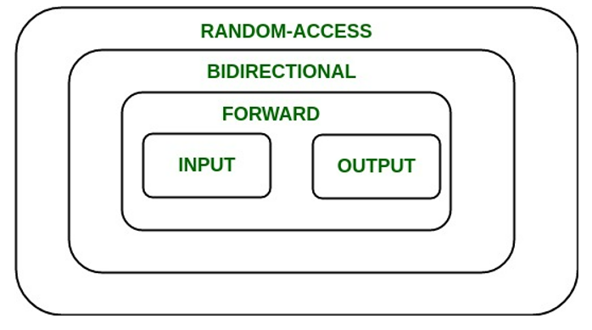
Iterator Categories
Not every iterator can be used with every container for example the list class provides no random access iterator
Every algorithm requires an iterator with a certain level of capability. For example to use the [] operator you need a random access iterator
Iterators are divided into five categories in which a higher (more specific) category always subsumes a lower (more general) category.

Slide 34
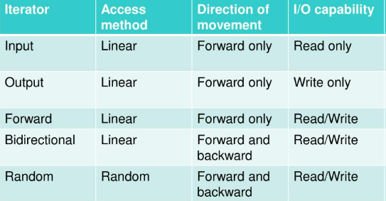
Iterators and their characteristics

Slide 35
Iterators for various containers
vector: Random access
list: Bidirectional
deque: Random access
set: Bidirectional
multiset: Bidirectional
map: Bidirectional
multimap: Bidirectional
stack, queue, priority queue: No iterator

Slide 36
Iterators—Program example
#include <vector>
#include <iostream>
using namespace std;
int main()
{
int arr[] = { 12, 3, 17, 8 }; // standard C array
vector<int> v(arr, arr+4); // initialize vector with C array
for (vector<int>::iterator i=v.begin(); i!=v.end(); i++)
// initialize i with pointer to first element of v
// i++ increment iterator, move iterator to next element
{
cout << *i << " "; // de-referencing iterator returns the
// value of the element the iterator points at
}
cout << endl;
}

