Slide 1

Welcome!
An Overview of Agile…

Slide 2
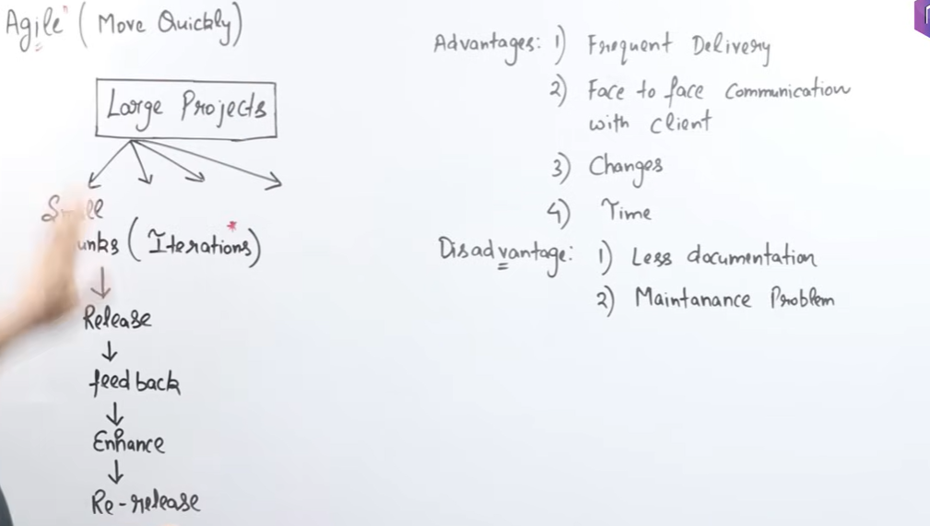

Slide 3
When To Use the Agile Model?
When frequent modifications need to be made, this method is implemented.
When a highly qualified and experienced team is available.
When a customer is ready to have a meeting with the team all the time.
when the project needs to be delivered quickly.
Projects with few regulatory requirements or not certain requirements.
projects utilizing a less-than-strict current methodology
Those undertakings where the product proprietor is easily reachable
Flexible project schedules and budgets.

Slide 4
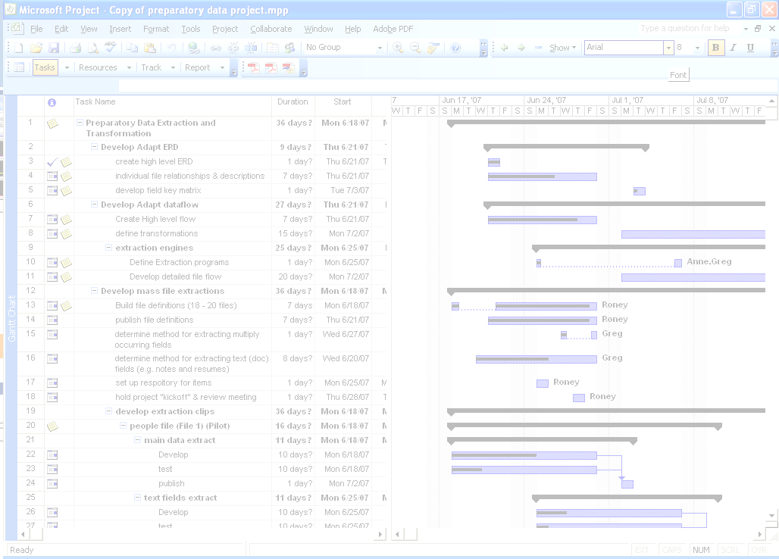
Let’s talk projects:
Almost all work is done as a “project”
All projects have a plan, execute, inspect, accept model
In Business projects are “managed” to ensure accountability and control.
Project Management has become a practice and career unto itself.
There are myriad methods and tools for project management.
All are about “delivered on time and on budget”.

Slide 5
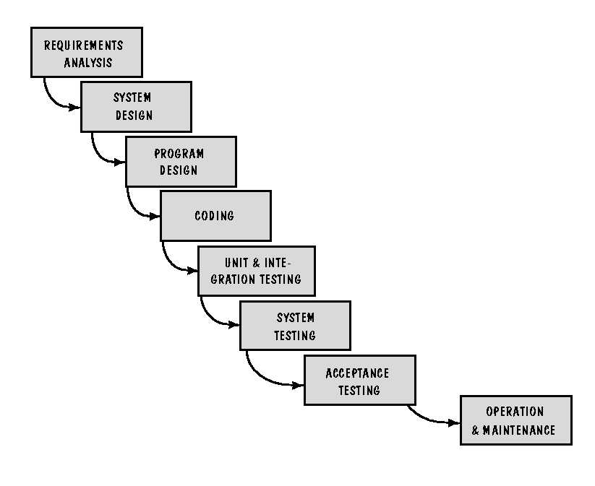

SDLC – What is it?
Feasibility
Study
Systems Development Life Cycle: The most commonly used, and generally accepted, project management approach..
Notes:
System Design is the process of designing the architecture, components, and interfaces for a system so that it meets the end-user requirements.

Slide 6

Classic SDLC Characteristics
Requirements & Tasks are expected to be well defined at outset.
Methodology is highly document driven.
Project roles are highly structured and well defined.
Communication is through PM and Sponsor.
Typically long cycle

Slide 7
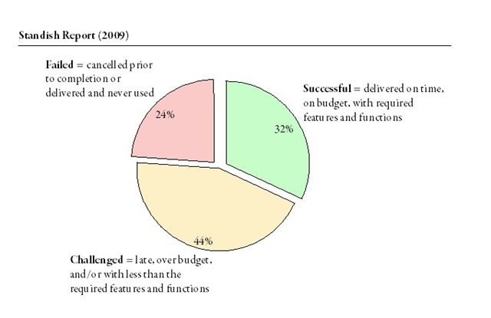
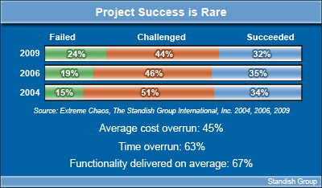
After 30 years of SDLC…
What we’re doing is not working!
Notes:
Overrun: take more time, space, or money than intended

Slide 8
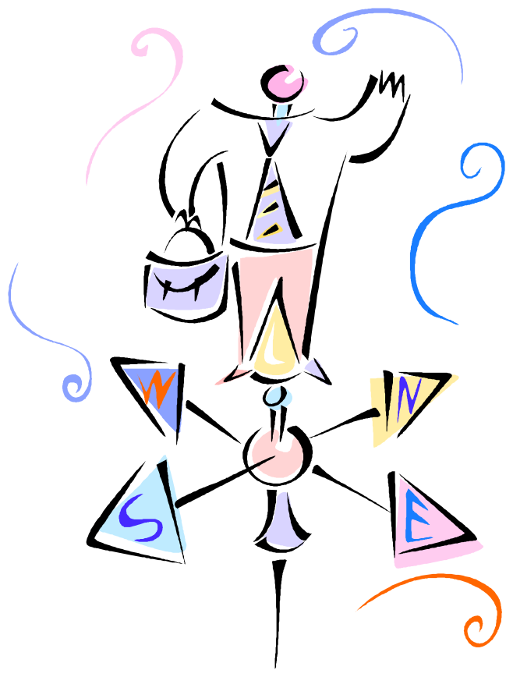
It’s All About…
Change!

Slide 9


The Agile Manifesto (2001) - A statement of values
Agile Practice favors:
Individuals and interactions
Process and tools
over
Working Product
Comprehensive documentation
over
Customer collaboration
Contract negotiation
over
Responding to change
Following a plan
over

Slide 10
The Big Paradigm Shift
We’re used to | Agile Wants
Time Lines | We’re done when it’s done.
Project Managers | Disciplined self managing teams.
Fixed Budgets | Assumed change means no fixed cost.
Predictable, all at once deliverables | Incremental deliverables driven by value and constant learning.
Multiple matrixed units in multiple locations make up team | Co-location – one team.
Communication by Document | Information Radiators.
Customer is removed | Customer is part of team.
Certain Knowledge | Action

Slide 11
The Key Components of Agile
User Stories – Simple statements of requirements written from the “customer's” point of view.
Product Backlog – Collection of user stories that need to be addressed to consider the effort (Product) complete.
Sprint (aka Iteration) – A fixed length work period in which items taken from the backlog are satisfied. An Agile project is a sequence of sprints.
Sprint Planning Session – A team meeting in which the product owner reviews and explains each backlog items and it’s priority, the other team members task out the items and commit (or not) to performing each item, and the agile coach sets up the sprint management tools.
Sprint Review Session – At the closure of each sprint, work completed is presented and reviewed, lessons learned discussed, the overall sprint is evaluated and reviewed.

Slide 12
Agile roles
Product Owner | Is (or is the representative of) the Customer Develops and maintains the Product Backlog Prioritizes the Product Backlog Empowered to make decisions for all customers and users Presents and explains Product Backlog to team
Scrum Team | Performs the work directed by the Customer Self-organizing Business and technical skills to build an increment of functionality Responsible for estimating and committing to work Full autonomy and authority during a Sprint
ScrumMaster | Guides the Agile Execution Responsible for the process Responsible for maximizing team productivity Sets up and conducts meetings Representative to management and team

Slide 13

The Agile Model

Slide 14

Faster – better - cheaper
Hospital – New Applicant Tracking System
Waterfall Approach
Design
Spec
Code
UAT
Launch
Change Management & Approval
Agile Approach
Sprint
Sprint
Sprint
Users
stories

Slide 15
Advantages of Agile model:
Customer satisfaction by rapid, continuous delivery of useful software.
People and interactions are emphasized rather than process and tools. Customers, developers and testers constantly interact with each other.
Working software is delivered frequently (weeks rather than months).
Face-to-face conversation is the best form of communication.
Close, daily cooperation between business people and developers.
Continuous attention to technical excellence and good design.
Regular adaptation to changing circumstances.
Even late changes in requirements are welcomed

Slide 16
Disadvantages of Agile model:
In case of some software deliverables, especially the large ones, it is difficult to assess the effort required at the beginning of the software development life cycle.
There is lack of emphasis on necessary designing and documentation.
The project can easily get taken off track if the customer representative is not clear what final outcome that they want.
Only senior programmers are capable of taking the kind of decisions required during the development process. Hence it has no place for newbie programmers, unless combined with experienced resources.

Slide 17
Agile Methods – Putting the Manifesto to work
‘Adaptable’ development approach
‘Human-centric’ thinking for creating business value
Agile Methods
Agile Methods
Traditional Methods
‘Values’
‘Principles’
‘Values’
Customer
Customer
valued
Contract
Realized
Collaboration
as
Interaction
more than
Negotiation
Individuals
&
High
-
Performance
valued
Processes
Interactions
Realized
Teams
more than
&
Tools
as
Working
Realized
Iterative
valued
Comprehensive
Software
as
Development
more than
Documentation
Responding
Adaptability
valued
Following
Realized
to Change
as
or Flexibility
more than
a Plan
Agile Manifesto. (2001). Manifesto for agile software development. Retrieved September 3, 2008, from http://www.agilemanifesto.org

Slide 18
What makes Agile work?
Better collaboration with business
More adapted to change/learning
Communication
Motivation
Doing Less
Collective ownership
Time boxes
Inspect & adapt
Focus on the real thing
Information radiators
Short feedback loops
Team autonomy
Accepted Responsibility

Slide 19
The Big Paradigm Shift – some reality
We’re used to | Agile Wants | What Works
Time Lines | We’re done when it’s done. | Time Boxes – not more than x time
Project Managers | Disciplined self managing teams. | Collaboration between Coach and Product Owner
Fixed Budgets | Assumed change means no fixed cost. | Cost Boxes – not more than x to spend.
Predictable, all at once deliverables | Incremental deliverables driven by value and constant learning. | Pre-project user story sessions (Release Planning)
Team spread out | Co-location. | Core time in room or on phone/virtual presence
Communication by Document | Information Radiators & Conversations | Information Radiators captured electronically and posted. Daily Meetings
Customer is removed | Customer is in room as part of team. | Core time in room

Slide 20
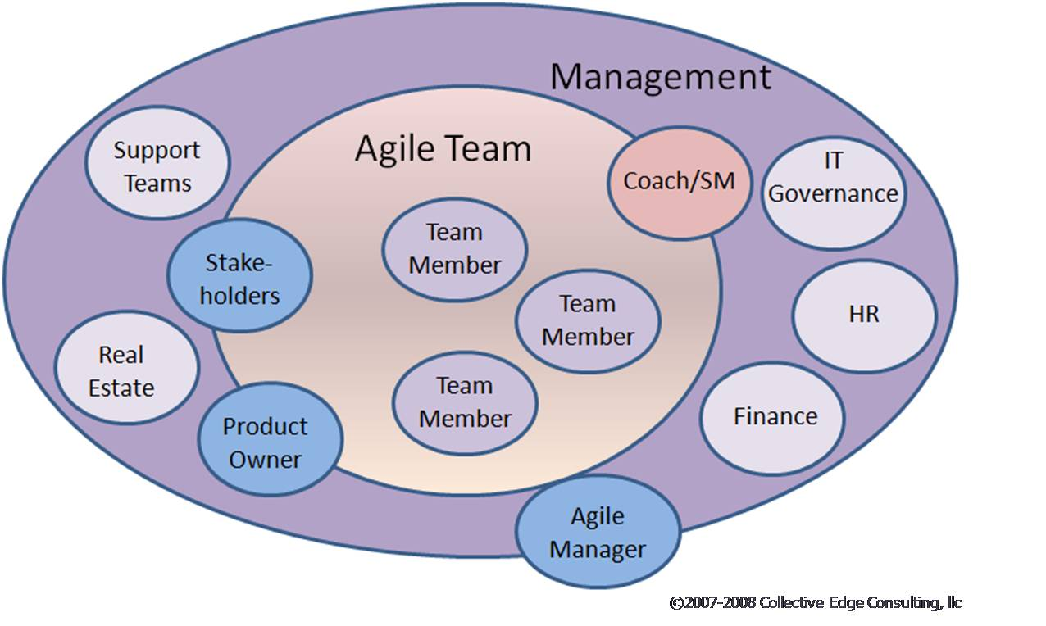
Agile roles - a second look

Slide 21

When is Agile best?
Creative Projects
New Technology Introductions
New Process Designs
Projects driven by critical business timing.
Projects with poorly defined needs

Slide 22
1. Which of the following is not a key issue stressed by an agile philosophy of software engineering? [UGC NET CS 2017]
(A) The importance of self-organizing teams as well as communication and collaboration between team members and customers
(B) Recognition that change represents an opportunity
(C) Emphasis on rapid delivery of software that satisfies the customer
(D) Having a separate testing phase after a build phase
Solution: Correct Answer is (D).

Slide 23
2. ​Which of the following is not one of the principles of the agile software development method? [UGC NET CS 2018]
(A) Following the plan
(B) Embrace change
(C) Customer involvement
(D) Incremental delivery
Solution: Correct Answer is (A).

