Slide 1
Scrum in 100 words
Scrum is an agile process that allows us to focus on delivering the highest business value in the shortest time.
It allows us to rapidly and repeatedly inspect actual working software (every two weeks to one month).
The business sets the priorities. Teams self-organize to determine the best way to deliver the highest priority features.
Every two weeks to a month anyone can see real working software and decide to release it as is or continue to enhance it for another sprint.

Slide 2
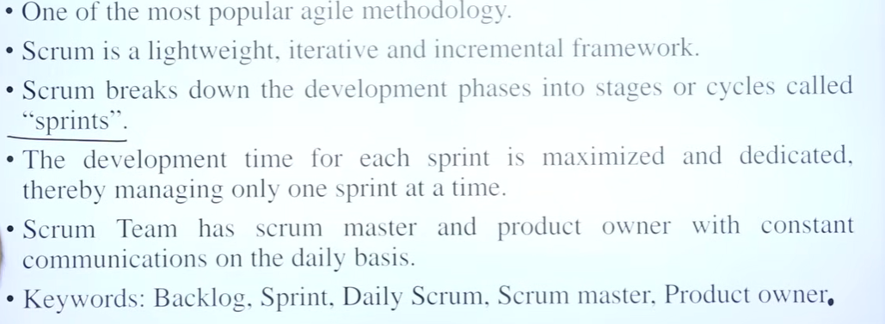

Slide 3
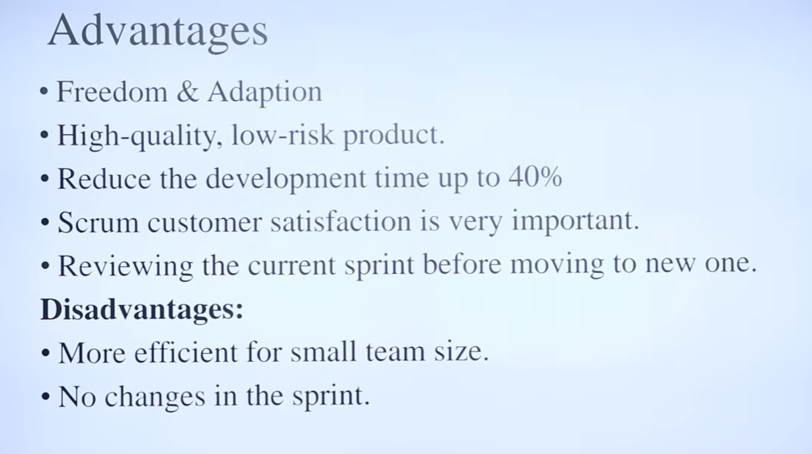

Slide 4
Difference between agile and scrum
Agile is a continuous iteration of development and testing in the software development process whereas Scrum is an Agile process to focus on delivering the business value in the shortest time.
Agile methodology delivers the software on a regular basis for feedback while Scrum delivers the software after each sprint.

Slide 5
In the Agile process, leadership plays a vital role; on the other hand, Scrum fosters a self-organizing, cross-functional team.
Agile involves collaborations and face-to-face interactions between the members of various cross-functional teams whereas Scrum collaboration is achieved in daily stand up meetings.
In Agile process design and execution should be kept simple whereas in Scrum process design and execution can be innovative and experimental.

Slide 6
Scrum has been used by:
Microsoft
Yahoo
Google
Electronic Arts
High Moon Studios
Lockheed Martin
Philips
Siemens
Nokia
Capital One
BBC
Intuit
Intuit
Nielsen Media
First American Real Estate
BMC Software
Ipswitch
John Deere
Lexis Nexis
Sabre
Salesforce.com
Time Warner
Turner Broadcasting
Oce

Slide 7
Scrum has been used for:
Commercial software
In-house development
Contract development
Fixed-price projects
Financial applications
ISO 9001-certified applications
Embedded systems
24x7 systems with 99.999% uptime requirements
the Joint Strike Fighter
Video game development
FDA-approved, life-critical systems
Satellite-control software
Websites
Handheld software
Mobile phones
Network switching applications
ISV applications
Some of the largest applications in use

Slide 8
Characteristics
Self-organizing teams
Product progresses in a series of month-long “sprints”
Requirements are captured as items in a list of “product backlog”
No specific engineering practices prescribed
Uses generative rules to create an agile environment for delivering projects
One of the “agile processes”

Slide 9





Scrum
24 hours
Sprint
2-4 weeks
Sprint goal
Return
Sprint backlog
Potentially shippable
product increment
Return
Cancel
Gift wrap
Coupons
Gift wrap
Cancel
Coupons
Product
backlog

Slide 10

Putting it all together
Image available at www.mountaingoatsoftware.com/scrum

Slide 11
Sprints
Scrum projects make progress in a series of “sprints”
  Analogous to Extreme Programming iterations
Typical duration is 2–4 weeks or a calendar month at most
A constant duration leads to a better rhythm
Product is designed, coded, and tested during the sprint

Slide 12



Sequential vs. overlapping development
Requirements
Design
Code
Test
Rather than doing all of one thing at a time...
...Scrum teams do a little of everything all the time
Source: “The New New Product Development Game” by Takeuchi and Nonaka. Harvard Business Review, January 1986.

Slide 13

No changes during a sprint
Change
Plan sprint durations around how long you can commit to keeping change out of the sprint

Slide 14
Scrum framework
Roles
Product owner
ScrumMaster
Team
Ceremonies
Sprint planning
Sprint review
Sprint retrospective
Daily scrum meeting
Artifacts
Product backlog
Sprint backlog
Burndown charts

Slide 15
Scrum framework
Roles
Product owner
ScrumMaster
Team
Ceremonies
Sprint planning
Sprint review
Sprint retrospective
Daily scrum meeting
Artifacts
Product backlog
Sprint backlog
Burndown charts

