Slide 1
MOSFET

Slide 2
MOSFET
It is a solid state device
It is a Voltage controlled Device
It is of two types
Depletion Mode D-MOSFET
Enhancement Mode E-MOSFET

Slide 3
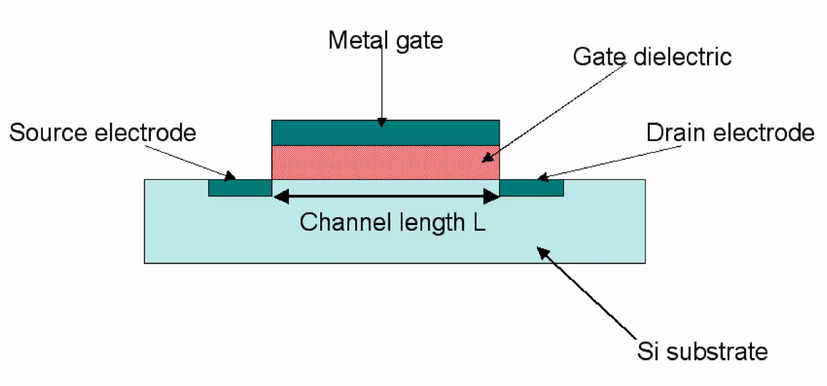

Slide 4
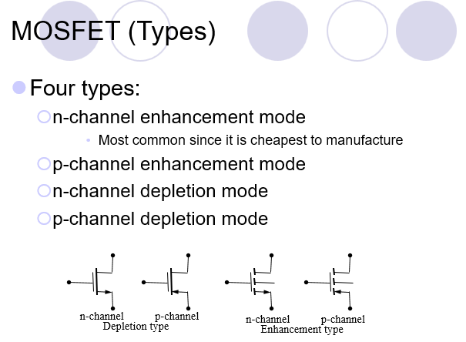

Slide 5
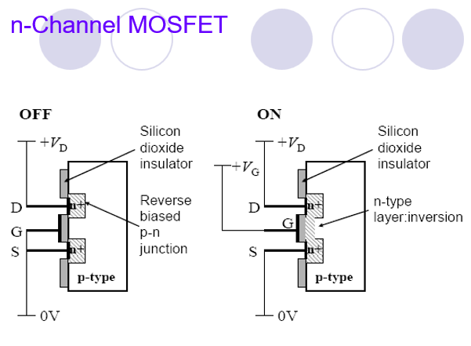

Slide 6
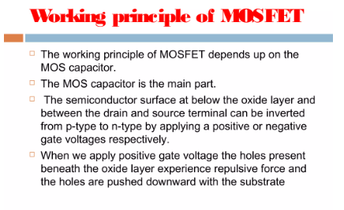

Slide 7
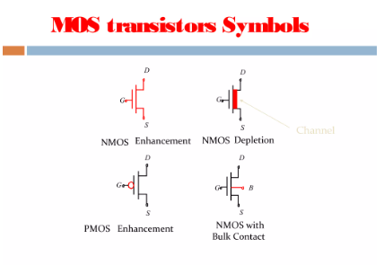

Slide 8
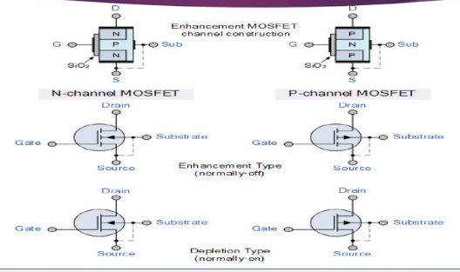

Slide 9
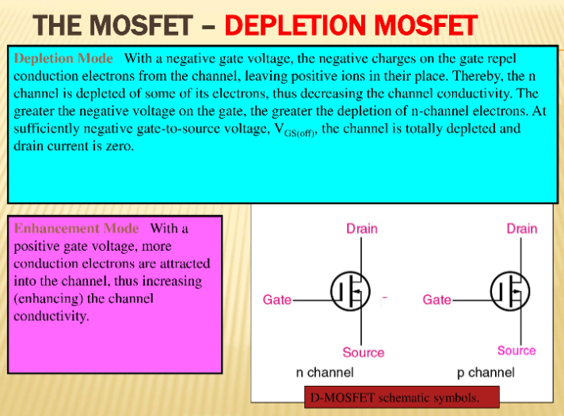

Slide 10
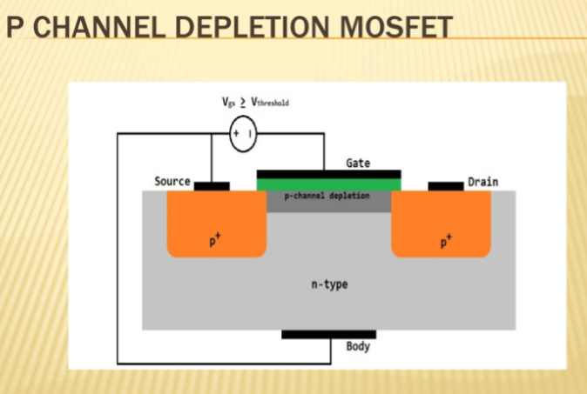

Slide 11
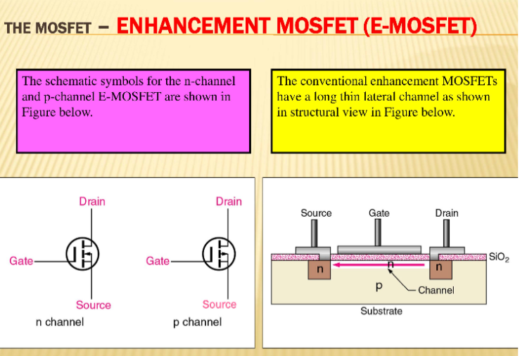

Slide 12
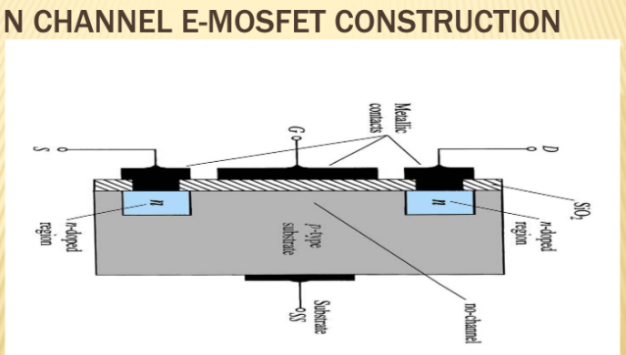

Slide 13
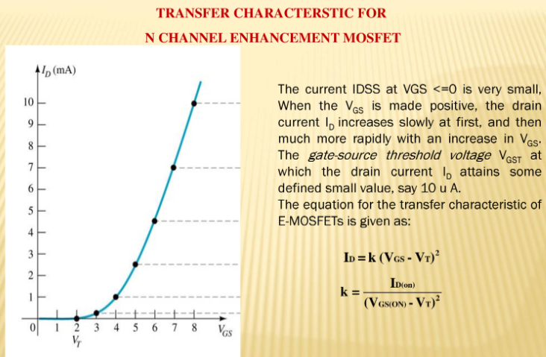

Slide 14
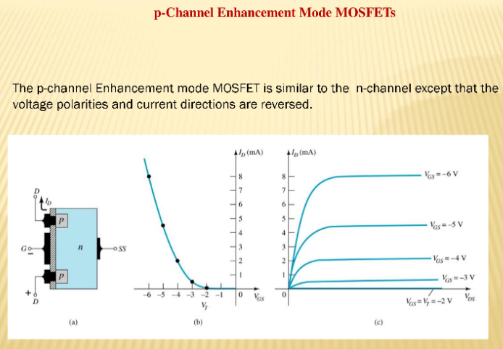

Slide 15
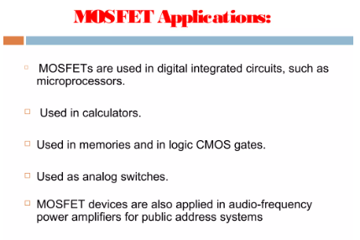

Slide 16
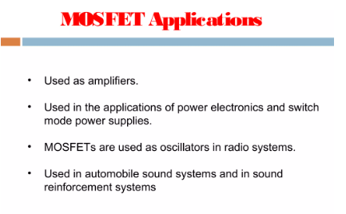

Slide 17
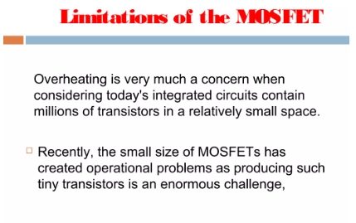

Slide 18
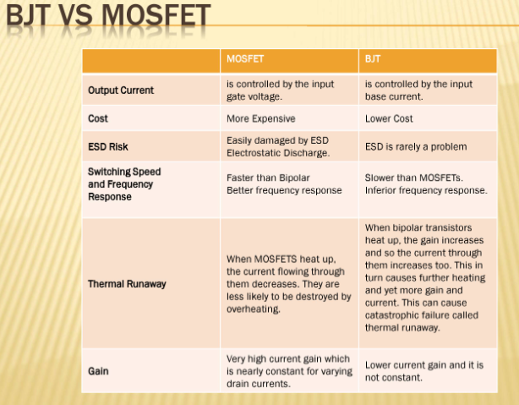

Slide 19
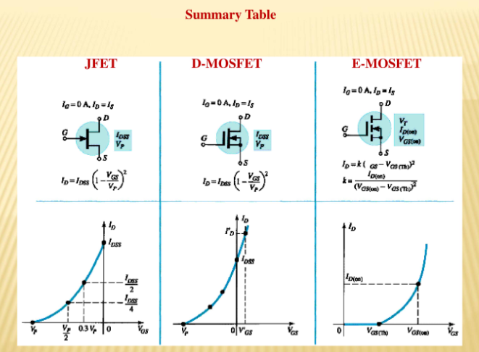

Slide 20
The MOSFET stands for
QUIZ POLL A.Metal oxidized selenium FET
B.Metal oxide surface FET
C.Metal oxide semiconductor FET
D.Metal of surface FET

Slide 21
Which of the following term does not belong to MOSFET:-
QUIZ POLL A) Source
B) Gate
C) Base
D) Drain

Slide 22
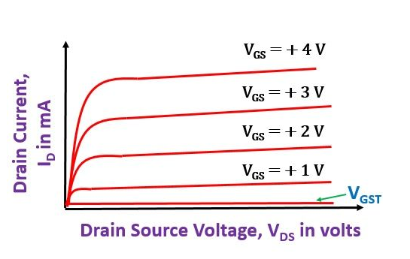
Characteristics of MOSFET

Slide 23
A MOSFET has …………… terminals
QUIZ POLL
two
five
four
three

Slide 24
Which transistor region is very thin and lightly doped?
QUIZ POLL
The emitter region
The collector region
The another region
The base region

Slide 25
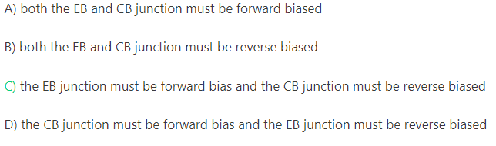
For a Transistor to function as an amplifier:-
QUIZ POLL
A)
B)
C)

Slide 26
With the E-MOSFET, when gate input voltage is zero, drain current is …..
at saturation
zero
Less than 10 A
widening the channel

