Slide 1
Unit-5 Combinational Circuit Adders Subtractor Decoder-Encoder Multiplexers-Demultiplexers Comparator Parity Generators

Slide 2
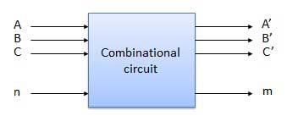
Combinational Circuits
Output depends only on the present input
The combinational circuit do not use any memory.
The previous state of input does not have any effect on the present state of the circuit.

Slide 3
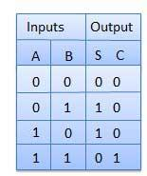

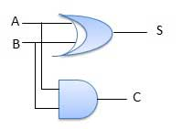
1. Half Adder
A combinational logic circuit with two inputs and two outputs.
The half adder circuit add two single bit Cary number
This circuit has two outputs carry and sum.
S(A, B) = ∑m (1, 2)
CY(A, B) = ∑m (3)

Slide 4
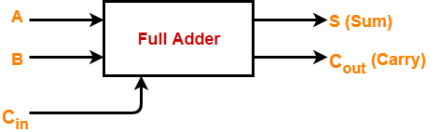
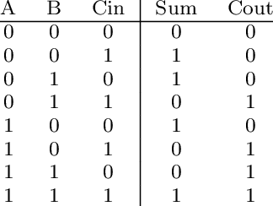
2. Full Adder (1-bit Adder)
A combinational logic circuit with 3 inputs and 2 outputs.
The Full adder circuit add 3 single bit Cary number
This circuit has two outputs carry and sum.

Slide 5
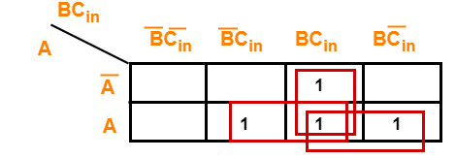
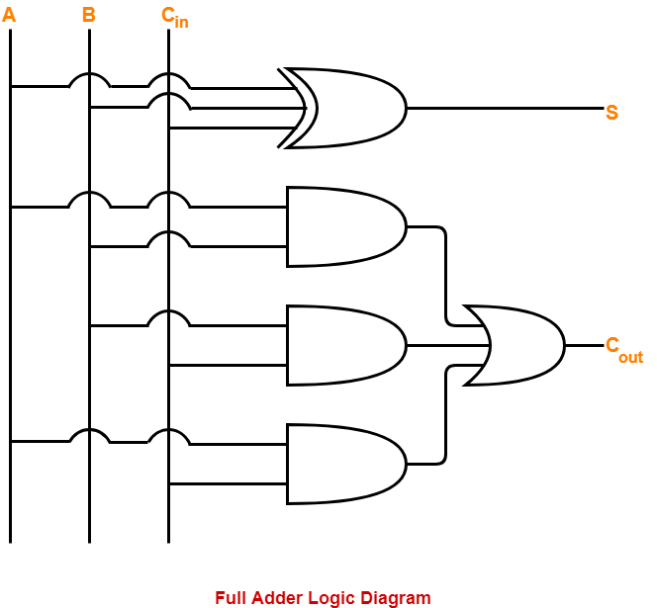
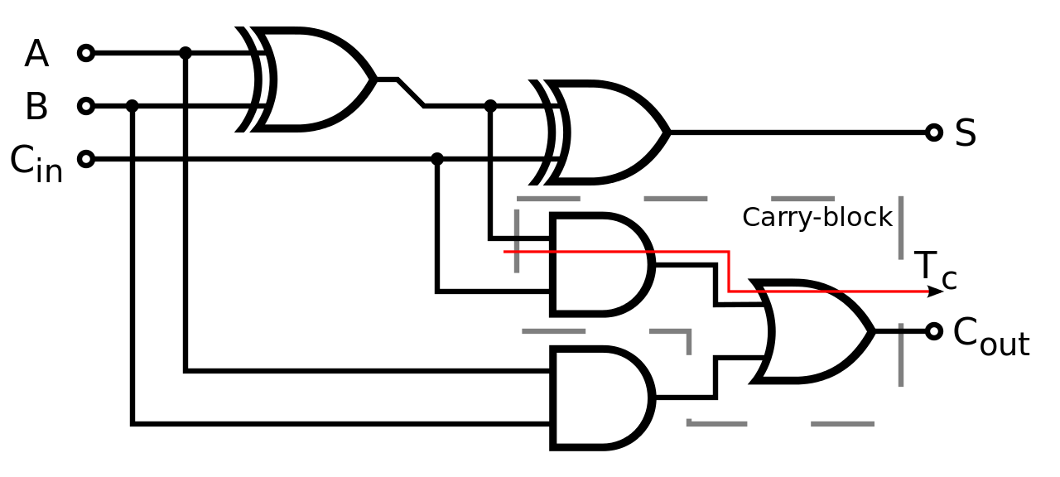
For Cout
Cout=AB+BC+AC

Slide 6
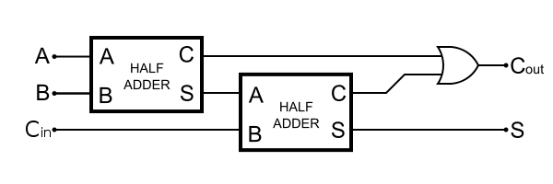
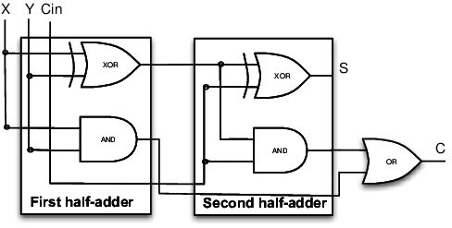
Full Adder using Half Adder
HA
Sum= A⊕B
Carry=AB
FA
Sum= A⊕B⊕C
Carry=AB+(A⊕B)C

Slide 7
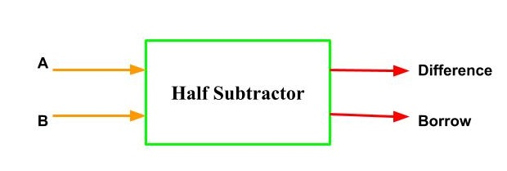
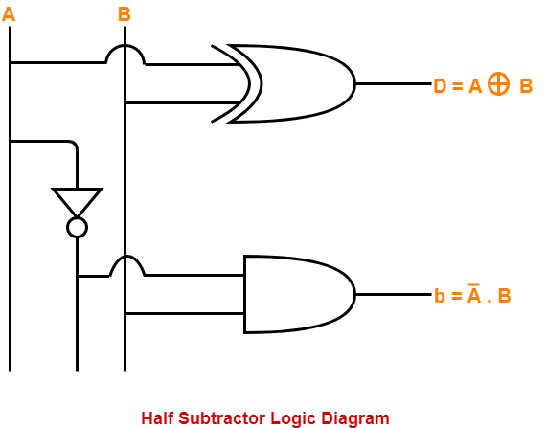
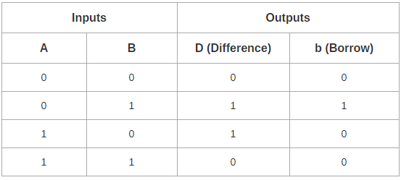
3. Half Subtractor
Combinational circuit perform binary Subtraction
Accepts 2 input and Two output Difference and Borrow

Slide 8
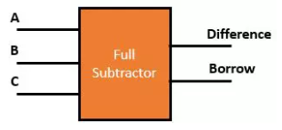
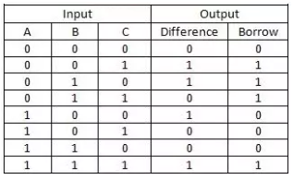
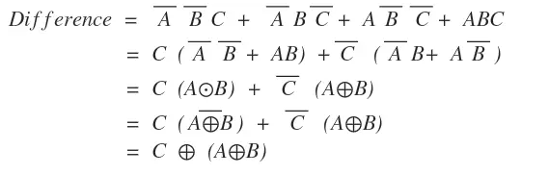
4. Full Subtractor
Performs subtraction of 3 bits
This circuit has three inputs and two outputs.
The three inputs A, B and C, denote the minuend, subtrahend, and previous borrow, respectively.
The two outputs, D and Bout
F(A, B,C) = ∑m (1, 2, 4, 7)
Bout(A, B,C) = ∑m (1,2,3,7)

Slide 9

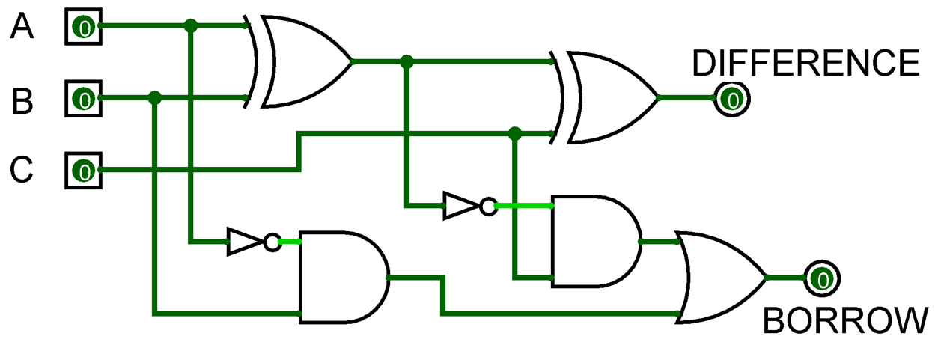
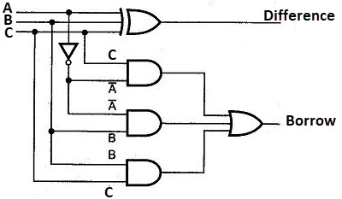
Bout = A’B’C + A’BC’ + A’BC + ABC
= C(AB + A’B’) + A’B(C + C’)
= C( A XNOR B) + A’B
= C (A XOR B)’ + A’B

Slide 10
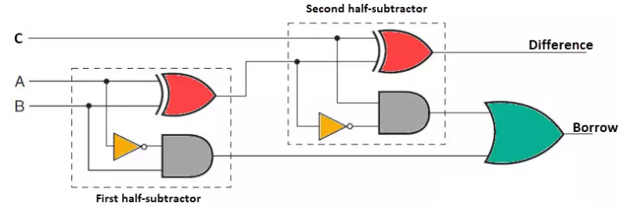
Full Subtractor using Half Subtractor
FS
Difference= A⊕B⊕C
Borrow=A’B+(A⊕B)’C
HS
Difference= A⊕B
Borrow=A’B

Slide 11
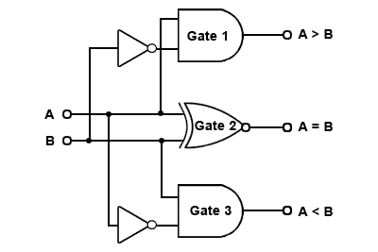
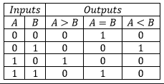
5. 1-BIT Magnitude Comparator
1-Bit Magnitude Comparator
GT
A
EQ
B
LT
EQ
GT
LT
GT=AB’
EQ=A’B’+AB
LT=A’B

Slide 12
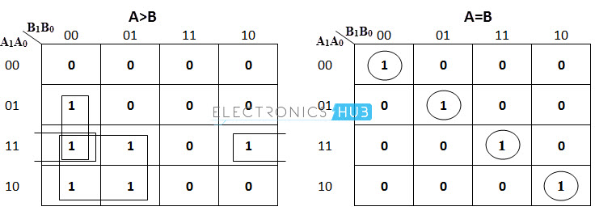
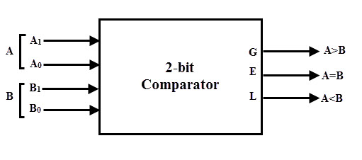
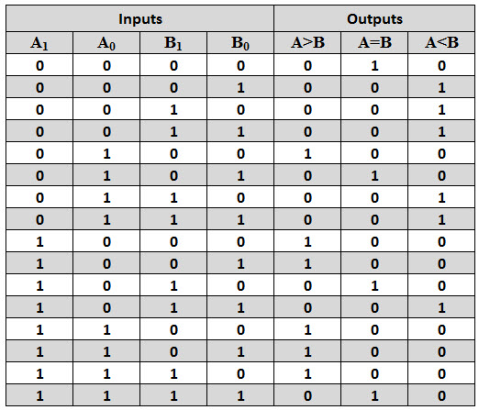
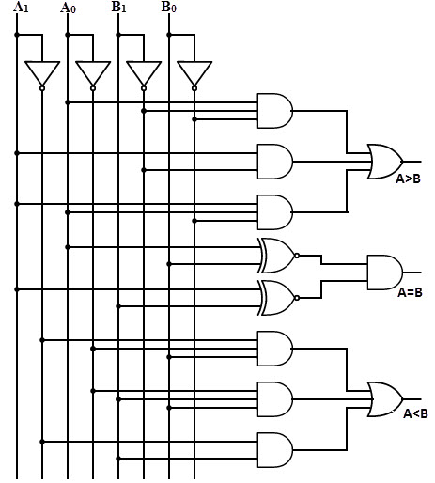
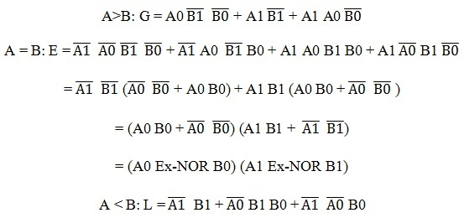
6. 2-BIT Magnitude Comparator

Slide 13
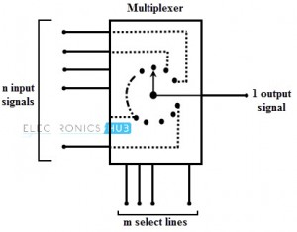
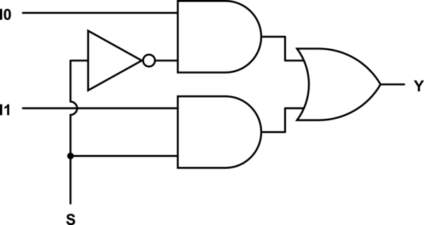
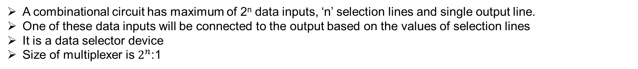
7. Multiplexer
A combinational circuit has maximum of 2^{n} data inputs, ‘n’ selection lines and single output line.
One of these data inputs will be connected to the output based on the values of selection lines
It is a data selector device
Size of multiplexer is $2^{n}$:1
2:1 Multiplexer
I0
0
Y
=S’I0 + SI1
I1
1
S

Slide 14
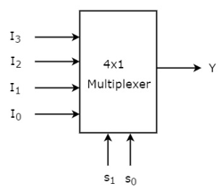

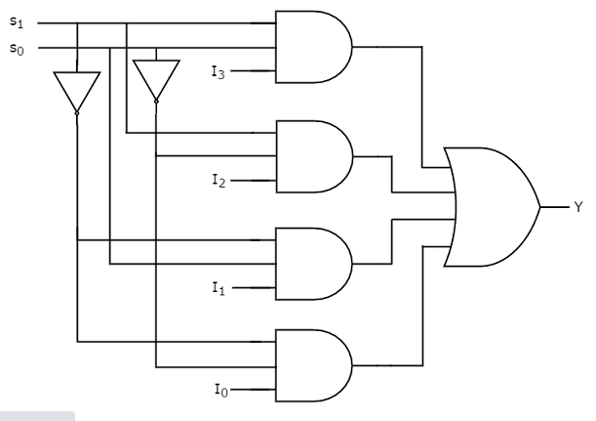
4:1 Multiplexer
Selection Lines |  | Output
S₁ | S₀ | Y
0 | 0 | I₀
0 | 1 | I₁
1 | 0 | I₂
1 | 1 | I₃

Slide 15
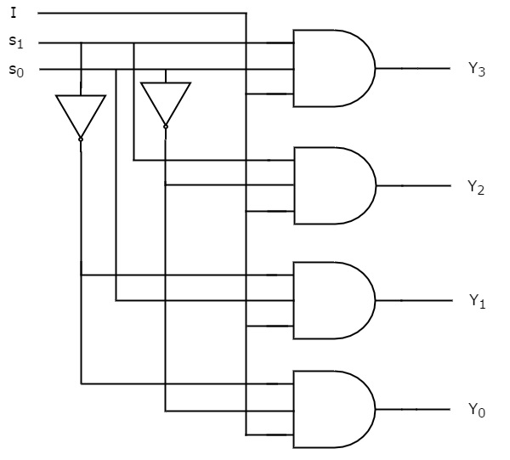
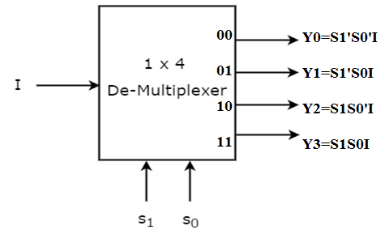
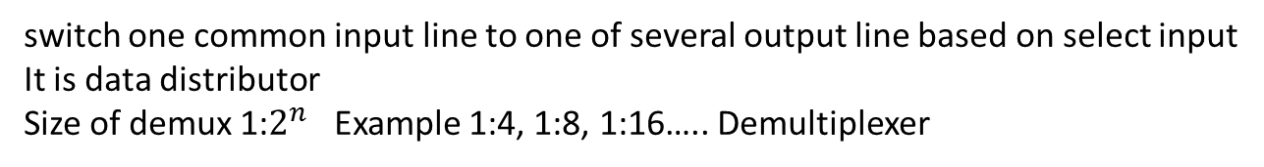
8. Demultiplexer
switch one common input line to one of several output line based on select input
It is data distributor
Size of demux 1:$2^{n}$ Example 1:4, 1:8, 1:16….. Demultiplexer
Selection Inputs |  | Outputs
S₁ | S₀ | Y₃ | Y₂ | Y₁ | Y₀
0 | 0 | 0 | 0 | 0 | I
0 | 1 | 0 | 0 | I | 0
1 | 0 | 0 | I | 0 | 0
1 | 1 | I | 0 | 0 | 0

Slide 16
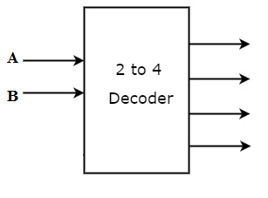

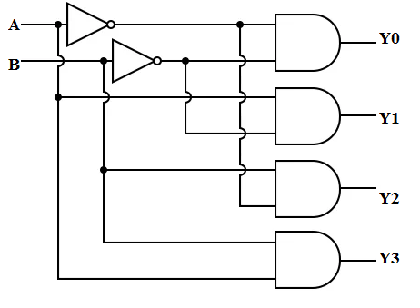
9. Decoder
A combinational circuit that has ‘n’ input lines and maximum of 2^{n} output lines.
One of these outputs will be active High based on the combination of inputs present, when the decoder is enabled.
The outputs of the decoder are min terms of ‘n’ input variables lines when it is enabled
Size of Decoder are 2:4, 3:8, 4:16….
A₁ | A₀ | Y₃ | Y₂ | Y₁ | Y₀
0 | 0 | 0 | 0 | 0 | 1
0 | 1 | 0 | 0 | 1 | 0
1 | 0 | 0 | 1 | 0 | 0
1 | 1 | 1 | 0 | 0 | 0

Slide 17
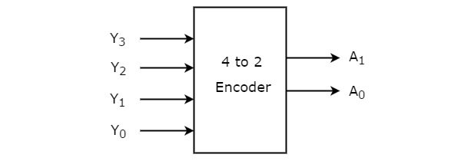
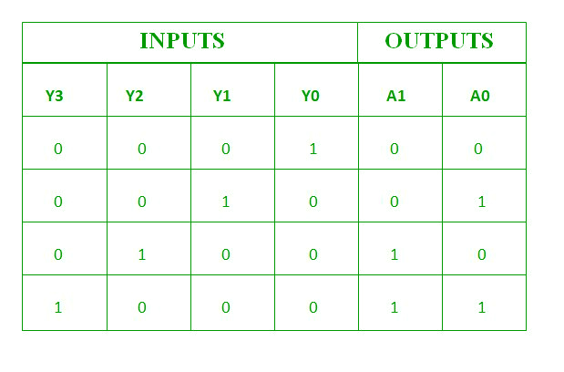
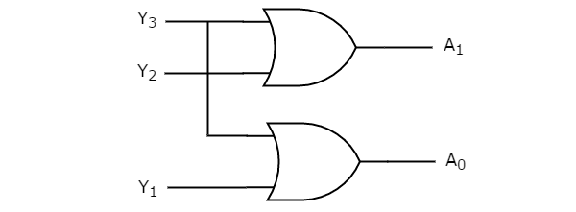
10. 4:2 Encoder

Slide 18
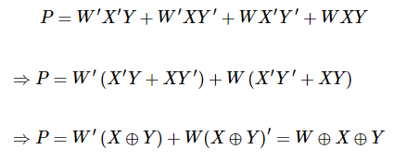
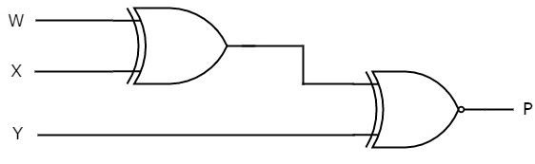
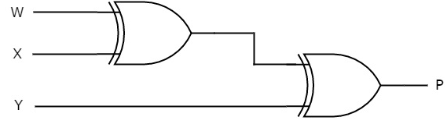
11. Parity Generator Circuit
Even Parity Generator
If odd number of ones present in the input, then even parity bit, P should be ‘1’ so that the resultant word contains even number of ones.
Odd Parity Generator
If even number of ones present in the input, then odd parity bit, P should be ‘1’ so that the resultant word contains odd number of ones
Binary Input WXY | Even Parity bit P
000 | 0
001 | 1
010 | 1
011 | 0
100 | 1
101 | 0
110 | 0
111 | 1
Binary Input WXY | Odd Parity bit P
000 | 1
001 | 0
010 | 0
011 | 1
100 | 0
101 | 1
110 | 1
111 | 0

