Slide 1

UNIT 2
(Artificial Intelligence & Machine Learning)
Notes:
1

Slide 2
Introduction to Machine Learning

Slide 3
What is Machine Learning?
“Learning is any process by which a system improves performance from experience.” - Herbert Simon
Definition by Tom Mitchell (1998):
Machine Learning is the study of algorithms that
improve their performance P
at some task T
with experience E.
A well-defined learning task is given by <P,T,E>

Slide 4
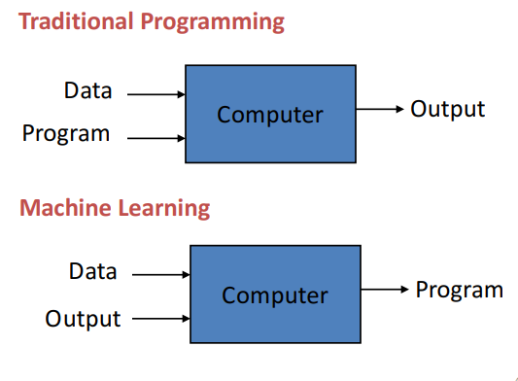

Slide 5
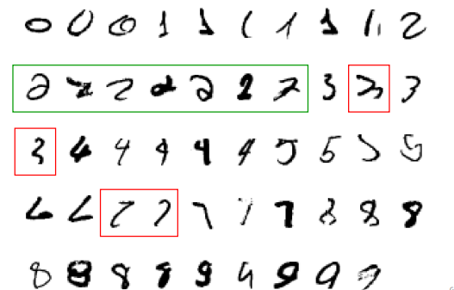
A classic example of a task that requires machine learning: It is very hard to say what makes a 2

Slide 6
Some more examples of tasks that are best solved by using a learning algorithm
Recognizing patterns:
– Facial identities or facial expressions
– Handwritten or spoken words
– Medical images
Generating patterns:
Generating images or motion sequences
Recognizing anomalies:
– Unusual credit card transactions
– Unusual patterns of sensor readings in a nuclear power plant
Prediction:
– Future stock prices or currency exchange rates

Slide 7
Introduction to AI

Slide 8
Artificial Intelligence (AI) is a branch of computer science that focuses on creating machines or systems capable of performing tasks that typically require human intelligence. These tasks include learning, reasoning, problem-solving, perception, language understanding, and decision-making. The ultimate goal of AI is to develop machines that can exhibit intelligence similar to or even surpassing human intelligence.

Slide 9
Types of AI
AI can be broadly categorized into two types:
Narrow AI (or Weak AI)
Narrow AI is designed to perform a specific task or a set of tasks, such as speech recognition, image recognition, or playing chess
General AI (or Strong AI)
General AI, on the other hand, refers to machines with the ability to understand, learn, and apply knowledge across various domains, similar to human intelligence.

Slide 10
Components of AI includes
Machine Learning (ML): It is a subset of AI that involves the development of algorithms and statistical models that enable computers to improve their performance on a task through experience.
Deep Learning: This is a subfield of machine learning that involves neural networks with multiple layers (deep neural networks). Deep learning has proven to be highly effective in tasks such as image and speech recognition, natural language processing, and more.
Natural Language Processing (NLP): NLP enables computers to understand, interpret, and generate human language. It is crucial for applications like chatbots, language translation, and sentiment analysis.
Computer Vision: This field focuses on enabling machines to interpret and understand visual information from the world, such as images and videos. Applications include facial recognition, object detection, and autonomous vehicles.
Robotics: Integrating AI with robotics allows machines to interact with the physical world, perform tasks, and make decisions based on sensory input.
Expert Systems: These are computer systems designed to mimic the decision-making abilities of a human expert in a specific domain. They use rule-based systems and knowledge representation to solve complex problems.

Slide 11
AI/ML
Machine learning is making great strides
Large, good data sets
Compute power
Progress in algorithms
Many interesting applications
commercial
scientific
Links with artificial intelligence
However, AI ≠ machine learning

Slide 12
Machine Learning Tasks
Supervised learning: the algorithm learns a mapping from input variables to output variables based on labeled training data.
regression: predict numerical values
classification: predict categorical values,
i.e., Spam email detection
Unsupervised learning: involves finding hidden patterns or structures in unlabeled data.
clustering: group data according to "distance"
association: find frequent co-occurrences
link prediction: discover relationships in data
data reduction: project features to fewer features
i.e., anomaly detection in network traffic.
Reinforcement learning: training agents to interact with an environment and learn from feedback to maximize cumulative rewards.
i.e., autonomous vehicle control.

Slide 13
Machine Learning Algorithms
Regression: Ridge regression, Support Vector Machines, Random Forest, Multilayer Neural Networks, Deep Neural Networks, ...
Classification: Naive Base, , Support Vector Machines, Random Forest, Multilayer Neural Networks, Deep Neural Networks, ...
Clustering: k-Means, Hierarchical Clustering, ...

Slide 14

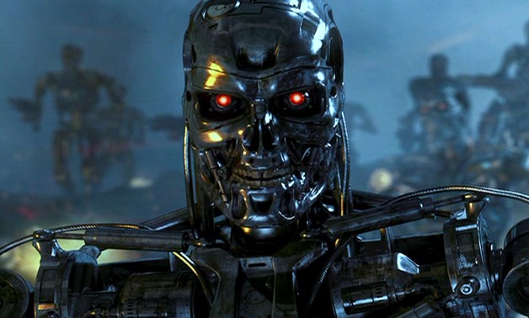
Issues
Many machine learning/AI projects fail (Gartner claims 85 %)
Ethics, e.g., Amazon has/had sub-par employees fired by an AI automatically

Slide 15
Reasons for failure
Asking the wrong question
Trying to solve the wrong problem
Not having enough data
Not having the right data
Having too much data
Hiring the wrong people
Using the wrong tools
Not having the right model
Not having the right yardstick

Slide 16
Expert Systems:
Expert systems are computer programs designed to emulate the decision-making ability of a human expert in a specific domain. They use a knowledge base of human expertise and an inference engine to provide solutions or make decisions. Expert systems are applied in various fields, including:
Medical Diagnosis: Expert systems can assist medical professionals in diagnosing diseases based on symptoms and patient history.
Financial Planning: They can provide advice on investment strategies and financial planning based on expert knowledge.
Troubleshooting: Expert systems can help users diagnose and solve technical problems by guiding them through a series of questions.

Slide 17
Fuzzy Systems:
Fuzzy logic is a mathematical framework that deals with uncertainty and imprecision. Fuzzy systems are particularly useful when dealing with vague or subjective information. Applications include:
Traffic Control Systems: Fuzzy logic can be used to optimize traffic signal timings based on real-time traffic conditions.
Home Appliances: Fuzzy controllers are employed in washing machines and air conditioners to adapt to varying conditions.

Slide 18
Augmented Reality:
Augmented Reality (AR) combines digital information with the user's real-world environment. AI plays a role in enhancing AR experiences through:
Object Recognition: AI algorithms can recognize and augment real-world objects in the user's view.
Gesture Recognition: AI helps interpret user gestures for interactive AR applications.

Slide 19
AI in Different Fields:
Natural Language Processing (NLP): Used in chatbots, language translation, sentiment analysis, and voice recognition.
Healthcare: AI is applied for diagnostics, drug discovery, personalized medicine, and patient management.
Agriculture: AI aids in precision farming, crop monitoring, and pest control.
Social Media Monitoring: AI is used to analyze social media data for sentiment analysis, trend prediction, and content moderation.

Slide 20
Tools and Techniques for Implementing AI:
Machine Learning Frameworks: TensorFlow, PyTorch, scikit-learn.
Development Platforms: Jupyter Notebooks, Google Colab.
Data Preprocessing: Pandas, NumPy.
Natural Language Processing Tools: NLTK, spaCy.

Slide 21
AI-powered Products:
Google Translator: Uses machine learning for language translation.
Driverless Cars: AI algorithms enable autonomous vehicles to navigate and make decisions.
Voice Assistants (Alexa, Siri): Use natural language processing to understand and respond to user commands.
ChatGPT: Utilizes a language model for generating human-like text responses.

Slide 22
Current trends and opportunities
Development in predictive analytics
Large Language Models (LLM)
Information security (InfoSec)
Launch of better autonomous systems
Art through NFTs
Digital avatars
Military weapons
Healthcare
Explainable AI (XAI): Enhancing transparency and interpretability of AI models.
Edge AI: Processing AI tasks on devices rather than relying solely on cloud computing.
AI Ethics and Bias Mitigation: Ensuring responsible and fair AI development.
Notes:
22

Slide 23
Job roles and skill set
SKill Set
Programming languages (Python, R, Java are the most necessary)
Linear algebra and statistics
Signal processing techniques
Neural network architectures
Machine Learning algorithms
Job Roles
Machine Learning Engineer
Data scientist
Robotics scientist
Research
NLP Engineer
Computer Vision Engineer.
Notes:
23

