Slide 1
Agile Metrics & Test-Driven Development (TDD) & Behavior-Driven Development (BDD)
Velocity, Burndown, Cycle Time, and Hands-on Exercises

Slide 2
Velocity in Agile
Measures the amount of work completed in a sprint
Helps teams predict future performance
Calculated as story points completed per sprint
Used for sprint planning and forecasting

Slide 3
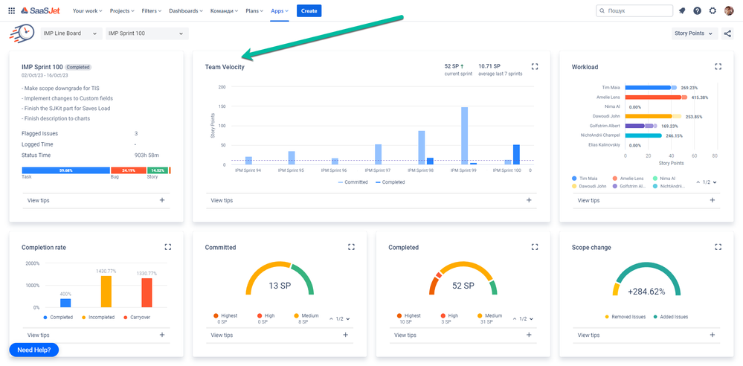

Slide 4
Burndown Chart
Tracks remaining work over time
Helps visualize progress toward sprint goals
X-axis: Time (days, weeks)
Y-axis: Remaining work (story points, hours)

Slide 5
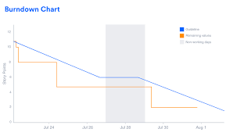

Slide 6
Cycle Time
Measures the time taken to complete a task
Helps improve process efficiency
Lower cycle time = faster delivery
Can be visualized using cumulative flow diagrams

Slide 7
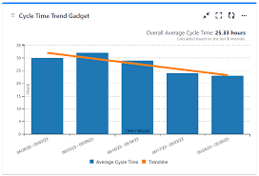

Slide 8
Test-Driven Development (TDD)
Write tests before writing the actual code
Follow the Red-Green-Refactor cycle:
1. Write a failing test (Red)
2. Write minimal code to pass the test (Green)
3. Refactor and improve the code
Ensures code reliability and maintainability

Slide 9
Behavior-Driven Development (BDD)
Focuses on user behavior and system response
Uses natural language (Gherkin syntax)
Example:
Given a user logs in
When they enter correct credentials
Then they should direct to the dashboard page
Enhances collaboration between developers, testers, and business stakeholders

Slide 10
Hands-on Exercises: TDD & BDD
TDD Exercise: Write unit tests before coding a simple calculator
BDD Exercise: Define user stories for an e-commerce login system
Use tools like JUnit (for TDD) and Cucumber (for BDD)
Practice refactoring and improving code iteratively

Slide 11
Pair Programming Practice
Involves two programmers working together on one workstation
Roles: 'Driver' (writes the code) & 'Navigator' (reviews and strategizes)
Improves code quality, knowledge sharing, and collaboration
Helps in early detection of bugs and logical errors
Encourages better design decisions and adherence to coding standards

Slide 12
Peer Evaluations in Pair Programming
• Provides constructive feedback on coding skills and collaboration
• Evaluates communication, problem-solving, and adaptability
• Can be done through structured rubrics or informal feedback sessions
• Helps identify strengths and areas for improvement
• Encourages continuous learning and team synergy

Slide 13
Using Agile Metrics in Project Management Tools
Tools like Jira, Trello, and Azure DevOps track Agile progress
Key Agile Metrics used in project management:
- Velocity: Measures completed work per sprint
- Burndown Chart: Tracks remaining work over time
- Cycle Time: Measures time taken to complete tasks
- Lead Time: Tracks time from request to completion
- Cumulative Flow Diagram: Visualizes task distribution
Helps teams improve efficiency and make data-driven decisions

Slide 14
Benefits of Tracking Agile Metrics
Provides transparency into project progress
Helps identify bottlenecks and inefficiencies
Enables better sprint planning and workload distribution
Enhances team accountability and continuous improvement
Supports stakeholder communication with clear data insights

Slide 15
MCQ
1. What does Velocity measure in Agile?
A) The number of defects fixed
B) The amount of work completed in a sprint
C) The number of team members
D) The amount of documentation produced
2. Which metric tracks remaining work over time in Agile
Velocity B) Cycle Time C) Burndown Chart D) Lead Time
3. What does Cycle Time measure?
A) The time taken to complete a task
B) The number of sprints completed
C) The number of team meetings
D) The amount of user stories delivered

Slide 16
4. What is the first step in Test-Driven Development (TDD)?
A) Writing the actual code
B) Writing a failing test
C) Refactoring the code
D) Writing documentation
5. In the Red-Green-Refactor cycle of TDD, what does ‘Green’ signify?
A) Writing a new test
B) Fixing a bug
C) Writing the minimal code to pass the test
D) Refactoring the code
6. What does BDD stand for?
A) Basic Development Design
B) Behavior-Driven Development
C) Best Development Decisions
D) Bug-Driven Design

Slide 17
7. Which syntax is commonly used in BDD?
A) JSON B) XML C) Gherkin D) YAML
8. Which of the following is NOT a benefit of TDD?
A) Reduces debugging time
B) Increases test coverage
C) Removes the need for testing
D) Improves code quality
9. What is the purpose of a Burndown Chart?
A) To track team performance
B) To measure code efficiency
C) To visualize remaining work in a sprint
D) To identify defects

Slide 18
10. Which tool is commonly used for BDD?
A) Junit B) Selenium C) Cucumber D) Jenkins
11. What is the key focus of BDD?
A) Writing unit tests
B) System behavior from a user perspective
C) Code optimization
D) Measuring velocity
12. Which of the following is a correct example of a BDD scenario?
A) 'if (x > y) return x; else return y;'
B) 'Given a user is logged in, When they click on logout, Then they should be logged out'
C) 'def add(a, b): return a + b'
D) 'SELECT * FROM users WHERE active = 1;'

Slide 19
13. Which Agile metric helps teams estimate future performance?
A) Burndown Chart B) Velocity C) Test Coverage D) Code Complexity
14. How does TDD help in software development?
A) By eliminating the need for debugging
B) By ensuring code passes tests before implementation
C) By writing code without requirements
D) By increasing code duplication
15. Which Agile metric is used to measure the speed of task completion?
A) Sprint Goal
B) Cycle Time
C) Test Cases
D) Bug Rate

