Slide 1
UNIT – 5
Part-1

Slide 2
Table of Contents
Introduction to Scaling Agile Frameworks
SAFe (Scaled Agile Framework)
LeSS (Large Scale Scrum)
Scrum@Scale
Agile Practices for Distributed and Large Teams

Slide 3
Introduction to Scaling Agile Frameworks
Scaling Agile involves extending Agile principles to large teams or organizations.
It aims to maintain Agile’s flexibility and efficiency while handling the complexity of larger projects and distributed teams.

Slide 4
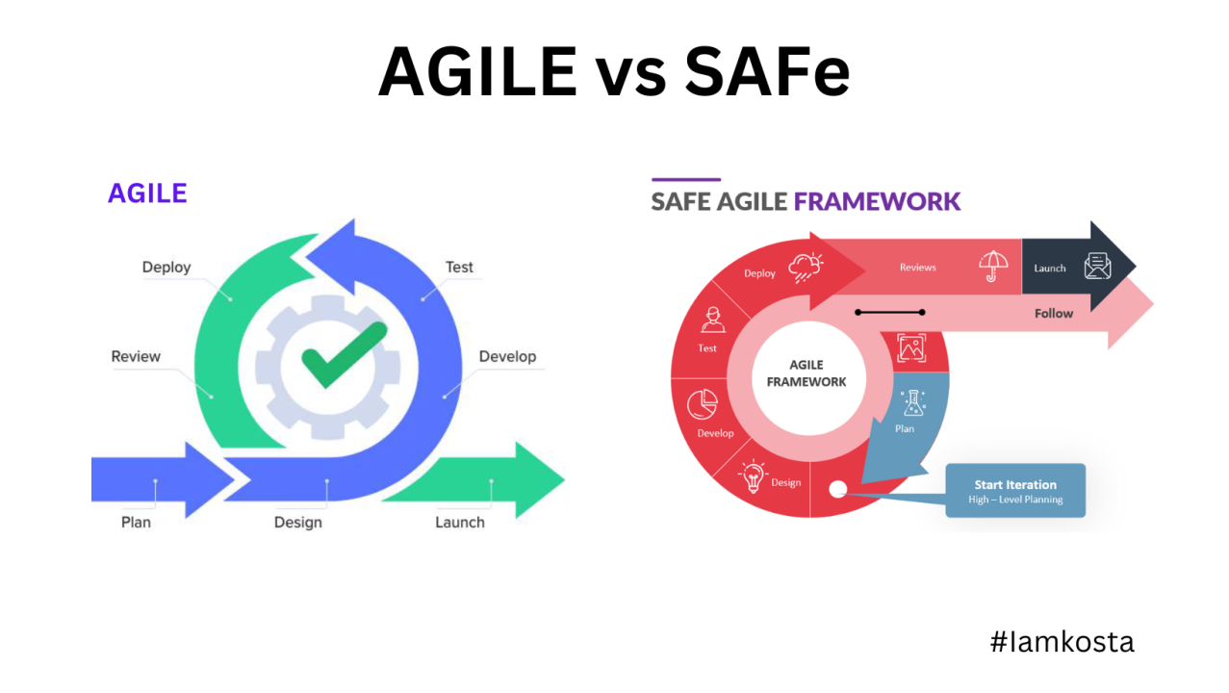

Slide 5
SAFe (Scaled Agile Framework)
SAFe is a framework that allows for the implementation of Agile, Lean, and DevOps practices at scale.
Key components include: Agile Teams, ARTs (Agile Release Trains), Value Streams, and Lean Portfolio Management.

Slide 6
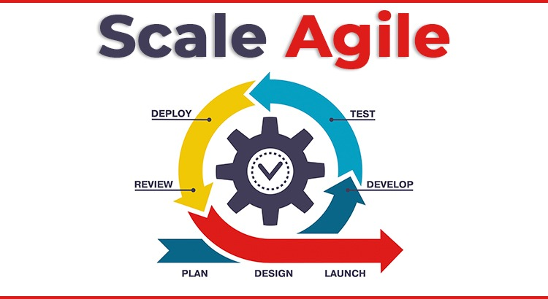

Slide 7
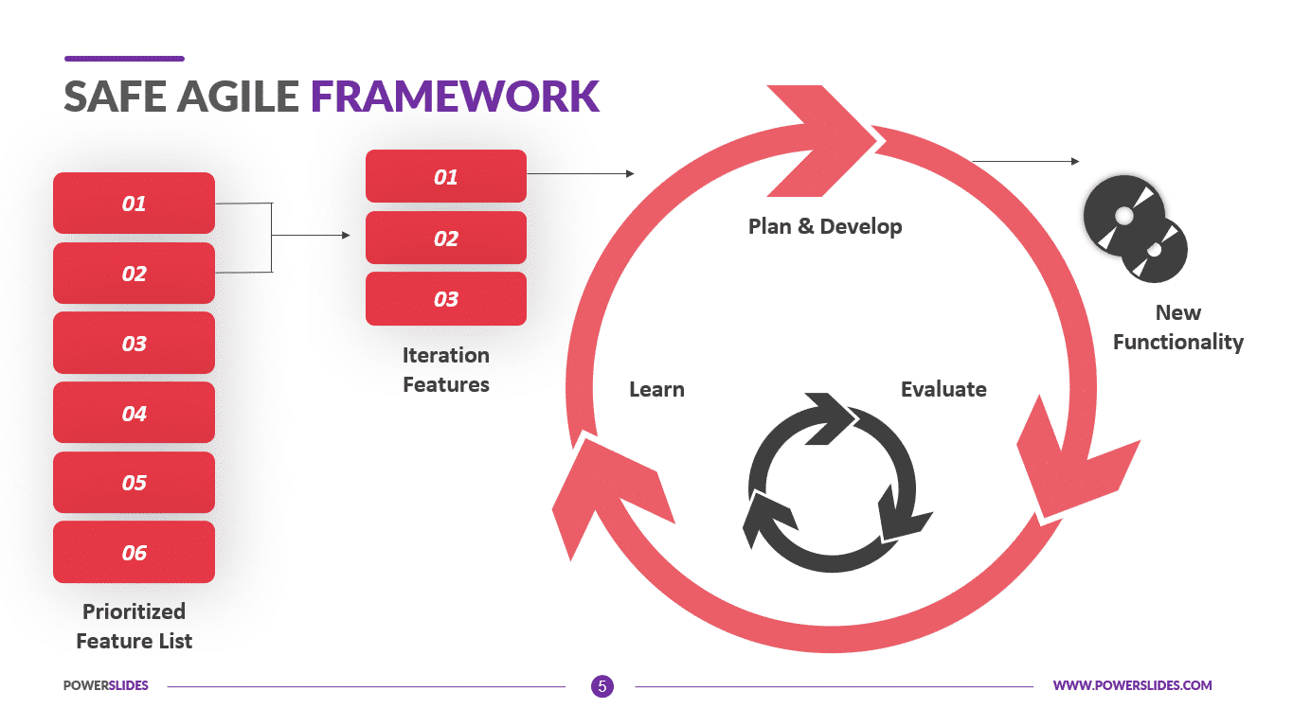

Slide 8
Agile Teams:- Agile Teams are cross-functional groups of individuals who work collaboratively to deliver high-quality, incremental value in short cycles.
ARTs (Agile Release Trains):- Agile Release Trains (ARTs) are long-lived teams of Agile teams that plan, commit, and deliver together.
Value Streams:- Value Streams represent the series of steps that an organization uses to build solutions that provide continuous value to the customer.
Lean Portfolio Management:- Lean Portfolio Management (LPM) aligns strategy and execution by applying lean and systems thinking to portfolio-level decisions.

Slide 9
LeSS (Large Scale Scrum)
LeSS is a simple, lightweight framework that scales Scrum to multiple teams working on a single product.
It focuses on empirical process control and transparency while keeping Scrum principles intact.

Slide 10
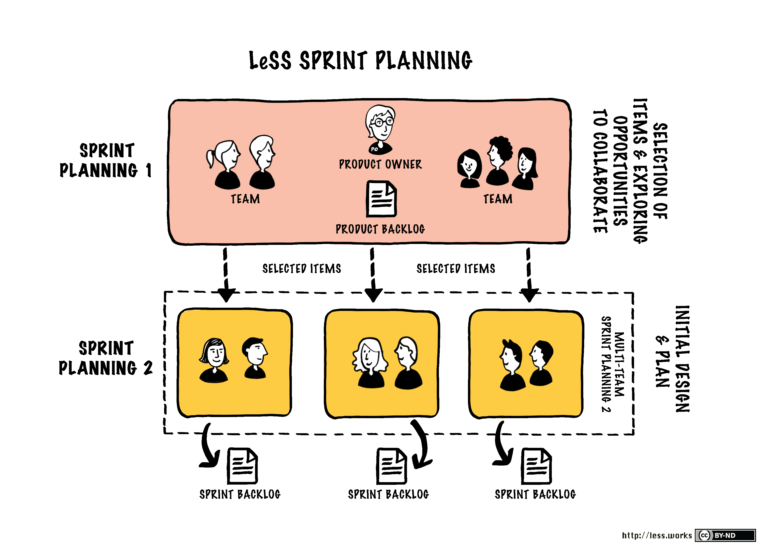

Slide 11
Scrum@Scale
Scrum@Scale extends Scrum using a scale-free architecture.
It consists of the Scrum Master Cycle and the Product Owner Cycle, enabling coordination across teams and aligning them with organizational goals.

Slide 12
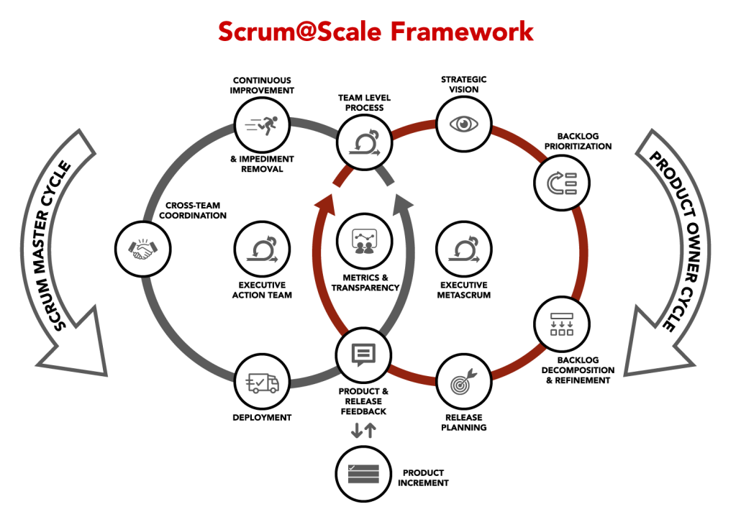

Slide 13
Agile Practices for Distributed and Large Teams
Key practices include:
Regular and effective communication (e.g., daily stand-ups, retrospectives)
Use of collaboration tools (e.g., Jira, Confluence, Slack)
Time zone consideration and work synchronization
Clear definition of roles, responsibilities, and workflows

Slide 14
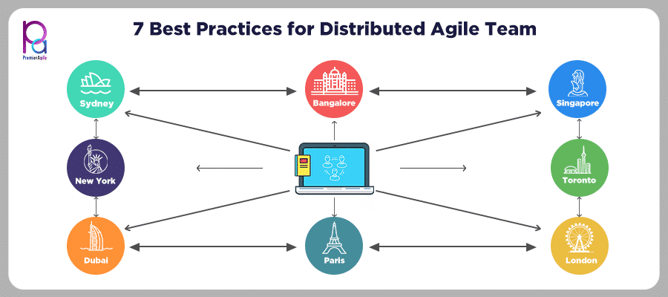

Slide 15
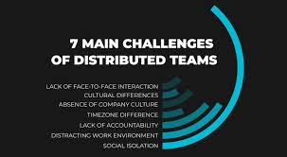

Slide 16
MCQ’s
1.Which framework introduces Agile Release Trains (ARTs)?
A. SAFe
B. LeSS
C. Scrum@Scale
D. None
2. LeSS focuses on:
A. Introducing ARTs
B. Scaling Scrum with minimal changes
C. Implementing DevOps
D. Portfolio Management
3. Scrum@Scale uses what kind of architecture?
A. Centralized
B. Layered
C. Scale-free
D. Modular

Slide 17
4. A key principle of SAFe is:
A. Minimal Scrum
B. Sprints
C. Scale-free Architecture
D. Lean Portfolio Management
5. Which framework emphasizes one product backlog for all teams?
A. LeSS
B. SAFe
C. Scrum@Scale
D. None
6. Distributed Agile teams benefit most from:
A. Documentation
B. Communication Tools
C. Waterfall Processes
D. Isolation

Slide 18
7. Which cycle is part of Scrum@Scale?
A. Scrum Master Cycle
B. DevOps Cycle
C. Kanban Cycle
D. Agile Cycle
8. SAFe stands for:
A. Scrum Agile Framework
B. Scaled Agile Framework
C. Safe Agile Framework
D. Strategic Agile Framework
9. Agile for large teams often requires:
A. Isolation
B. Micro-management
C. Synchronization
D. Solo Sprints

Slide 19
10. LeSS uses how many roles from Scrum?
A. One B. Two C. Four D. Three
11.Scrum@Scale integrates which roles?
A. Managers only B. Developers only
C. Product Owner & Scrum Master D. Stakeholders
12. Which Agile framework is the most lightweight?
LeSS B. SAFe C. Scrum@Scale D. None
13. SAFe includes the following element:
A. Teams of Teams B. Value Streams
C. Design Thinking D. Program Increments

Slide 20
14. Large distributed teams require:
A. Clear role definitions B. Independent projects
C. Fewer meetings D. Solo decision-making
15. Scrum@Scale aims to:
A. Replace Scrum B. Eliminate product owners
C. Coordinate multiple Scrum teams D. Create new methodologies
16. Which practice supports time zone differences?
A. Pair programming B. Central meetings
C. Stand-up only D. Asynchronous communication
17. LeSS advocates for:
A. Multiple Teams, multiple backlogs B. One Product Backlog
C. Independent Sprints D. Local Planning

Slide 21
18. Which framework is known for detailed roles and artifacts?
A. SAFe B. LeSS C. Scrum@Scale D. None
19. Scrum Master Cycle belongs to:
A.SAFe B. LeSS C. Scrum@Scale D. Agile Manifesto
20. A principle of Agile scaling includes:
A. Siloed development
B. Cross-team collaboration
C. Role ambiguity
D. Isolated delivery

