Slide 1


How 2 contribute to Mozilla code base
2017/09/11
Yangyi Peng
FT2 Team
https://freetimeteam.org/

Slide 2
Outline
Preface
Add feature to Firefox
Contribute to Mozilla flow
Lesson Learned

Slide 3




Preface
Why add a new feature for Firefox?

Slide 4
structure
Implement the W3C webdriver in rust. Needed by geckodriver.
webdriver-rust
Client call minimize window command
Process the minimize window command
Selenium-Python
webdriver
geckodriver
Marionette
Server send the minimize window command to
Marionette.
Window
Call minimize()

Slide 5
Add feature to Firefox
Add minimize command in webdriver-rust
https://github.com/mozilla/webdriver-rust
Add minimize command support in geckodriver
https://github.com/mozilla/geckodriver
Add code in Marionette
Should clone mozilla-central code base.
https://developer.mozilla.org/en-US/docs/Mozilla/Developer_guide/Build_Instructions/Simple_Firefox_build

Slide 6
Contribute to Mozilla flow
A. We should download the code base:
webdriver-rust
git clone https://github.com/mozilla/webdriver-rust.git
geckodriver
git clone https://github.com/mozilla/geckodriver.git
mozilla-central
a. download bootstrap.py: https://hg.mozilla.org/mozilla-central/raw-file/default/python/mozboot/bin/bootstrap.py
b. python bootstrap.py
c. sudo apt-get install mercurial
d. hg clone https://hg.mozilla.org/mozilla-central
e. hg clone mozilla-central mozilla-clean

Slide 7
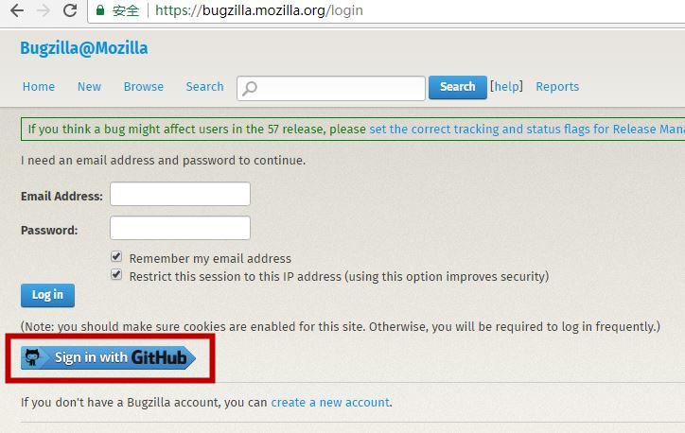
Contribute to Mozilla flow
B. Sign in the Bugzilla to create bug for above components.
You can sign in with your github account.

Slide 8
Contribute to Mozilla flow
C. Build each component and verify them in our local side.
webdriver-rust
No need to build, just add this part patch in the source code.
2. geckodriver
Need to use the local webdriver-rust, use Cargo tool to build the geckodriver binary.
Copy the built out geckodriver to the PATH like /usr/bin or /usr/local/bin.
mozilla-central
Need to run python bootstrap.py, then ./mach build

Slide 9
Contribute to Mozilla flow
D. Create the official patches in the clean code base
Should notice the sequence of the patches:
webdriver-rust
https://github.com/mozilla/webdriver-rust/pull/105
geckodriver
https://reviewboard.mozilla.org/r/158136/
marionette
https://reviewboard.mozilla.org/r/162018/diff/2#index_header
test cases
https://reviewboard.mozilla.org/r/170192/diff/1#index_header

Slide 10
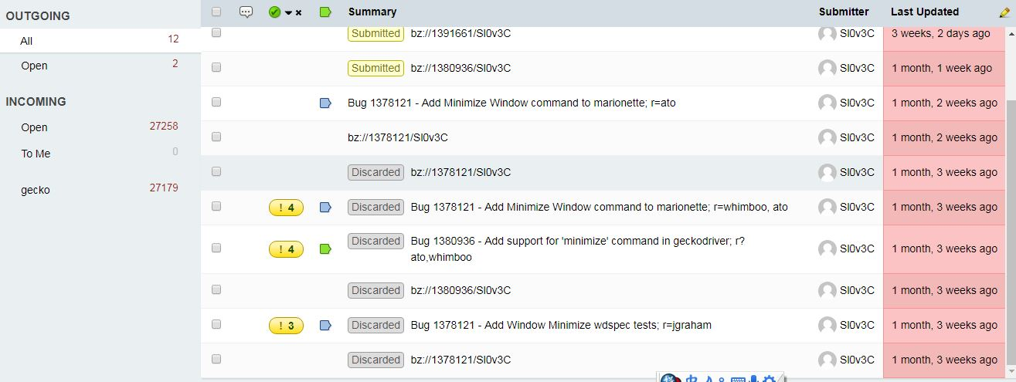
Contribute to Mozilla flow
E. Wait maintainer to review and merge
May be need modify patch many times, need be proficient with the Mercurial tool.
Or you can configure the git tool for mozilla: https://sny.no/2016/03/geckogit

Slide 11
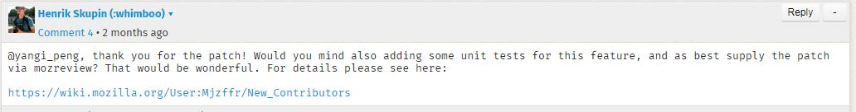
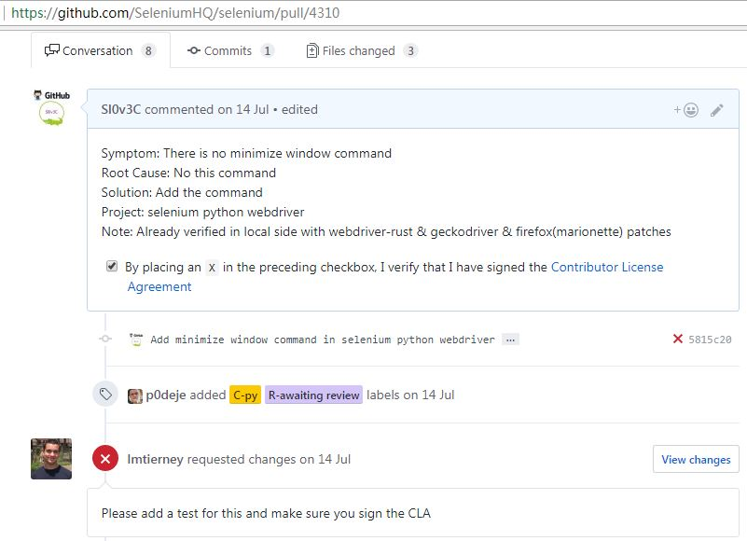
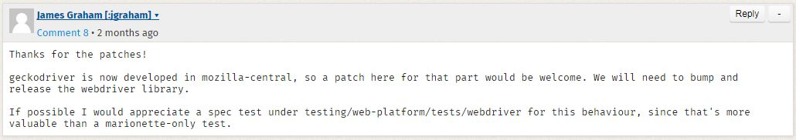
Lesson Learned
Test cases driven coding

Slide 12
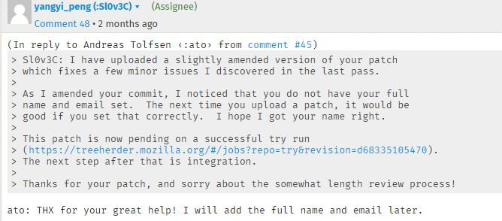
Lesson Learned
Distribution tool must be skilled

Slide 13
Lesson Learned
hg compared with git
hg clone git clone
hg pull & hg update -C git pull
hg update -C -r git reset --hard
hg add git add
hg remove git rm
hg diff git diff
hg commit git commit
hg status git status
hg log git log

Slide 14
Lesson Learned
Know how to use local check command
./mach lint testing/marionette/driver.js
help to check the Javascript grammar error.
./mach vendor rust
help to download all 3rd party dependencies to the source code.
./mach wpt-manifest-update
help to update the new configuration of the manifest
./mach marionette test
help to run marionette-test [file]
…

Slide 15
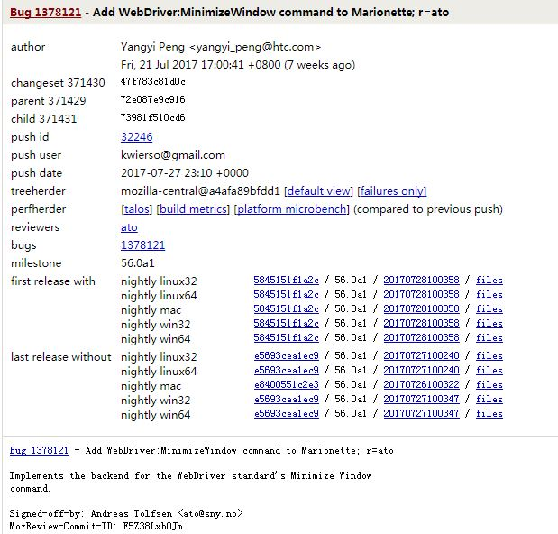
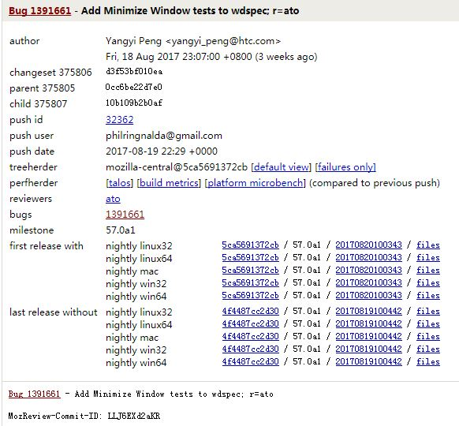
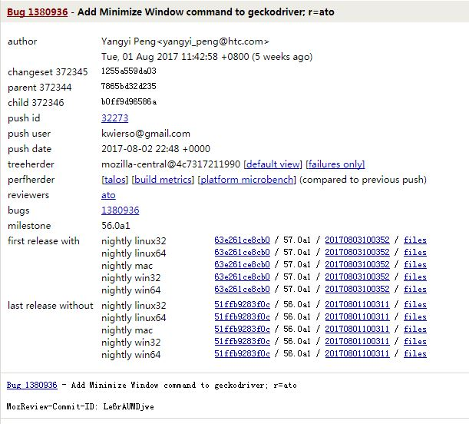
Lesson Learned
D. Do not fear to create Bugs & Patches

Slide 16
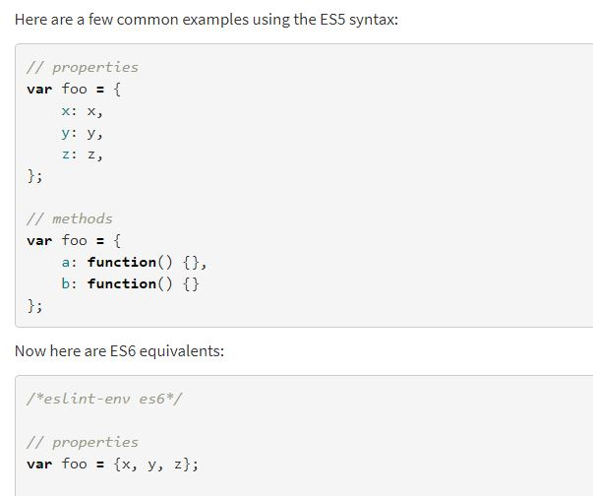
Question:
Why this code will cause build break?
resp.body = {
x: win.screenX,
y: win.screenY,
width: win.outerWidth,
height: win.outerHeight,
state:state,
};

Slide 17
Any Question?

Slide 18


