Slide 1
Server Side Programming
Jon Blair
Sr. Software Engineer

Slide 2

Client Side vs. Server Side

Slide 3
Client Side
Client-side means that the action takes place on the user’s computer.
Doesn’t need a compiler in order to be rendered.
Browser based so little CPU resources needed.
Interacts with Server Side code by making requests and consuming responses (JSON, XML)

Slide 4

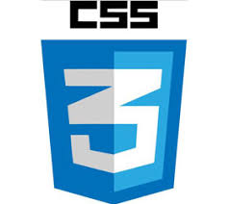
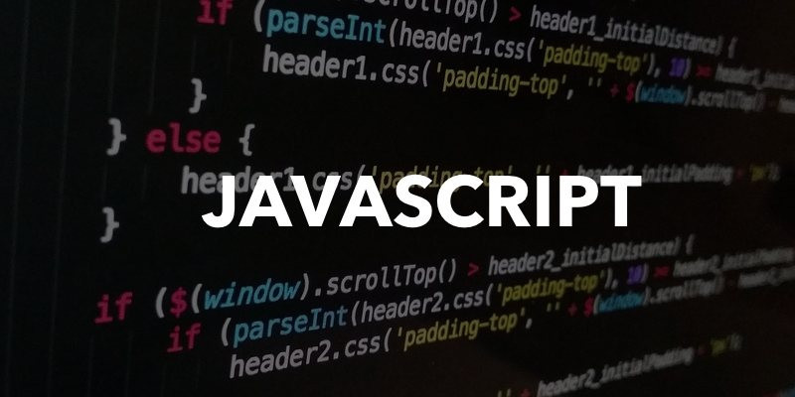
Client Side Examples

Slide 5
Server Side

Slide 6
Server Side
Server-side means that the action takes place on a web server.
The primary advantage to server-side scripting is the ability to highly customize the response based on the user's requirements, access rights, or queries into data stores.
Language Examples:
.Net (C#, VB.Net, F#, C++)
Python
PHP
Java
Uses:
Process user input.
Compiles pages.
Structure web applications.
Interact with permanent storage (SQL, files).

Slide 7
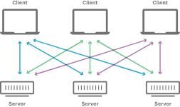
Client and Server Side Interactions

Slide 8
Demo and Q&A
Please refer all questions to Alex Clark

