Slide 1
FreeRTOS v9 Chapter 5 Software Timer Management
Kate Huang

Slide 2
Outline
I. Introduction
II. Software Timer Callback Functions
III. Attributes and States of a Software Timer
IV. The Context of a Software Timer
V. Creating and Starting a Software Timer
VI. The Timer ID
VII. Changing the Period of a Timer
VIII.Resetting a Software Timer

Slide 3
I. Introduction＆Scope
◎ Introduction
Software timers are implemented by, and are under the control of, the FreeRTOS kernel.
They do not require hardware support, and are not related to hardware timers or hardware counters.

Slide 4
I. Introduction＆Scope
◎ Scope :
The characteristics of a software timer compared to the characteristics of a task.
The RTOS daemon task.
The timer command queue.
The difference between a one shot software timer and a periodic software timer.
How to create, start, reset and change the period of a software timer.h.

Slide 5

II.Settings
Software timer functionality is optional. To include software timer functionality:
1. Build the FreeRTOS source file FreeRTOS/src/timers.c as part of your project.
2. Set configUSE_TIMERS to 1 in FreeRTOSConfig.h
https://github.com/feilipu/Arduino_FreeRTOS_Library
https://sourceforge.net/projects/avrfreertos/?source=typ_redirect

Slide 6

II. Function Prototype
Void ATimerCallback(TimerHandle_t xTomer);

Slide 7
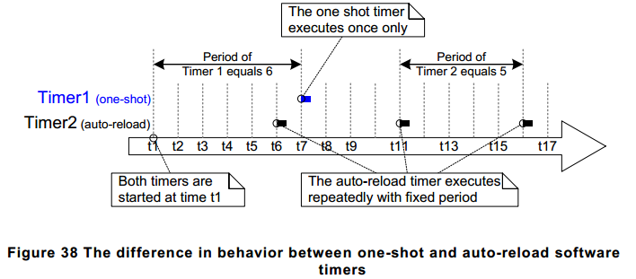
III.TYPE
One-shot timers
Auto-reload timers

Slide 8
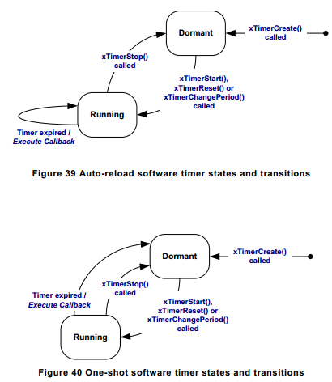
III. Status and Transitions of Timers
Auto-reload timer
One-shot timer
The xTimerDelete() : A timer can be deleted at any time.

Slide 9
IV. The RTOS Daemon (Timer Service) Task
It is a standard FreeRTOS task that is created automatically when the scheduler is started.
Its priority and stack size are set by the configTIMER_TASK_PRIORITY and configTIMER_TASK_STACK_DEPTH compile time configuration constants respectively.
Both constants are defined within FreeRTOSConfig.h

Slide 10
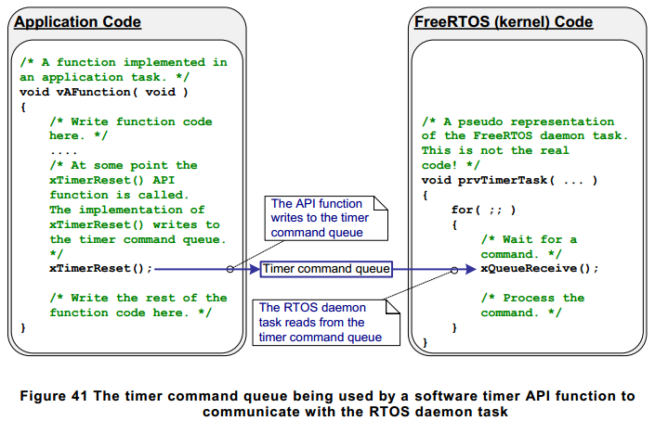
IV. The RTOS Daemon (Timer Service) Task
The daemon task is scheduled like any other FreeRTOS task; it will only process commands, or execute timer callback functions, when it is the highest priority task that is able to run.

Slide 11
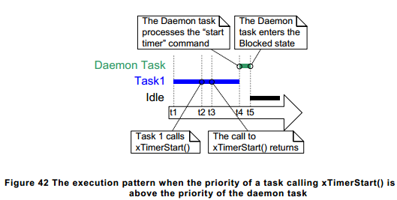
IV. The RTOS Daemon (Timer Service) Task
The priority of Task 1 is higher than the priority of the daemon task, and the priority of the daemon task is higher than the priority of the Idle task.

Slide 12
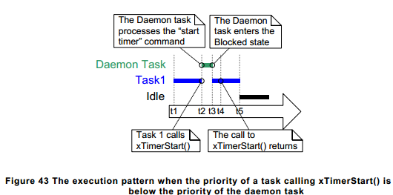
IV. The RTOS Daemon (Timer Service) Task
The priority of the daemon task is higher than the priority of Task 1, and the priority of the Task 1 is higher than the priority of the Idle task.

Slide 13
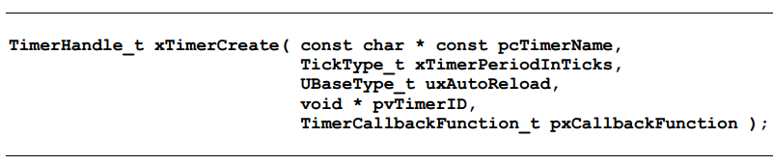

V. Creating & Starting
The xTimerCreate() API Function
The xTimerStart() API Function

Slide 14
V. Creating & Starting
Sample 1
Creating and Starting functions
Sample 2
Creating one-shot and auto-reload timers

Slide 15


VI. The Timer ID
The vTimerSetTimerID() API Function
The pvTimerGetTimerID() API Function

Slide 16
VI. The Timer ID
Sample3: Using the callback function parameter and the software timer ID

Slide 17
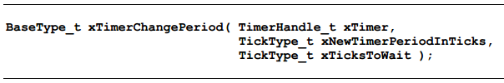
VII. Changing the Period
The xTimerChangePeriod() API Function
Sample 4:
Changing the Period(LED Toggles)

Slide 18
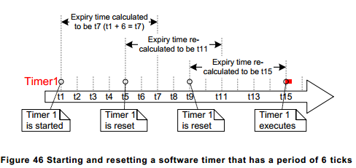
VIII. Resetting
Resetting a software timer means to re-start the timer; the timer’s expiry time is recalculated to be relative to when the timer was reset, rather than when the timer was originally started. This is demonstrated by Figure 46, which shows a timer that has a period of 6 being started, then reset twice, before eventually expiring and executing its callback function.

Slide 19

VIII. Resetting
The xTimerReset() API Function
Sample 5:
Resetting a software timer

Slide 20
THE END
Thanks for your attendance.

Slide 21
appendix
Kate Huang

Slide 22
Hardware Timer v.s. Software Timer
HW:
hardware timer 
1.integrated into microcontroller or separate chip 
2.can be exact 
3.allows actions in parallel

Slide 23
Hardware Timer v.s. Software Timer
SW: 效率跟準確性都取決於程式的寫法
software delay loop 
1.easy to insert; requires no additional hardware 
2.Causing problem if other actions are to be done in parallel 
3.Time can be accurate if code is carefully timed 
4.IDE may have timing option

Slide 24
Reference
HW : Arduino Mega 2560
SW : Eclipse Cpp Neon IDE
Document : Mastering the FreeRTOS Real Time Kernel - a Hands On Tutorial Guide

