Slide 1
FreeBSD in Audio Studio
Sing, beastie, sing
FOSDEM, 2019

Slide 2
Who am I?
Goran Mekić (meka)
Tilda Center, Novi Sad, Serbia
Electronics / IT
Band member
Metal / Goa Trance

Slide 3
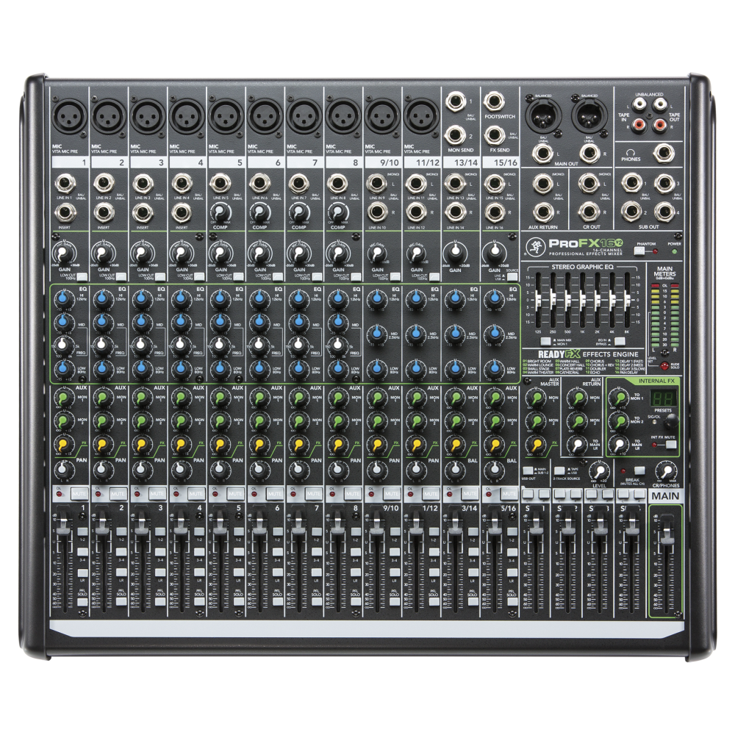
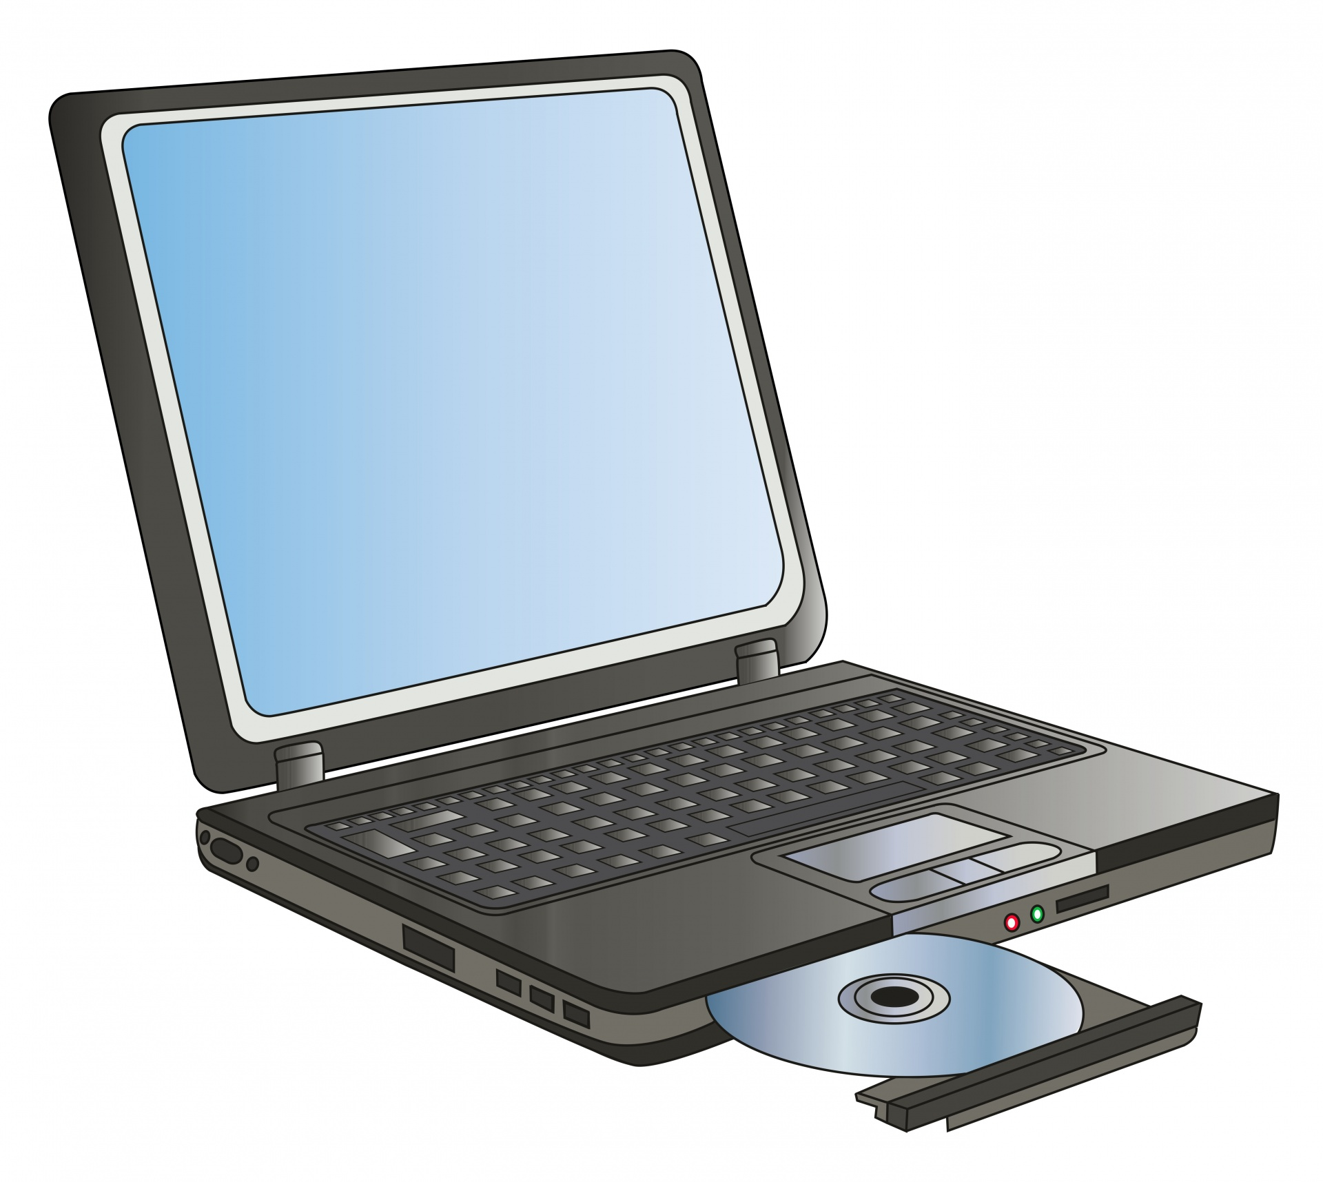
Studio Layout
USB

Slide 4
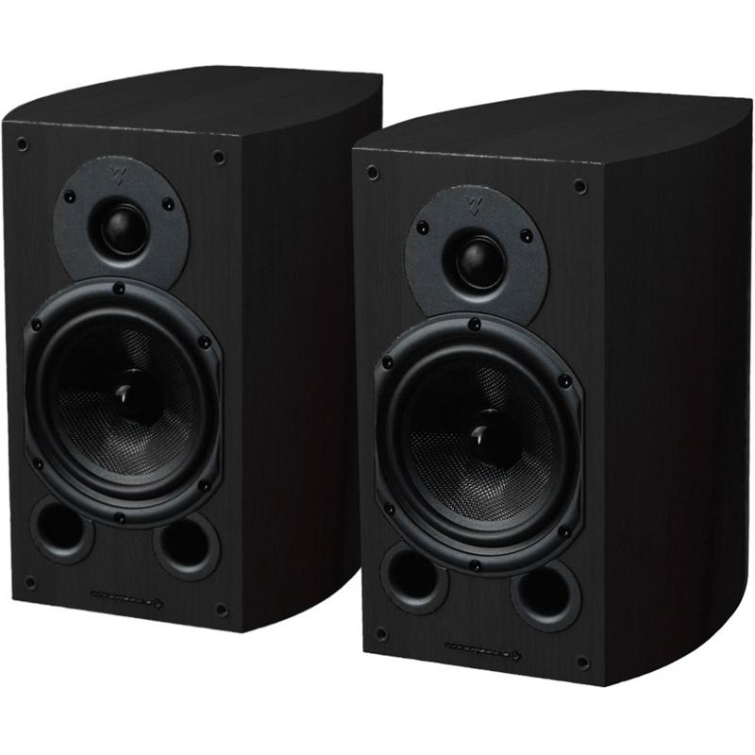
Studio Layout
USB

Slide 5
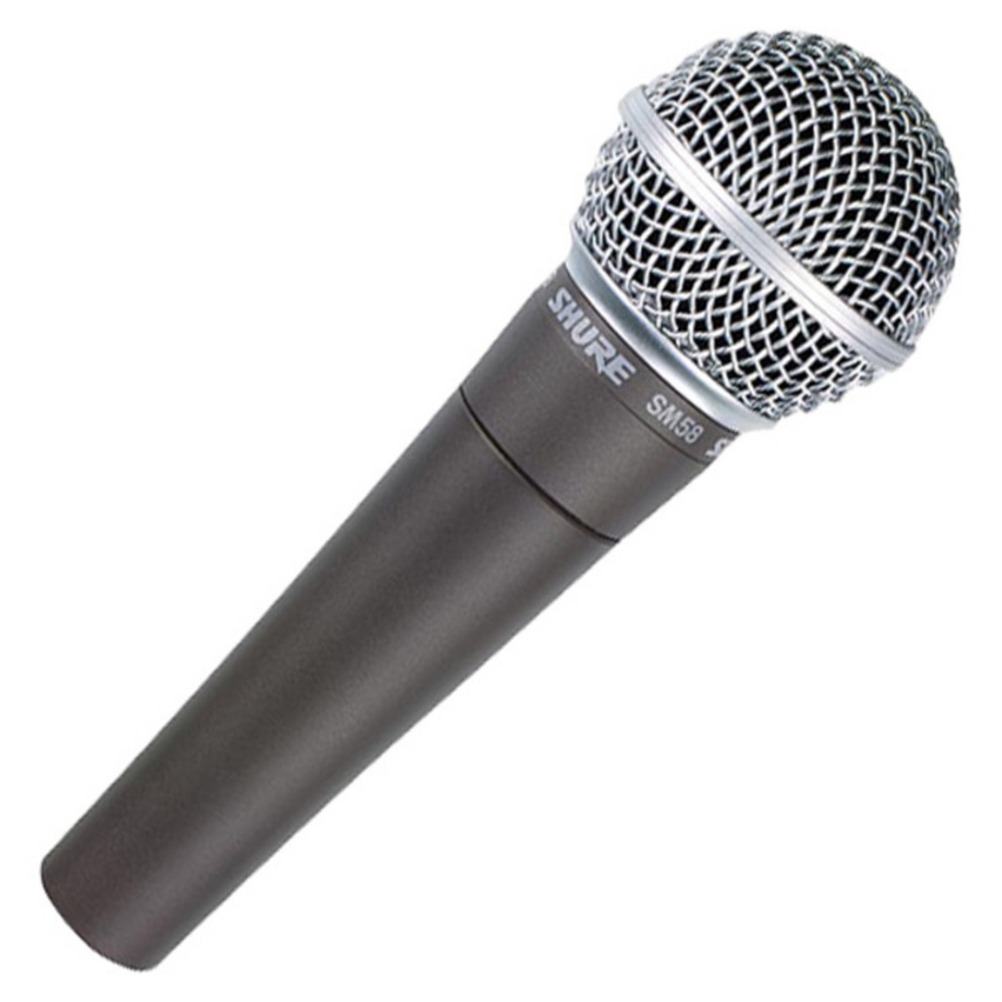
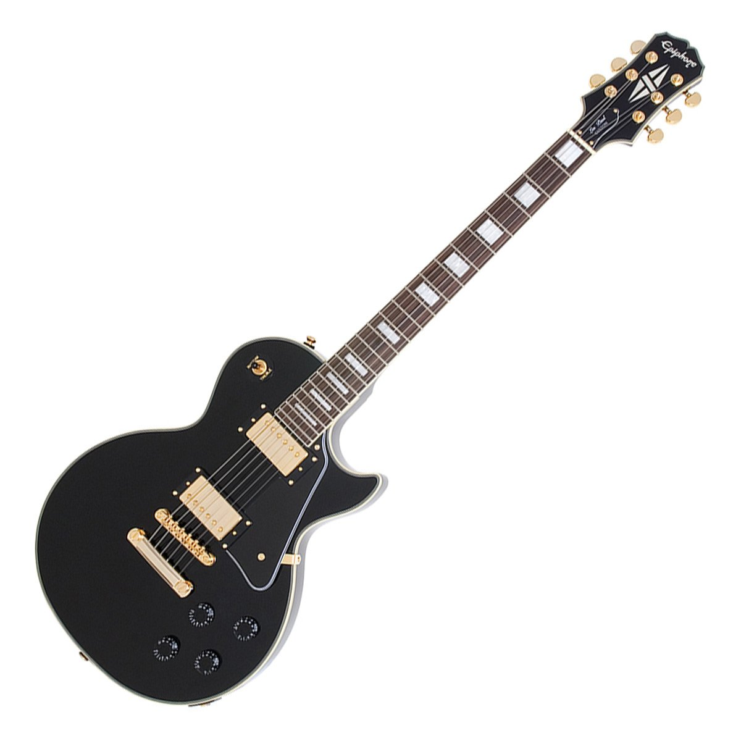
Studio Layout
USB

Slide 6
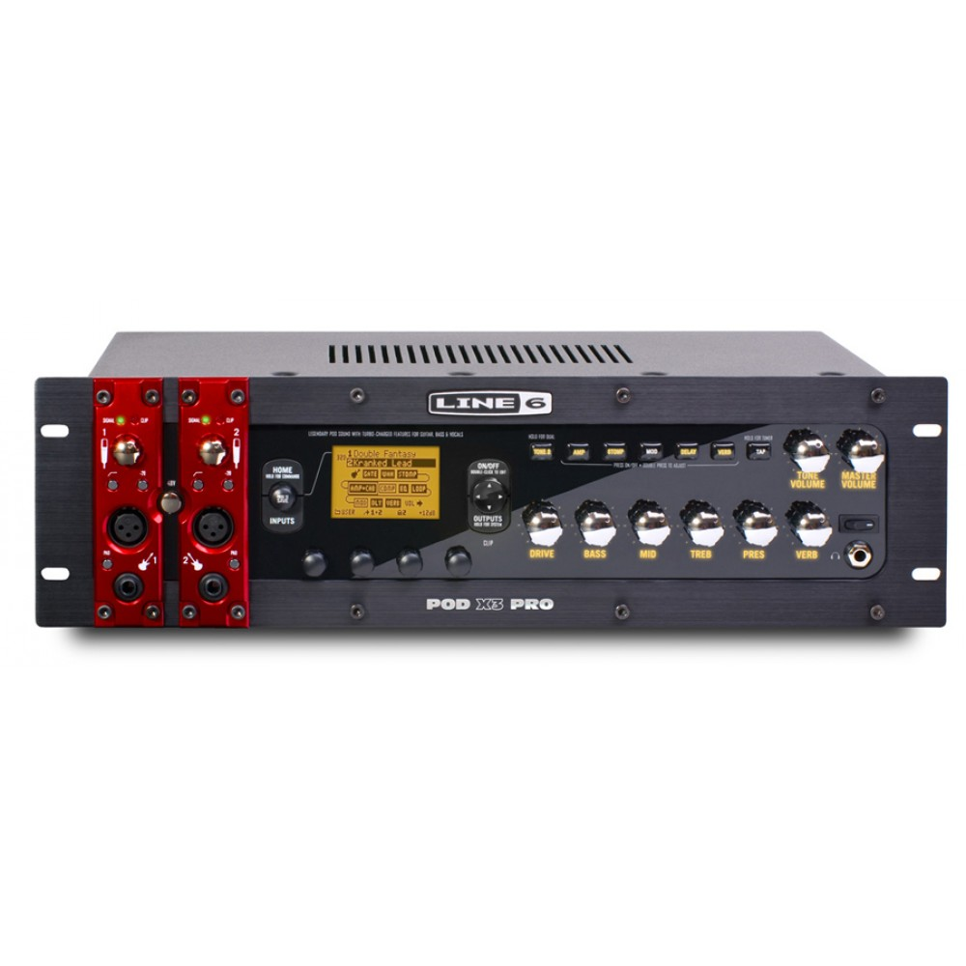
Studio Layout
USB

Slide 7
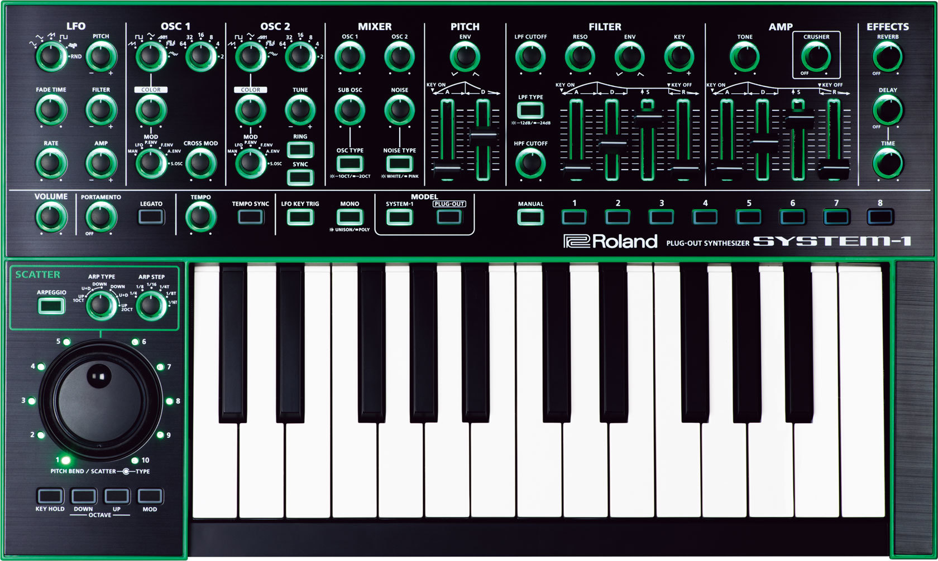
Studio Layout
USB

Slide 8
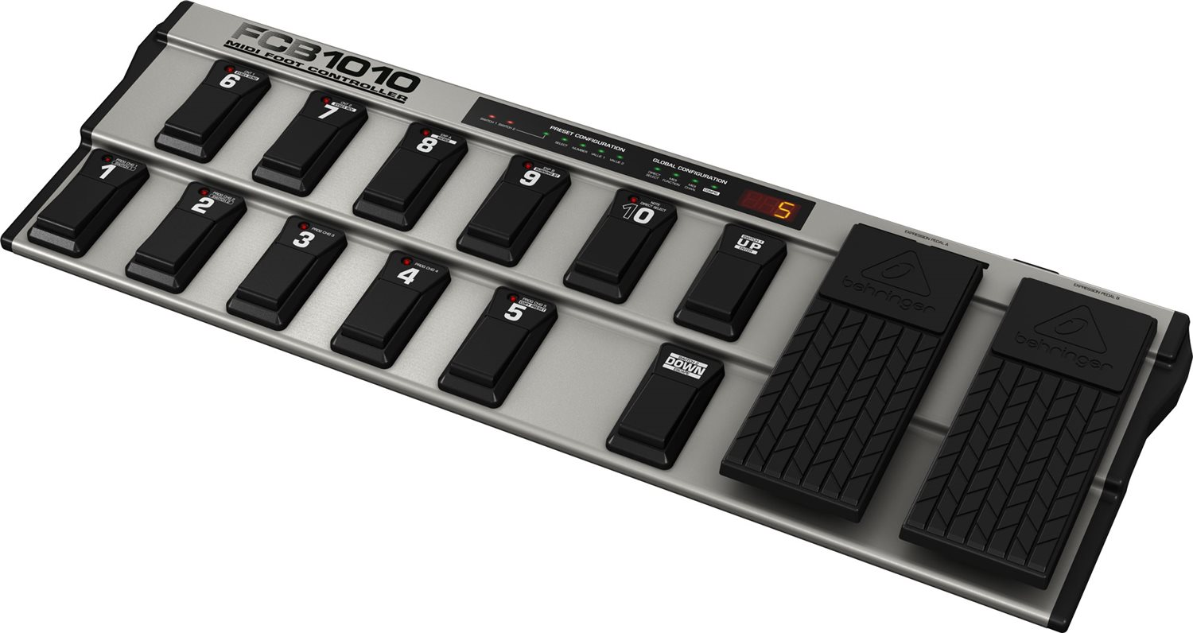
Studio Layout
USB

Slide 9
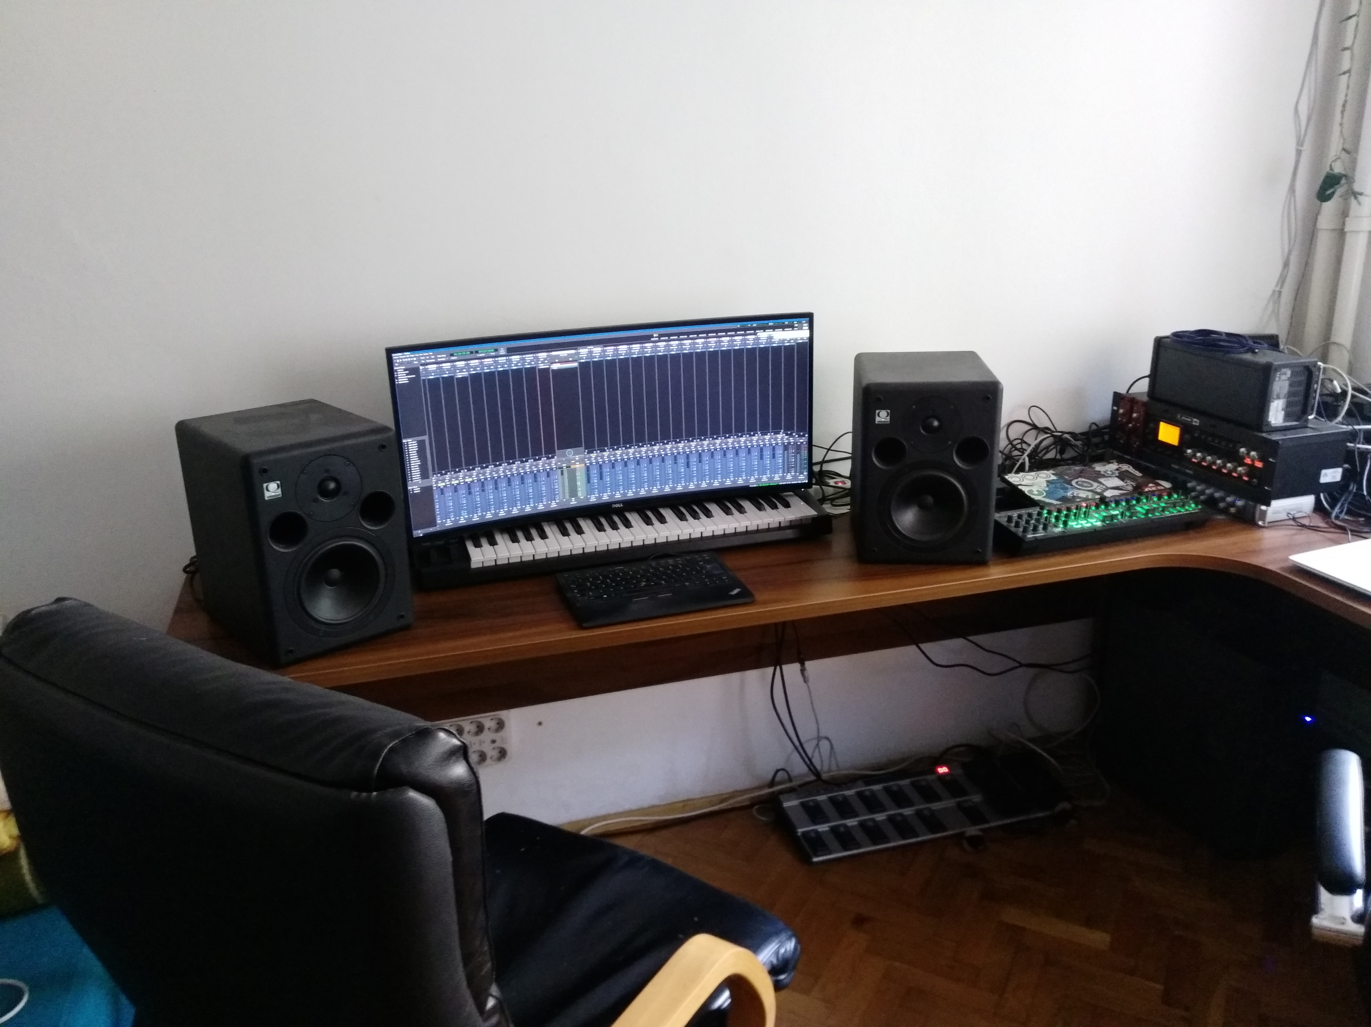
Studio Layout

Slide 10
Software
FreeBSD / HardenedBSD
Virtual OSS
Ardour 5
Drumgizmo
*-lv2
JACK

Slide 11
Real Time

Slide 12
Tuning sysctl
kern.timecounter.alloweddeviation=0
hw.usb.uaudio.buffer_ms=2
hw.snd.latency=0
dev.pcm.0.bitperfect=1

Slide 13
Virtual OSS
virtual_oss -S -i 8 -b 32 -s 708
-c 2 -m 8,0,9,1 -d dsp
-M i,0,8,0,0,0 -M i,0,9,0,0,0

Slide 14
Non-musical aspect
A lot of GDB!
Community
System administration
Kernel development

Slide 15
Debugging
break audio.cpp:28
print var

Slide 16
Next?

Slide 17
Plans/Ideas/Whishes
Maolan
Open source digital mixer
Tuning and education
RAVENNA/AES67

Slide 18
Thank you!
Hans Peter Selasky
Yuri Victorovich
Tommi Pernila
Drumgizmo
Ardour
Tilda Center

Slide 19
Questions

Slide 20
Contact
meka.rs
@meka@bsd.network
@meka_floss
meka@tilda.center

