Slide 1
CBSD
Isolation manager
BSD DevRoom
FOSDEM 2018

Slide 2
My background
CBSD now!
Future plans

Slide 3
Who am I
Goran Mekić
Flask + React developer
meka
FreeBSD hacker, musician

Slide 4
Docker vs Jails
Different approach
Security
Nesting

Slide 5
CBSD administration
{b,j,x}construct{,-tui}
SSH for node communication
Networking made easy

Slide 6
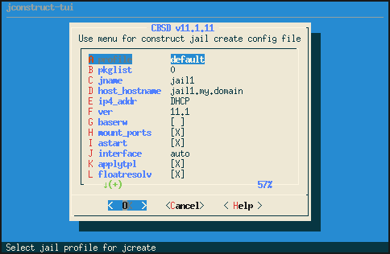
CBSD jconstruct-tui

Slide 7
CBSD implementation
cbsd command => script
Minimal C (termios)
Minimal dependencies

Slide 8
CBSD advanced
Hooks
Profiles
Skel
Using existing infrastructure

Slide 9
Bhyve
Support for ZVOL and MD-backend
VNC support
PCI Passthrough and SR-IOV
Shared folders for bhyve vm (via virtio-p9)
UEFI PXE boot support (with unattended install)
virtual disc management
VALE support: the virtual switch

Slide 10
Jail
Full or partial jail data encryption (via GELI)
XJails (Xorg in jail)
NAT support (pf, ipfw, ipfilter)
VIMAGE support
CARP support
RACCT/RCTL support
Per-jail Traffic Accounting
Port expose - network port forwarding
Conversion to PXE/ISO/Memstick
VNC support

Slide 11
Xen
Create
Destroy
Start
Stop
Network
. . .

Slide 12
ClonOS
WEB distro around FreeBSD and CBSD

Slide 13
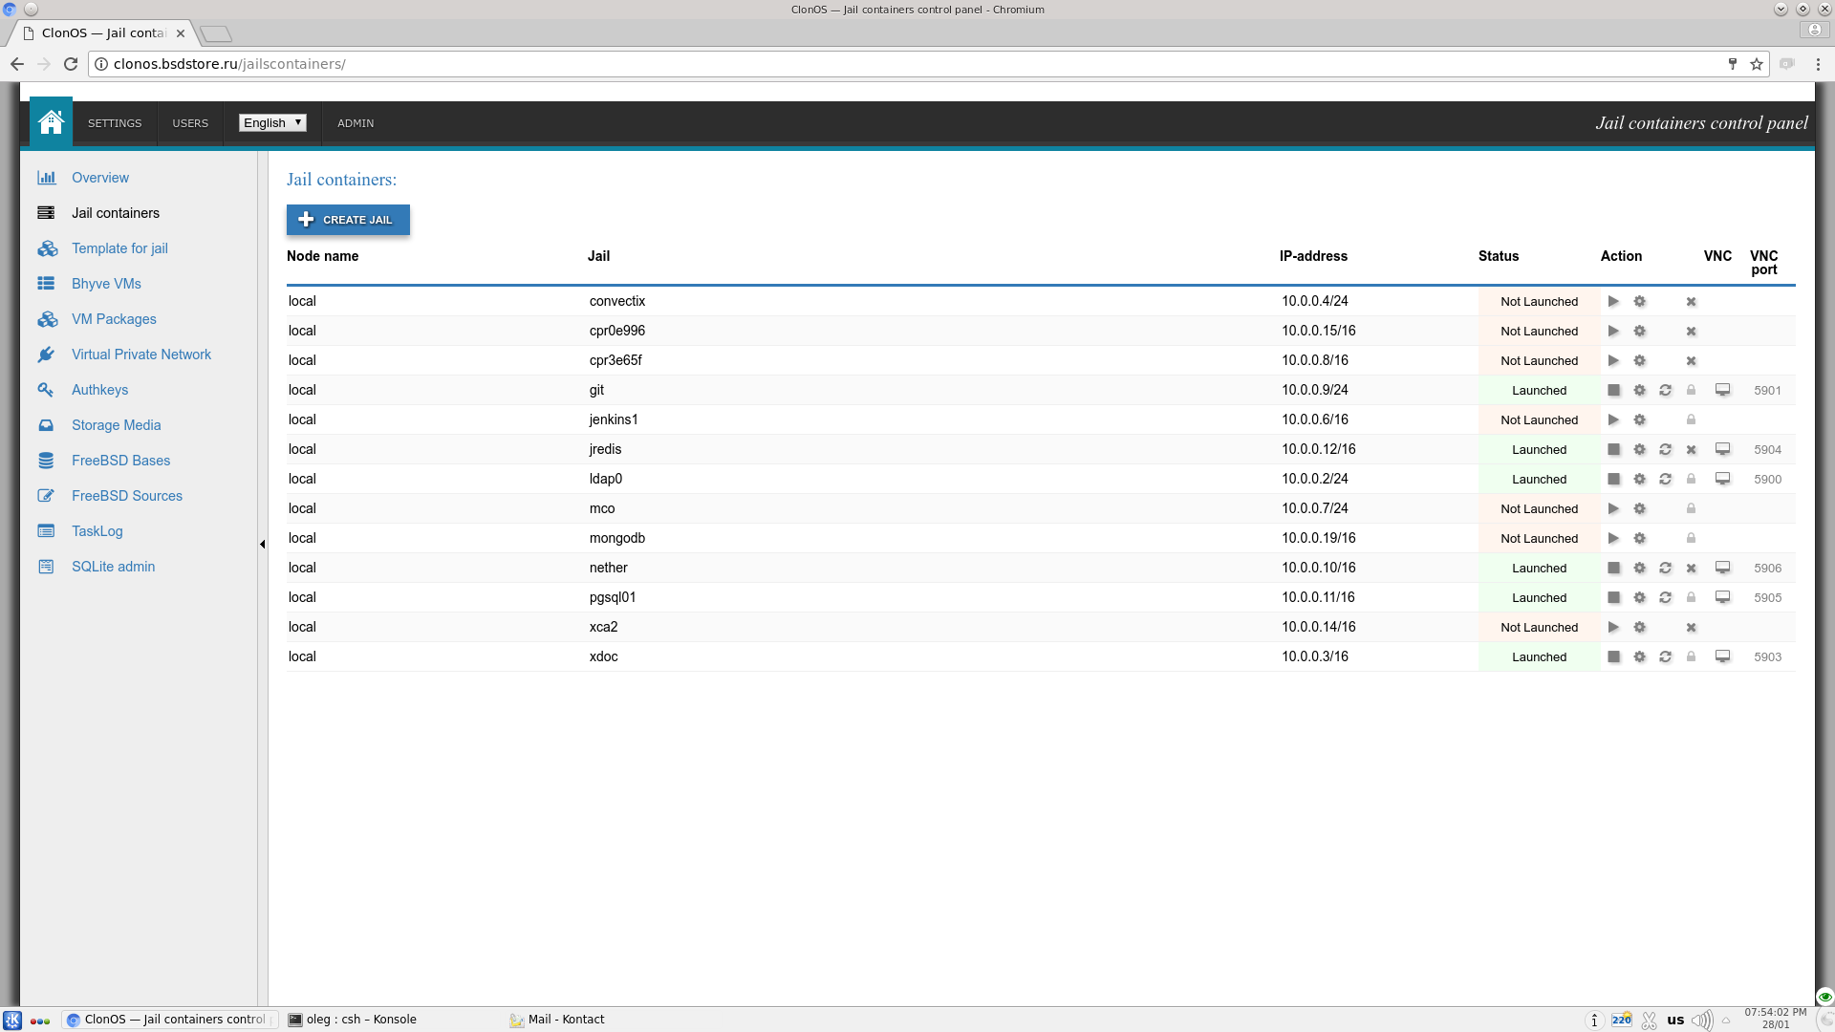

Slide 14
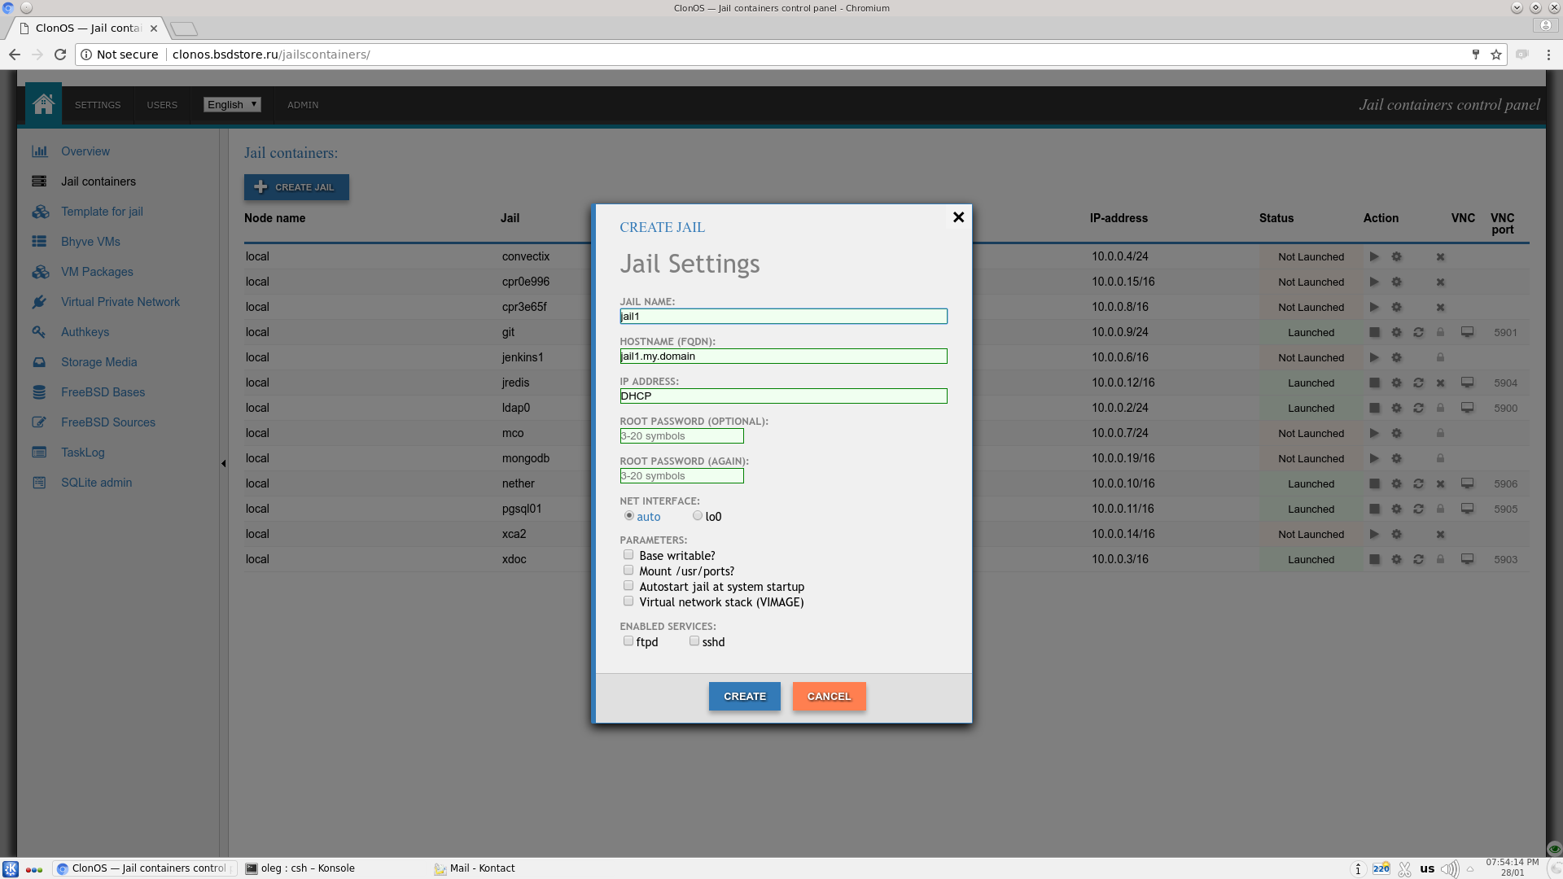

Slide 15
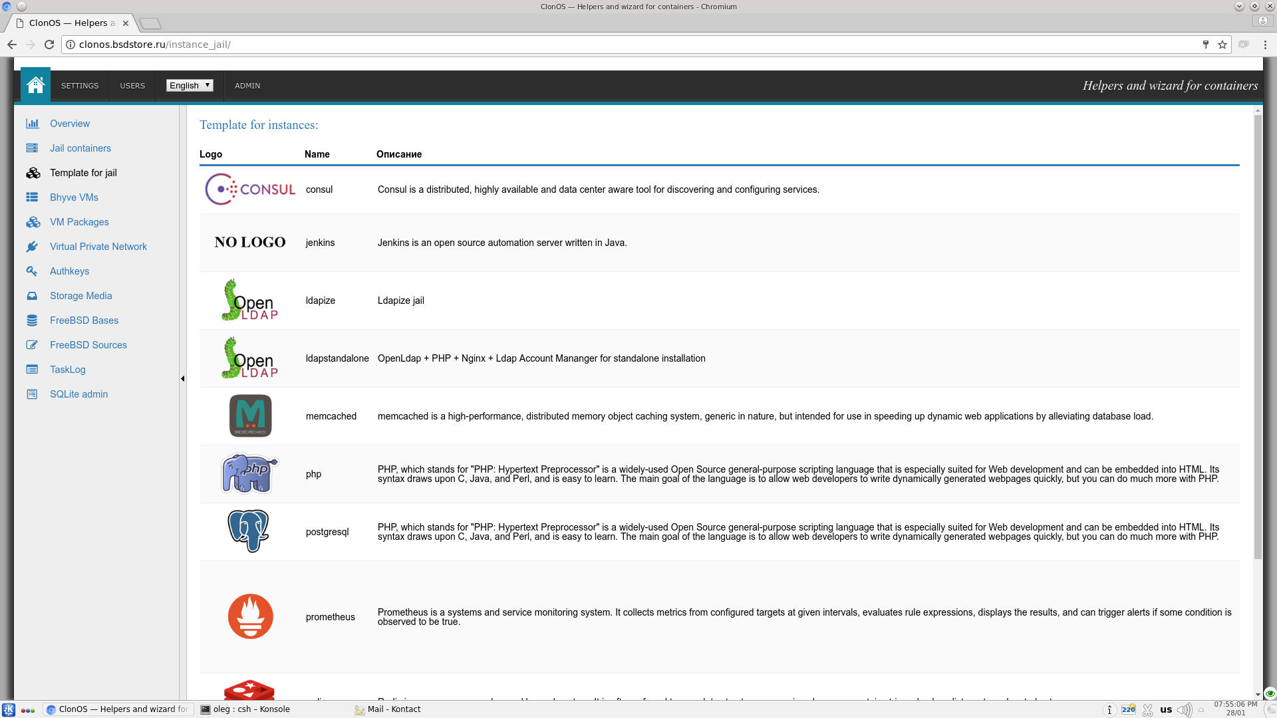

Slide 16
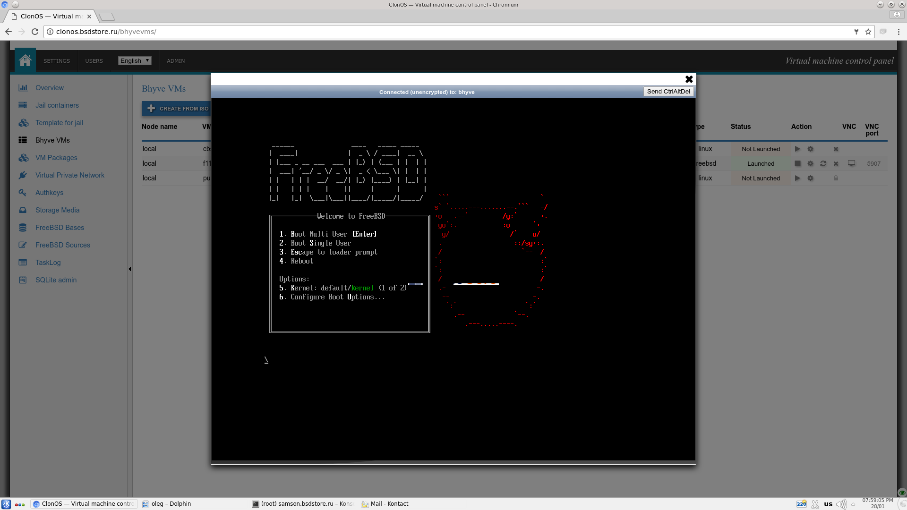

Slide 17
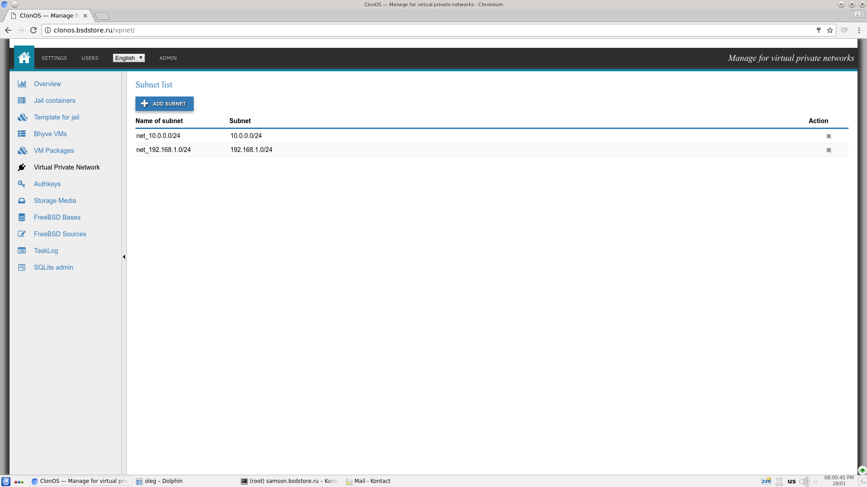

Slide 18
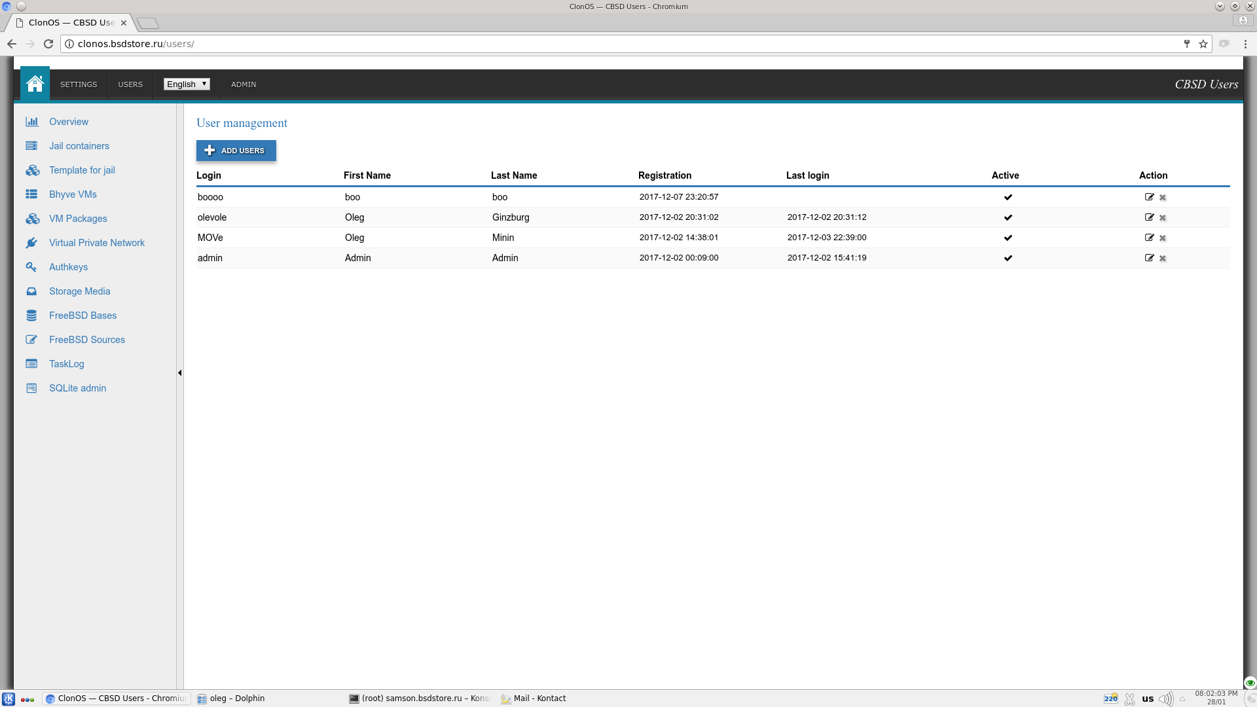

Slide 19
Future
ClonOS
Forms
Reggae
Testing
Multiple instances
Sockets
HardenedBSD
Documentation

Slide 20
Usable links
bsdstore.ru
github.com/cbsd
meka.rs

Slide 21
Thank you!
FOSDEM
Oleg Ginzburg
FreeBSD
Tilda Center

Slide 22
QUESTIONS?

