Slide 1
Running Linux applications on FreeBSD
Chuck Tuffli
chuck@freebsd.org
BSDCan Conference
University of Ottawa, Ontario
June 8-9, 2018

Slide 2


Slide 3
Motive
[root@fluffy fabric]# uname -srv
Linux 51.50.0 FreeBSD 12.0-CURRENT #26 fa797a5a3(trueos-stable-18.03): Mon Mar
[root@fluffy fabric]# make KVER=3.10.0-693.2.2.el7.x86_64
make -C /lib/modules/3.10.0-693.2.2.el7.x86_64/build/ M=/home/ctuffli/dev/hostsw/ape-drvr/fabric modules
make[1]: Entering directory `/usr/src/kernels/3.10.0-693.2.2.el7.x86_64'
CC [M] /home/ctuffli/dev/hostsw/ape-drvr/fabric/eth.o
CC [M] /home/ctuffli/dev/hostsw/ape-drvr/fabric/eth-disco.o
LD [M] /home/ctuffli/dev/hostsw/ape-drvr/fabric/nvmeth.o
Building modules, stage 2.
MODPOST 1 modules
CC /home/ctuffli/dev/hostsw/ape-drvr/fabric/nvmeth.mod.o
LD [M] /home/ctuffli/dev/hostsw/ape-drvr/fabric/nvmeth.ko
make[1]: Leaving directory `/usr/src/kernels/3.10.0-693.2.2.el7.x86_64'

Slide 4
History
$ svn log -r9313
------------------------------------------------------------------------
r9313 | sos | 1995-06-25 10:32:43 -0700 (Sun, 25 Jun 1995) | 11 lines
First incarnation of our Linux emulator or rather compatibility code.
This first shot only incorporaties so much functionality that DOOM
can run (the X version), signal handling is VERY weak, so is many
other things. But it meets my milestone number one (you guessed it
- running DOOM).
Uses /compat/linux as prefix for loading shared libs, so it won't
conflict with our own libs.
Kernel must be compiled with "options COMPAT_LINUX" for this to work.
------------------------------------------------------------------------

Slide 5
How – The Triad
Matching ISA

Slide 6
How – The Triad
Matching ISA
Syscall support

Slide 7
How – The Triad
Matching ISA
Syscall support
Execve(2) and ELF “branding”

Slide 8
How – The Triad
Matching ISA
Syscall support
Execve(2) and ELF “branding”
Emulation path (i.e. /compat/linux/)

Slide 9




Emulation?
Matching ISA
Syscall support
Pseudo-files
“Linuxulator”

Slide 10
The Easy Button
enemyterritory - game
hamachi - VPN software
icc - Intel compiler
kzip - compressor
oracle - database client
pocketreader - OCR
quake3 - game
rtc - real-time clock
seatools - disk utility
skype - video chat
stuffit - archiver
telegram - messaging

Slide 11
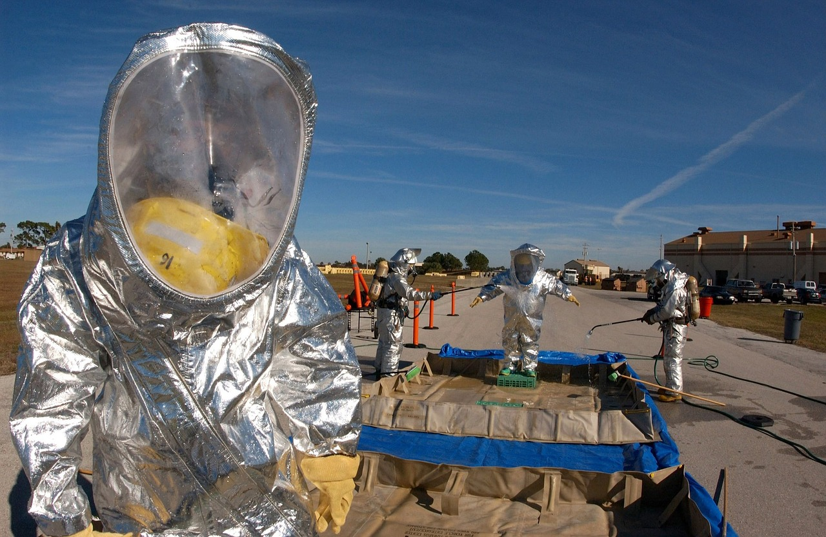
Building Drivers

Slide 12

Linux Containers - LXC
#
# template script for generating CentOS container for LXC
#
...
# download a mini centos into a cache
echo "Downloading centos minimal ..."
YUM="yum --installroot $INSTALL_ROOT -y --nogpgcheck"
PKG_LIST="yum initscripts passwd rsyslog vim-minimal dhclient chkconfig"
...
mkdir -p $INSTALL_ROOT/var/lib/rpm
rpm --root $INSTALL_ROOT --initdb
rpm --root $INSTALL_ROOT -ivh $INSTALL_ROOT/centos-release-$release-...
$YUM install $PKG_LIST
...
https://gist.github.com/mattwillsher/3483828

Slide 13
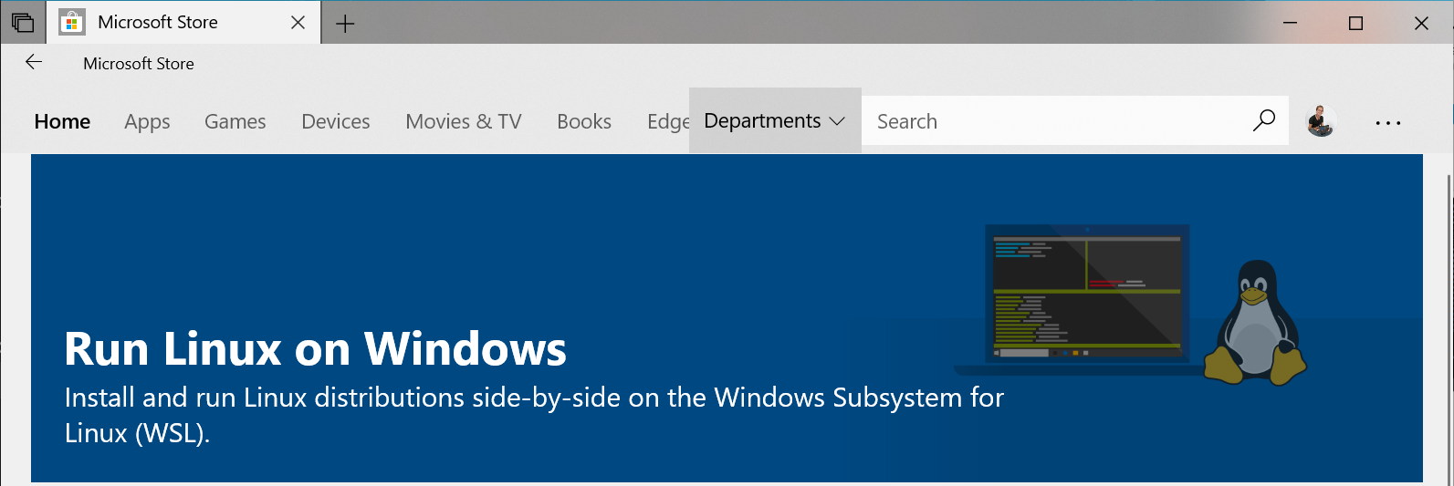
Linux on Windows

Slide 14


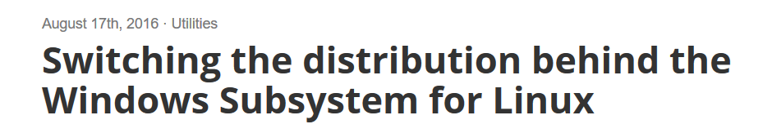
Linux on Windows

Slide 15
Helper - linprocfs
Emulated Linux process file system
# mount -t linprocfs linproc /compat/linux/proc
…
# ls /proc
0 2 3 3742 7 cmdline mounts stat
1 20 30 4 8 cpuinfo mtab swaps
10 21 31 4615 9 devices net sys
1066 22 3724 5 927 filesystems partitions uptime
11 2213 3734 6 942 loadavg scsi version
12 2227 3735 6986 955 meminfo self
# cat /proc/3742/cmdline | tr '\0' '\n'
/usr/local/lib/libreoffice/program/soffice.bin
--impress
--splash-pipe=5

Slide 16
Helper - linsysfs
Emulated Linux kernel subsystem file system
# mount -t linsysfs linsys /compat/linux/sys
…
# tree /sys/
/sys/
├── class
│ ├── drm
│ │ └── card0
│ │ └── device -> ../../../devices/pci0000:00/...
│ └── scsi_host
│ └── host0
│ ├── device -> ../../../devices/pci0000:00/...
│ └── proc_name
└── devices
├── pci0000:00
│ ├── 0000:00:00.0

Slide 17
Helper - devfs
Application access to kernel devices
# mount -t devfs devfs /compat/linux/dev
…
# ls /dev
acpi fd klog midistat random sysmouse
apm fido kmem netmap reroot ufssuspend
apmctl full label nfslock sndstat urandom
audit fuse led null stderr zero
auditpipe input mdctl pci stdin zfs
autofs io mem pts stdout zvol

Slide 18
Helper - others
fdescfs – File-descriptor file system
  # mount -t fdescfs -o linrdlnk null /compat/linux/dev/fd
nullfs
  # mount_nullfs /usr/home/you /linux/vm0/home/you

Slide 19

ping

Slide 20
ping
# ping 8.8.8.8
WARNING: your kernel is veeery old. No problems.
ping: recvmsg: Address family not supported by protocol
ping: recvmsg: Address family not supported by protocol
ping: recvmsg: Address family not supported by protocol
ping: recvmsg: Address family not supported by protocol
ping: recvmsg: Address family not supported by protocol
ping: recvmsg: Address family not supported by protocol
ping: recvmsg: Address family not supported by protocol
ping: recvmsg: Address family not supported by protocol
ping: recvmsg: Address family not supported by protocol
ping: recvmsg: Address family not supported by protocol
ping: recvmsg: Address family not supported by protocol
...

Slide 21
Capabilities
CAP_MKNOD
  create special files using mknod(2)
CAP_SETUID
  make arbitrary manipulations of the process UIDs
CAP_NET_RAW
  allow using RAW and PACKET sockets
CAP_NET_ADMIN
  allow performing various network-related operations

Slide 22
Capabilities
cap_get_flag(cap_cur_p, CAP_NET_ADMIN, CAP_PERMITTED, &cap_ok);
if (cap_ok != CAP_CLEAR) {
cap_set_flag(cap_p, CAP_PERMITTED, 1, &cap_admin, CAP_SET);
}

Slide 23
Capabilities
Linux capset(2)
CAP_MKNOD
CAP_SETUID
CAP_NET_RAW
CAP_NET_ADMIN
FreeBSD priv(9)
PRIV_VFS_MKNOD_DEV
PRIV_CRED_SETUID
PRIV_NET_RAW
PRIV_NET_{…|…|…| }

Slide 24
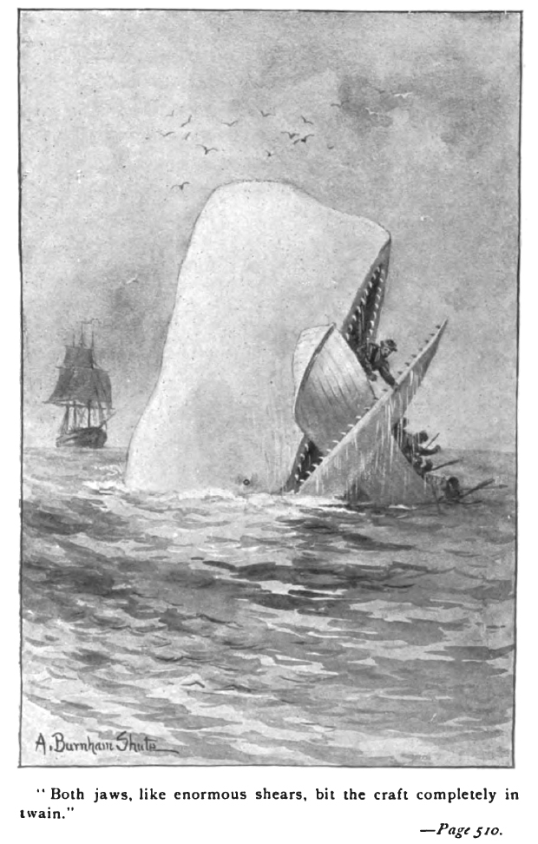
mremap(2)

Slide 25
mremap(2)
We don't have a native mremap() (and nor do we particularly want one)
- illumos anon

Slide 26
mremap(2)
There are a thousand ways to do it, which is why linux's mremap() syscall is stupid.
* simply mmap() a larger block ...
* mmap() the tail end of the file ...
* munmap() and re-mmap() the file.
* Don't depend on a single monolithic
mmap()...
- BSD anon

Slide 27
mremap(2) - realloc
Change size of memory region
Physical memory
  DIMMs
Virtual address range

Slide 28
mremap(2) - truncate
virtual address
physical
page
physical
page
physical
page
physical
page
physical
page

Slide 29
mremap(2) - truncate
virtual address
physical
page
physical
page
physical
page
physical
page
physical
page
virtual address

Slide 30
mremap(2) - extend
virtual address
physical
page
physical
page
physical
page

Slide 31
mremap(2) - extend
virtual address
physical
page
physical
page
physical
page
physical
page
physical
page
virtual address

Slide 32
mremap(2) - move
virtual address
virtual address
physical
page
physical
page
physical
page

Slide 33
mremap(2) - move
virtual address
virtual address
physical
page
physical
page
physical
page
physical
page
virtual address

Slide 34

Core Dumps

Slide 35
Core File
ELF Header
OS/ABI=Linux … Type=CORE ...
Program Header
Process Status
Notes
Process Info
Signal Info
Load
Aux Vector
Load
Mapped Files
...

Slide 36
Unfortunate Events
[you@freebsd] # gdb cdump cdump.core -quiet
warning: A handler for the OS ABI "GNU/Linux" is not built into this configuration of GDB. Attempting to continue with the default i386:x86-64 settings.
[you@linux] # gdb cdump cdump.core -quiet
Reading symbols from /home/ctuffli/dev/linux/cdump/cdump...done.
warning: A handler for the OS ABI "FreeBSD ELF" is not built into this configuration of GDB. Attempting to continue with the default i386:x86-64 settings.
"/home/ctuffli/dev/linux/cdump/cdump.core": no core file handler recognizes format

Slide 37
gdb - core file ?
/* Support for core dump NOTE sections. */
static bfd_boolean
elf_x86_64_grok_prstatus (bfd *abfd, Elf_Internal_Note *note)
{
switch (note->descsz)
{
default:
return FALSE;
case 296: /* sizeof(istruct elf_prstatus) on Linux/x32 */
...
break;
case 336: /* sizeof(istruct elf_prstatus) on Linux/x86_64 */
...
break;
}
return TRUE;

Slide 38
Node.js example
[root@fluffy fabric]# npm install
Aborted (core dumped)
[root@fluffy fabric]# gdb node npm.core
Program terminated with signal 6, Aborted.
#0 0x0000000803c351f7 in __GI_raise (sig=sig@entry=6) at ../nptl/sysdeps/unix/sysv/linux/raise.c:56
56 return INLINE_SYSCALL (tgkill, 3, pid, selftid, sig);
(gdb) backtrace
#0 0x0000000803c351f7 in __GI_raise (sig=sig@entry=6) at ../nptl/sysdeps/unix/sysv/linux/raise.c:56
#1 0x0000000803c36a28 in __GI_abort () at abort.c:119
#2 0x000000000146a6a9 in read_times (statfile_fp=statfile_fp@entry=0x23254c0, numcpus=8, ci=ci@entry=0x2325700) at
../deps/uv/src/unix/linux-core.c:758
#3 0x000000000146b63e in uv_cpu_info (cpu_infos=0x7fffffff69f0, count=0x7fffffff69e0) at
../deps/uv/src/unix/linux-core.c:603
#4 0x000000000127292b in node::os::GetCPUInfo(v8::FunctionCallbackInfo<v8::Value> const&) ()
#5 0x0000000000b1a473 in v8::internal::FunctionCallbackArguments::Call(void (*)(v8::FunctionCallbackInfo<v8::Value>)) ()
#6 0x0000000000b9023c in v8::internal::MaybeHandle<v8::internal::Object> v8::internal:: ...) ()
#7 0x0000000000b90e8f in v8::internal::Builtin_HandleApiCall(int, v8::internal::Object**, v8::internal::Isolate*) ()

Slide 39
Debugging npm crash
#2 0x000000000146a6a9 in read_times (statfile_fp=statfile_fp@entry=0x23254c0, numcpus=8, ci=ci@entry=0x2325700) at
../deps/uv/src/unix/linux-core.c:758

Slide 40
Debugging npm crash
#2 0x000000000146a6a9 in read_times (statfile_fp=statfile_fp@entry=0x23254c0, numcpus=8, ci=ci@entry=0x2325700) at
../deps/uv/src/unix/linux-core.c:758
# vi node/deps/uv/src/unix/linux-core.c
static int read_times(FILE* statfile_fp, …) {
...
if (6 != sscanf(buf + len,
"%lu %lu %lu %lu %lu %lu",
&user,
&nice,
&sys,
&idle,
&dummy,
&irq))
abort();

Slide 41
Debugging npm crash
#2 0x000000000146a6a9 in read_times (statfile_fp=statfile_fp@entry=0x23254c0, numcpus=8, ci=ci@entry=0x2325700) at
../deps/uv/src/unix/linux-core.c:758
# vi node/deps/uv/src/unix/linux-core.c
static int read_times(FILE* statfile_fp, …) {
...
if (6 != sscanf(buf + len,
"%lu %lu %lu %lu %lu %lu",
&user,
&nice,
&sys,
&idle,
&dummy,
&irq))
abort();
# cat /proc/stat
cpu 42577 0 15154 4010351
cpu0 5167 0 1763 501473
...

Slide 42

What’s Next?

Slide 43
Questions ?
chuck@FreeBSD.org | people.freebsd.org/~chuck/doc/linuxulator
Slides and notes in directory

