Slide 1
Economics of Peace:
Unveiling the Financial Beneficiaries of
Middle Eastern Conflicts
CSIT356_01FA23: Intro to Data Science
Richie Molina 12/5/23

Slide 2
Basic Info
A Holistic Approach
The Israel-Hamas War has been a central point of geopolitical tension, with recurrent conflicts affecting the region.
These events often lead to humanitarian crises, but the economic impacts and the entities that benefit financially from such conflicts receive less attention.
This study aims to address this gap and contribute to the discourse on conflict economics, specifically in the context of the Middle East

Slide 3
Project Objectives
To conduct a comprehensive analysis of financial entities and sectors that have either benefited or shown resilience following recent events in Gaza
Understanding the economic dimensions of the conflict.

Slide 4
Description of Data set
Financial Market Data
Bloomberg Intelligence: Historical stock prices, financial statements, outlook reports, and market data in CSV format.
Stockholm International Peace Research Initiative (SIPRI) Arms Transfers Database: Details international transfers of major conventional arms since 1950.
The World Bank’s DataBank: Provides aggregated alternative stock data such as GDP over time

Slide 5
Description of Data set
Bloomberg Intelligence Market Data
(https://www.bloomberg.com/professional/product/bloomberg-intelligence/)
via SRZ LIBRARY at SCHULTE ROTH & ZABEL (https://www.srz.com) This document, the information contained herein and any derived information created therefrom are for the exclusive use of SRZ LIBRARY at SCHULTE ROTH & ZABEL.
Construction & Real Estate, Aerospace & Defense, US Defense Budget, and Cybersecurity Sector market data
REFERENCE: In any grid on either tab, there are common columns:
Description: The row label that matches the row label you'd find on BI
Ticker: The company/index ticker corresponding to that row (this is the ticker used in the BDP/BDH formula for that row, if applicable)
Field ID: The calcrout ID used to structure the BDP/BDH formula for that row (where applicable).
Field Mnemonic: The calcrout mnemonic corresponding to the field ID used to structure the BDP/BDH formula for that row (where applicable).
Data State: The state of the data within that particular row, including 'Dynamic', 'Static', 'Sum', 'Average', 'Median' or 'Heading'. If 'Dynamic' then new data will be expected to come to the sheet when it becomes available in the database with no need for another export. If 'Static' then there are no live links in this row and new data will only be procured by running and exporting from BI again. If it's 'Sum', 'Average', 'Median' or 'Expression', then new data may come to the sheet for some expression components, but to ensure the latest data is present in the sheet, BI should be run and exported again.

Slide 6
Description of Data set
SIPRI Trend Indicator Value Data
Stock Market Indices: Defense industry-specific indices showing company stock performance.
SIPRI: Data on the arms industry and military spending
TIV of arms imports & exports from all, 1950-2022
Figures are SIPRI Trend Indicator Values (TIVs) expressed in millions.
Figures may not add up due to the conventions of rounding.
A '0' indicates that the value of deliveries is less than 0.5m
For more information, see http://www.sipri.org/databases/armstransfers/sources-and-methods/
Source: SIPRI Arms Transfers Database

Slide 7
Description of Data set
Dataset 3: GDP via The World Bank
Source: The World Bank: DataBank "World Development Indicators"
World Development Indicators (WDI) is the primary World Bank collection of development indicators, compiled from officially recognized international sources. It presents the most current and accurate global development data available, and includes national, regional and global estimates. [Note: Even though Global Development Finance (GDF) is no longer listed in the WDI database name, all external debt and financial flows data continue to be included in WDI. The GDF publication has been renamed International Debt Statistics (IDS), and has its own separate database, as well
https://databank.worldbank.org/databases#

Slide 8
Description of Data set
Bloomberg Intelligence Construction & Real Estate Industry Data
Trading Economics: Economic indicators including construction output in CSV format.
Bureau of Economic Analysis: Industry economic data, including construction sector information.
The US & CAN Construction & Real Estate financial data from 1984-2023

Slide 9
Exploration of Data Analysis
Data Preparation
Data Loading: Use automated scripts to load CSV datasets into Python's pandas environment.
Data Cleaning: Handle missing values, duplicates, and outliers using techniques like imputation and filtering.
Data Analysis using Descriptive Statistics: Compute basic descriptive statistics (mean, median, mode, standard deviation, percentiles) to summarize central tendency, dispersion, and shape of the dataset’s distribution.

Slide 10
Exploration of Data Analysis
Data Preparation
Other Data Manipulation Techniques:
Pivot Tables: Create pivot tables for multi-dimensional data aggregation.
Merging/Joining: Combine multiple datasets for enriched analysis.
Data Transformation: Apply transformations like logarithmic scaling to normalize data distributions.

Slide 11
Data Visualization
Use standard plots (histograms, bar charts, line graphs, scatter plots) to visualize distributions and trends.

Slide 12
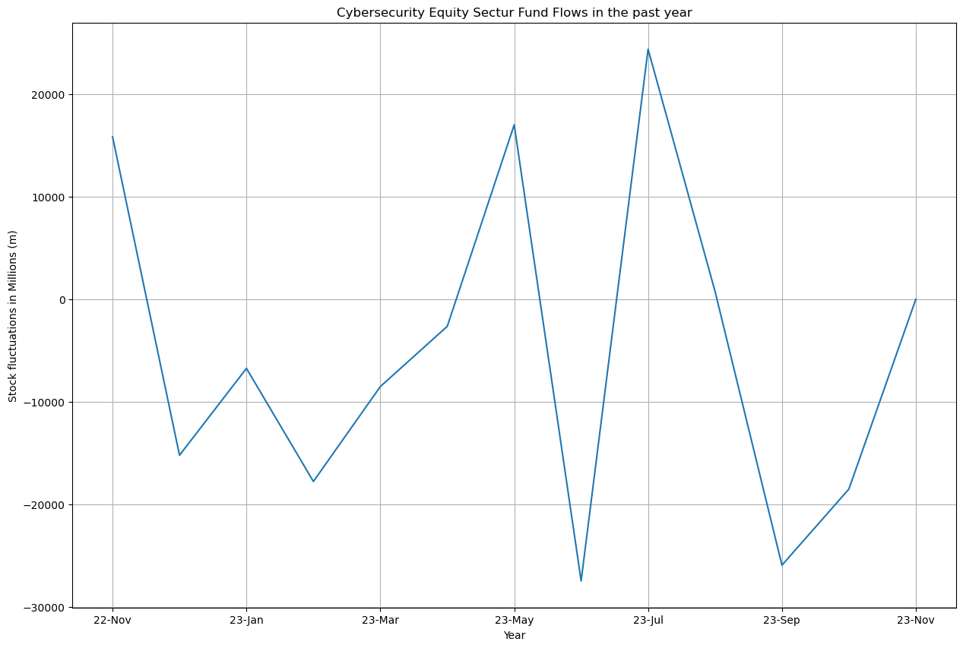
Data Visualization

Slide 13
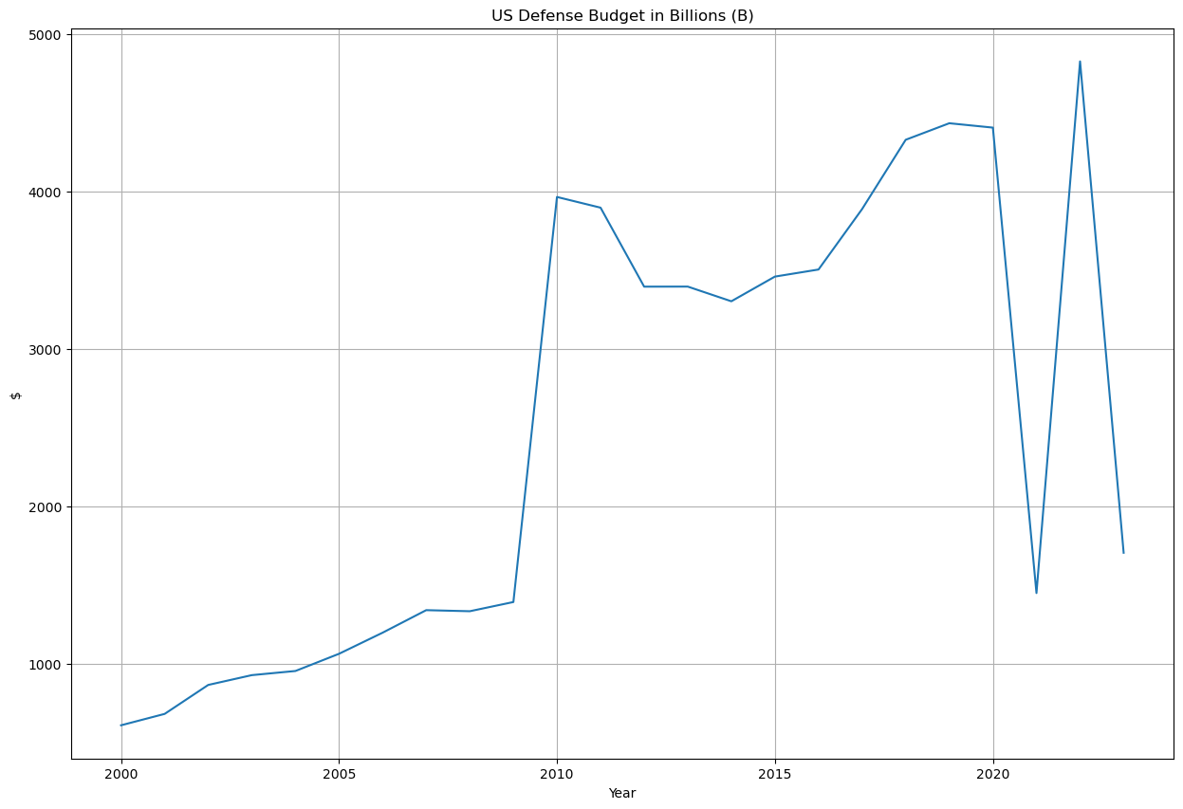
Data Visualization

Slide 14
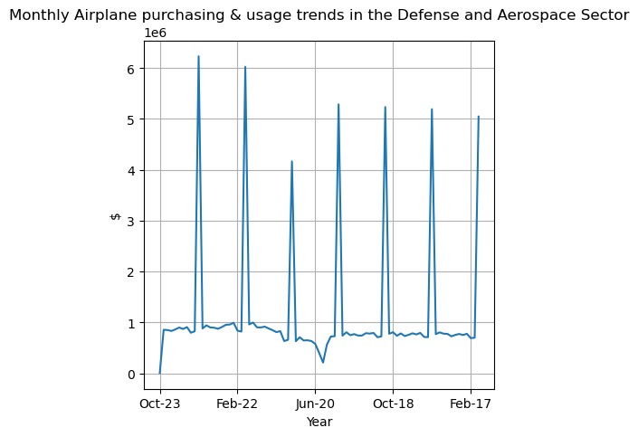
Data Visualization

Slide 15
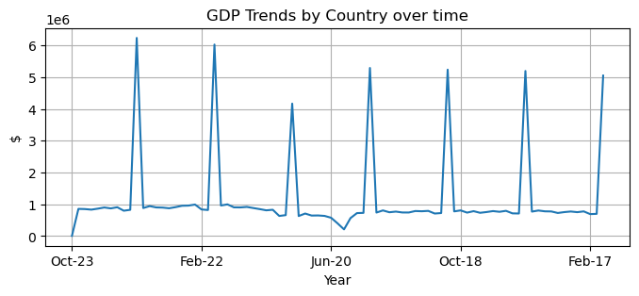
Data Visualization

Slide 16
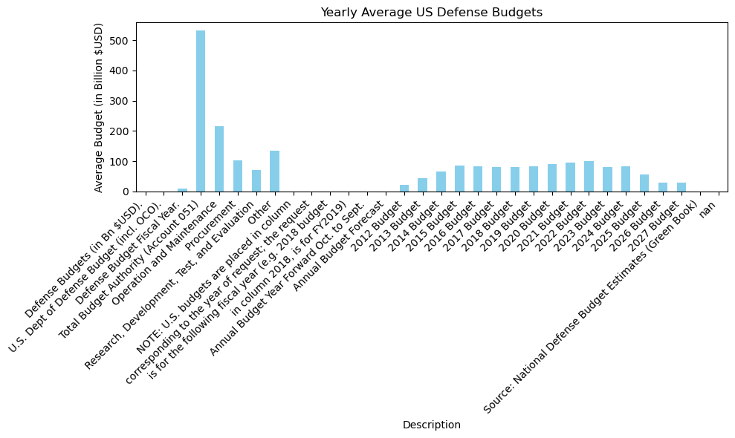
Data Visualization

Slide 17
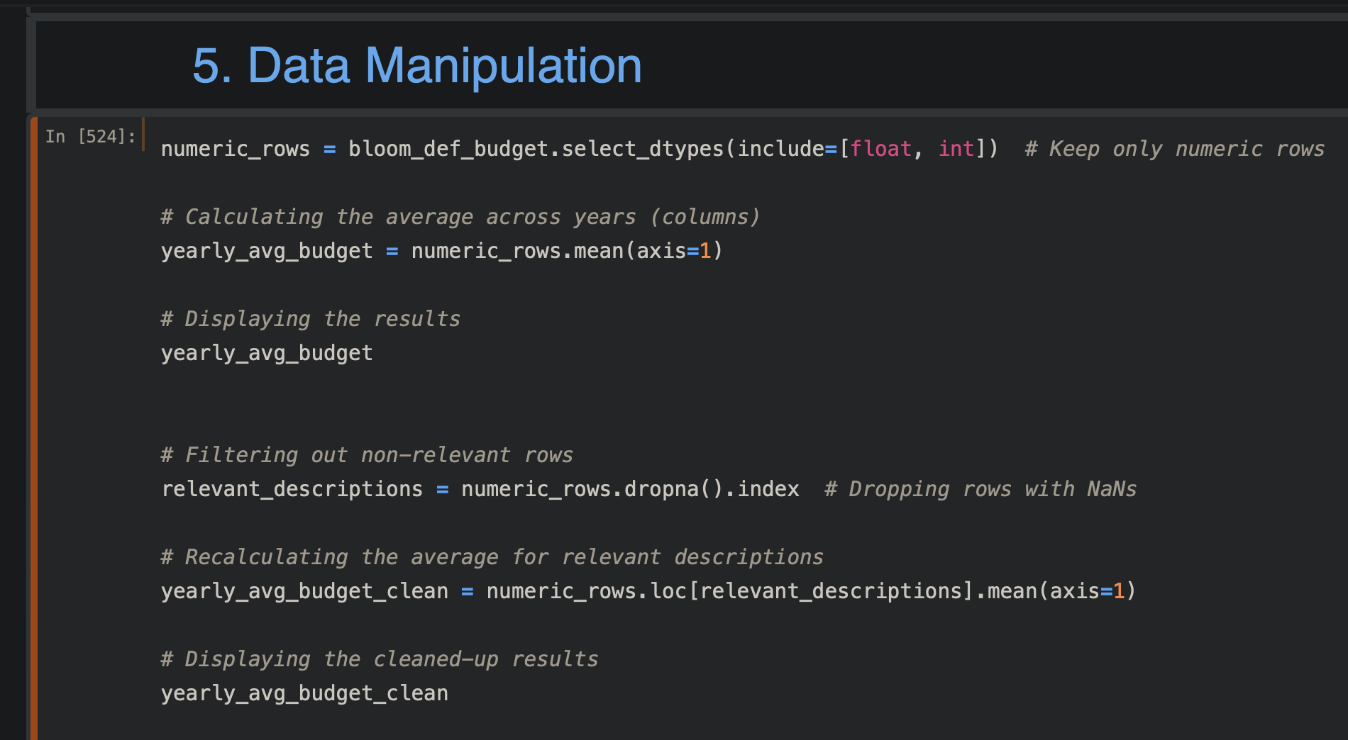
Data Manipulation
Description
Defense Budgets (in Bn $USD). 0.000000
U.S. Dept of Defense Budget (incl. OCO). 0.000000
Defense Budget Fiscal Year. 9.714286
Total Budget Authority (Account 051) 531.915893
Operation and Maintenance 216.691393
Procurement 102.891714
Research, Development, Test, and Evaluation 70.214000
Other 134.554429
NOTE: U.S. budgets are placed in column 0.000000
corresponding to the year of request; the request 0.000000
is for the following fiscal year (e.g. 2018 budget 0.000000
in column 2018, is for FY2019) 0.000000
Annual Budget Year Forward Oct. to Sept. 0.000000
Annual Budget Forecast 0.000000
2012 Budget 22.146107
2013 Budget 45.042643
2014 Budget 65.457429
2015 Budget 86.293250
2016 Budget 82.870357
2017 Budget 79.922964
2018 Budget 80.530464
2019 Budget 84.173107
2020 Budget 89.738714
2021 Budget 95.862964
2022 Budget 101.378714
2023 Budget 79.990393
2024 Budget 82.518821
2025 Budget 56.333357
2026 Budget 29.357143
2027 Budget 29.571429
Source: National Defense Budget Estimates (Green Book) 0.000000
NaN 0.000000
dtype: float64

Slide 18
Specific Industries
Benefiting from the perpetuation of Conflicts
The perpetuation of conflicts, especially in regions like the Middle East, tends to benefit certain industries, largely due to increased demand for their products and services in response to geopolitical instability and security concerns.
These industries often experience growth in times of conflict due to the increased demand for their products and services. However, it's important to note that while these sectors may benefit economically, the ethical and long-term implications of profiting from conflict can be complex and controversial.

Slide 19
Specific Industries
Benefiting from the perpetuation of Conflicts
Defense and Arms Manufacturing: The most direct beneficiaries are defense contractors and arms manufacturers. These companies see increased demand for military hardware, weapons, ammunition, and related technology. This encompasses everything from small arms to advanced missile systems and military aircraft.
Cybersecurity and Intelligence: With the growing sophistication of cyber warfare and espionage, companies specializing in cybersecurity, surveillance, and intelligence technology see heightened demand. This includes firms developing software for cybersecurity, data encryption, and intelligence gathering.
Aerospace and Aviation: Beyond commercial aviation, this sector includes companies that manufacture military aircraft and drones. They benefit from the demand for surveillance, air combat, and transportation capabilities in conflict zones.
Private Military and Security Companies (PMSCs): These firms provide private military services, including combat support, training, logistics, and security services for personnel and infrastructure in conflict zones.
Construction and Engineering: Post-conflict reconstruction drives demand for construction and engineering services. These companies are involved in rebuilding infrastructure, such as roads, buildings, and utility systems.

Slide 20
Specific Industries
Benefiting from the perpetuation of Conflicts
Energy and Natural Resources: Companies in the oil, gas, and mineral extraction industries can benefit from conflicts, especially when they lead to changes in resource control or access to resource-rich areas.
Financial Services: Financial institutions and investment firms can benefit indirectly through investments in the above sectors. Additionally, conflict situations can lead to fluctuations in commodity prices, currency values, and interest rates, which can create profitable opportunities for savvy investors.
Technology and Telecommunications: Advanced communication equipment, satellite technology, and information technology services see increased demand for maintaining communication and information flows in conflict areas.
Logistics and Supply Chain: Firms specializing in logistics and transportation often experience increased demand for moving materials, equipment, and personnel in and out of conflict zones.

Slide 21
Conclusion
It appears that the economic gears continue to churn as if not much is happening around the world when it comes to war. It appears that due the economic activity by nearly avoiding a recession during the pandemic, the outcome is resilient nonetheless despite the bloodshed and the pandemic increasing Arms spending since 2020, the start of the Ukraine war.
While in some ways, the data finds those of us living far away feeling safer because we live so far from the conflict. In any event, it makes me wonder about the actual cost of the privilege we have living in the United States.

