Slide 1
Fresno FreeCodeCamp: Python
Introduction to new curriculum!
8/1/2020

Slide 2
Introductions
Name
First time to Free Code Camp?
Have you used Python before?
Favorite ice cream flavor?

Slide 3
Introduction to Python
Python is an interpreted, high-level, general-purpose programming language.
https://en.wikipedia.org/wiki/Zen_of_Python
Beautiful is better than ugly.
Explicit is better than implicit.
Simple is better than complex.
Complex is better than complicated.
Readability counts.
Notes:
Python console: import this

Slide 4
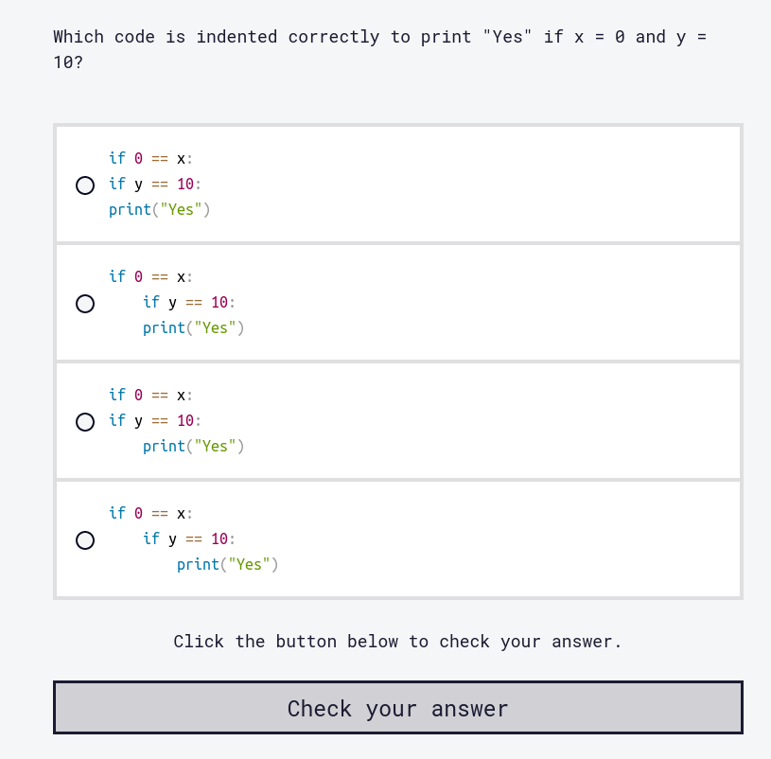
What makes python special?
Very utilitarian and provides many options to do get a job done.
Community is huge and welcoming. Huge libraries for just about everything.
Pip package manager
White space is enforced
Notes:
https://www.freecodecamp.org/learn/scientific-computing-with-python/python-for-everybody/conditional-execution

Slide 5
FCC: What was added!
Scientific Computing with Python
Data Analysis with Python
Information Security
Machine Learning with Python
All new curriculum starts off lecture based, with youtube videos attached to each lesson. After each lecture, problems will be presented. At the end of each certification, projects must be completed.

Slide 6

Installation and setup
Check to see if its already installed:
Go to console/terminal and type python3.
If not, then go to https://www.python.org/downloads/
And install python3 to your machine.

Slide 7
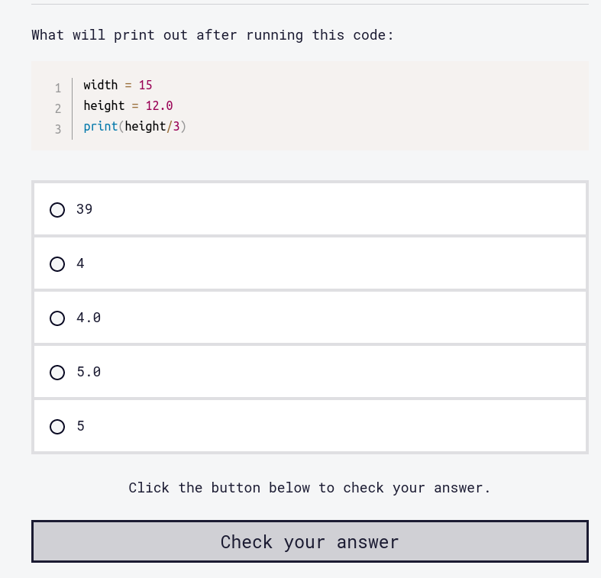
Scientific Computing with Python Certification
Goes over the basics of python as a language. Python for Everybody.
Next will go over Scientific Computing with Python Projects.
All lessons will have a video attached. Watch the video and try to answer the question.
Use REPL when confused.
Notes:
https://www.freecodecamp.org/learn/scientific-computing-with-python/python-for-everybody/intermediate-expressions

Slide 8
Data Analysis with Python Certification
Broken up into three courses:
Data Analysis with Python Course
Numpy
Data Analysis with Python Projects

Slide 9
Information Security
Broken into three parts. You should know Javascript before starting this section:
Information Security with Helmetjs
Python for Penetration Testing
Information Security Projects

Slide 10
Machine Learning with Python Certification
Tensorflow
How Neural Networks work
Machine Learning with Python Projects

Slide 11
Links
https://www.freecodecamp.org
https://www.freecodecamp.org/news/python-curriculum-is-live/

