Slide 1
FIFO comparison
Compare different FIFO implementations
  area
  speed
Three architectures
  several versions on some architectures
  two versions of shift register included

Slide 2
FIFO structures
a) Input-output mux
b) Input mux
1-to-n demux
1-to-n demux
...
...
...
shift
...
n-to-1 mux
c) Shift register
d) Hierarchical shift register, 3 stages
1-to-n/stages demux
shift
shift
shift
shift
c2) Shift register that automatically shifts data
towards output
Figure 1.

Slide 3
FIFO
Output and Input are always the same registers
Data is shifted in the input buffer when write occurs
Mux chooses which data is moved to the output after read
Input register
Output register
Input
Output
Input
Buffer
+
Figure 2.
Notes:
When data is read, output buffer is fed with the oldest data after the read ->output is always from the same register and up-to-date
If data is written for the 1st time, it’s written straight to the output register, otherwise it’s always written to the same register
If read and write occur simultaneously and fifo is full, no data is written but one data is read.

Slide 4
Different FIFOs (1)
fifo_iom: uses mux in the input and output (Fig1a)
fifo_im: uses mux in the input (Fig1b)
  fifo_im_case: implemented as fifo_im except that uses "case" instead of "if".
    makes it concurrent rather than sequential
  there is a problem with fifo_im (both) when trying to write data even though fifo is full.
Fifo_cases (Fig2):
  tested: doesn't set the output to '0's when last data is read.
  Result: doesn't have a significant impact on anything

Slide 5
Different FIFOs (2)
Fifo_case (all versions)
  input and output-register is always the same.
  after the first data the following data is stored to a shift register
Differencies between fifo_case versions:
  v3 : bug discovered - don't use
  v4 : uses a variable for Data_amount to update control signals (Empty, Full, etc.).
    register inferred from variable
    v4a : same as v4 but doesn't reset to zero any register. only control + data_amount
  v5 : signal is used for Data_amount
    v6 : same as v5 but doesn't reset buffer and output registers
  Use either v4 or v5 which have a proper reset!
    v5 seems more orthodox

Slide 6
Synthesis results
Uses double_fifo_muxed_read components which include two FIFOs and a read multiplexer
FIFOs are 3b wide
ASIC
  ST microelectronics 0.18 um
  Synopsys Design Compiler
Synthesis for FPGA
  used Mentor Graphics Precision RTL Synthesis 2003a.29
  Synthesized for Altera Excalibur ARM, frequency 20 MHz

Slide 7
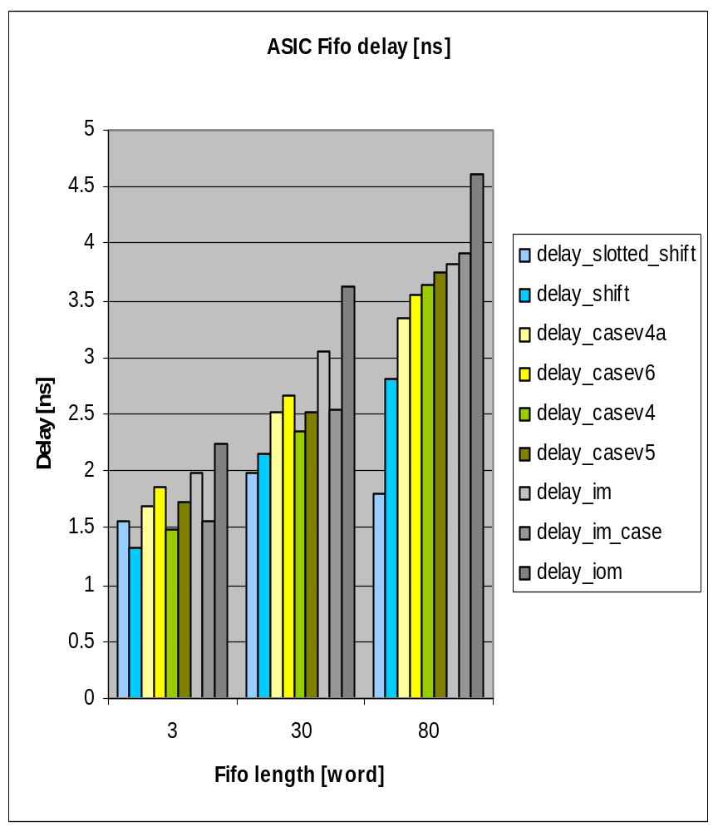
ASIC Delay 0.18 um
Sorted according to delay of 80 units long fifo
casev4 fastest fifo
iom slowest fifo
  im faster than iom

Slide 8
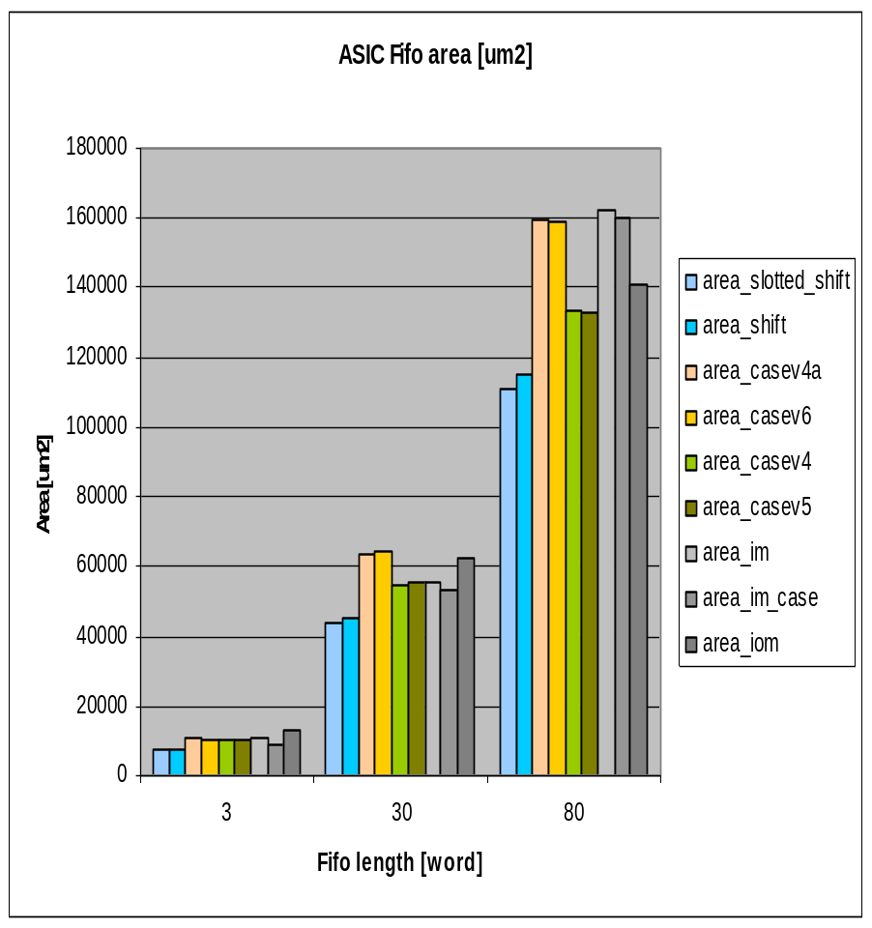
ASIC Area 0.18 um
Sorted according to delay of 80 units long fifo
casev5 smallest fifo
casev4/im biggest
Not reseting buffer registers increases area

Slide 9
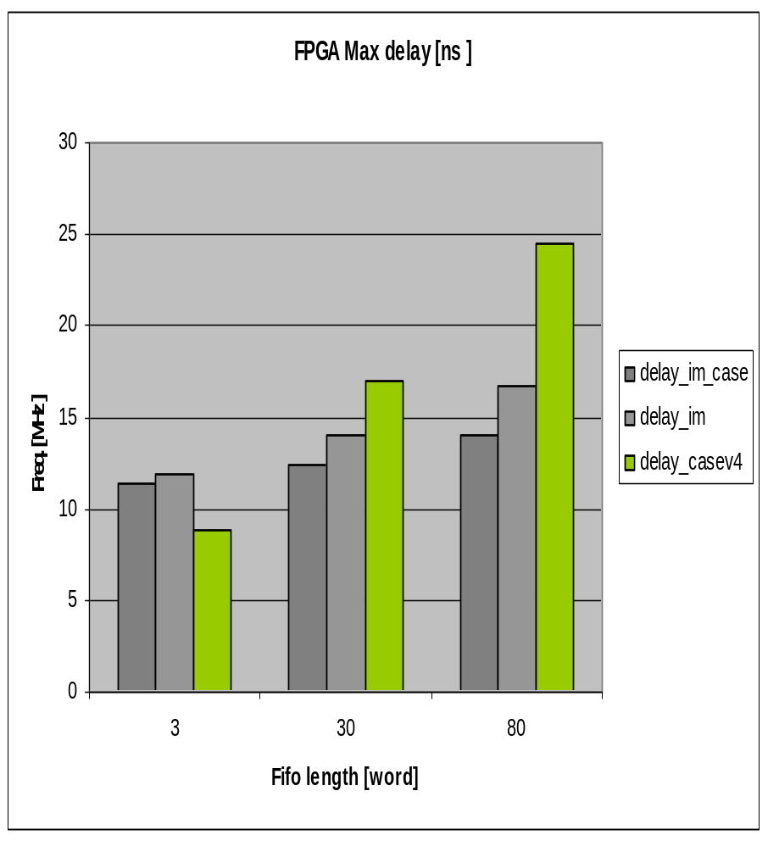
FPGA Delay
Sorted according to delay of 80 units long fifo
case bigger than muxed fifo

Slide 10
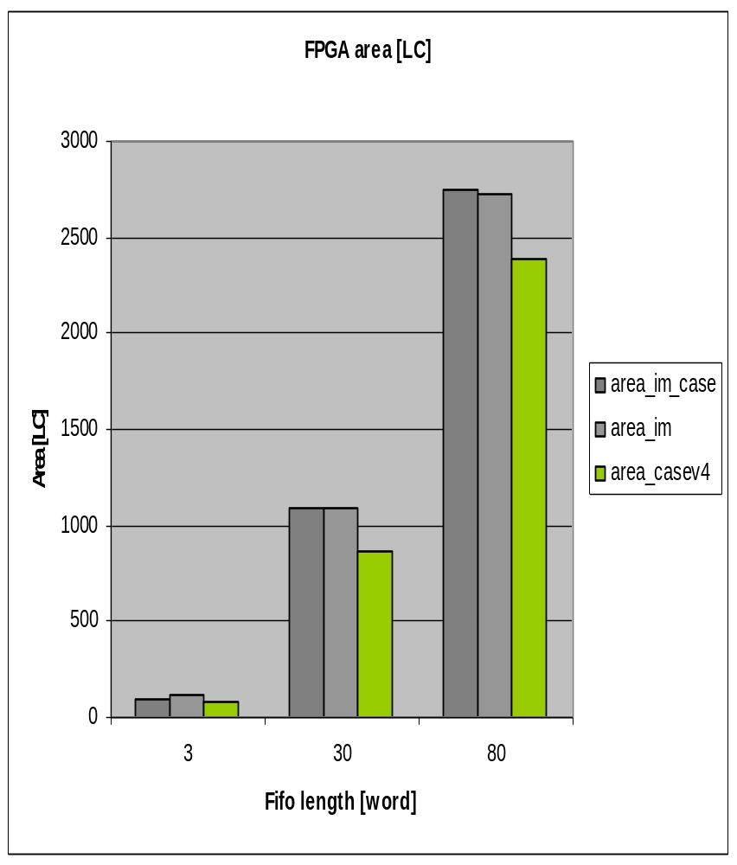
FPGA Area
Sorted according to delay of 80 units long fifo
case smaller than muxed fifo

Slide 11
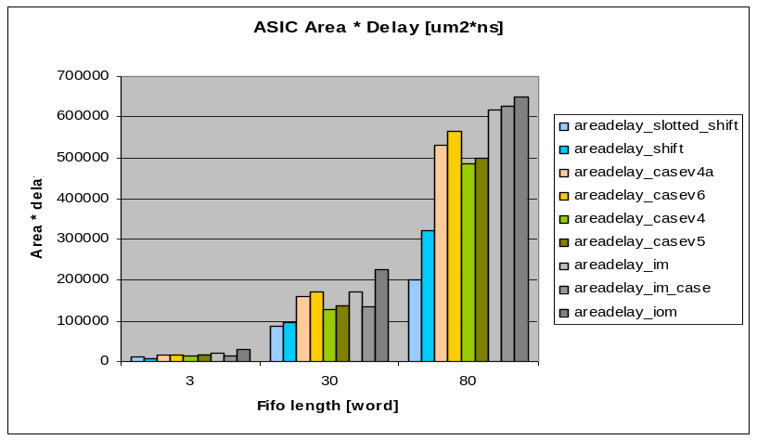
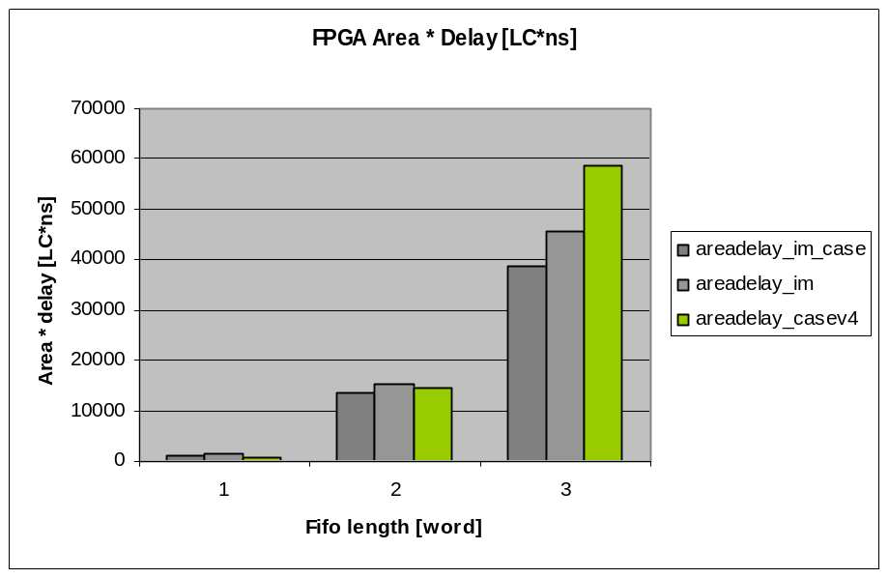
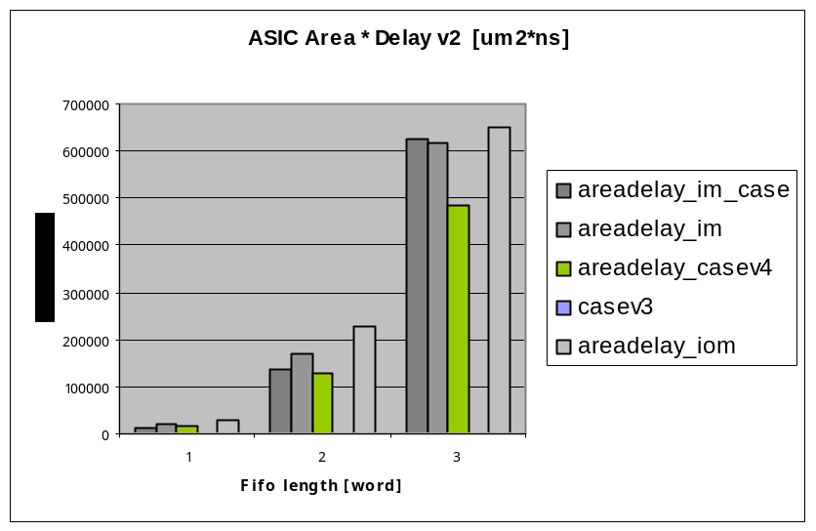
Area * Delay

Slide 12
Conclusion
Shift register much smaller and faster than FIFO
Areas does not change much with coding style
  Delay is the main concern
ASIC and FPGA favor different FIFOs
  ASIC : casev4 and FPGA: im_case
  casev4 inferres register with variable, scary...
im_case seems best (perhaps, probably...)

Slide 13
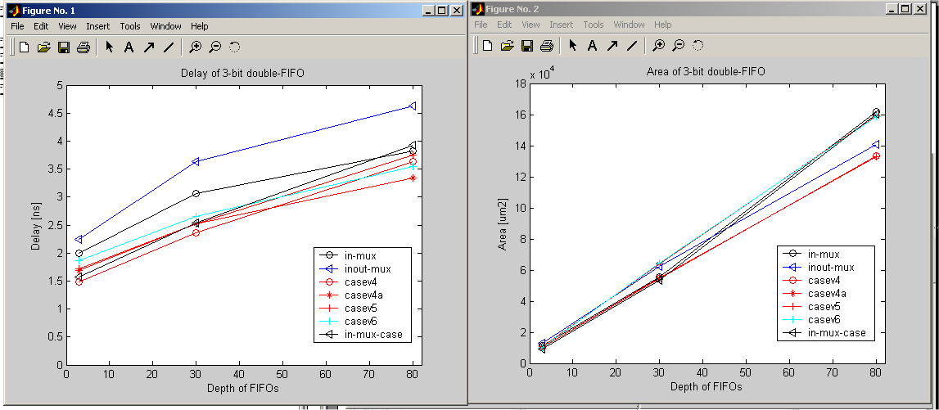
ASIC

Slide 14
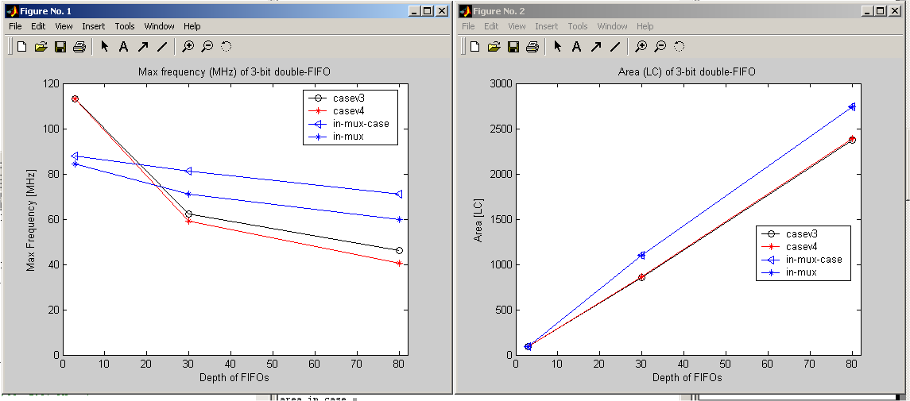
FPGA

