Slide 1
PCIe to HIBI
Pictures for documentation

Slide 2
General PCIe information

Slide 3
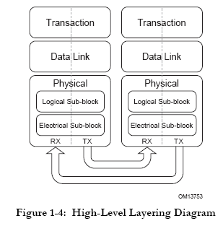
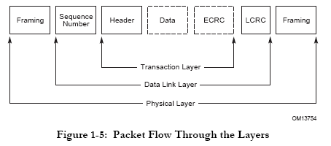
PCIe layers

Slide 4
PCIe packet handling
S
t
a
r
t
N
o
I
s
R
e
q
u
e
s
t
T
S
u
p
p
o
y
p
e
r
t
e
d
?
Y
U
n
s
u
p
p
o
e
s
r
t
R
e
q
u
e
s
e
d
t
Y
e
s
R
e
q
u
e
s
t
T
y
p
e
=
M
s
g
?
D
o
e
s
R
e
q
u
e
s
N
o
t
r
e
q
u
i
r
a
C
o
m
p
e
N
o
l
e
t
i
o
n
?
O
p
t
i
o
n
a
E
n
d
l
Y
e
s
D
o
e
s
R
e
q
u
e
s
Y
t
N
o
S
e
n
d
C
o
m
p
e
s
l
e
t
i
o
n
:
D
o
e
s
R
e
q
u
e
s
t
v
i
o
l
a
t
e
r
e
q
u
i
r
C
o
m
p
e
a
l
e
t
i
o
n
S
t
a
t
u
s
=
U
R
D
e
v
i
c
e
p
r
o
g
r
a
m
m
i
n
g
C
o
m
p
l
e
t
i
m
o
d
e
o
n
?
l
?
E
n
d
E
n
d
Y
N
o
e
s
S
e
n
d
C
o
m
p
l
e
t
i
o
n
C
o
m
p
:
l
e
t
i
o
n
S
t
a
t
u
s
=
C
A
P
r
o
c
e
s
s
R
e
q
u
e
s
t
a
c
c
o
r
d
i
n
g
t
R
e
q
u
e
s
o
t
h
a
n
d
l
i
n
g
r
u
l
(
e
s
E
n
d
d
e
t
e
r
m
i
n
e
C
o
m
p
l
e
t
i
o
n
S
t
a
t
u
s
I
,
s
v
a
l
u
e
i
N
o
n
i
f
a
p
p
l
i
c
a
b
l
e
M
e
s
s
a
g
e
C
o
d
e
)
f
i
e
l
d
d
e
f
i
n
e
d
?
Y
e
s
D
o
e
s
R
e
q
u
e
s
N
o
t
r
e
q
u
i
r
P
e
r
o
c
e
s
s
M
e
s
s
a
g
e
a
C
o
m
p
l
e
t
i
U
n
s
u
p
p
o
o
n
?
r
t
e
d
a
c
c
o
r
d
i
n
g
t
s
o
M
e
s
s
a
g
e
R
e
q
u
e
t
H
a
n
d
E
n
d
l
i
n
g
R
u
l
e
s
Y
e
s
S
e
n
d
C
o
m
p
l
e
t
i
E
n
d
E
n
d
o
n
E
n
d

Slide 5
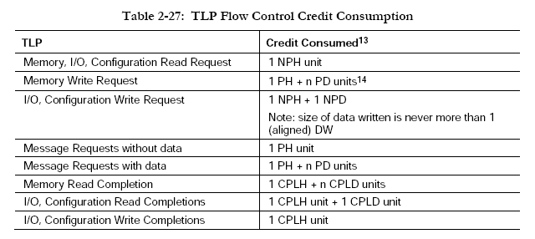
PCIe TLP credits

Slide 6
PCIe transaction types
Address Space | Transaction Types | Basic Usage
Memory | Read / Write | Transfer data to/from a memory-mapped location.
I/O | Read / Write | Transfer data to/from an I/O-mapped location
Configuration | Read / Write | Device Function configuration/setup
Trusted Configuration | Read / Write | Trusted Device Function configuration/setup
Message | Baseline (including Vendor–defined) | From event signaling mechanism to general purpose messaging

Slide 7
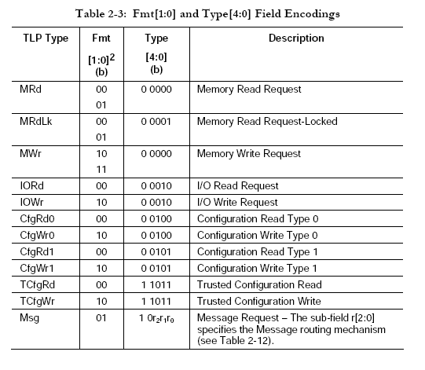
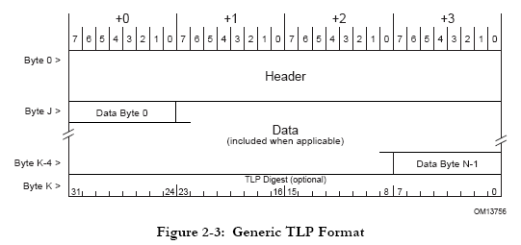
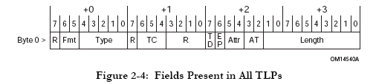
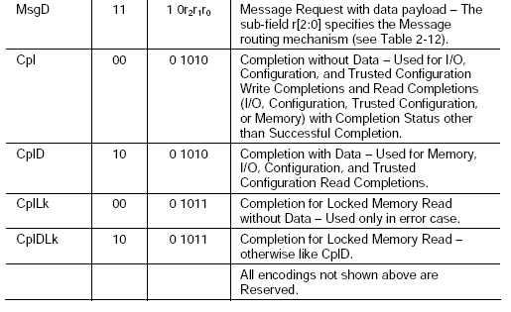
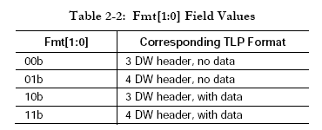
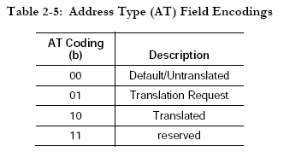
TLP headers
in DWs

Slide 8
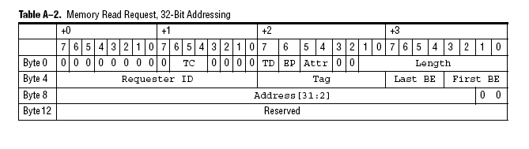
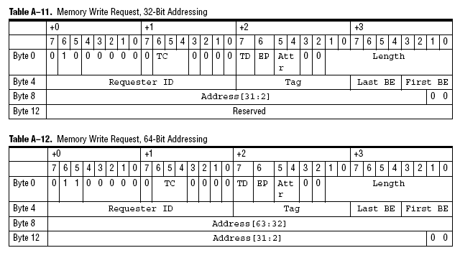
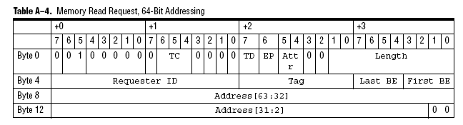
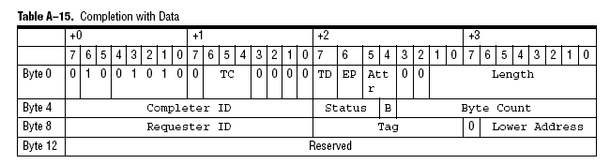
TLP headers for read/write

Slide 9
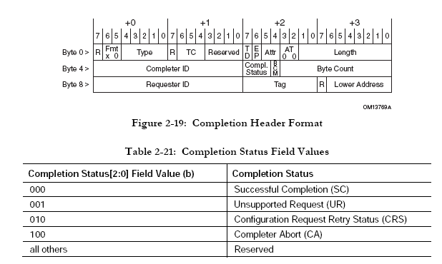
TLP completion header

Slide 10
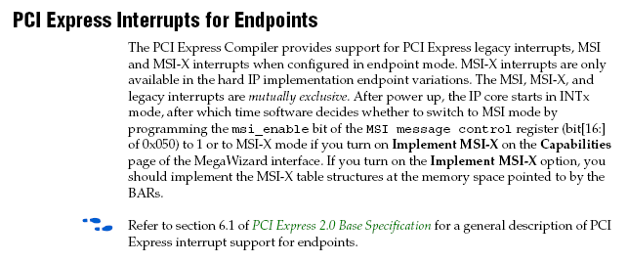
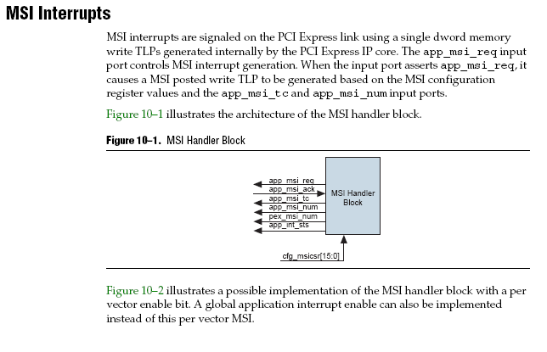
PCIe interrupts
three types of interrupts:
legacy PCI
MSI
MSI-X
Which type to use?
better support for legacy PCI on linux?

Slide 11
Funbase SoC HW platform essential IP blocks and layers
PC
FUNCAPI (SW)
NIOS II
FUNCAPI (SW)
HW IP-block
FUNCAPI transport
FUNCAPI interface (HW)
FUNCAPI transport
PCIe driver
FUNCAPI IP interface
PCIe PHY
DDR2 PHY memory
ETH PHY
DMA driver
DMA interface (HW)
PCIe controller (Altera)
DDR2 controller (Altera)
ETH
controller (Altera)
Dualport
RAM
Dualport
RAM
Device specific interface (HW)
PCIe to HIBI
HIBI MEM DMA
ETH2HIBI
HIBI PE DMA
HIBI PE DMA
HIBI IP interface (HW)
HIBI wrapper
HIBI wrapper
HIBI wrapper
HIBI wrapper
HIBI wrapper
HIBI network

Slide 12
PCIe to HIBI
Altera PCIe Hard IP Core
MegaWizard parameters
Tx/Rx
Sideband
PCIe PHY
TLP decoder/encoder
Tx/Rx
Sideband
Altera PCIe controller
Generics
Avalon ST if.
TLP Rx/Tx
PCIe to HIBI
Avalon ST if.
TLP Rx/Tx
PCIe to HIBI
Generics
HIBI wrapper r3
DMA configuration registers
DMA configuration parameters
HIBI PHY
HIBI IP interface
HIBI wrapper

Slide 13
Memory map
HIBI MEM DMA configuration addresses
DDR2 memory @FPGA board
PC memory map
PCIe device
HIBI memory map
PCIe dev 1 BAR 1
BAR1
IP-blocks (1M)
0x00000
BAR1+ (min 4k offset)
PCIe dev n BAR n
0x00BFF
Code etc
0x00C00
BAR_n
DDR2 (1M-2G)
Data etc
BAR_n+ (min 4k offset)
Direct access
DMA access
0x1FFFFFFF

Slide 14
Example system
Atom
PCIe PHY
Altera PCIe controller
Avalon ST if.
RX / 128 bit
Avalon ST if.
PCIe to HIBI
HIBI wrapper r3
32 bit
HIBI PHY
TX / 128 bit
Other PCIe components
PCIe RX/TX
HIBI RX/TX
Are there other components on the PCIe bus?
Other PCIe components
TLP enc/dec

Slide 15
General layout
FPGA board
PC / Atom
FPGA
Cmp 0
x1/x4/x8 PCIe connector
Altera PCIe controller
PCIe to HIBI
Cmp 1
PCIe phy
Cmp 2
HIBI phy

Slide 16
Function example
FPGA board
PC / Atom
FPGA
1. read request
address translation
Cmp 0
x1/x4/x8 PCIe connector
Altera PCIe controller
PCIe to HIBI
Cmp 1
Cmp 2
2. response with data

Slide 17
Simulation test bench
Rootpoint
Endpoint
Altera simulation generator
x8 PCIe connector
Altera PCIe controller
PCIe to HIBI
HIBI MEM DMA
Altera DDR2 controller
DDR2 chip sim. model
PCIe phy
HIBI phy

Slide 18
Test case 1
Linux PC
Arria II GX FPGA board
Arria II GX FPGA
HIBI MEM DMA
Altera DDR2 controller
DDR2 chip
x8 PCIe connector
Altera PCIe controller
PCIe to HIBI
HIBI MEM DMA
On-chip mem
PCIe phy
HIBI phy

Slide 19
Detailed layout
PCIe x1/x4/x8 PHY
Altera PCIe controller
Avalon ST if.
RX / 128 bit
Avalon ST if.
PCIe to HIBI
HIBI wrapper r3
RX 32 bit
HIBI PHY
TX / 128 bit
PCIe to HIBI addr. trans. table
IRQ if.
IRQ if.
TX 32 bit
LM if.
LM if.
FPGA border
Avalon ST RX if.
PCIe RX
IPKT if.
IPKT if.
HIBI if
HIBI msg RX
IPKT RX
H2P req ctrl
HIBI msg reader
HIBI RX
Req ctrl
Avalon ST TX if.
PCIe TX
OPKT if.
OPKT if.
HIBI msg TX
OPKT TX
Packet buf
HIBI TX
IRQ if.
LM if.
PCIe ctrl cfg

Slide 20
Detailed layout - KELLODOMAINIT
PCIe x1/x4/x8 PHY
Altera PCIe controller
Avalon ST if.
RX / 128 bit
Avalon ST if.
PCIe to HIBI
HIBI wrapper r3
TX 32 bit
HIBI PHY
TX / 128 bit
IRQ if.
IRQ if.
RX 32 bit
LM if.
LM if.
FPGA border
Avalon ST RX if.
PCIe RX
HIBI if
HIBI wrapper r3 TX
PCIe DMA
Req ctrl
Avalon ST TX if.
PCIe TX
Packet buf
HIBI wrapper r3 RX
IRQ if.
PCIe to HIBI addr. trans. table
LM if.
PCIe ctrl cfg

Slide 21
Detailed layout
PC
PCIe x1/x4/x8 PHY
Altera PCIe controller
Avalon ST if.
RX / 128 bit
Avalon ST if.
PCIe to HIBI
HIBI wrapper r3
TX 32 bit
HIBI PHY
TX 32 bit
HIBI wrapper r3
HIBI_MEM_DMA
Alt_ddr2_ctrl
ddr2_chip
TX / 128 bit
RX 32 bit
RX 32 bit
IRQ if.
IRQ if.
LM if.
LM if.
FPGA border
Avalon ST RX if.
PCIe RX
HIBI if
HIBI wrapper r3 TX
PCIe DMA
Req ctrl
Avalon ST TX if.
PCIe TX
Packet buf
HIBI wrapper r3 RX
IRQ if.

Slide 22
Detailed layout
PC
PCIe x1/x4/x8 PHY
Altera PCIe controller
Avalon ST if.
RX / 128 bit
Avalon ST if.
PCIe to HIBI
HIBI wrapper r3
RX/TX 32 bit
TX / 128 bit
IRQ if.
IRQ if.
LM if.
LM if.
HIBI PHY
FPGA border
ddr2_chip
Alt_ddr2_ctrl
HIBI_MEM_DMA
HIBI wrapper r3

Slide 23
Detailed layout
Arria II GX FPGA board
125 MHz
100 MHz
PC
PCIe x8 PHY
Altera PCIe controller
Avalon ST if.
RX / 128 bit
Avalon ST if.
PCIe to HIBI
HIBI wrapper r3
TX / 128 bit
RX/TX 32 bit
IRQ if.
IRQ if.
HIBI PHY
LM if.
LM if.
200 MHz
DDR2 dimm
Altera DDR2 controller
HIBI MEM DMA
HIBI wrapper r3
RX/TX 32 bit
clock domain

Slide 24
PC to HIBI DMA write
PC
PCIe phy
Alt PCIe ctrl
PCIe_to_HIBI PCIe_RX/TX
PCIe_to_HIBI PCIe_DMA
PCIe_to_HIBI HIBI_if
HIBI_phy
HIBI_MEM_DMA
alt_mem_ctrl
offchip_mem
1:
DMA write config word 0
2:
DMA write config word 0
3:
DMA write config word 0
4:
DMA write config word 0
5:
DMA write config word 3
6:
DMA write config word 3
7:
DMA write config word 3
8:
DMA write config word 3
10:
Read req, 256 DW
9:
Read req, 256 DW
11:
Read req, 256 DW
transfer descriptors
transfer descriptors
12:
Read req, 256 DW
transfer descriptors
13:
transfer descriptors
transfer descriptors, 256 DW
14:
transfer descriptors, 256 DW
15:
transfer descriptors, 256 DW
16:
transfer descriptors, 256 DW
loop
21:
Read req, 128 DW
20:
Read req, 128 DW
17:
channel config, 3 DW
18:
channel config, 3 DW
[ ]
23:
Read req, 128 DW
22:
Read req, 128 DW
write data
write data
19:
channel config, 3 DW
write data
write data
[ ]
24:
write data, 128 DW
25:
write data, 128 DW
26:
write data, 128 DW
27:
write data, 128 DW
28:
write data, 128 DW
29:
write data, 128 DW
30:
write data, 128 DW
31:
write data, 128 DW

Slide 25
PC to HIBI DMA read
PC
PCIe phy
Alt PCIe ctrl
PCIe_to_HIBI PCIe_RX/TX
PCIe_to_HIBI PCIe_DMA
PCIe_to_HIBI HIBI_if
HIBI_phy
HIBI_MEM_DMA
alt_mem_ctrl
offchip_mem
1:
DMA write config word 0
2:
DMA write config word 0
3:
DMA write config word 0
4:
DMA write config word 0
5:
DMA write config word 3
6:
DMA write config word 3
7:
DMA write config word 3
8:
DMA write config word 3
10:
Read req, 256 DW
9:
Read req, 256 DW
11:
Read req, 256 DW
transfer descriptors
transfer descriptors
12:
Read req, 256 DW
transfer descriptors
transfer descriptors
13:
transfer descriptors, 256 DW
14:
transfer descriptors, 256 DW
15:
transfer descriptors, 256 DW
16:
transfer descriptors, 256 DW
loop
17:
channel config, 3 DW
18:
channel config, 3 DW
19:
channel config, 3 DW
[ ]
20:
read req, 128 DW
21:
read req, 128 DW
[ ]
23:
write data, 128 DW
22:
read data, 128 DW
25:
write data, 128 DW
24:
write data, 128 DW
27:
write data, 128 DW
26:
write data, 128 DW
29:
write data, 128 DW
28:
write data, 128 DW
Commercial Development is strictly Prohibited

Slide 26
Design progress
PCIe to HIBI addr. trans. table
95%
75%
100%
Avalon ST RX if.
TLP dec
HIBI if
HIBI wrapper r3 TX
Req ctrl
largest component
100%
100%
Avalon ST TX if.
TLP enc
Packet buf
HIBI wrapper r3 RX
IRQ if.
Avalon ST RX if.
PCIe RX
HIBI if
HIBI wrapper r3 TX
LM if.
PCIe ctrl cfg
90%
PCIe DMA
Req ctrl
0%
Avalon ST TX if.
PCIe TX
Packet buf
HIBI wrapper r3 RX
IRQ if.
LM if.
PCIe ctrl cfg
100%
99%

Slide 27
Design progress
100%
95%
100%
Avalon ST RX if.
PCIe RX
HIBI if
HIBI wrapper r3 TX
PCIe DMA
Req ctrl
largest component
Avalon ST TX if.
PCIe TX
Packet buf
HIBI wrapper r3 RX
IRQ if.
100%
99%
99%
LM if.
PCIe ctrl cfg

Slide 28
PCIe to HIBI addr. trans.
PC memory map
PCIe device 0
PCIe to HIBI
HIBI memory map
PCIe dev 0 BAR 0
PCIe dev 0 BAR 0
P2H PCIe addr 0
P2H PCIe addr 1
P2H HIBI addr 0
PCIe dev 1 BAR 1
P2H HIBI addr 1
PCIe dev 0 BAR 1
PCIe dev 0 BAR 1
P2H PCIe addr 2
PCIe dev 1 BAR 0
Code etc
Data etc
P2H HIBI addr 2

Slide 29
PCIe to HIBI addr. trans.
PC memory map
PCIe device 0
PCIe to HIBI
HIBI memory map
PCIe dev 0 BAR 0
PCIe dev 0 BAR 0
P2H PCIe addr 0
P2H PCIe addr 1
P2H HIBI addr 0
PCIe dev 1 BAR 1
P2H HIBI addr 1
PCIe dev 0 BAR 1
PCIe dev 0 BAR 1
P2H PCIe addr 2
PCIe dev 1 BAR 0
Code etc
Data etc
P2H HIBI addr 2

Slide 30
PCIe to HIBI addr. trans.
PC memory map
PCIe A2GX device
PCIe to HIBI
HIBI memory map
PCIe dev 0 (A2GX) BAR 0
PCIe A2GX dev BAR 0
A2GX PCIe addr 0
NIOS II cpu mem
A2GX PCIe addr 1
ETH2HIBI
PCIe dev 1 BAR 1
HW IP-block
PCIe to HIBI
PCIe dev 0 (A2GX) BAR 1
PCIe A2GX dev BAR 1
A2GX PCIe addr 2
PCIe dev 1 BAR 0
HIBI MEM DMA
Code etc
Data etc

Slide 31
PCIe to HIBI addr. trans.
PC memory map
PCIe to HIBI
HIBI memory map
H2P DMA channels
PCIe to HIBI
inefficient to have single word transfers over PCIe
H2P HIBI addr 0
H2P HIBI addr 1
H2P PCIe addr 0
HIBI comp 0
H2P PCIe addr 1
HIBI comp 1

Slide 32
PCIe to HIBI addr. trans.
PC memory map
PCIe to HIBI
HIBI memory map
H2P DMA channels
PCIe to HIBI
HIBI comp 0
HIBI comp 1

Slide 33
PCIe to HIBI addr. trans.
PC memory map
PCIe to HIBI
HIBI memory map
PCIe A2GX dev BAR 0
NIOS II cpu mem
ETH2HIBI
PCIe dev 1 BAR 1
HW IP-block
H2P DMA channels
PCIe to HIBI
PCIe A2GX dev BAR 1
PCIe dev 1 BAR 0
HIBI MEM DMA
Code etc
Data etc

Slide 34
PCIe to HIBI addr. trans.
PC memory map
HIBI memory map
H2P DMA wr chan 0
H2P DMA channels
H2P DMA wr chan n
H2P HIBI addr 0
H2P DMA rd chan 0
H2P HIBI addr 1
H2P DMA rd chan n
H2P direct addr
H2P PCIe addr 0
H2P PCIe addr 1

Slide 35
TLP dec
TLP dec
clk
rst_n
Rx_St_Data_i[127…0]
Rx_St_Valid_i
Rx_St_Sop_i
tlp_write
Rx_St_Eop_i
tlp_read
Rx_St_Bardec_i[7…0]
tlp_header_size
Rx_St_Be_i[15…0]
tlp_data_en
Rx_St_Ready_o
tlp_header_amount
Rx_St_Mask_o
tlp_data_amount
tlp_header_re
tlp_data_re
PCIe controller side / Avalon ST
PCIe to HIBI internal signals

Slide 36
PCIe RX
ready to valid latency max. 3 cycles (PCIe compiler guide Figure 5–14)
not possible
cnt < max_count - 3
tlp header fifo cnt
32-bit parts
ipkt = in packet
cnt < max_count – 4*3
tlp data fifo cnt
ipkt_is_write
Rx_St_Data_i[127…0]
wdata
tlp header fifo
rdata
ipkt_addr[63…0]
Rx_St_Valid_i
full
empty
ipkt_rw_length[31…0]
one_p
one_d
is write
ipkt_first_be[3…0]
Rx_St_Sop_i
we
re
addr
ipkt_last_be[3…0]
Rx_St_Eop_i
first be
Rx_St_Bardec_i[7…0]
last be
ipkt_valid
tlp packet part cnt
first data
ipkt_first_data
Rx_St_Be_i[15…0]
last data
ipkt_last_data
Rx_St_Ready_o
128-bit
counts down
ipkt_re
Rx_St_Mask_o
ipkt_data[31…0]
PCIe controller side
/ Avalon ST 128-bit
wdata
tlp data fifo
rdata
full
empty
32-bit
one_p
one_d
we
re
not required
d1
is_header
cnt += 4
cnt -= 1
PCIe to HIBI internal signals

Slide 37
TLP enc
tlp header fifo cnt
tlp data fifo cnt
opkt = out packet
is write
wdata
tlp header fifo
rdata
addr
opkt_is_write
full
empty
addr width
opkt_addr[63…0]
Tx_St_Data_o[127…0]
rw length
opkt_addr_width
Tx_St_Valid_o
we
re
first be
opkt_rw_length[31…0]
Tx_St_Sop_o
last be
opkt_first_be[3…0]
Tx_St_Eop_o
opkt_last_be[3…0]
TxCred_i[35…0]
Tx_St_Ready_i
opkt_ready
app_msi_req
opkt_start
app_msi_ack
wdata
tlp data fifo
rdata
opkt_we
app_msi_tc[2...0]
opkt_data[31…0]
app_msi_num[4...0]
full
empty
we
re
PCIe to HIBI internal signals
PCIe controller side
/ Avalon ST 128-bit

Slide 38
HIBI if
mem init
mem init done
ipkt_is_write_in
wdata
free rpkt chan fifo
rdata
ipkt_is_read_req_in
full
empty
hibi_data_in[31…0]
ipkt_is_rdata_in
one_p
one_d
hibi_comm_in[2…0]
ipkt_addr_in[63…0]
we
re
hibi_empty_in
ipkt_addr_size_in
hibi_re_out
ipkt_length_in[31…0]
hibi_addr_out[31…0]
ipkt_req_id_in[15…0]
hibi_data_out[31…0]
ipkt_first_be_in[3…0]
hibi_comm_out[2…0]
ipkt_last_be_in[3…0]
wdata
pcie rpkt mem
rdata
hibi_full_in
ipkt_valid_in
waddr
raddr
hibi_msg_addr_in[31…0]
ipkt_first_part_in
we
re
hibi_msg_data_in[31…0]
ipkt_last_part_in
hibi_msg_comm_in[2…0]
ipkt_re_out
hibi_msg_empty_in
ipkt_data_in[31…0]
wdata
pcie rpkt data mem
rdata
hibi_msg_re_out
waddr
raddr
hibi_msg_addr_out[31…0]
we
re
hibi_msg_data_out[31…0]
hibi_msg_comm_out[2…0]
hibi_msg_full_in
HIBI r3

Slide 39
Address trans.
dma cmp 0 begin addr
dma cmp 0 end addr
is HIBI DMA
dma cmp n end addr
cmp 0 pcie begin addr
wr req addr 0
gen cmp 0 begin addr
cmp 0 pcie end addr
wr req addr 1
gen cmp 0 end addr
cmp n pcie end addr
ret addr cnt
wr req addr n
gen cmp n end addr
wr chan req
wr conf 0
hibi_addr_in[31…0]
hibi_data_in[31…0]
tlp_write
wr conf 1
hibi_comm_in[2…0]
tlp_addr[63…0]
1
wr conf 2
hibi_empty_in
tlp_rw_length[31…0]
hibi_re_out
tlp_first_be[3…0]
hibi_addr_out[31…0]
tlp_last_be[3…0]
conf cnt
hibi_data_out[31…0]
hibi_comm_out[2…0]
tlp_valid
hibi_full_in
tlp_first_data
tlp_last_data
hibi_msg_addr_in[31…0]
tlp_re
hibi_msg_data_in[31…0]
tlp_data[31…0]
hibi_msg_comm_in[2…0]
hibi_msg_empty_in
from generics
dma cmp 0 base addr
hibi_msg_re_out
dma cmp 1 base addr
wr req offset
hibi_msg_addr_out[31…0]
rd req offset
hibi_msg_data_out[31…0]
dma cmp n base addr
rd chan req
hibi_msg_comm_out[2…0]
wr chan offset
rd conf 0
hibi_msg_full_in
gen cmp 0 base addr
cmp 0 cur wr chan
gen cmp 1 base addr
cmp 1 cur wr chan
rd conf 1
rd conf 2
HIBI r3
gen cmp n base addr
cmp n cur wr chan
rd chan offset
cmp 0 cur rd chan
cmp 1 cur rd chan
cmp n cur rd chan

Slide 40
Address trans.
is HIBI single
is HIBI DMA
tlp_write
HIBI single trans. gen
tlp_addr[63…0]
tlp_rw_length[31…0]
tlp_first_be[3…0]
tlp_last_be[3…0]
tlp_valid
HIBI DMA trans. gen
tlp_first_data
tlp_last_data
tlp_re
tlp_data[31…0]
tlp_packet_cnt
tlp_data_amount
tlp_data_en
tlp_addr_size
tlp_rw_length
tlp_data_re
HIBI single trans. gen
PCIe to HIBI internal signals

Slide 41
Address trans.
is HIBI single
is HIBI DMA
hibi_addr_in[31…0]
HIBI single trans. gen
hibi_data_in[31…0]
tlp_write
hibi_comm_in[2…0]
tlp_addr[63…0]
hibi_empty_in
tlp_rw_length[31…0]
hibi_re_out
tlp_first_be[3…0]
hibi_addr_out[31…0]
tlp_last_be[3…0]
hibi_data_out[31…0]
hibi_comm_out[2…0]
tlp_valid
HIBI DMA trans. gen
hibi_full_in
tlp_first_data
tlp_last_data
hibi_msg_addr_in[31…0]
tlp_re
hibi_msg_data_in[31…0]
tlp_data[31…0]
hibi_msg_comm_in[2…0]
hibi_msg_empty_in
hibi_msg_re_out
hibi_msg_addr_out[31…0]
hibi_msg_data_out[31…0]
hibi_msg_comm_out[2…0]
hibi_msg_full_in
HIBI single trans. gen
PCIe to HIBI internal signals

Slide 42
Req ctrl
32-bit parts
ipkt = in packet
ipkt_is_write
init_done_out
ipkt_addr[63…0]
req_re_in
ipkt_rw_length[31…0]
is write
ipkt_first_be[3…0]
Rx_St_Sop_i
addr
ipkt_last_be[3…0]
Rx_St_Eop_i
first be
Rx_St_Bardec_i[7…0]
last be
ipkt_valid
tlp packet part cnt
first data
ipkt_first_data
Rx_St_Be_i[15…0]
last data
ipkt_last_data
Rx_St_Ready_o
128-bit
counts down
ipkt_re
Rx_St_Mask_o
ipkt_data[31…0]
PCIe controller side
/ Avalon ST 128-bit
wdata
tlp data fifo
rdata
full
empty
32-bit
one_p
one_d
we
re
not required
d1
is_header
cnt += 4
cnt -= 1
PCIe to HIBI internal signals

Slide 43
TLP enc/dec
TLP enc/dec
clk
rst_n
Rx_St_Data_i[127…0]
mem_init_done_in
Rx_St_Valid_i
Rx_St_Sop_i
mem_ready_in
Rx_St_Eop_i
mem_wr_req_out
Rx_St_Bardec_i[7…0]
mem_rd_req_out
Rx_St_Be_i[15…0]
mem_addr_out[22…0]
Rx_St_Ready_o
mem_wdata_out[31…0]
Rx_St_Mask_o
mem_be_out
mem_rdata_valid_in
Tx_St_Data_o[127…0]
mem_rdata_in[31…0]
Tx_St_Valid_o
Tx_St_Sop_o
mem_burst_begin_out
Tx_St_Eop_o
mem_burst_size_out
Tx_St_Ready_i
TxCred_i[35…0]
PCIe controller side / Avalon ST
PCIe to HIBI internal signals

Slide 44
Interface signals
PCIe to HIBI
clk
rst_n
Avalon ST RX
Rx_St_Data_i[127…0]
hibi_addr_in[31…0]
HIBI RX
Rx_St_Valid_i
hibi_data_in[31…0]
Rx_St_Sop_i
hibi_comm_in[2…0]
Rx_St_Eop_i
hibi_empty_in
Rx_St_Bardec_i[7…0]
hibi_re_out
Rx_St_Be_i
HIBI TX
Rx_St_Ready_o
hibi_addr_out[31…0]
Rx_St_Mask_o
hibi_data_out
Avalon ST TX
hibi_comm_out
Tx_St_Data_o[127…0]
hibi_full_in
Tx_St_Valid_o
hibi_we_out
Tx_St_Sop_o
HIBI message RX
Tx_St_Eop_o
hibi_msg_addr_in[31…0]
Tx_St_Ready_i
hibi_msg_data_in[31…0]
TxCred_i[35…0]
hibi_msg_comm_in[2…0]
PCIe IRQ
hibi_msg_empty_in
app_msi_req
hibi_msg_re_out
app_msi_ack
HIBI message TX
app_msi_tc[2…0]
hibi_msg_addr_out[31…0]
app_msi_num[4…0]
hibi_msg_data_out
pex_msi_num[4…0]
hibi_msg_comm_out
app_int_sts
hibi_msg_full_in
app_int_ack
hibi_msg_we_out
LMI
lmi_data_in[31…0]
lmi_data_out[31…0]
lmi_addr_out[11…0]
lmi_re_out
lmi_we_out
lmi_ack_in
PCIe controller side
HIBI side / HIBI wrapper r3

Slide 45
Altera PCIe Hard IP Core

Slide 46
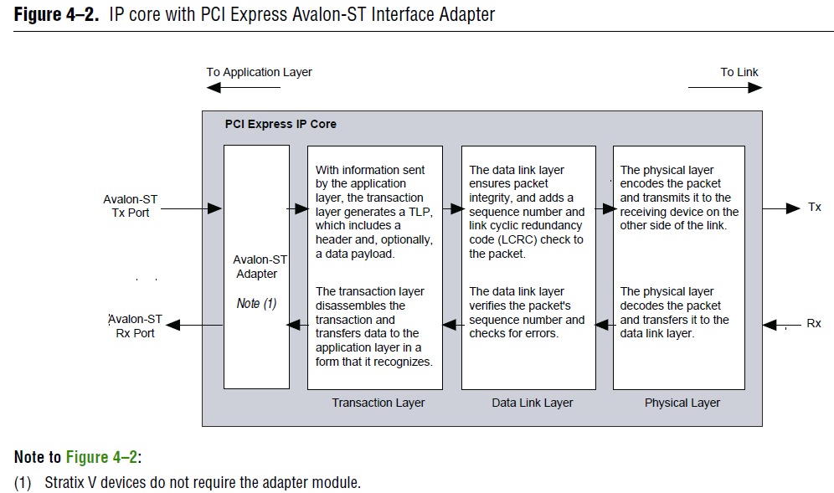

Slide 47
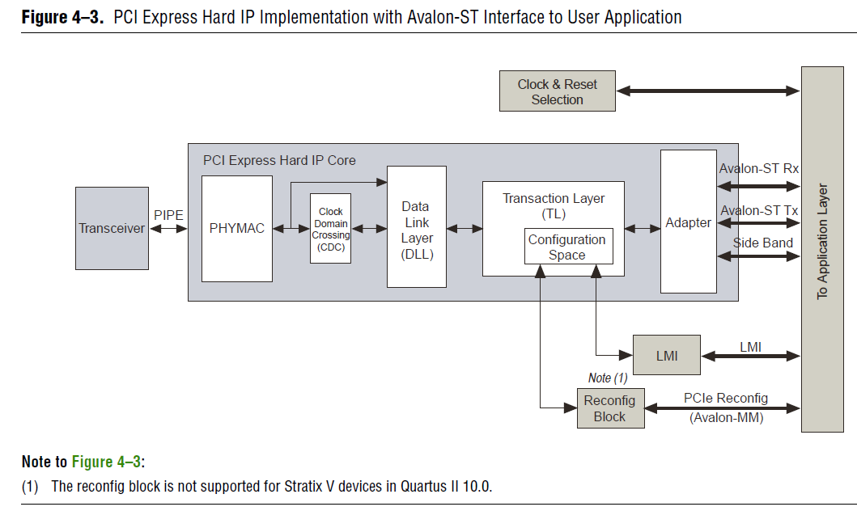

Slide 48
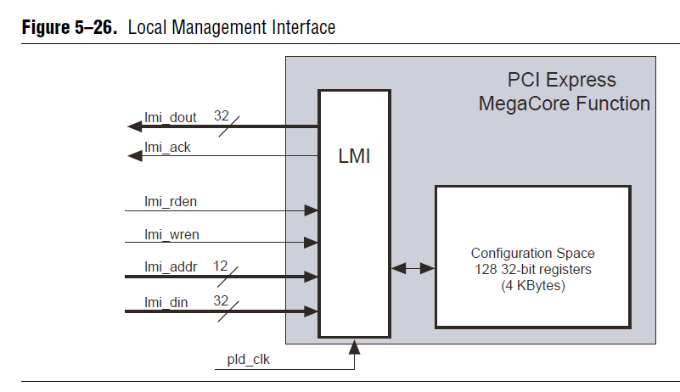

Slide 49
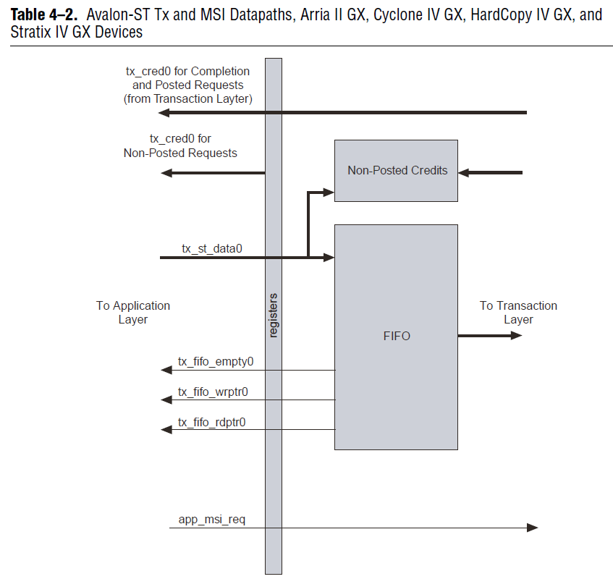

Slide 50
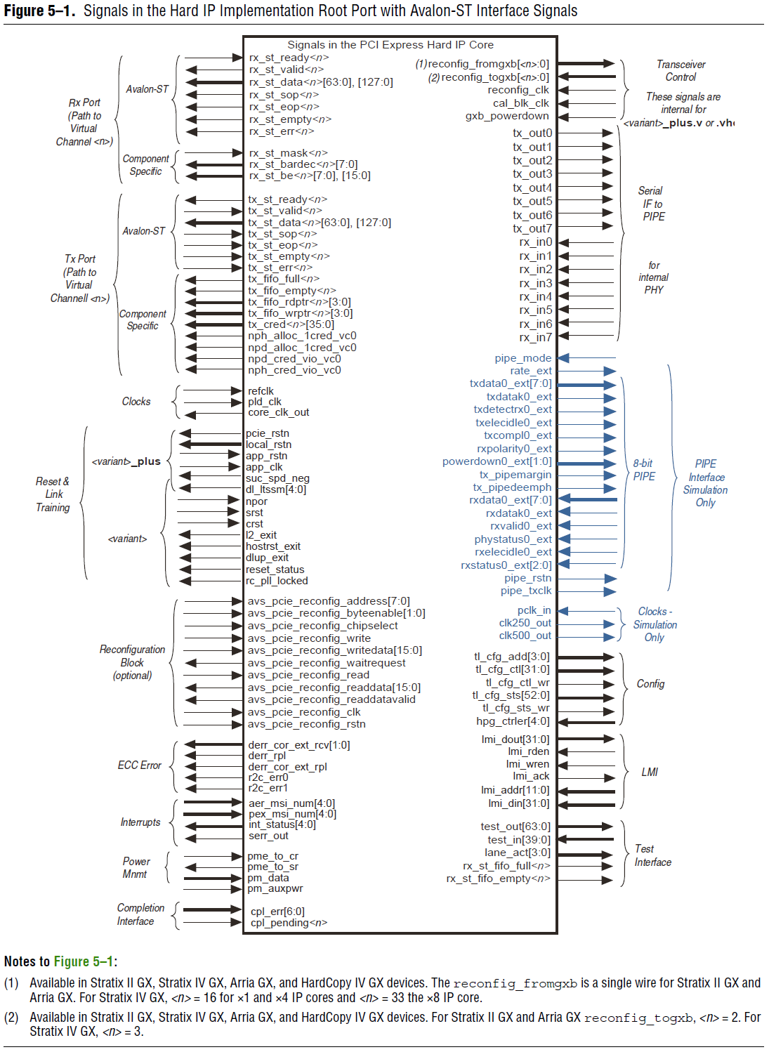
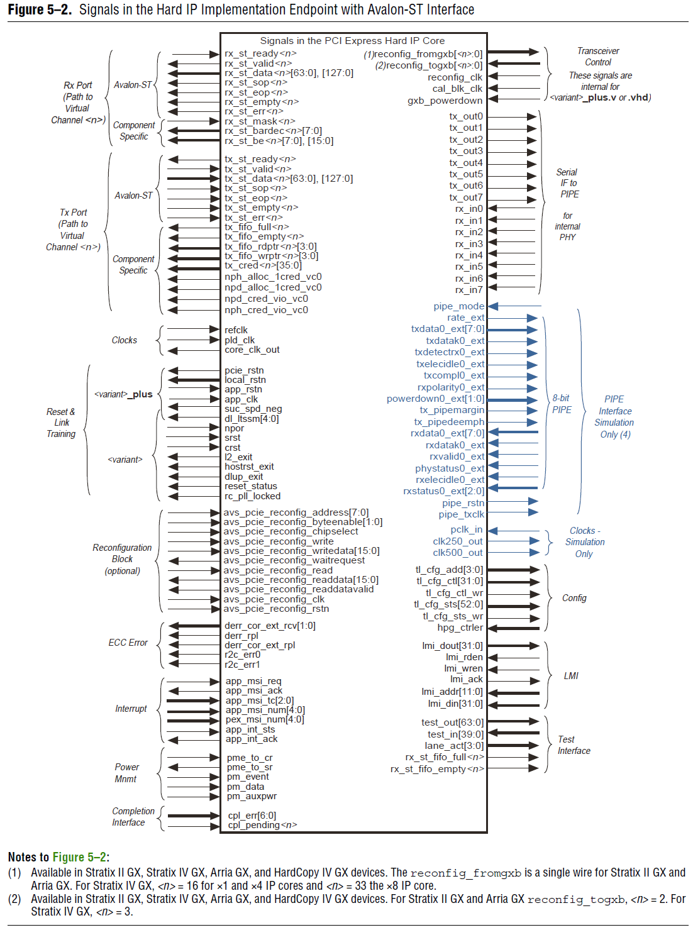

Slide 51
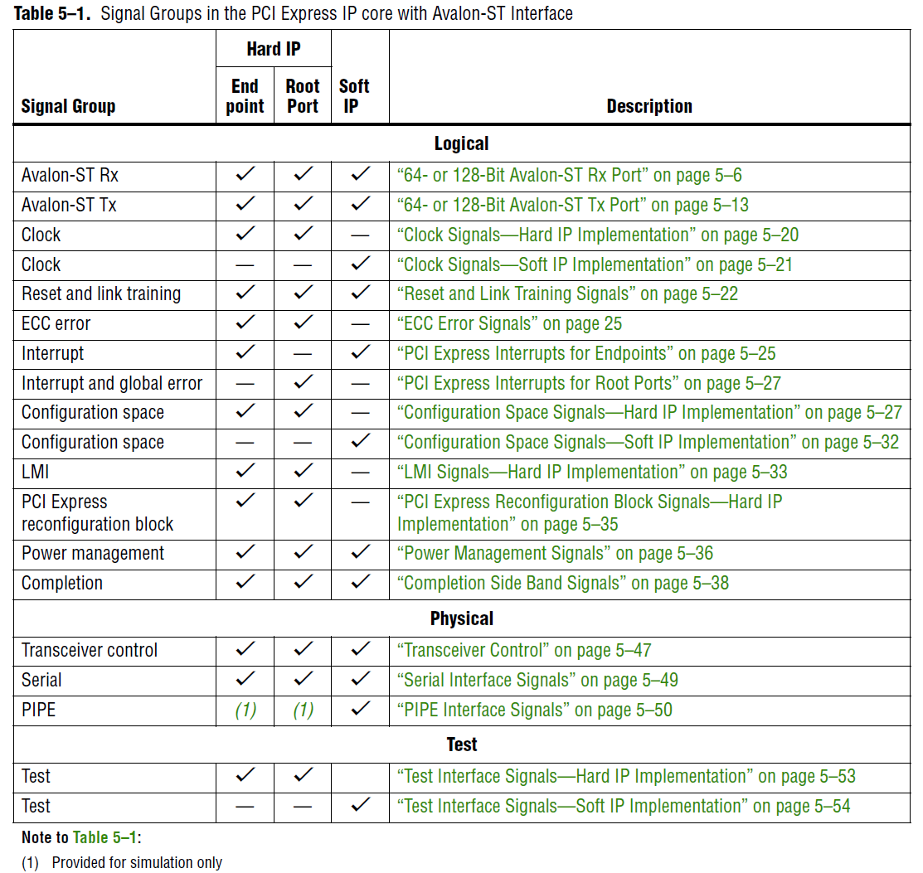

Slide 52
e
e
t
t
T
L
P
y
D
a
y
t
a
P
a
y
l
o
a
d
T
L
P
D
i
g
e
s
B
B
1
t
a
0
a
-
H
e
a
d
e
N
r
(
i
n
c
l
u
d
e
d
w
h
e
n
a
p
p
l
i
c
a
b
l
e
)
(
o
p
t
i
o
n
a
l
t
t
)
a
a
D
D
b
y
t
e
0
1
2
J
J
+
1
J
+
2
K
K
+
1
K
+
2
K
+
3
+
0
+
1
+
2
+
3
7
6
5
4
3
2
1
0
7
6
5
4
3
2
1
0
7
6
5
4
3
2
1
0
7
6
5
4
3
2
1
0
B
y
t
e
0
>
H
e
a
d
e
r
B
y
t
e
J
>
D
a
t
a
B
y
t
e
0
D
a
t
(
a
i
n
c
l
u
d
e
d
w
h
e
n
a
p
p
l
i
c
a
b
l
e
)
B
y
t
e
K
-
4
>
D
a
t
a
B
y
t
e
N
-
1
T
L
P
D
i
g
e
s
t
(
o
p
t
i
o
n
a
l
B
y
)
t
e
K
>
3
1
2
4
2
3
1
6
1
5
8
7
0
5
1

