Slide 1
HIBI v3
Pictures for documentation

Slide 2
General layout
HIBI segment
Hibi wrapper R3
Hibi wrapper R3
HIBI phy
PCIe to HIBI
Cmp 0

Slide 3
General layout
HIBI wrapper R3
normal interface
HIBI wrapper R1
addr_data_mux_write
addr_data_mux_read
HIBI segment
HIBI component
addr_data_mux_write
addr_data_mux_read
message interface

Slide 4
HIBI wrapper resource usage – Arria II GX
comb. aluts: 533
registers: 935
comb. aluts: 533
registers: 935
HIBI wrapper fifo:
width: 38 bits (data 32, address_valid 1, comm 5)
size: 4 words
comb. aluts: 76-104
registers: 155-167
4 fifos in 1 R1 wrapper
HIBI wrapper R3:
comb. aluts: 724-763
registers: 1039-1168
HIBI wrapper R1:
comb. aluts: 466-533
registers: 825-935
HIBI wrapper R3
normal interface
HIBI wrapper R1
addr_data_mux_write
addr_data_mux_read
HIBI segment
HIBI component
addr_data_mux_write
addr_data_mux_read
message interface
comb. aluts: 533
registers: 935
comb. aluts: 533
registers: 935

Slide 5
HIBI wrapper R1
double fifo demux read
transmitter
HIBI segment
HIBI component
double fifo demux write
receiver

Slide 6
HIBI wrapper R3
double fifo demux read
normal interface
fifo mux read
fifo
HIBI wrapper R1
addr data mux write
HIBI wrapper R1
fifo
addr data mux read
transmitter
double fifo demux read
HIBI segment
HIBI component
addr data mux write
receiver
double fifo demux write
double fifo demux write
addr data mux read
fifo
message interface
fifo

Slide 7
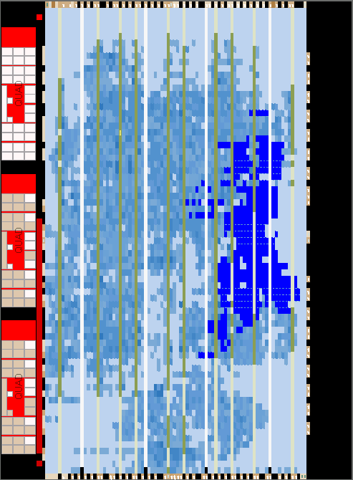
HIBI v3 resource usage
Onchip memories can also be used for the HIBI wrapper fifos
Requires atleast 12 m9k blocks per wrapper on a Arria II GX (one m9k memory 18 bits wide in two port mode, 32-bit HIBI wrapper fifo 38 bits wide)

Slide 8
HIBI v3 performance
troughput of a 32-bit HIBI segment, data and address on the same bus, transfer between two HIBI components without other signal traffic, 1024 word transfer:
Theoretical max performance would be achieved in 1025 cycles (1024 data cycles + 1 address cycle)
Wrapper fifo size 4 words: 1847 cycles
Wrapper fifo size 5 words: 1600 cycles
Wrapper fifo size 6 words: 1185 cycles
Wrapper fifo size 7 words: 1168 cycles
Wrapper fifo size 8 words: 1181 cycles
Wrapper fifo size 9 words: 1180 cycles
Wrapper fifo size 10 words: 1167 cycles
Wrapper fifo size 11 words: 1175 cycles
Wrapper fifo size 64 words: 1114 cycles
Wrapper fifo size 256 words: 1077 cycles

Slide 9
HIBI v3 performance

