Slide 1
Video_gen_1
Generates continous image pattern data feed to HIBI-bus
USED IN FUNBASE FIRST APPLICATION

Slide 2
General Info
640 x 480 size, 8bit wide gray image
3 different test pattern images
After reset, one image is been generated and written through HIBI-bus to DDR2 block
After that waiting for permission to start over and producing the next image frame

Slide 3
Generics
image_data_width: Bits, tells how wide is the image data.
image_fps : Not implemented.. For the future…
Desired frames per second…
image_pattern_id: Which kind of image pattern is been produced;
1 = Constant Squares, 2 = T-letter, 3 = Moving T-letter
(Default is 1.)
H_pixels_across: Image size in Horizontal direction (Default 640)
V_pixels_down: Image size in Vertical direction (Default 480)
video_gen_1_addr_g: Own HIBI address: x"00000010"
ddr2_controller_addr_g: DDR2 controller IP block HIBI address: x"00000011"
Picture_manipulator_addr_g: Picture Manipulator HIBI address: x"00000012"
HIBI-BUS;
data_width_g : integer := 32;
comm_width_g : integer := 3;

Slide 4
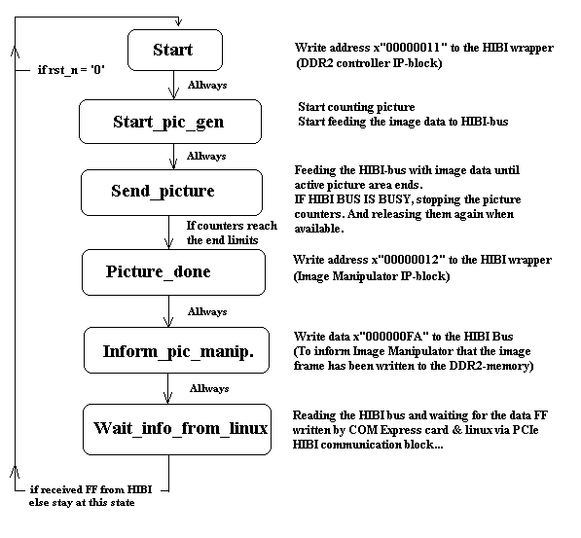
State Diagram

Slide 5
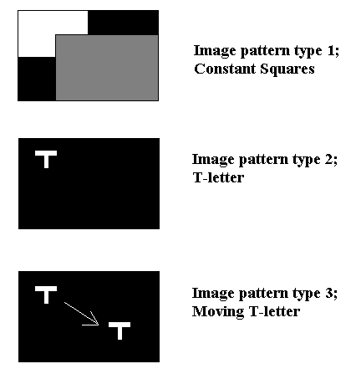
Image patterns
By changing the generic;
Image pattern type,
Several test pattern images can be produced.
New ones can be easily made, if needed.

Slide 6
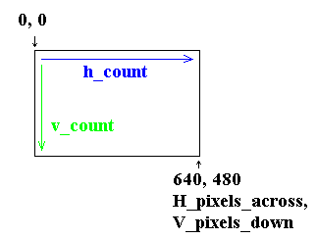
Process frame
----------------------------------------------------------------
-- PROCESS FOR CALCULATING THE PICTURE SIZE
----------------------------------------------------------------
frame : process(rst_n, pix_clk)
begin
if rst_n = '0' then
counting_picture <= '0';
h_count <= 0;
v_count <= 0;
elsif (pix_clk'EVENT and pix_clk = '1')then
if (hibi_full = '0') then
if (start_counting_picture = '1' or counting_picture = '1') then
if (h_count = H_pixels_across) then h_count <= 0;
else h_count <= h_count + 1;
counting_picture <= '1';
end if;
if (v_count >= V_pixels_down) and (h_count >= H_pixels_across) then v_count <= 0;
elsif (h_count = H_pixels_across) then v_count <= v_count + 1;
end if;
end if; -- if hibi_full = '1', we will stop the counters.
end if;
end process frame;
----------------------------------------------------------------
If after reset or when got info to start over, then start counting the image.
If HIBI bus gets busy somehow, stopping the counters until the bus is again available.

Slide 7
Future versions?
Stopping the image counters is not so good idea after all...
What if, next time we need to plug in a camera, which clock we cant’t stop?
Need to figure out a better way ”to do the thing”, maybe use some linememory; catch up the incoming feed if HIBI is not available, or direct writing to the memory.
(Ringbuffer for the incoming video data)

